Slide 1
Game Development for Smart Twisty Puzzles
Jacob Hreshchyshyn
Ajay Bansal, Chair
Alexandra Mehlhase
Tyler Baron

Slide 2
Outline
Thesis ---------------------------------------------------------- 3
Project Goals ------------------------------------------------- 4
Motivation ---------------------------------------------------- 5
Twisty Puzzles Overview ----------------------------- 6 - 11
Project Development with React Native ---------- 12-13
Project Development in WOWCube SDK -------- 14-37
  Game Mode Descriptions -------------------------- 15
  Simulator ------------------------------------------ 16
  API -------------------------------------------- 18-19
  Word Bank ----------------------------------------- 20
  Scrambling Algorithm Implementation -------- 21-23
  Topology Detection --------------------------- 24-27
  Letter Rendering ------------------------------ 28-33
  Solution Checking ----------------------------- 34-37
Research Statements ------------------------------------- 38
Survey Questions and Responses for Evaluation -39-47
Responses and Evaluation Interpretation ------------- 48
Future Works ------------------------------------------ 49-51
Conclusion -------------------------------------------------- 52

Slide 3
Thesis
Smart twisty puzzle applications made for devices that integrate the software application with the physical topology of the twisty puzzle can improve upon the educational/entertainment value of existing twisty puzzle toys and devices with respect to critical thinking and language skills

Slide 4
Project Goals
Initially, to develop a React Native application that assists players in learning to solve a Rubik’s Cube
  Involved a tactics game that taught Rubik’s Cube fundamentals, like basic solve algorithms
Updated to leveraging the WOWCube to make an edutainment application to develop language skills while exercising critical thinking
Notes:
Mention that this goal is related to research in using Rubik’s Cubes to teach group theory, but that there remains the opportunity to explore a twisty puzzle’s application in language learning.

Slide 5
Motivation
To explore novel ways in which STEM principles, such as critical thinking, can be applied to education in different contexts in order to engender student interest in reaching developmental benchmarks while facilitating the administration of that education.

Slide 6
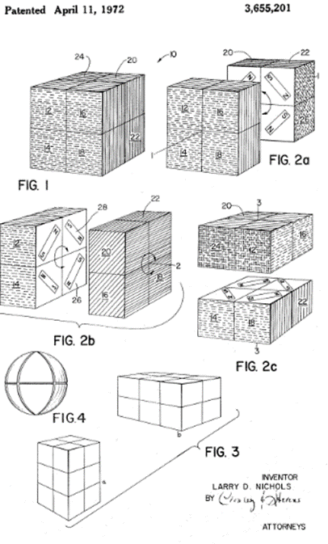
Overview of Twisty Puzzles: Inception
Dr. Larry D. Nichols’s 1972 2x2x2 cube puzzle patent
Ernő Rubik followed up with a 3x3x3 twizzle in 1975

Slide 7
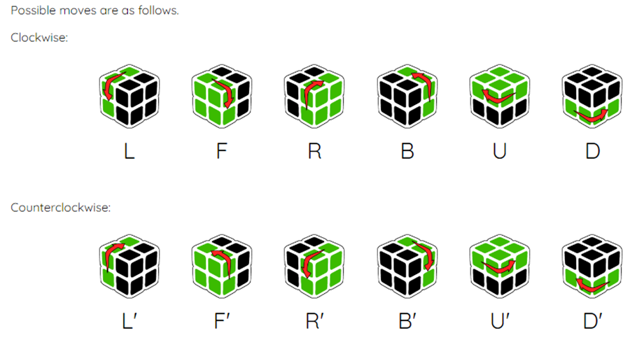
Overview of Twisty Puzzles: Computer Science
David Singmaster’s introduction of cube move notation
Herbert Kociemba and the quest for God’s number, which is 20

Slide 8
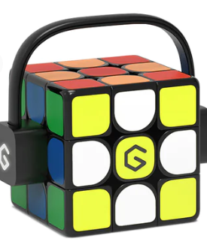
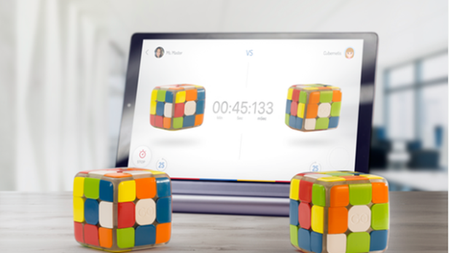
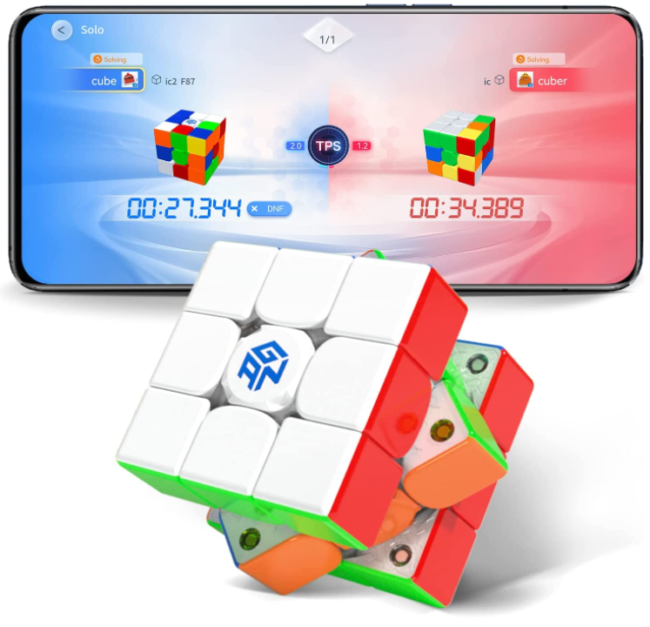
Overview of Twisty Puzzles: Smart Cubes
GoCube
GAN
Giiker

Slide 9
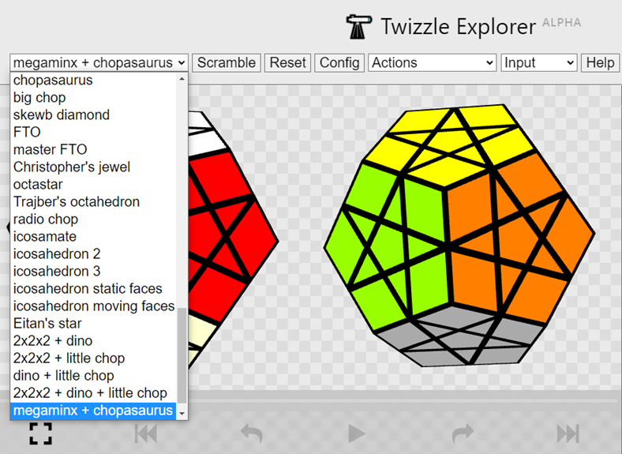
Overview of Twisty Puzzles: Open Source
Lucas Garron’s Twizzle.net

Slide 10
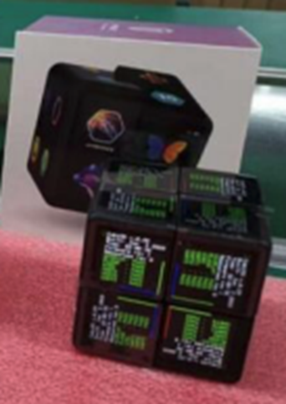
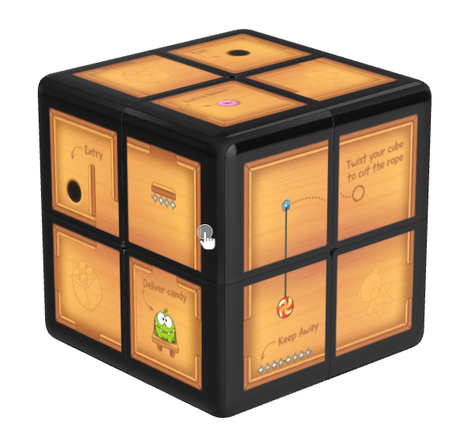
Overview of Twisty Puzzles: WOWCube
Ilya and Savva Osipov’s WOWCube
  24 LCD screens
  Custom OS called CubiOS
Includes games like 2048 and
Cut the Rope

Slide 11
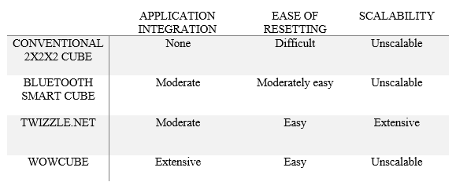
Comparison of Current Twisty Puzzles

Slide 12
Project Development with React Native
Using this research, a joint effort was made to develop an educational application for a smart cube to teach players how to solve a Rubik’s Cube and present relevant solve statistics
The joint effort began working with React Native Expo, followed by Bare React Native

Slide 13
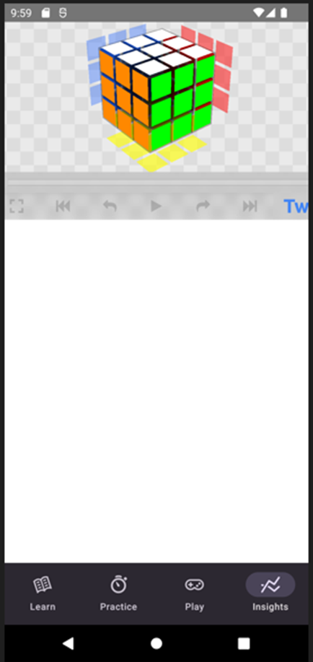
Project Development with React Native
Considered using Expo, a JavaScript framework with
a set of libraries compatible across iOS and Android
platforms.
Due to limitations with Expo, development shifted to Bare
React Native
Bare React Native development was not feasible due to lack
of macOS development tools and continued compatibility issues
with open source libraries
Notes:
Limitations with Expo include the initial lack of native Bluetooth support and compatibility issues that arose with open source frameworks like React Native Game Engine and three.js.
Main compatibility issues include Twizzle.net’s use of web components for representing its visual elements. Indicate this with the picture, which shows the Twizzle.net player wrapped in a WebView component, which restricts the ability to modify its visuals and scaling.

Slide 14
Project Development in WOWCube SDK
Following these project difficulties, the joint effort for a React Native application was disbanded
Based on previous research in the smart cube market, the WOWCube was chosen to begin work on a new edutainment application

Slide 15
Project Development in WOWCube SDK
The game would have the following features:
A game mode that tasks the player with rearranging symbols such that each face has matching symbols (essentially a standard 2x2x2 puzzle). This is Game Mode 1.
A game mode that tasks the player with rearranging letter symbols such that each face has a valid four-letter word. Letter orientation does not matter. This is Game Mode 2.
A game mode that tasks the player with rearranging letter symbols such that each face has a valid four-letter word. Letter orientation does matter. This is Game Mode 3.

Slide 16
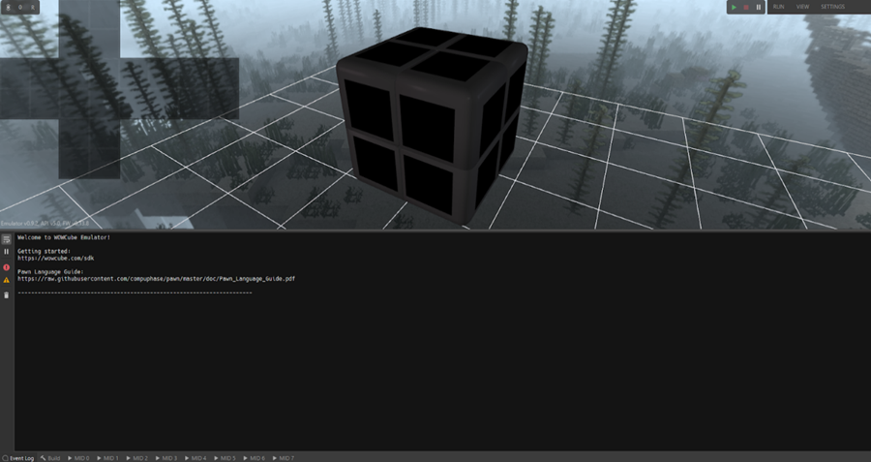
Project Development in WOWCube SDK: Emulator
Notes:
An interactive 3D model of the WOWCube, whose faces can be twisted by clicking and dragging with the mouse and whose 24 LCD squares can be tapped by clicking on the desired square.
A collection of logging tools to facilitate debugging, including an Event Log, a Build Log, and eight module logs, each of which corresponds to one of the WOWCube’s modules. More information on modules can be found in Section 6.2.
An unwrapped view of the cube faces to assist in visualizing all of the cube at once.
A collection of configuration settings to facilitate debugging and to modify how the rendering of the 3D cube model and environment is visualized.
Start, Stop, and Pause commands to test the cube application at runtime. It functions very much like a runtime environment in a game engine, such as Unity [19].

Slide 17
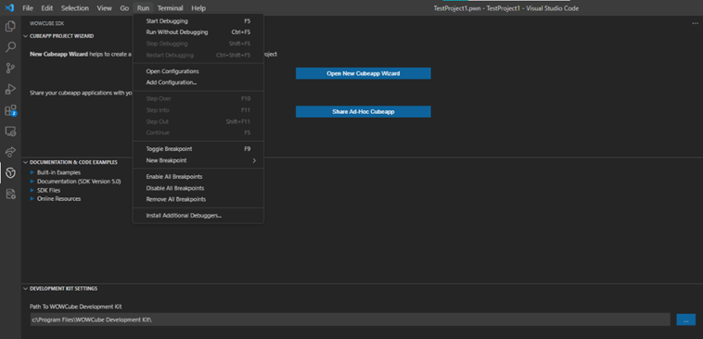
Project Development in WOWCube SDK: API

Slide 18
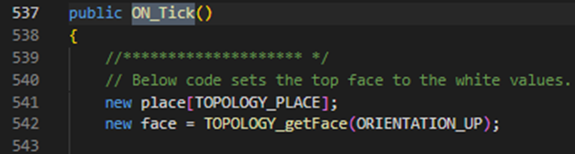
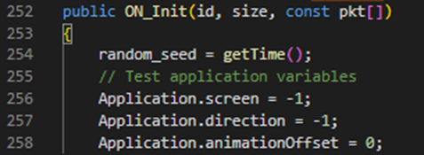
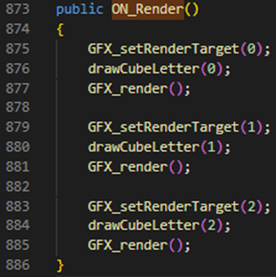
Project Development in WOWCube SDK: API
ON_Init
  Runs at application startup, often used for initialization instructions
ON_Tick
  The main game loop responsible for repeatedly executing instructions for various game logic
  ON_PhysicsTick is similar, but operates on a separate loop. It handles physics calculations.
ON_Render
  Callback responsible for drawing images on WOWCube screens
Notes:
When discussing ON_Tick, mention ON_PhysicsTick, which operates on physics updates separately from the main application loop of ON_Tick.

Slide 19
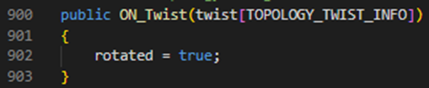
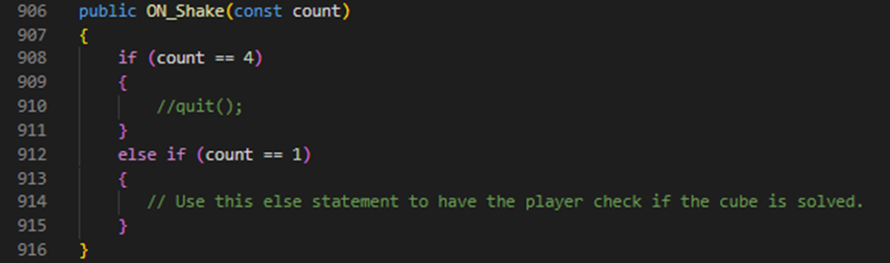
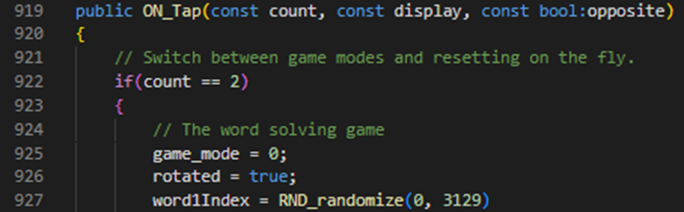
Project Development in WOWCube SDK: API
ON_Twist
  Event handler responsible for executing instructions when a twist is detected
ON_Shake
  Event handler responsible for executing instructions when a shake is detected
  Theoretically can perform different instructions based on the number of shakes, though this can’t be tested in the emulator
ON_Tap
  Event handler responsible for executing instructions when a tap is detected on a screen
  Can perform different instructions based on the number of taps on a screen
Notes:
Experimentation of solution checking using these different handler callbacks.

Slide 20
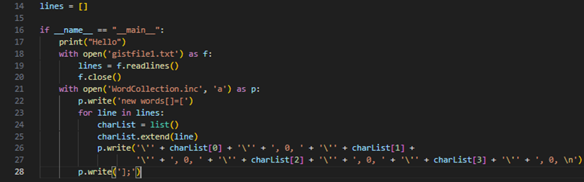

Project Development in WOWCube SDK: Word Bank
Python script to generate a word bank stored in memory
Word indexing done to include terminating characters after every other character to allow for printing letters directly from the string
Notes:
To produce a dictionary of 3,130 words, a Python script was used to create the necessary include file since access to external APIs is limited on the WOWCube.
Also mention character access, which involved using a null terminating character between each character in case one of those characters needed to be printed.

Slide 21
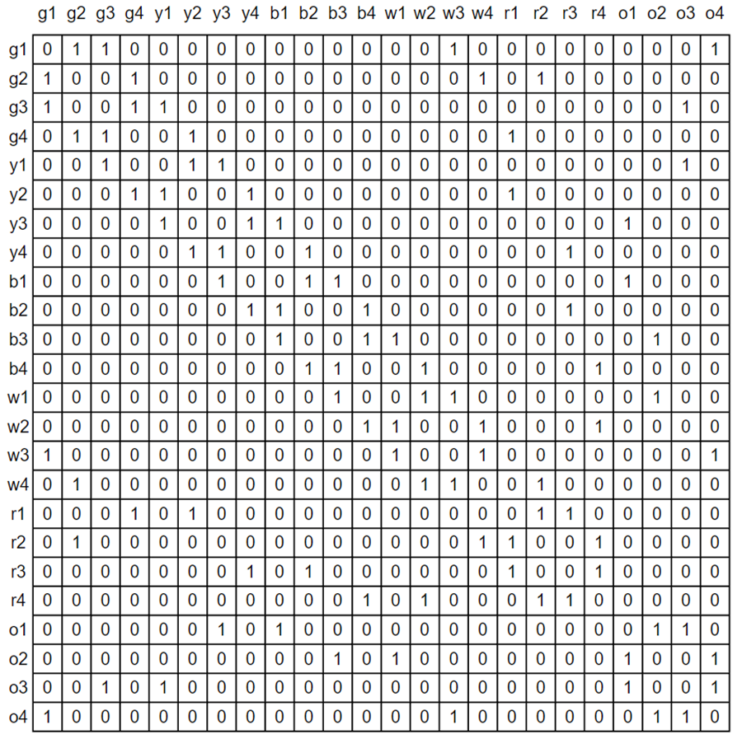
Project Development in WOWCube SDK: Scrambling Algorithm Implementation
Early conception of adjacency matrix
to store letter positions and encode
scrambles
Abandoned due to complexity of
maintaining such a structure

Slide 22
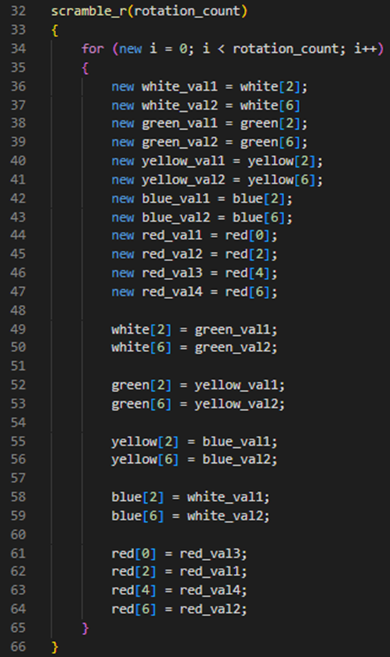
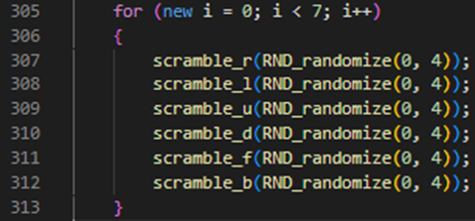
Project Development in WOWCube SDK: Scrambling Algorithm Implementation
Instead of an adjacency matrix, 6 lists were used to store letter data
These lists are initially unscrambled
By using a model to map cube twists to state changes, deterministic algorithms that correctly update the cubes state based on the specific cube twist can be encoded
These algorithms deterministically swap elements between lists to produce scrambles
This scrambling is iterated 7 times with a random number generator to regulate how many times a specific twist is performed to ensure good scrambles
Notes:
Encoding of R move and iteratively scrambling using different scrambling algorithms.
All of this helps in mixing up the words we selected. Now we have to take those mixed up lists and display them in the right locations. This is where topology detection comes in.

Slide 23
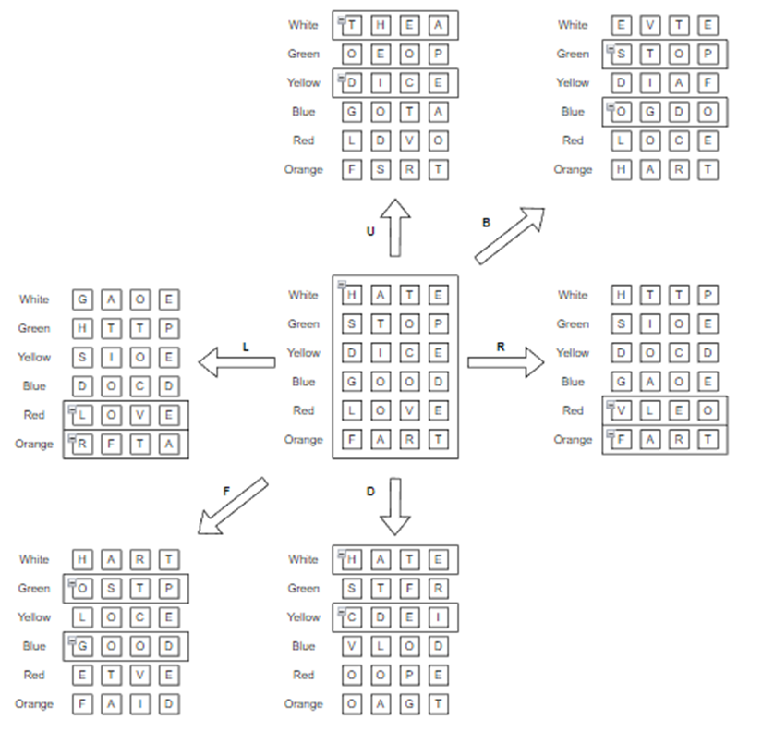
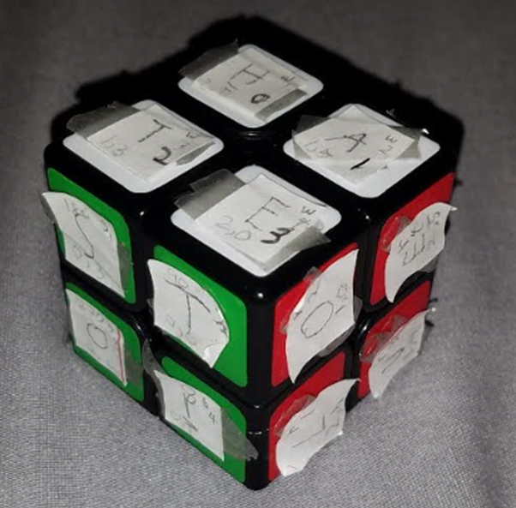
Project Development in WOWCube SDK: Scrambling Algorithm Implementation
Notes:
Mapping quarter turn rotations

Slide 24
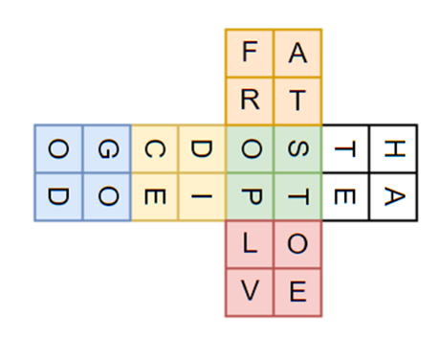
Project Development in WOWCube SDK: Topology Detection
How face lists correspond to cube
topology
Notes:
Assuming that White faces Up and Green faces Forward, then the other face orientations are as follows: Yellow faces Down, Blue faces Back, Red faces Right (of the Green face), and Orange faces Left (of the Green face).
This helps in specifying the types of lists represent face clusters. I need to map these face lists to these portions of the cube’s topology at runtime.

Slide 25
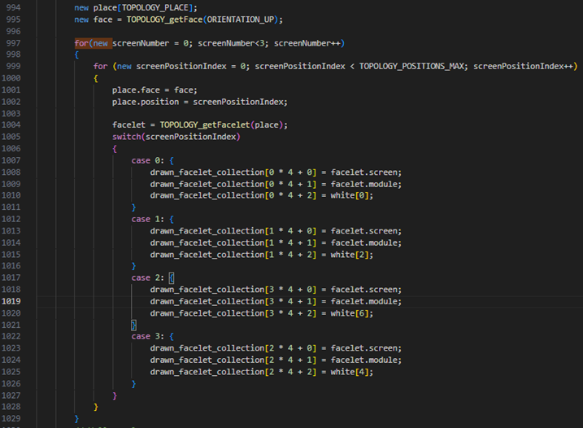
Project Development in WOWCube SDK: Topology Detection
Using the WOWCube gyroscope
and TOPOLOGY_getFace API to
specify upward and downward
facing facelets
Notes:
In order to get an unambiguous representation of what is up and what is down, I can use the WOWCube’s gyroscope and TOPOLOGY_getFace API to specify the upward and downward facing facelets.
Also note the need for screen/module pairings to uniquely identify each of the 24 facelets.

Slide 26
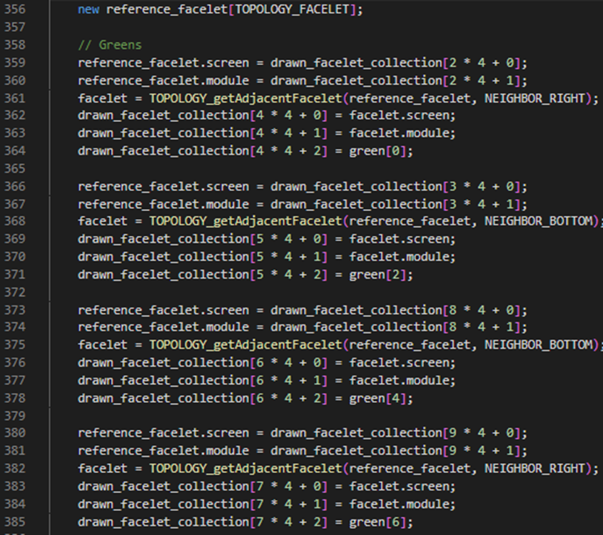
Project Development in WOWCube SDK: Topology Detection
With the detected facelets, use
TOPOLOGY_getAdjacentFacelet
to unambiguously determine the
remaining facelets
Notes:
Once I have the up and down facelets, I can use TOPOLOGY_getAdjacentFacelet to find facelets adjacent to those I just found so that I can map out the remaining side facelets.
This method is done in the ON_Init portion of the app for game modes 1 and 2. 3 uses a different approach.

Slide 27
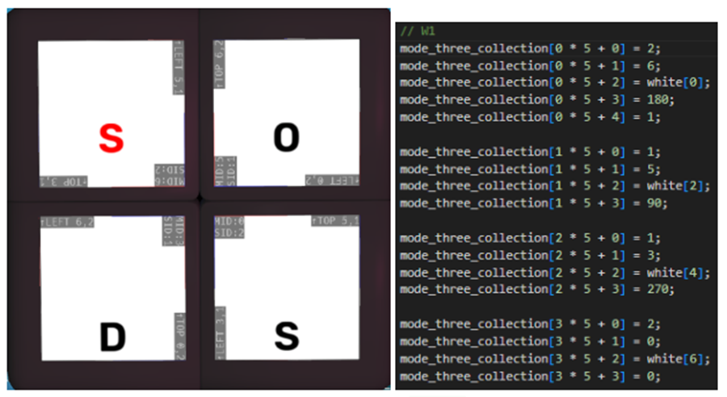
Project Development in WOWCube SDK: Topology Detection
Use of debug tools to hard code facelet positions for Game Mode 3
Notes:
Using debug tools and the WOWCube Emulator, you can determine the initial orientation of each facelet and use that to encode what letters appear on what facelets. This makes game mode 3 unable to update dynamically. However, because the cube relies on the player to scramble it while playing the other puzzles, the need to scramble the puzzle is offloaded onto the player.

Slide 28
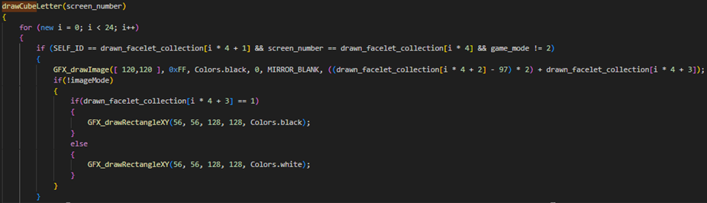
Project Development in WOWCube SDK: Letter Rendering
Renders letters by checking if the ID of the module executing the code matches that in the “dictionary” of letters associated with module ID and screen ID numbers
If the screen ID also matches, it renders an image corresponding to that letter on the specified facelet.
Notes:
The main draw letter method used in the ON_Render callback. Given a screen number, the module executing the code checks if its ID matches that in the drawn facelet collection and if the screen ID matches one in the collection as well. If so, it renders an image corresponding to that letter onto the specified facelet.
Mention the implied partitioning of the drawn facelet collection into those different face lists described in the topology detection section.
Notice the last parameter, which specifies the index pointing to the image location. This is how that selection happens.

Slide 29
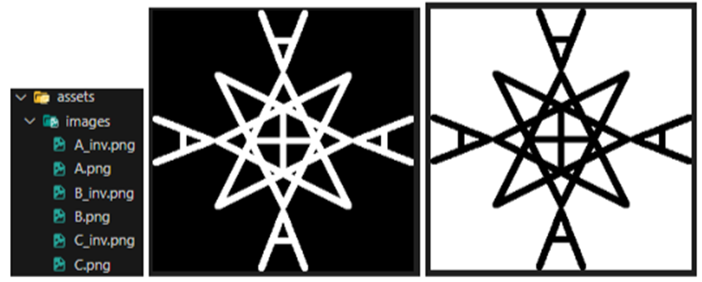
Project Development in WOWCube SDK: Letter Rendering
Image file name ordering. The higher the priority, the lower the index (starting at 0)
Notes:
File name ordering. The higher the priority, the lower the index.

Slide 30
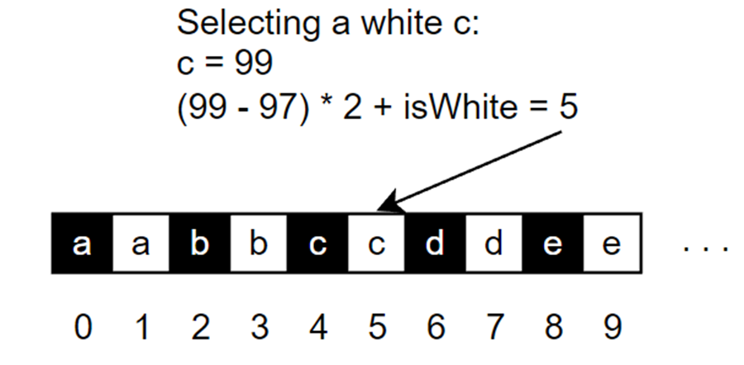
Project Development in WOWCube SDK: Letter Rendering
Image asset selection when rendering
Notes:
Using ASCII values of characters and the isWhite offset to select the correct image.

Slide 31
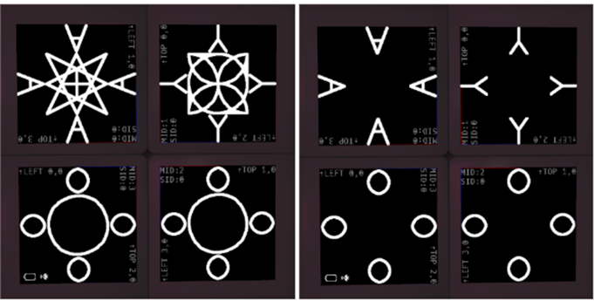
Project Development in WOWCube SDK: Letter Rendering
Option to hide center symbol with a single screen tap
Notes:
Extra conditional used to clean up the look of the images by hiding the symbol behind a rectangle.

Slide 32
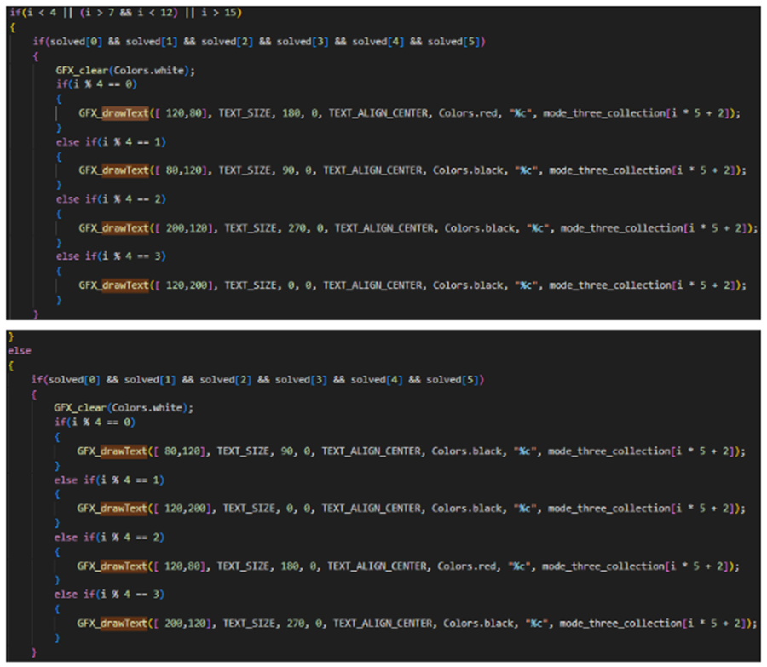
Project Development in WOWCube SDK: Letter Rendering
Game Mode 3 letter rendering
Importantly, it applies rotation
information so that the app renders
a solved cube with all letters oriented
correctly
Rotation values are accordingly
hard coded
Notes:
Game mode 3 letter rendering. Importantly, it applies rotation information so that the app renders a solved cube with all the letters oriented correctly.

Slide 33
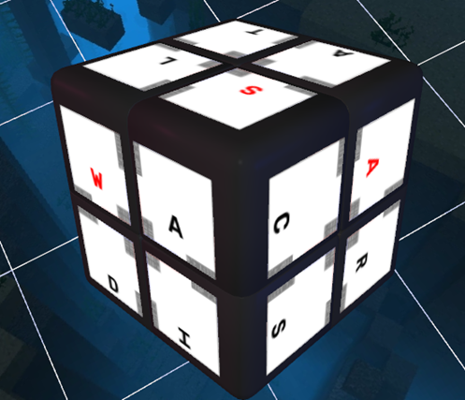
Project Development in WOWCube SDK: Letter Rendering
Notes:
Finished game mode 3 puzzle. Notice how the specified rotation angles make the words legible, but allows for entire word collections to be oriented differently than others.

Slide 34
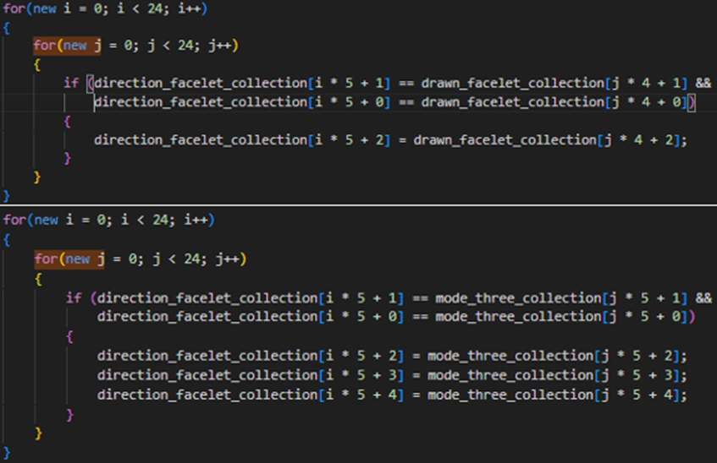
Project Development in WOWCube SDK: Solution Checking
Use of topology detection
to determine how each of
the letters are oriented so
that partitions of letters
within the
direction_facelet_collection
can be iterated over to
determine if the puzzle is
solved
Notes:
Use of a form of topology detection to determine how each of the letters are oriented on the cube so that partitions of letters within the direction_facelet_collection can be iterated over to determine if the puzzle is solved.

Slide 35
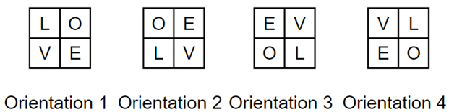
Project Development in WOWCube SDK: Solution Checking
For game modes 1 and 2, solution checking requires examining four possible letter arrangements for each face.
Each arrangement in the figure below spells out the word “LOVE” depending on where the player starts reading the word. This is why these combinations all must be considered.
Notes:
Consideration of different possible orientations of letters when checking for solutions.

Slide 36
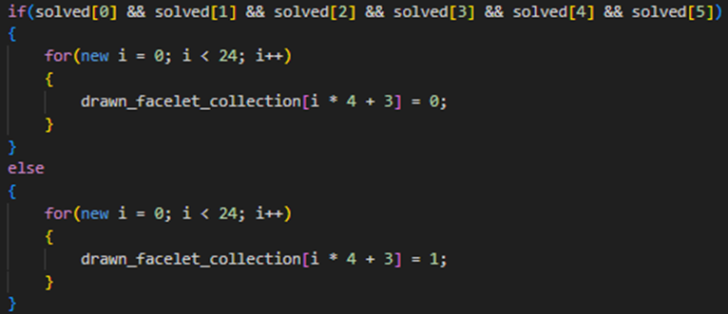
Project Development in WOWCube SDK: Solution Checking
Once all faces have a valid four-letter
word, each face is colored white
by setting the offset to 0. When
unsolved, the faces are colored
black with the offset set to 1.
Notes:
If they are all solved, for each element of the drawn facelet collection, the flag responsible for the isWhite offset is appropriately set.

Slide 37
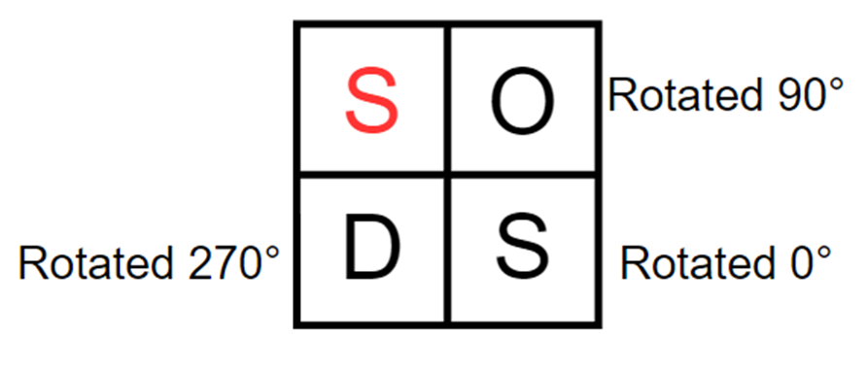
Project Development in WOWCube SDK: Solution Checking
Game mode 3 solution checking requires the consideration of the rotation angles of each square as well as the position of the first letter of the word. All this information is encoded and helps in quickly determining whether a face might have a potential solution before performing topology detection.
Notes:
Rotation angles and position of first letter. Necessary considerations for solution checking for game mode 3.

Slide 38
Research Statements
Examining the history of twisty puzzles and the current state of the art with respect to smart cubes, there does not exist any notable example of leveraging twisty puzzles for language learning.
In order for a twisty puzzle application to effectively improve upon the entertainment and educational value of similar puzzles, a new puzzle must be considered enjoyable by players and must have qualities that appear to facilitate education through its administration and the topological qualities of the puzzle.
The goals of the puzzle must be clearly understood by players. The puzzle itself must be intuitive to manipulate.

Slide 39
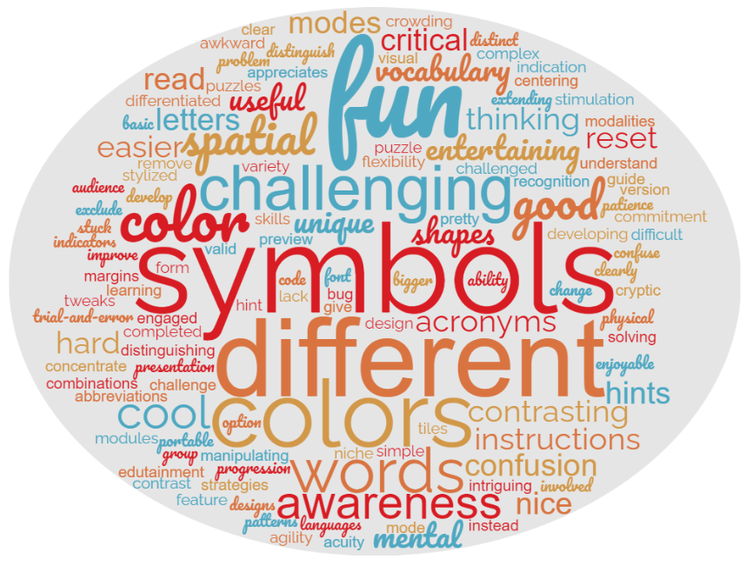
Responses and Evaluation
To determine the efficacy of
WordBox as an educational and
entertaining puzzle game based on the
previous criteria, a survey
posted on the WOWCube Discord
server was used. There were 10
respondents.
The survey contained general
qualitative questions designed to
determine what players liked and
disliked about the application.
Questions also asked about the overall
perceived educational and
entertainment value.
These questions were made to be
open-ended in order to mitigate bias in
aligning responses with metrics described
in research statements.
Notes:
Users surveyed indirectly over Discord without any additional intervention from the researcher to obtain their feedback on the application. Participants were able to play the game using either the WOWCube Emulator or the WOWCube device itself.

Slide 40
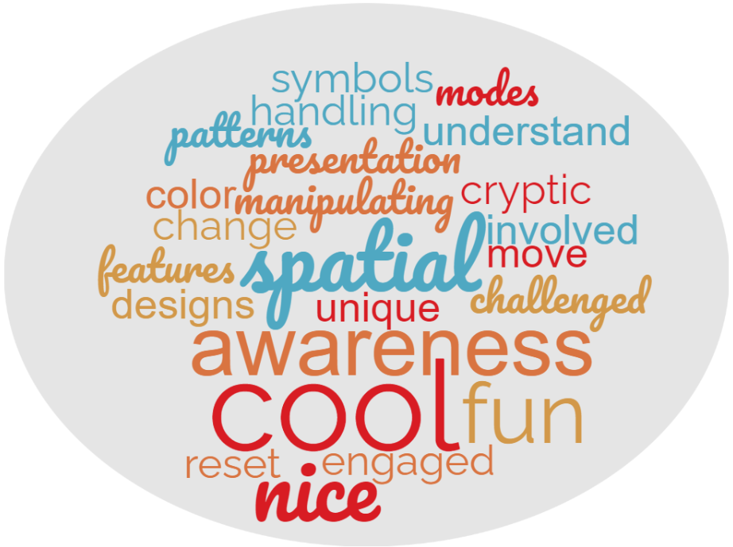
Responses and Evaluation:
Game Mode 1 Positives
Question: What did you like about
Game Mode 1 (the standard 2x2x2
puzzle)?
50% responded positively to the
presentation of the application.
Also reports of people getting a better
sense of spatial awareness when
manipulating the puzzle.
Players also appreciated the intuitive
nature of the puzzle, particularly with
respect to resetting the puzzle without
physically altering the cube’s topology.
Overall, it was the unique presentation
coupled with the familiar Rubik’s Cube
format that made the puzzle engaging
for the respondents.
Notes:
Game Mode 1, which tasks players with rearranging the letter symbols on the cube to ensure each square on a face matches each other, was received positively overall. 50% of the participants responded positively to the presentation of the application with players expressing their appreciation of the cryptic appearance of the squares. These players also enjoyed the visual feedback of solving the puzzle, which results in the squares changing from black to white. The remaining players found enjoyment in the intuitive nature of the puzzle, the ability to easily reset and change the puzzle, and the ease of manipulating the puzzle in a virtual environment. Figure 40 illustrates these positive impressions.

Slide 41
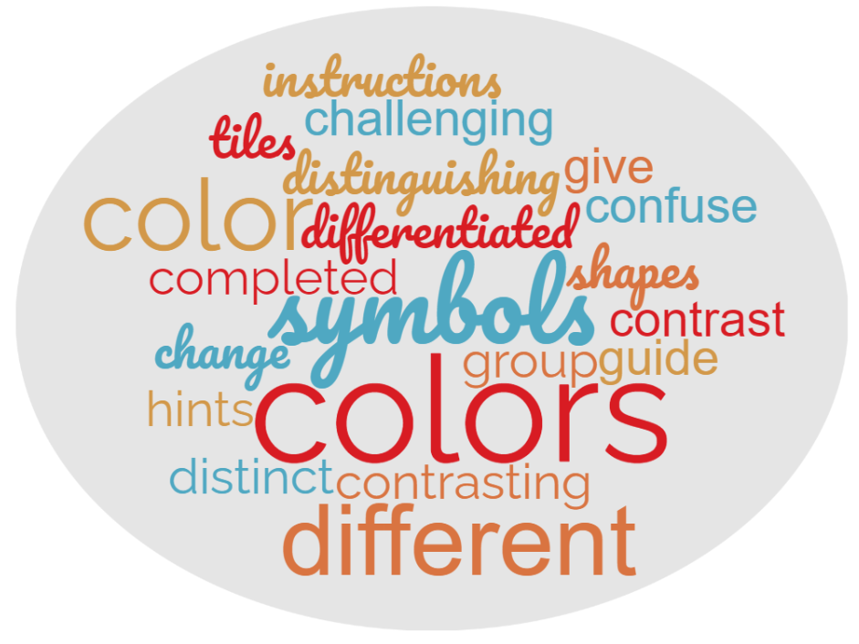
Responses and Evaluation:
Game Mode 1 Critiques
Question: What could be improved
with Game Mode 1 (the standard
2x2x2 puzzle)?
50% of the participants indicated the
desire to include more colors to assist in
distinguishing letter symbols and in
providing hints about how to group
letters.
Mentions of guides and hints suggested
players’ desires for a better sense of
progression and goals in the game.
Notes:
Regarding constructive criticism, 50% of the participants indicated the desire to include more colors to assist in distinguishing letter symbols and in providing hints about how to group letters. One participant suggested a means of communicating progression in puzzle solving by perhaps changing the color of the cube or providing additional hints as the player gets closer to completely solving the puzzle. Additionally, one participant suggested that in-game instructions be provided to inform players on how to interact with and solve the puzzle. Figure 41 illustrates these critical perceptions.

Slide 42
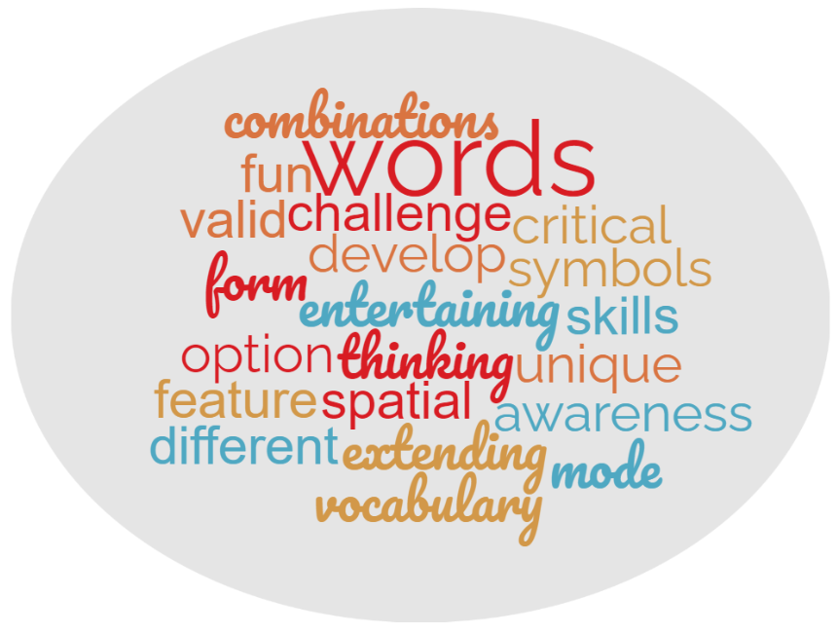
Responses and Evaluation:
Game Mode 2 Positives
Question: What did you like about
Game Mode 2 (the symbolic word
puzzle)?
Participants expressed how they felt this
could be useful in developing critical thinking
and vocabulary skills.
30% of the participants expressed enjoyment
of exploring how combinations of letters
can form different words, leading to multiple
solutions.
Notes:
Game Mode 2, which tasks players with rearranging the letter symbols on the cube to form valid four-letter words regardless of individual letter orientation, was again received positively. 30% of the participants indicated their enjoyment of exploring how each of the letters can form different words, allowing for more ways to solve the puzzle than the standard 2x2x2 puzzle. One participant speculated on this mode’s possibility of developing critical thinking and vocabulary skills because of the combinatorial nature of letter arrangements on the cube in addition to the combinatorial nature of the cube itself. Many of the participants echoed their appreciation of the symbol designs shown in Game Mode 1. Figure 42 illustrates these positive perceptions.

Slide 43
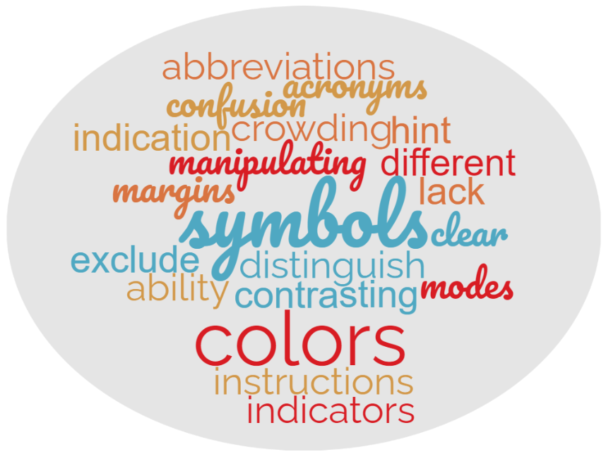
Responses and Evaluation:
Game Mode 2 Critiques
Question: What could be improved
with Game Mode 2 (the symbolic word
puzzle)?
Once again, 50% of participants expressed
the need for a progression communication
system via hints and indicators.
Expressed desire for in-game instructions.
Better contrast with symbols was reiterated.
Notes:
Regarding criticism, 50% of players expressed the desire for the game to communicate a player’s progress on solving the cube. Additionally, 20% of the players expressed the desire for better indicators that tell players what words they are trying to reproduce on the puzzle. One of the players pointed out a visual glitch that results in certain letter symbols disappearing while others appear as normal. Finally, likely due to some players playing with the WOWCube Emulator instead of a physical WOWCube device, one of the players expressed the desire of seeing the entire cube as a whole instead of feeling restricted to viewing a single face at a time. Figure 43 illustrates these critical perceptions.

Slide 44
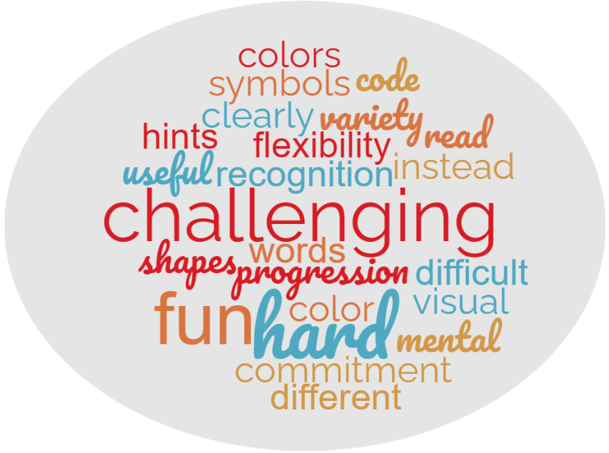
Responses and Evaluation:
Game Mode 3 Positives
Question: What did you like about
Game Mode 3 (the restrictive word
puzzle)?
60% of participants indicated it was
challenging in a positive sense.
40% of participants expressed
approval of the visual variety and use
of color with certain letters to assist
in solving the puzzle.
Notes:
Game Mode 3, which tasks players with rearranging the letters on the cube to form valid four-letter words while considering the orientation and position of individual letters, received more of a mixed reception. 60% of the participants felt that this mode was quite difficult, though most participants maintained that the game was still enjoyable to play. One of the participants felt that it was easier to complete since there was no need to worry about the symbols that correspond with the letters. Furthermore, 40% of the participants expressed approval of the visual variety and use of color with certain letters to assist in solving the puzzle. Figure 44 illustrates these positive perceptions.

Slide 45
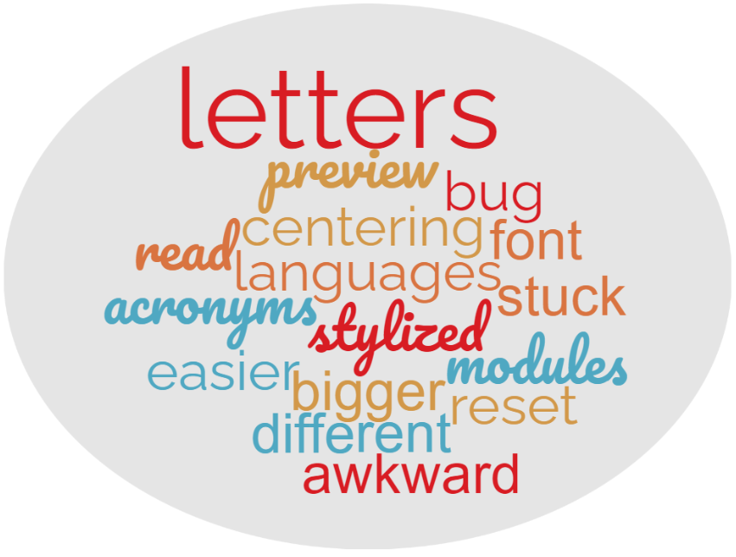
Responses and Evaluation:
Game Mode 3 Critiques
Question: What could be improved
with Game Mode 3 (the restrictive word
puzzle)?
Again expressed the need for hints about what
the completed puzzle should look like to help
in providing a sense of progression.
30% of participants felt that letters needed to
be tweaked, perhaps made slightly larger.
Participant testing with physical device noted
that the game got stuck when attempting to
exit.
Notes:
On the other hand, players continued to express the desire to see what the completed puzzle should look like in order to help them in solving the puzzle. Additionally, despite the visual variety, 30% of the participants noted that the letters in the game mode were slightly awkward to read and could have benefited from using a larger font size. Finally, one of the players, who indicated their use of a physical WOWCube device, noted that one of the cube modules was stuck on Game Mode 3 despite quitting. The player ultimately had to delete the game and reset the cube in order to flush out the error. This error was likely the result of a limited testing environment since no physical WOWCube devices were available to leverage at the time of project development. Figure 45 illustrates these critical perceptions.

Slide 46
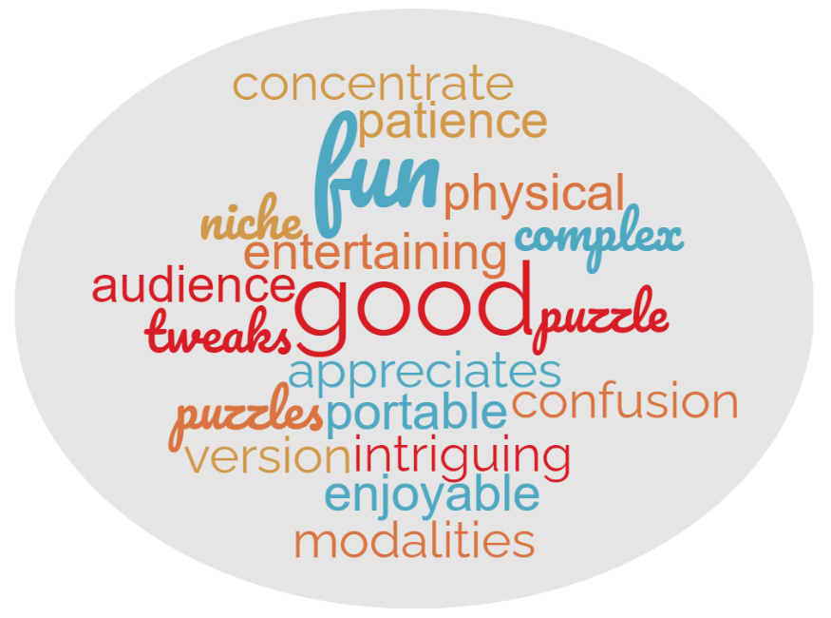
Responses and Evaluation:
Perceived Entertainment Value
Question: What is the overall entertainment
value of this application?
Participants generally agreed that it was a fun
and captivating experience, especially for fans
of puzzles.
One of the participants felt that they would
rather continue playing Game Modes 1 and 2
instead of 3.
One of the participants attempted to rate the
entertainment value of the application with
a score of 8/10.
Notes:
Regarding the entertainment value of the puzzle as a whole, the participants generally agreed that it was a fun and captivating experience, especially for those who enjoy solving puzzles. Notably, one of the participants indicated that they would likely continue playing Game Modes 1 and 2 instead of 3. Finally, one of the participants attempted to quantify the entertainment value by giving the app a score of 8/10. Figure 46 illustrates these thoughts.

Slide 47
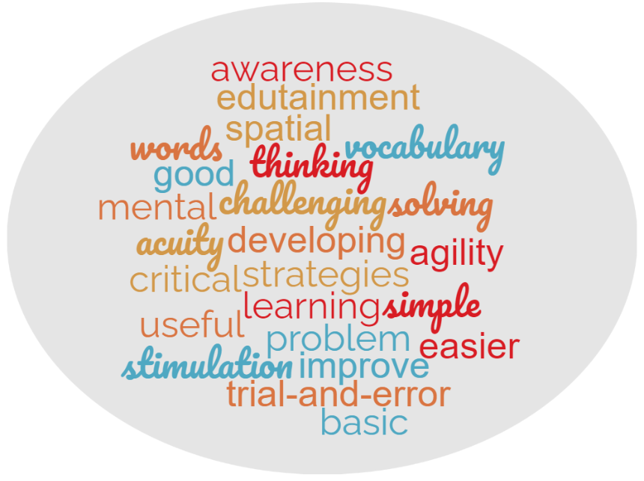
Responses and Evaluation:
Perceived Educational Value
Question: What is the overall educational
value of this application?
100% of participants indicated that the
application holds some educational value.
20% held that it can be used for teaching basic
vocabulary and critical thinking skills.
One of the participants applauded the fact that
the application stimulates thinking via word
construction as opposed to the perceived
trial-and-error nature of other puzzles.
A participant again gave an educational value
score of 8/10.
Notes:
Regarding the educational value of the application, 100% of the participants indicated that the application holds some educational value. 20% of the participants held that this application can be used for teaching basic vocabulary and improving critical thinking skills. One of the participants applauded the fact that the application differs from most puzzles in that it stimulates thinking via word construction as opposed to the perceived trial-and-error nature of other puzzles. One of the participants went so far as to express the application’s potential as an evaluation tool for determining an individual’s mental acuity and spatial awareness due to the layers of problems to solve with the puzzle. Finally, a participant again attempted to quantify the educational value by giving the app a score of 8/10. Figure 47 illustrates these thoughts.

Slide 48
Responses and Evaluation:
Interpretation
Responses indicate that the application can assist in developing critical thinking and language skills.
Assists in mitigating resetting issues of a Rubik’s Cube based on previous research on use of Rubik’s Cube in teaching group theory.
However, improvements to the application can be made that would enhance the intuitiveness of interacting with the device and help in getting players to understand the goals of each puzzle.
Notes:
Elaborate on the resetting issue. Alleviates frustration.

Slide 49
Future Works
Removal of small application glitches, such as inconsistent hiding of image symbols and hanging issues.
Partially relies on Cubios Inc. updating the SDK tools to allow for the application to properly exit due to nuanced cube shaking detection.
Larger font size, in-app instructions, removal of abbreviations and acronyms, and improved visuals to better distinguish letters.
Notes:
It is possible that, in some instances of players attempting to twist the puzzle, a tap was simultaneously triggered, resulting in certain modules removing the symbol while leaving others. This behavior is a side effect of the fact that each cube module is running a copy of the application, each with its own copies of state variables. In order to address this issue, the application source code must be updated to support intermodule communication of these state variables to ensure consistency in what is displayed.

Slide 50
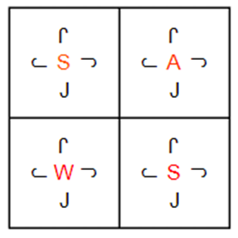

Future Works
Features to assist in conveying a sense of progression

Slide 51
Future Works
Support for different languages
Expansion of puzzle resetting features (specifying random seed, more puzzle generation options)
Ability to specify what words to solve for
Additional game modes, e.g. endless mode
Personal leaderboards to keep track of solve times.

Slide 52
Conclusion
The development of WordBox and its survey on players sought to demonstrate the potential of smart twisty puzzle applications in exercising players’ critical thinking and language skills.
By encouraging players to evaluate the game based on general questions regarding what they liked/disliked about each game mode as well as their perceptions on the merits of the application as an educational/entertainment tool, an honest assessment of the effectiveness of the game in aligning with research statements corresponding to the above thesis can be made.
Despite the survey revealing room for improvement with respect to both communicating progression and symbol rendering, the survey revealed that players perceived strong potential in the application’s ability of teaching language skills while captivating players with a puzzle that requires critical thinking to solve.
This ultimately demonstrates the potential of smart twisty puzzle applications like WordBox in developing critical thinking and language skills.

Slide 53
Thank You

