Slide 1
Designing a DH Project
September 26th, 2018
Institute for Humanities Research
Faculty Development Workshop Series
Elizabeth Grumbach @EMGrumbach
Notes:
I’ll start our workshop on “designing a digital humanities project” today by introducing myself and my background in digital humanities. I’ve worked as a project manager and an alternative academic (#altac professional) for over six years. In that time, I’ve served as the project manager for a number of projects and initiatives. I’ve worked on the Early Modern OCR Project, a Mellon-funded Grant at Texas A&M university that trained machines to generate text (read digitized images) from the first printed books, been part of the team that founded the first humanities-only visualization research center, and worked as the Project Manager for the Advanced Research Consortium, an organization that aggregates humanities data and offers peer review of scholar-produced digital projects. Since coming to ASU, I’ve worked on many scholar-driven research projects. Including “Arizona’s Forgotten Pandemic” - a project that collected data from death certificates in 1918 to build an installation that re-embodied the stories of the Arizona communities impacted by the 1918 Influenza Pandemic.

Slide 2
bit.ly/design-dh-ihr
Notes:
This link leads to not only our slides for today but also the script for today’s workshop - because my DH is also accessible. I’ll circulate these slides to everyone that wants one - so please put your email on the sign in sheet today if you’d like to receive the link (these slides will be available forever).
If you happen to have a smartphone, tablet, or computer today, following along with these slides will also enable you to click links included in this workshop and more fully participate in some of the discussions I hope to foster today. If you don’t have access to this technology, no worries! We’ll find solutions together as we go.
Our goal, and what I hope we all accomplish together, for today is to walk through the first steps of visioning, designing, and planning a digital humanities project. If you’re already working on a project, you’ll likely find today’s content very familiar. If you aren’t, I hope some of the steps we go through and the questions we answer together will be inspiring.
Before we begin in earnest, I would love for each of your to give a brief introduction - just a who you are and what you work on, or where you’re joining us from today. If there’s a specific digital project that you’re thinking on or currently planning, please share a quick description.

Slide 3
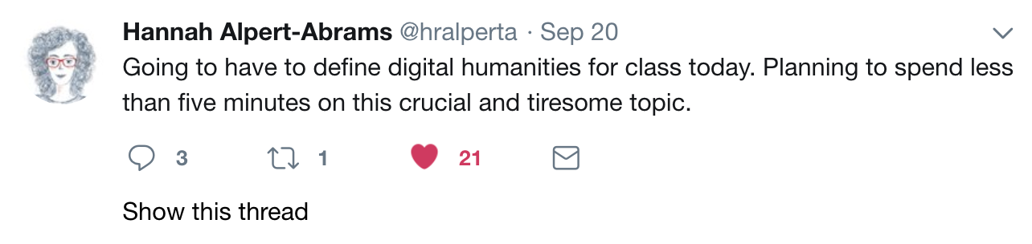
Notes:
And because there’s no way to drive past it, I’ll start today by spending a very few minutes on what digital humanities is/are - or what it can be.

Slide 4
“Whatever else it might be then, the digital humanities today is about a scholarship (and a pedagogy) that is publicly visible in ways to which we are generally unaccustomed, a scholarship and pedagogy that are bound up with infrastructure in ways that are deeper and more explicit than we are generally accustomed to, a scholarship and pedagogy that are collaborative and depend on networks of people….”
Kirschenbaum, “What is Digital Humanities and What’s it Doing in English Departments?” (2010)
Elizabeth Grumbach @EMGrumbach
Notes:
In 2010, Matthew Kirschenbaum wrote a bit about why digital humanities seemed so new and disruptive in the humanities, even though many humanists used digital means to conduct research online and taught and wrote using computers. The difference seemed to be that DH afforded a new kind of visibility online for the modes of scholarly knowledge production, that it was inherently about infrastructure building, and that it was collaborative in nature. I would argue myself that humanities work was always already about infrastructure and collaboration, and what the rise of digital humanities did for our scholarly communities was shine a retrospective, positive, and sometimes critical light on the ways in which we do our work.
Kirschenbaum article available here: https://mkirschenbaum.files.wordpress.com/2011/01/kirschenbaum_ade150.pdf

Slide 5
“The particular contribution of the digital humanities, however, lies in its exploration of the difference that the digital can make to the kinds of work that we do as well as to the ways that we communicate with one another.….”
Fitzpatrick, “The Humanities, Done Digitally” (2012)
Elizabeth Grumbach @EMGrumbach
Notes:
Two years later, Kathleen Fitzpatrick wrote that what DH afforded the humanities was the ability to explore and experiment with the digital to form new ways of communicating humanities knowledge and communicating with other humanists.
Fitzpatrick article: http://dhdebates.gc.cuny.edu/debates/text/30

Slide 6
“For me, what counts as digital humanities, ultimately, is work that doesn’t try to police the boundaries of what counts as digital humanities.”
Jesse Stommel (2015)
Elizabeth Grumbach @EMGrumbach
Notes:
And this is my absolute favorite definition of DH from Jesse Stommel, who wrote in 2015 that really, DH is work that is concerned with itself and it’s engagement with humanities and human questions - and doesn’t try to police or define what counts as DH.
Stommel: http://www.disruptingdh.com/the-public-digital-humanities/

Slide 7
"Along with the digital archives, quantitative analyses, and tool-building projects that once characterized the field, DH now encompasses a wide range of methods and practices: visualizations of large image sets, 3D modeling of historical artifacts, 'born digital' dissertations, hashtag activism and the analysis thereof, alternate reality games, mobile makerspaces, and more. In what has been called 'big tent' DH, it can at times be difficult to determine with any specificity what, precisely, digital humanities work entails."
Lauren F. Klein and Matthew K. Gold (2016)
Elizabeth Grumbach @EMGrumbach
Notes:
And this last attempt at definition that I’ll show today is from the second Debates in the Digital Humanities volume - Lauren Klein and Matthew Gold write that DH is now multiple. That it can and does mean digital archives, large scale quantitative analyses, and tool-building, but also “visualizations of large image sets, 3D modeling of historical artifacts, 'born digital' dissertations, hashtag activism and the analysis thereof, alternate reality games, mobile makerspaces, and more”
And so with that last definition, I hope that I’ve at least opened up possibilities for us today. DH is about the choices we make to explore the humanities questions we’ve always been interested in asking, and so...
Klein and Gold: http://dhdebates.gc.cuny.edu/debates/2

Slide 8
1st: Question
2nd: Tool
“Everybody working on a digital humanities project needs to be writing. I am suggesting that this is simply a fact of life. If you don’t have at least a one-pager for your project, then you don’t have a project…”
Trevor Owens (2011)
Elizabeth Grumbach @EMGrumbach
Notes:
Let’s talk about choices, and first steps, towards designing a digital project. Most, if not all, successful digital projects that I’ve encountered began with a question, with the research and the humanities perspective, and from there choose or develop a tool that can help achieve the goals of the project. In my experience, this means exactly what Trevor Owens says in this quote - that writing is at the heart of DH, and that without a rationale or a one-pager or a question at the heart of a project, there is no project. That question can be “how do I make content or materials accessible online?” or “how can I represent a dataset about the 1918 flu in a way that liberates the stories of the dead from a spreadsheet?” or or or….
Owens article: http://journalofdigitalhumanities.org/1-1/please-write-it-down-by-trevor-owens/

Slide 9
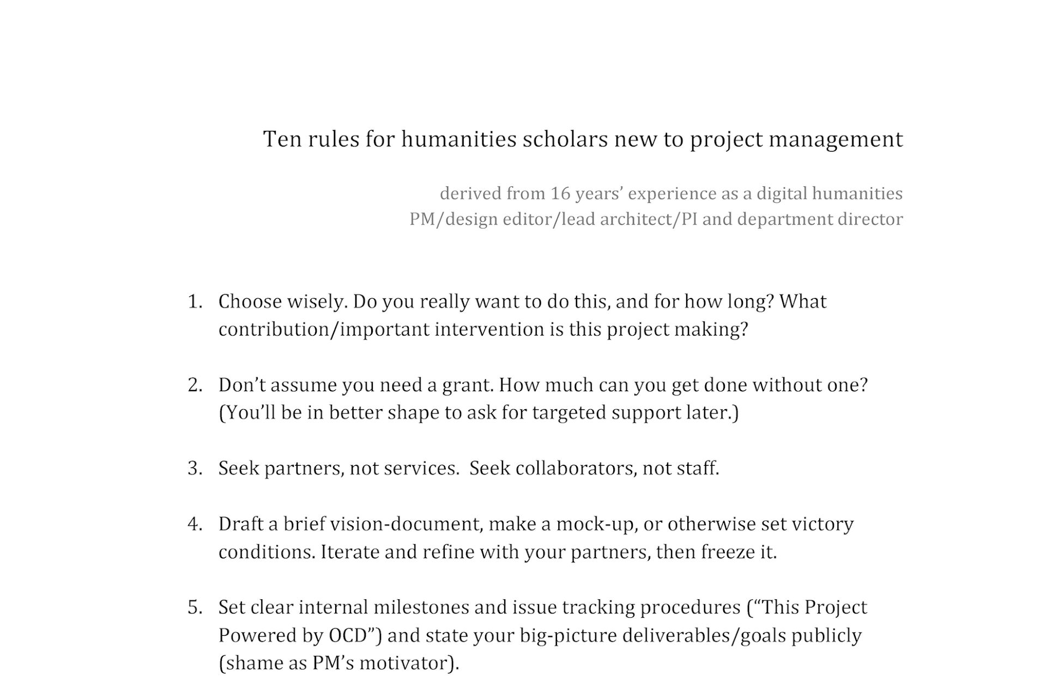
Bethany Nowviskie (2012)
Notes:
Before we start considering questions together, I wanted to point to this invaluable document from Bethany Nowviskie. I actually have these “ten rules” taped up in my office, and while they are excellent for project manager like me, they are also perfect rules for anyone considering designing a digital humanities project. I won’t go through all ten of them, but I will say that a few of them are not only incredibly good advice, but also embody the spirit of the digital humanities community.
The first rule is the most important, though we’re also going to talk about vision-documents and milestones today.
Choose wisely. Designing a DH project well depends on knowing how much time you have to devote to it, if it’s the right time in your career to develop your digital project idea, and/or how much you have passion for the idea. Nowviskie also implies something very important here - that if this project is a timely intervention or needed contribution to a community or discipline, then that will impact how the project develops and how it should be planned.
Nowviskie’s Ten Rules Handout: http://nowviskie.org/handouts/DH/10rules.pdf

Slide 10
Visioning, Planning, Design Documents….
What is the research question at the heart of your project?
Who are the stakeholders involved? Who are your collaborators?
Where/what are your sources (digitized images, text, sound files, maps, social media data, an unexplored archive, a physical object, a spreadsheet…)?
What is the purpose of this project, and/or who is the audience for it?
What is the ultimate goal of this project, and/or what new knowledge or perspective will this project communicate?
Notes:
With that in mind, I have quite a few questions here - which are honestly questions that I’ve developed for myself, in consultation and collaboration over years, to start shaping a digital project.
The first is the research question itself - and this could also be a problem or issue. For example, the early modern ocr project had a problem to solve, and that problem was: how do we, as humanists, know what’s contained in our archive of digitized page images from 1473-1800 if we can’t search the text contained within it?
It’s also incredibly important to know who your stakeholders are and who your collaborators are - and how to tell the difference between them. A stakeholder might be a granting institution, or future researchers that use your project, or students. But collaborators are the individuals that can help you actively achieve your goals (and should be credited for that work).
It’s equally important to define what your sources for the project are - specifically here, data sources, but also individuals who might have the stories you need to tell. And both of these sources can help you define project goals or your intended audience.
And maybe most importantly and therefore last: what is the anticipated outcome, which honestly might change as the project develops, but is always helpful to have clearly defined at the outset. What new knowledge or perspective will be generated?

Slide 11
3 minutes! Write it down….
What is the research question at the heart of your project?
Who are the stakeholders involved? Who are your collaborators?
Where/what are your sources?
  Examples: digitized images, text, sound files, video files, maps, social media data, an unexplored archive, a physical object, oral histories, a spreadsheet…
What is the purpose of this project, and/or who is the audience for it?
What is the ultimate goal of this project, and/or what new knowledge or perspective will this project communicate?
Notes:
For the next 3 minutes, there are paper and writing utensils scattered around the room, and I would love it if you would answer a few of these questions for me - or at least the highlighted questions.
If you aren’t currently working or thinking about a project, no worries! Perhaps there’s a digital project that you admire - it would be excellent to hear how you think another digital project team would answer these questions.
After this, I’ll ask you to share with someone sitting next to you for a bit. And then I’ll ask for any brave volunteers that want to share and get feedback from this whole group.

Slide 12
5 minutes! Share it out loud...
What is the research question at the heart of your project?
Who are the stakeholders involved? Who are your collaborators?
Where/what are your sources?
  Examples: digitized images, text, sound files, video files, maps, social media data, an unexplored archive, a physical object, oral histories, a spreadsheet…
What is the purpose of this project, and/or who is the audience for it?
What is the ultimate goal of this project, and/or what new knowledge or perspective will this project communicate?

Slide 13
1 minute or less! Share it out loud...
What is the research question at the heart of your project?
Who are the stakeholders involved? Who are your collaborators?
Where/what are your sources?
  Examples: digitized images, text, sound files, video files, maps, social media data, an unexplored archive, a physical object, oral histories, a spreadsheet…
What is the purpose of this project, and/or who is the audience for it?
What is the ultimate goal of this project, and/or what new knowledge or perspective will this project communicate?
Notes:
Thank you all for sharing.

Slide 14
Best Practices
Where is your data/content?
How will you compile, retrieve, and/or create this data/content?
Are there any privacy, security, or legal issues involved in using this data/content?
How does this data/content relate to your research question?
sources & data collection
Notes:
If any of you were able to ask yourself or your partner about sources, then your next step in project planning is likely to be thinking about data collection - and by data here I mean many things. Like texts, or oral histories, images, sound files, information able to be processed by machines, citations or a bibliography.
And so these are some of those next step questions - the most important of which are I think:
where will you find your data? is it easily compiled? (I have a horror story from EMOP about this)
are there any ethical, legal, or security issues to consider when compiling this data, or when presenting this data?
This is a step in which usually, in project planning/designing, goals and project timelines shift - the earlier they are considered, the more prepared you’ll be to begin creating.

Slide 15
Best Practices
Text Encoding Initiative (TEI)
Music Encoding Initiative (MEI)
HTML5
Metadata
Minimal Computing & Markdown
User-centered web design
Clean(ed) text files / unicode
Site Documentation
a brief & incomplete list
Notes:
If also be completely out of line if I didn’t mention best practices that currently exist for digital projects. And I list and mention these today for two reasons:
committing to using community standards for development is also a commitment to sustainability (TEI, MEI, HTML5 for interactive web content instead of Adobe Flash)
Should this project will be reviewed by a discipline-specific journal, or a DH organization, or submitted in a promotion/tenure binder, committing to best practices ensures the success of this review
Academic organizations like the MLA have resources for the development of digital projects, as well.
Guidelines for Authors of Digital Resources: https://www.mla.org/About-Us/Governance/Committees/Committee-Listings/Professional-Issues/Committee-on-Information-Technology/Guidelines-for-Authors-of-Digital-Resources

Slide 16
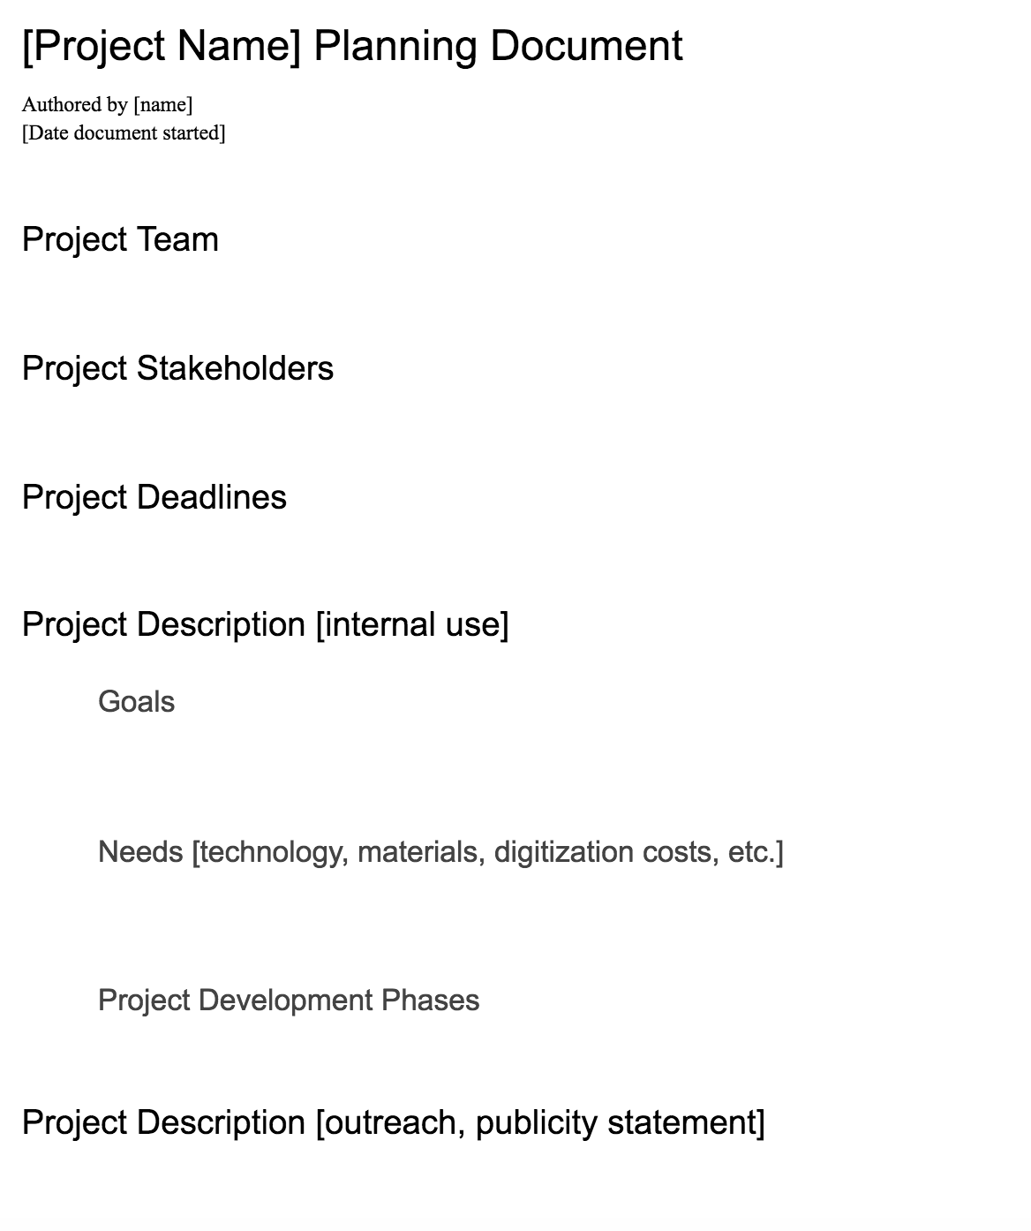
Getting Started
vision/planning document
Notes:
And now we’re approaching the fun part of DH project development - after considering these questions, you likely have a one-page or a project description. I’ve put my personal template here as an example of where I start with every collaboration.
Your document does not have to look like mine, but having a working map for a project is always a brilliant idea. If you’re writing a grant, to begin or eventually, having an initial design document is important, too.

Slide 17
bit.ly/design-dh-ihr
Notes:
The next few slides are a bit intense, so I’ll recommend again that you follow along, should you have a tablet, smartphone, or computer with you today!

Slide 18
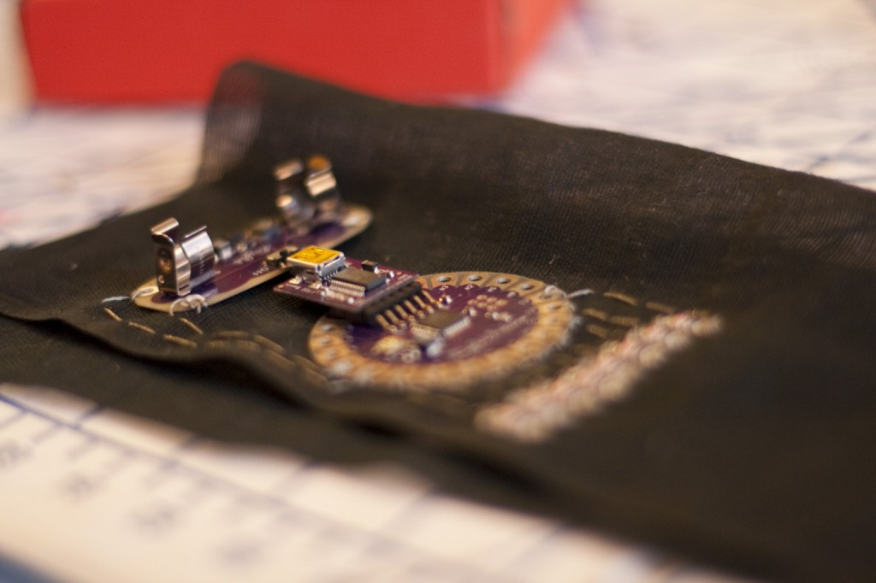
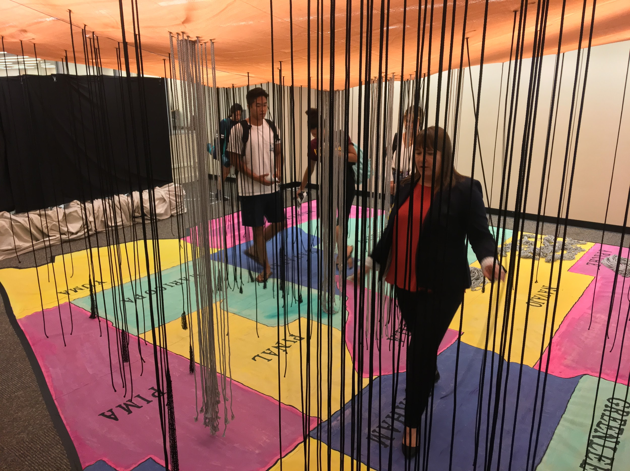
The sincerest form of flattery….
Photo by Amy Pickup, UT Dallas
Notes:
Analyzing other DH projects - Imitation is definitely a form a flattery (maybe not the most sincere), but being inspired by a digital project is definitely the best form of flattery.
Fashioning Circuits - wearables, fashion, and communicating humanities data via tangible, embodied experiences
Counting the Dead project - being inside a space where data can be interacted with in an embodied experience via touch, sight, and/or sound

Slide 19
The sincerest form of flattery….
Digital Publishing
Unghosting Apparitional Histories (bit.ly/unghosting)
Digital Archives
Bracero Archive (braceroarchive.org)
dc1968 (dc1968project.com)
Digital Companions
Becoming Richard Pryor (bit.ly/pryor-peoria)
Social Media
Documenting the Now (docnow.io)
Text Analysis
Viral Texts (viraltexts.org)
Text Mining
Quantifying Kissinger (quantifyingkissinger.com)
Large Scale Visualization
On Broadway (on-broadway.nyc)
Mapping
Borderlands Archives Cartography (bacartography.org)
Baldwin’s Paris (baldwinsparis.com)
Networks
Six Degrees of Francis Bacon (bit.ly/6-d-bacon)
Linked Jazz (linkedjazz.org/network)
Notes:
The bulk of the rest of our workshop is going to be spent on this page, and I hope you’ll join me in discussion.
If everyone/most people have access to this powerpoint via tablet, computer, or smartphone, I’d really like to treat this like a choose your own adventure exercise. I’ve put somewhat descriptive and fairly arbitrary DH boxes on this slide, along with example projects that may be inspirational. If you don’t see a DH box that applies to your goals, please let me know!
If most people don’t have access to this PowerPoint, we’ll take suggestions and walk through some examples together - which we would do anyway as a group after some individual or group explorations.
When exploring these examples:
what do these projects do well?
what is missing?
is anything particularly attractive in the way they represent information or data?
or perhaps in the tools that they’ve decided to use?
do these projects describe how they were made?

Slide 20
Getting Started
platform choices

Slide 21
to host or not to host...
Reclaim Hosting (reclaimhosting.com)
Pantheon (pantheon.io)
Dreamhost (dreamhost.com)
Amazon Web Services (aws.amazon.com)
Scalar (scalar.usc.edu)
Omeka.net (omeka.net)
Wordpress.com (wordpress.com)
ESRI StoryMaps (storymaps.arcgis.com)
Humanities Commons (hcommons.org)
Notes:
Making choices about platforms and tools requires a consideration of not only funding and the sustainability/ephemerality (or planned obsolescence) of the project, but also take into account audience and the ultimate goals of the project. When possible, using a known and community-supported platform with the ability to interact with the “front-end” of an application is always best - especially for projects that have specific goals.
Publishing a multi-media or digital book in the open Scalar community, where you can request a user account and immediately start building a narrative, is useful to both the prototyping phase of a project and, perhaps, the finished project itself. Using a free account on Omeka.net is excellent if the goal is to make more accessible and form exhibits around a smaller number of digitized archive materials. And a free wordpress.com site or blog is a great way to have a front-facing project website for any stage of a project (and now - you can sign up for an account with Humanities Commons and build your website within a Humanities-focused digital community!).
[Click through Humanities Commons] - learn more in the October IHR workshop! (https://www.eventbrite.com/e/faculty-development-workshop-using-digital-commons-platforms-tickets-48965527210)
In the left-hand side column here, however - I have some recommendations for hosting options. The first two options, both Reclaim Hosting and Pantheon, have point-and-click installation for content management systems. For a fee, Pantheon will host a WordPress or Drupal project and allow access to a development dashboard that is slightly more intuitive for scholars not familiar with versioning systems or development workflows. For a much more reasonable fee (but with less customer support), Reclaim Hosting has point-and-click installation option for WordPress and Drupal, but also for platforms like Scalar and Omeka. If you have massive amounts of data, or if you want to customize the look and feel of your digital project, then Reclaim Hosting is an excellent choice.
If you’re developing from the code up, or if you’re customizing code or a new platform, or if you want absolute full control (called root access) to a virtual server, both Dreamhost and Amazon Web Services offer these capabilities for a yearly fee. These are for large-scale, resource heavy digital projects that need large amounts of computing power or storage space. For example, before moving the data to physical servers, a project I worked on considered indexing our 2.5 million metadata records and about 1 millions text files with associated digitized book page images on Amazon Web Services.
We’re going to return to Reclaim before I advance these slides to explore hosting options.

Slide 22
Getting Started
setting milestones

Slide 23
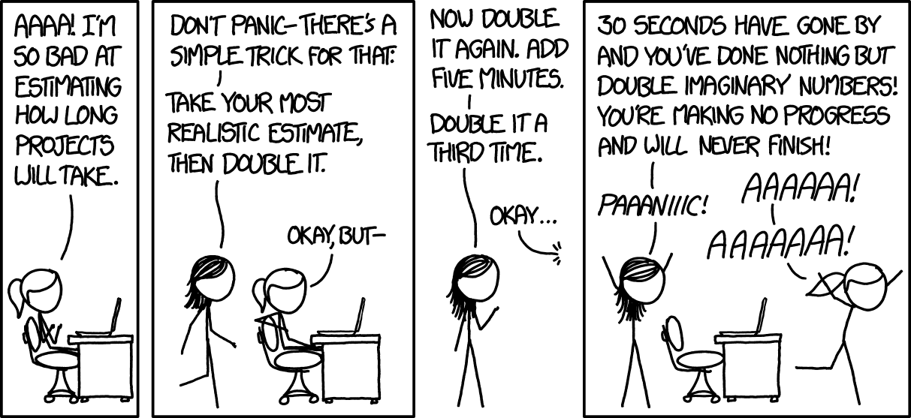
Image Source: xkcd.com/1658
Notes:
I think about this xkcd comic almost once a week.

Slide 24
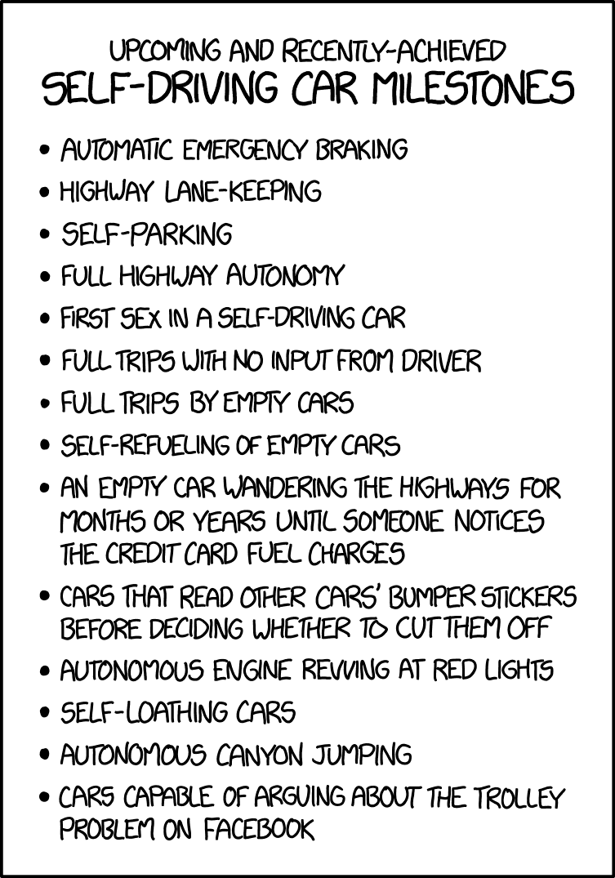
S - Specific
M - Measurable
A - Attainable
R - Relevant
T - Timebound
Image Source: xkcd.com/1658
Notes:
Every project milestone must fulfill all of the SMART criteria.
Specific: What specific need does this milestone fulfil?
Measurable: How do I measure success?
Attainable: Is this goal realistic, especially for my set time frame and the support or funding I currently have?
Relevant: Does this milestone actually help me reach the finish line?
Time-bound: This is related closely to measuring - how do I know when this milestone has been achieved (when you *stop* iterating or perfecting). This is the “draw a line in the sand” criteria.
Example project milestones can be things like:
finish initial research on primary/secondary source materials
conduct a specific number of oral history interviews
plot geographic data points in a mapping tool (or record geographic coordinates into a spreadsheet for migration into a mapping tool)
get feedback from stakeholders or the community

Slide 25
Getting Started
sharing out & sharing credit
Notes:
Sharing out: You’re done (according to your project planning document and milestones)! Now what?
Attend a discipline-specific conference or a DH conference and share your work. Or share the project on social media, or via an ASU Now article, or by simply sharing it with the stakeholders, collaborators, and consultants who’ve helped you develop, build, and achieve the project’s goals. Especially be sure to share it with any communities or community members that are featured in the project. But before doing that, make sure that your collaborators are appropriately credited in the project.

Slide 26
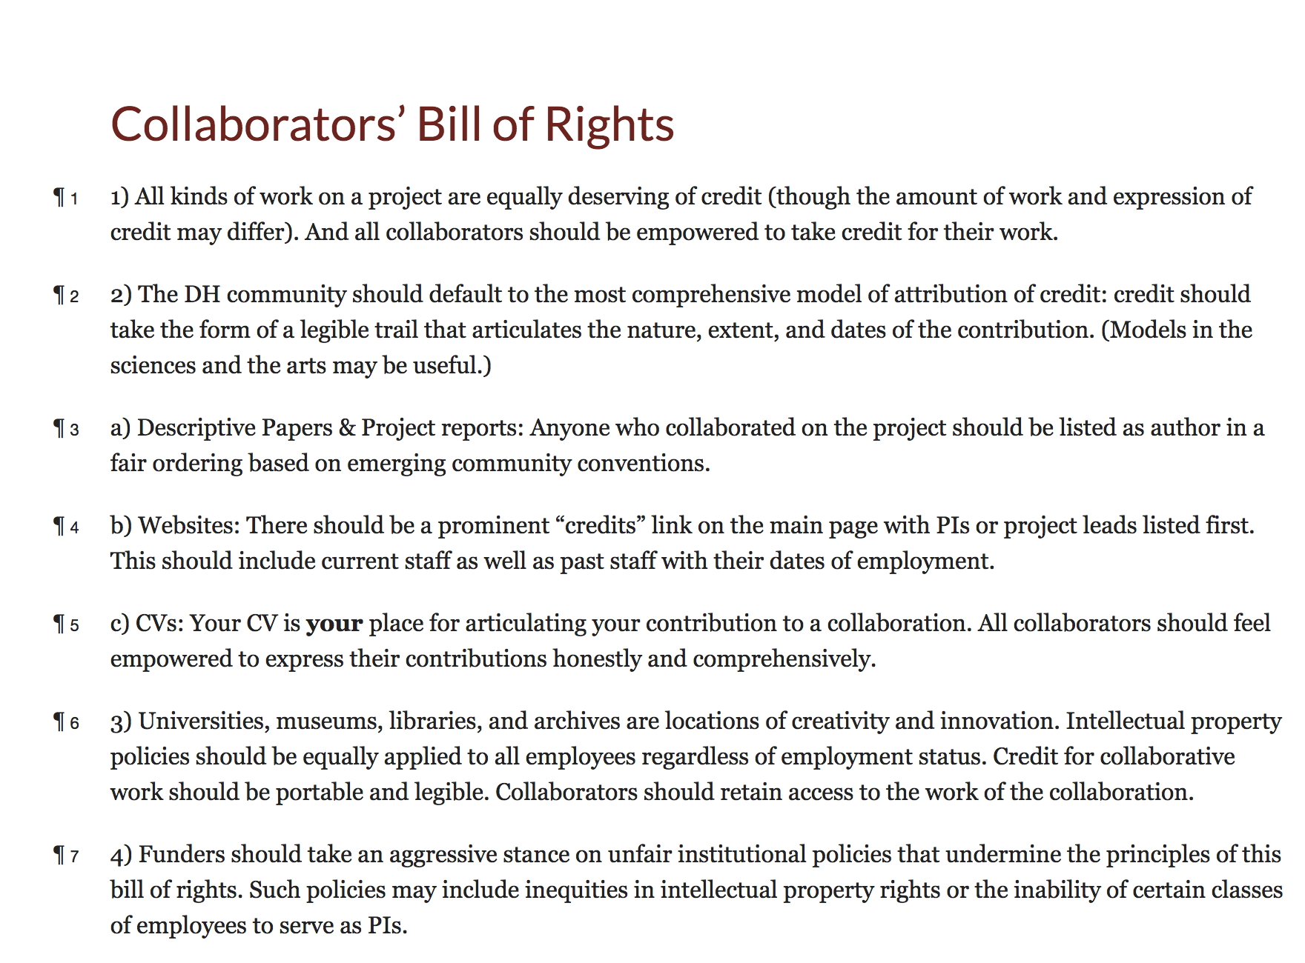
bit.ly/Collab-Rights
Notes:
In 2011, a group of scholars came together to work on a number of things, including the Collaborators’ Bill of Rights. This bill of rights expresses not only how collaborators on a project should likely be represented (e.g., through a legible trail, on a prominent “credits and acknowledgements” page on the project website), but also how funding agencies, cultural heritage institutions, and universities should treat the intellectual property of collaborators.

Slide 27
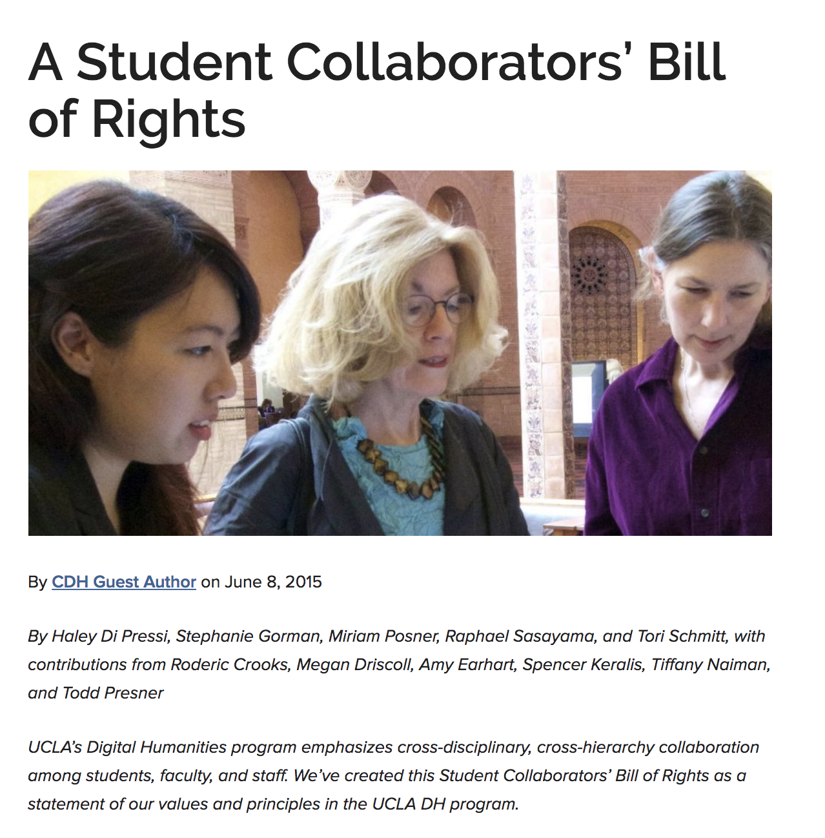
bit.ly/Collab-Rights-Students
Notes:
And I’ll wrap up today and lead into questions with the incredibly important Student Collaborators’ Bill of Right, written in 2015. I actually couldn’t fit the entire Bill of Rights on this slide because of the length, but if you plan to work with students of any level, from any institution, I urge you to take a look at these principles and values - which cover everything from unpaid labor, to the rights of students to list projects on their resumes, to mentorship recommendations and more.

Slide 28
More Resources
The Programming Historian (peer-reviewed tutorials)
programminghistorian.org
“How Did They Make That” (Miriam Posner)
miriamposner.com/blog/how-did-they-make-that
DiRT Directory (registry of digital tools and platforms)
dirtdirectory.org
“Where to Start? On Research Questions in The Digital Humanities” (Trevor Owens)
bit.ly/2OUNMHr
Elizabeth Grumbach @EMGrumbach
Notes:
Thank you for your time. And always happy to answer questions!
What are your hesitations with doing a DH project?
What are the barriers or roadblocks or intimidations?
How can we build resources or a community that supports DH efforts here at ASU?

