Slide 1


Designing Career Exploration Tools
for Full-Time MBA Students
Jessica Devereaux
April 17, 2019
Assistant Dean and Director,
Parker Career Management Center
Notes:
Welcome Introductions: Name/Title / Thank guests for attending.
Hello, My name is ____ and I am the ____ for the Full-Time MBA program at UCLA Anderson. I would like to thank you for your time this afternoon/evening. We are a 2-year MBA program located in the fantastic city of Los Angeles.
Ask everyone where they are from and their industry & functional interest to gauge your audience.

Slide 2

Intro & Roadmap
What We’ll Cover:
    Project Overview (including target users and project objectives)
    Project Development Experiences
    Evaluation of Project Effectiveness
    Learning Outcomes
    Questions
Jessica Devereaux
Communications Manager
Parker Career Management Center
@UCLA Anderson School of Management

Slide 3
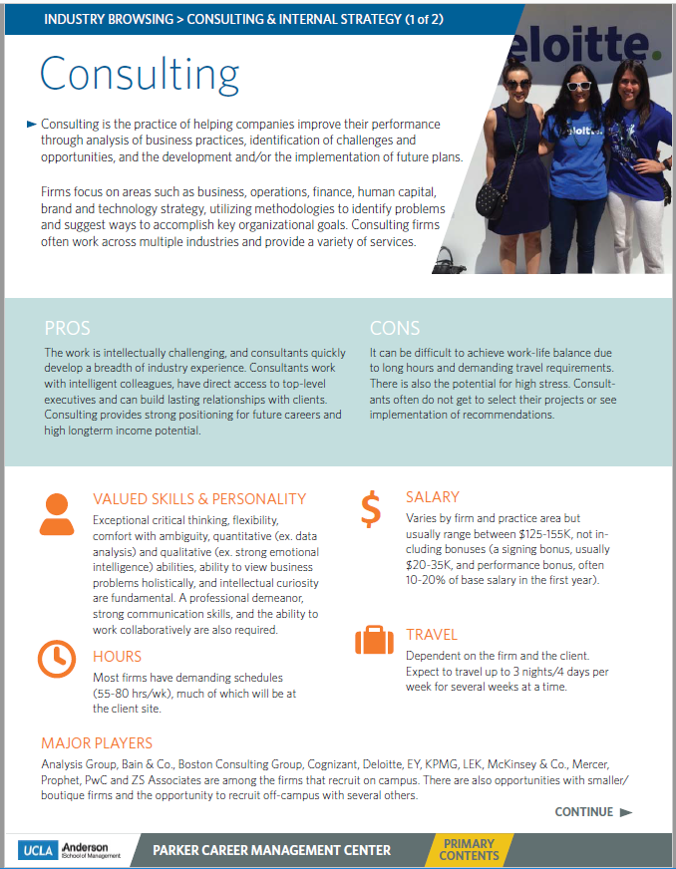
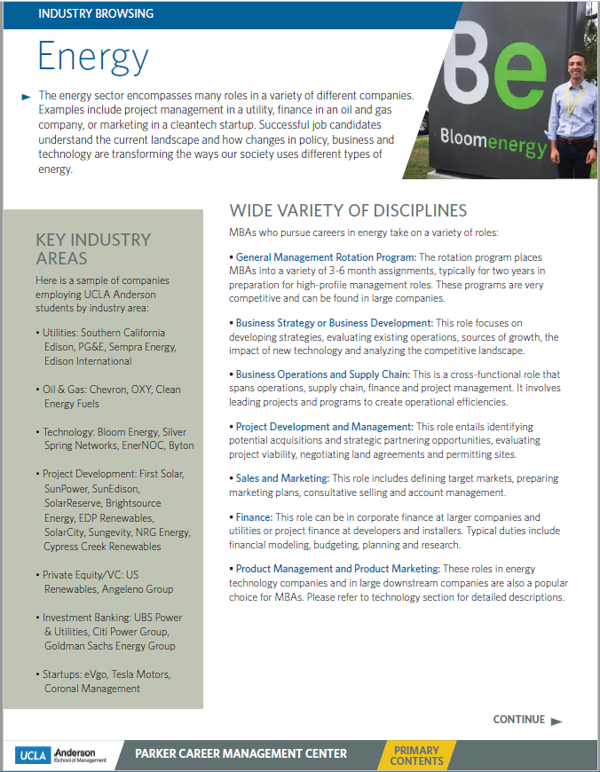
About the Project
Workplace Deliverable
14 career exploration and preparation resources in the form of industry segmented, downloadable e-books, housed on an internal web portal.
For the following industries:
Consulting
Corporate Finance
Energy
Entertainment
Healthcare
HR/HCC
Investment Banking
Investment Management
Marketing
Operations
Real Estate
Retail
Sports
Tech

Slide 4
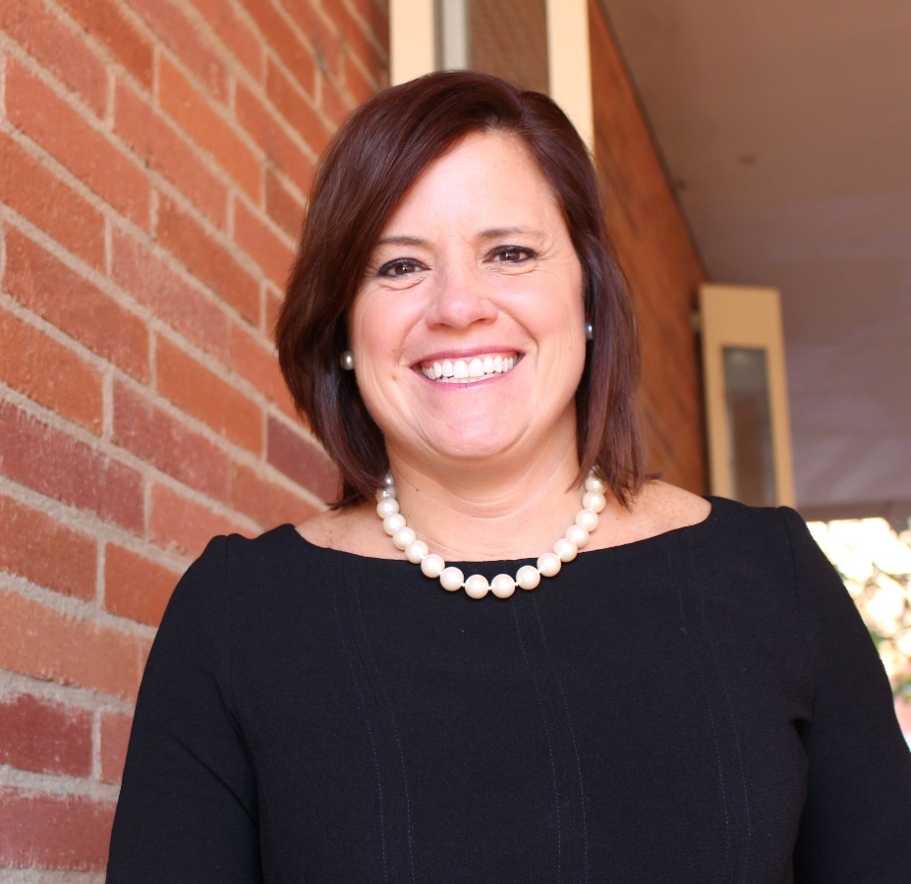
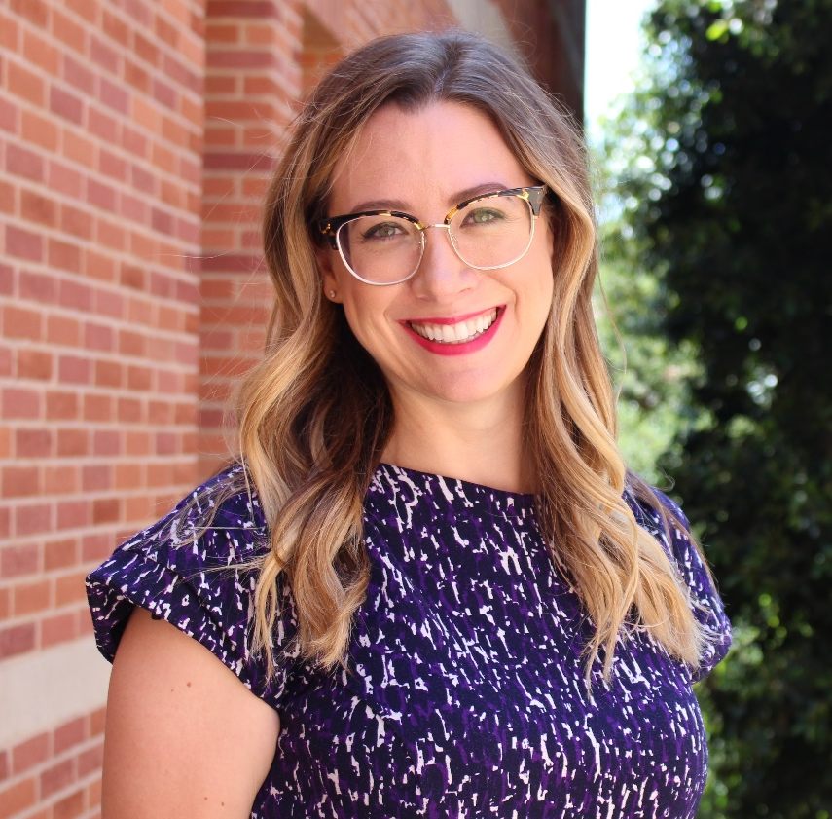
About the Workplace Deliverable
Project Commissioners
Emily Cruse
Associate Director,
MBA Career Education
Regina Regazzi
Assistant Dean & Director

Slide 5

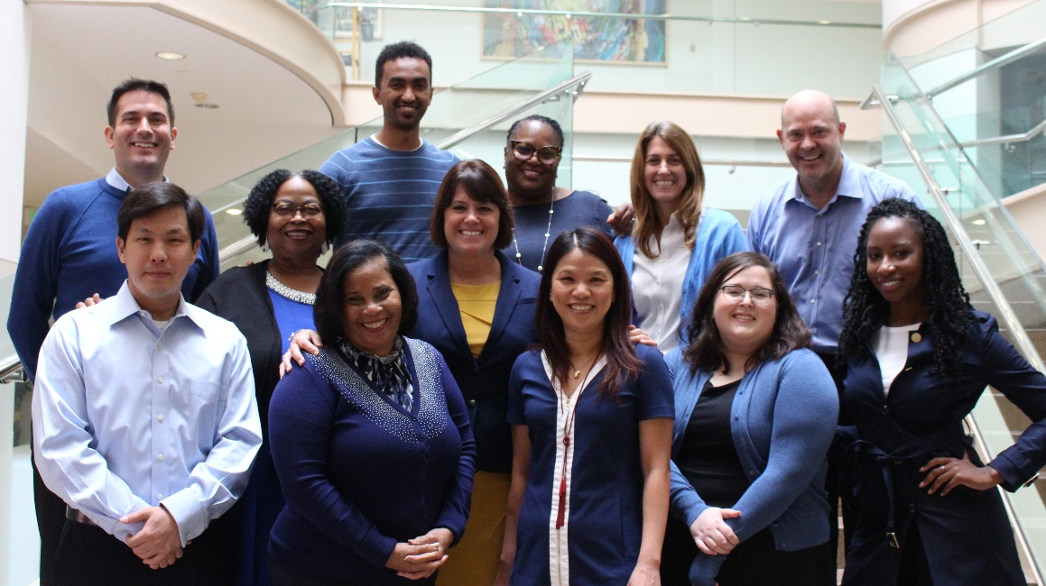
About the Workplace Deliverable
Target Users
700 + current full-time MBA students
360+ student intends
Parker’s internal staff and career advising team

Slide 6
About the Workplace Deliverable
Project Objectives
    Create tools that allow students to begin the process of career explorations before they arrive to campus at throughout the course of their MBAs
    Ensure consistency of information, content inclusions, and visuals across all tools
    Allow these tools to be conveniently accessed and navigated remotely
    Respond to a communicated need and contribute to the overall strong satisfaction rating of Parker’s career development services

Slide 7

What Happened
Applicable Studies
    Project Management
    Principles of Visual Communications
    Visualizing Data and Information
    Technical Editing
    Web User Experience

Slide 8
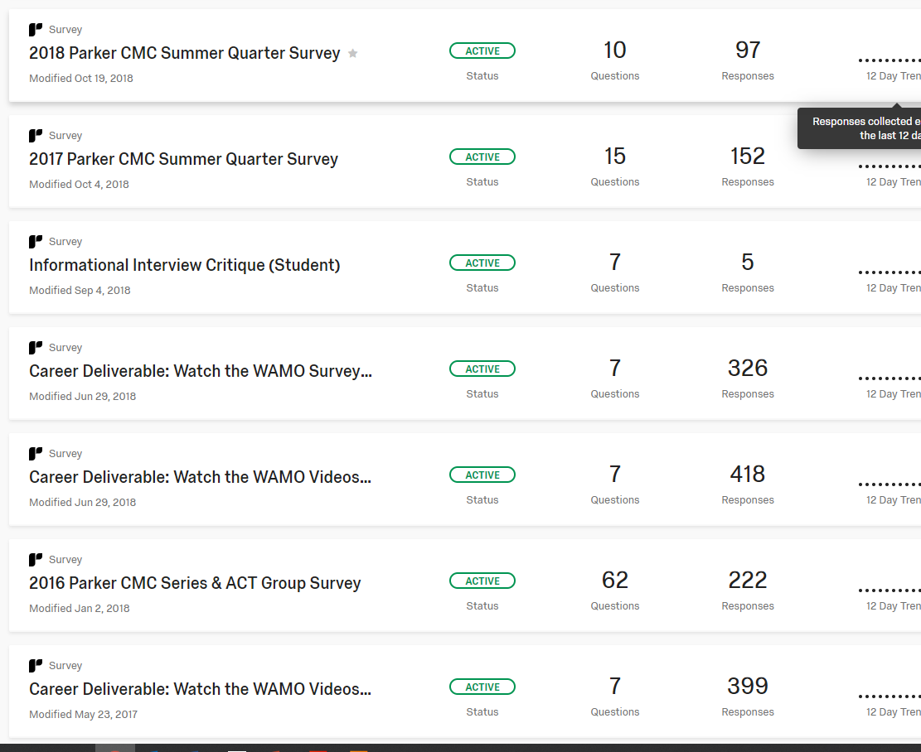


What Happened
Project Planning & Stakeholder Identification
Brainstormed Project Ideas
Evaluated past department metrics
Common Themes:
    Students wanted more opportunities for career exploration prior to arriving on campus
    Convenient, centralized access to sample application materials, networking resources, and more

Slide 9



What Happened
Considering Organizational Structure
Balanced Matrix Orgs:
    Power is shared between the project manager and functional manager
    Clear and consistent communication is key
Project Manager
Functional Manager

Slide 10
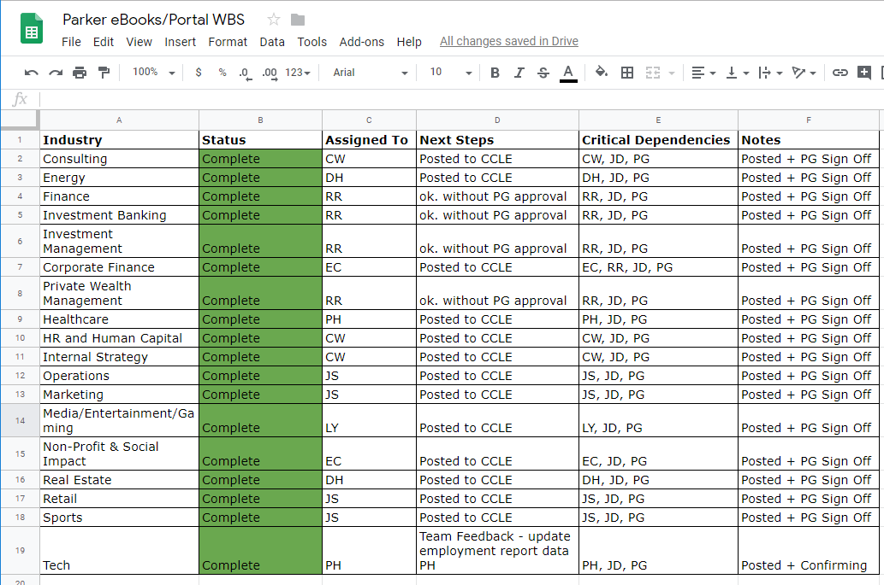
What Happened
Structuring Project & Tracking Goals

Slide 11
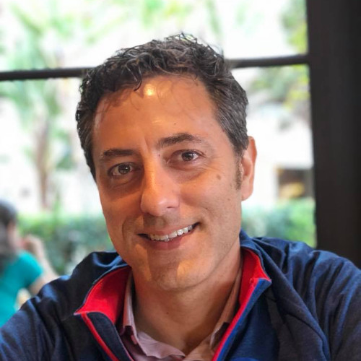
What Happened
Problem Solving & Crisis Management
Managing Stakeholder Accountability
Regina’s Sabbatical
Change Management

Slide 12
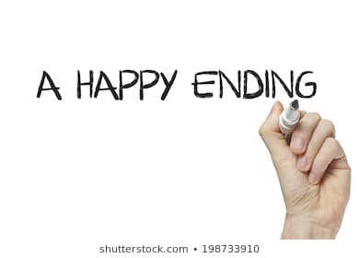
What Happened
Closing & Evaluating Project
    All 14 eBooks were completed and reviewed by internal staff
    Were released to the current student population in December 2018
    Will obtain official metrics on their effectiveness in August 2019 from the Class of 2021 admits

Slide 13

Evaluating Effectiveness
Recap of Project Goals
    Create tools that allow students to begin the process of career explorations before they arrive to campus at throughout the course of their MBAs
    Ensure consistency of information, content inclusions, and visuals across all tools
    Allow these tools to be conveniently accessed and navigated remotely
    Respond to a communicated need and contribute to the overall strong satisfaction rating of Parker’s career development services

Slide 14
Evaluating Effectiveness
Recap of Project Goals
    Create tools that allow students to begin the process of career explorations before they arrive to campus at throughout the course of their MBAs
    Deliverables were completed in December 2018 and will be released to the incoming Class of 2021 this summer, prior to their arrival on campus. Students will be assigned career exploration activities which involve the eBooks.
    Ensure consistency of information, content inclusions, and visuals across all tools
    All eBooks were designed to adhere to the same standards of content and visual consistency. All documents include same categories of resource inclusions in the same order, and stylistically, the use of color, proportion, and typography is presented in the same way across documents.

Slide 15
Evaluating Effectiveness
Recap of Project Goals
    Allow these tools to be conveniently accessed and navigated remotely
    All eBooks are centrally located on an internal web portal and can be accessed and downloaded remotely
    Respond to a communicated need and contribute to the overall strong satisfaction rating of Parker’s career development services
    Deliverables were designed in direct response to student need (as communicated in historical performance metrics). Although we won’t obtain official feedback until August 2019, we have received positive, informal feedback from target users

Slide 16

Learning Outcomes
Leveraging Learning for My Future
    Can approach tasks as a more skillful project manager
    More confident in visual communications capabilities
    Improved technical editing proficiency
    Better interpersonal communications and cross-functional collaboration aptitudes
    Navigate challenges with more grit and resiliency

Slide 17

Learning Outcomes
Reconnecting with Intrinsic Motivations
    Allowed me to reconnect with my motivations for pursuing career as a communications professional
    Presented me with opportunity to take on exciting new tasks, pursue my interests, and reconnect with my intrinsic motivations
    Enabled me to use my creative aptitudes to make an impact on my organization and the student population we serve

Slide 18

Any Questions?

Slide 19
References
Internal & Department Data Sources:
UCLA Anderson Career Impact. (2018). Retrieved from
https://www.anderson.ucla.edu/degrees/full-time-mba/career-impact/. Web. 2 Sep 2018.
UCLA Anderson FTMBA Class of 2017 and 2018 Employment Report. September
2018. PDF.
University of California, Los Angles, Anderson School of Management. 12 twenty
reporting system (compilation of student reported job placement and compensation
data) (2018). Retrieved from https://anderson-
ucla.admin.12twenty.com/. Web. 21 Oct 2018.
Other Sources:
Berger, A. A. (2012). Seeing is believing: An introduction to visual communication.
New York: McGraw-Hill Education.
Dinsmore, P. C., & Cabanis-Brewin, J. (2006). The AMA handbook of project management. New York: AMACOM.
Kerzner, H. (2017). Project Management - A Systems Approach to Planning, Scheduling, and Controlling (12th Edition). John Wiley & Sons. Retrieved from
https://app.knovel.com/hotlink/toc/id:kpPMASAPSC/project-management-systems/project-management-systems. Web. 27 March 2019.
Maciver, L. (2011). Project Management Competence – Soft Skills & Behavioral Competence Overview. Retrieved from http://www.maciverprojectservices.co.uk/2011/project-manager-competence-soft-skills-behavioural-competencies-overview/. Web 23 December 2018.
Perrin, Richard. PMP Exam Prep Boot Camp. Denver: EdWel Programs, 2016. EdWel.co,. EdWel Programs. Web. 14 Oct. 2018.

