Slide 1




Business Sustainability
by Leveraging the
Phoenix Green Business Leader Program
Ashley Weisman
Notes:
Brief introduction/outline & problem statement
“Good afternoon everyone. My name is Ashley Weisman. And my project is ‘Business Sustainability by Leveraging the Phoenix Green Business Leader Program’”.
Presentation Outline
Brief introduction/outline & problem statement
Who is the client/ what problem were u trying to solve?
What solution was proposed?
What methods you used to solve the problem?
What were the project outcomes for the client?
What did I learn/ major takeaways from a learning perspective?
What recommendations for my client?
Call to action
8-10 minutes. 6-8 minutes for questions. 2 minute transition.

Slide 2



Notes:
Who is the client/ what problem were u trying to solve?
“My project aimed to help a local architecture and design firm, Winslow+Partners, to implement enough sustainable practices to achieve Platinum level certification in the Phoenix Green Business Leader Program. Then, I took a step back and looked at green business programs from a more critical, holistic perspective and looked at how I could contribute to improving green business programs in the US.”

Slide 3

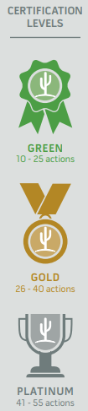
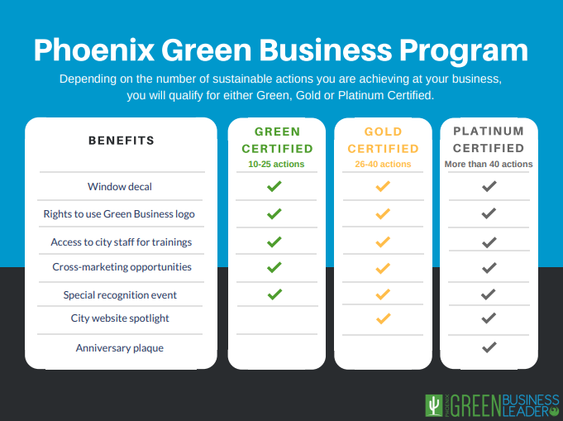
Notes:
What solution was proposed?
“Hundreds of green business programs and certifications exist worldwide, and like many of these programs, the Phoenix program is a checklist. Depending on the amount of boxes you check, you will qualify for either Green, Gold, or Platinum certification, then City of Phoenix representatives conduct a site evaluation to confirm your checklist. On the left, these are the categories that the Phoenix program covers, as well as the benefits offered for the different levels of certification”.

Slide 4
Project Process
Phase 1: Introductory Meeting & Tour
Phase 2: Creation of Strategy Proposal
Phase 3: Strategy Proposal Meeting
Phase 4: Sustainability Strategy Execution
Phase 5: Green Business Program Analysis
Phase 6: Overview Meeting
Phase 7: Phoenix Green Business Leader Certification
Notes:
What methods you used to solve the problem: Highlights of the process & how I engaged with the staff.
“My project process had 7 phases. The first three phases included understanding the current state of the business and creating the project strategy based on that current state, phase 4 was the longest in duration as I executed the strategy, in phase 5 I conducted the green business program analysis, in phase 6 all the staff and myself had our overview meeting to go through the checklist one last time together and submit the checklist, and in phase 7 the 2 City of Phoenix representatives conducted their site evaluation”.

Slide 5
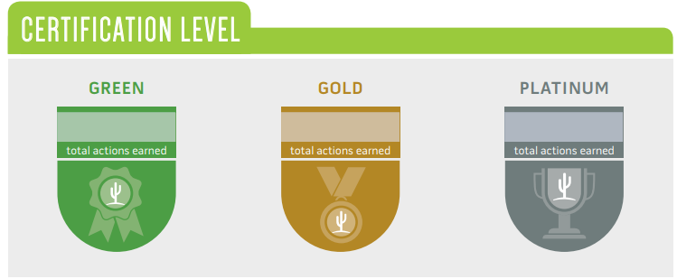
December 2018
25
Notes:
What were the project outcomes for the client?
“Winslow+Partners already had sustainable initiatives in their business before I started the project. For example, they implement water and energy efficient features in their architecture projects, they recycled, had some donation and reuse initiatives, had 3 Energy Star rated appliances, and had occupancy sensors for their lighting. So before the project, this earned Green Level certification, with 25 points”.
Newly implemented practices
Sustainability Guide
The Winslow + Partners Sustainability Guide will serve as a resource-filled how-to guide, informing how to sustain the new sustainability practices at Winslow + Partners. Sections for where/how to buy different sustainable items/services I’ve purchased, copies of the labels/posters I created, a sustainability plan for moving forward that we will continue to create together, etc.
Phoenix Green Business Leader Report
highlight the gaps and opportunities for the Green Business Leader Program to become a transformational sustainability tool
will serve as a case study for the public works department by addressing the project results, best practices, and lessons learned, but will focus on recommendations for the program based on the Literature Review
This report will analyze the Program within a wider sustainability context, to increase the Program’s ability to be a transformational sustainability leadership tool with my suggestions on how to delve deeper into all three pillars of sustainability. (include behavior change resources)

Slide 6
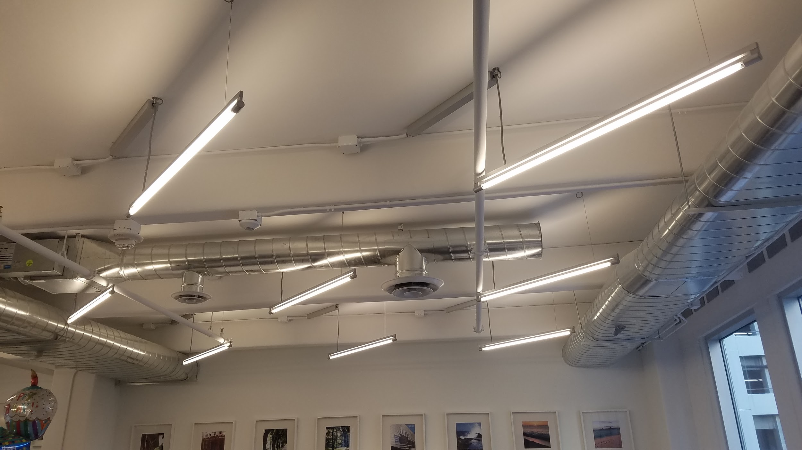
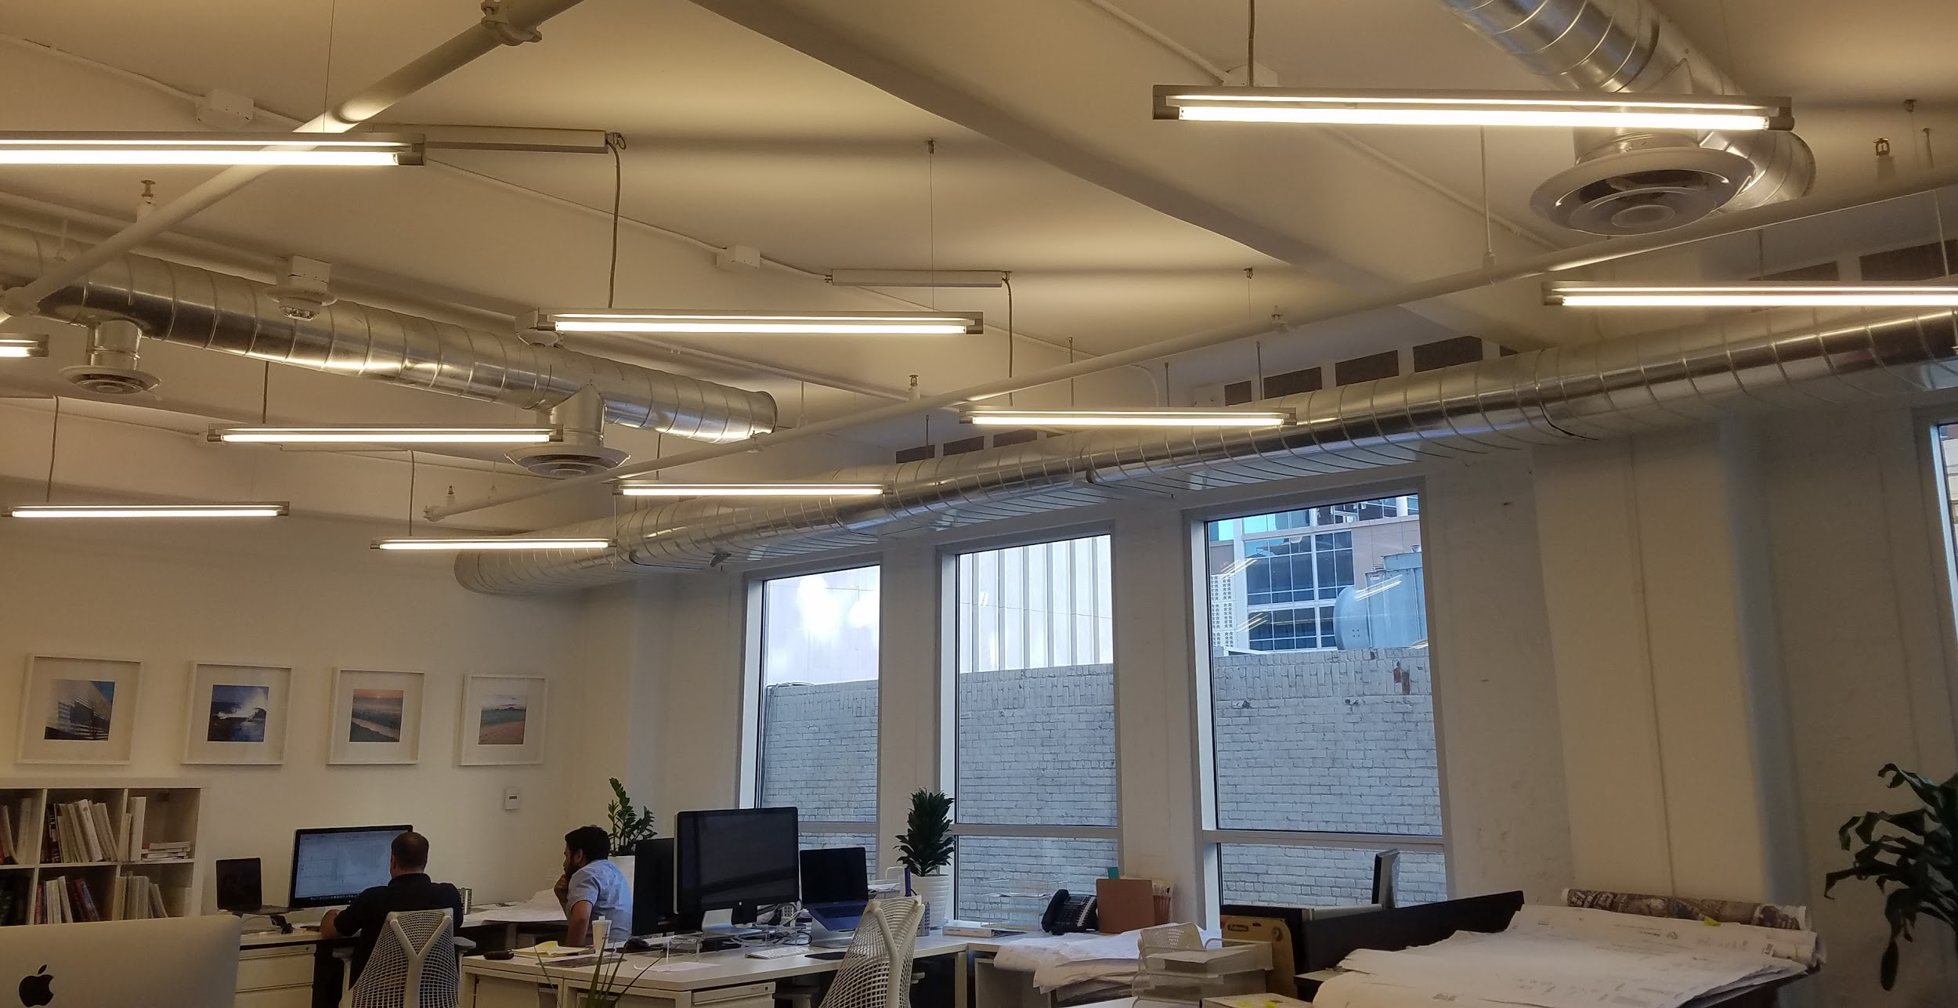
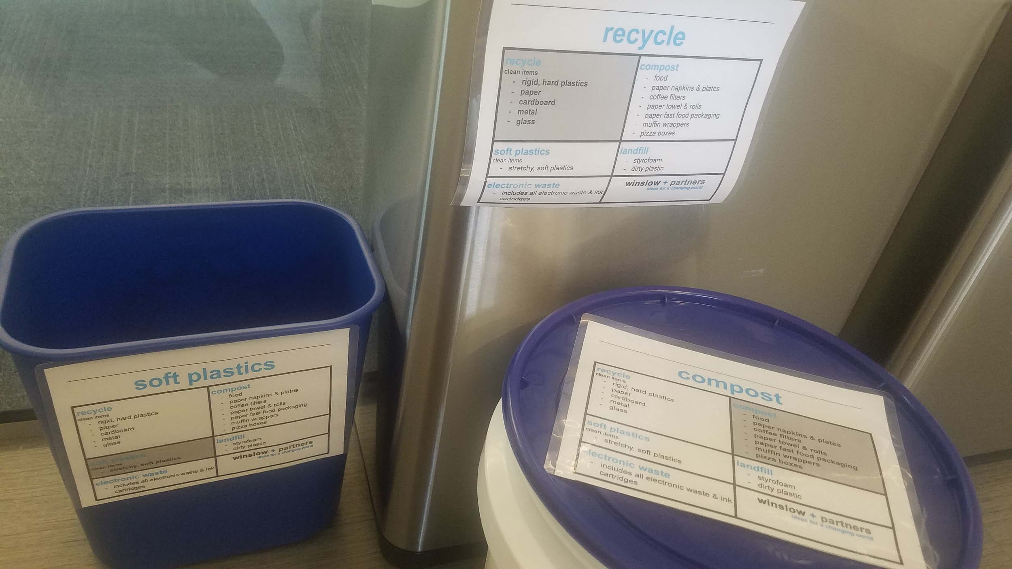
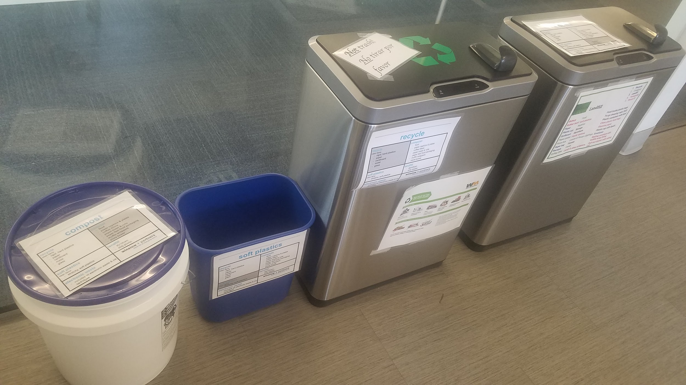
Notes:
What were the project outcomes for the client?
“During the project, I’ve converted 67% of the lighting to LEDs, and the office will actually be 100% LED here in the next week or so once the rest of the bulbs are delivered. Also they now have 5 waste streams, including composting, soft plastics, recycling, landfill, and electronic waste”.

Slide 7
Results
100%
LED lighting
5,980
gallons annual projected water savings
73%
diversion rate
6%
increase in diversion rate
Notes:
What were the project outcomes for the client?
“Some of the quantitative results of the project include 73% diversion rate at the office. Through a waste audit i conducted in January and in April, their diversion rate increased by 6%. I will note that since I facilitated the initial staff waste diversion training, 4 new employees were hired, so that tells me that the bin labels, waste PDF I sent to the staff, and the tour of the recycling facility worked in awareness and reinforcement of the 5 waste streams. Also, I set up a water leak audit with the City of Phoenix Water Smart Program, and this projected an annual savings of nearly 6k gallons of water. This is especially valuable because the building management refuses to implement recycling in the building, so we are hoping that if we show the building owner their potential cost savings on water annually, then he can use this savings to purchase recycling services. We hope to find some sort of common ground that way”.

Slide 8
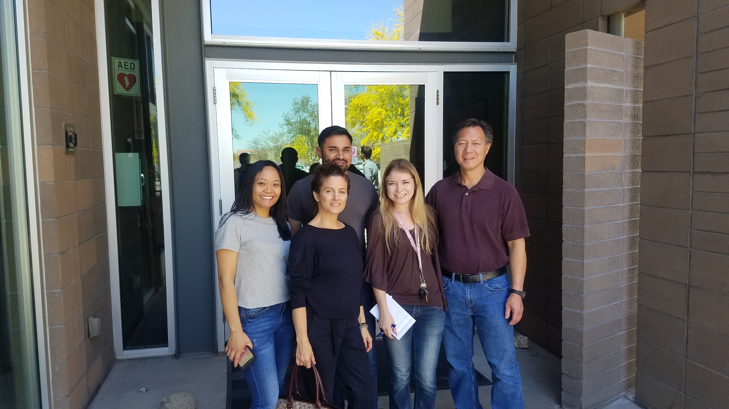
Results
Facilitated Sustainability Think Tanks
Winslow+Partners Sustainability Guide
  Sustainability plan & green office program
  Committed to submittal of diversion rate quarterly
Notes:
What were the project outcomes for the client? & What recommendations for my client?
“We also facilitated two Sustainability Think Tanks. So the idea behind this was to reach our sustainability efforts past the firm itself and into the community to get the other businesses on the block interested in Phoenix Green Business Leader certification, in order to ‘create the first sustainable block in Phoenix’, is how we marketed it. I planned an hour session, I created fliers and went around to businesses on the block and invited them in person, and went around a second day to remind them, and zero businesses showed up. But that’s okay, we went back to the drawing board and strategized for our second think tank, where we invited people we already had relationships with to kind of start the conversation there. This conversation included a local property manager, two local business owners, and two City of Phoenix representatives and this was a fruitful conversation.
The firm also has their Winslow+Partners Sustainability Guide, which is a resource-filled how-to guide to help the firm continue the new practices. I’m also continuing my work with the firm in crafting their firm’s Sustainability Plan & green office program. The office also volunteered to submit their waste diversion rate every quarter to the City to keep them aware and accountable for their waste... And more! For another example, here’s a picture of some of the staff and I when we toured the recycling facility.”

Slide 9
December 2018
April 2019
25
51
Notes:
What were the project outcomes for the client?
“After I facilitated some staff sustainability trainings and more, and I’m proud to announce that Winslow+Partners earned their platinum cert with 51 points”.

Slide 10
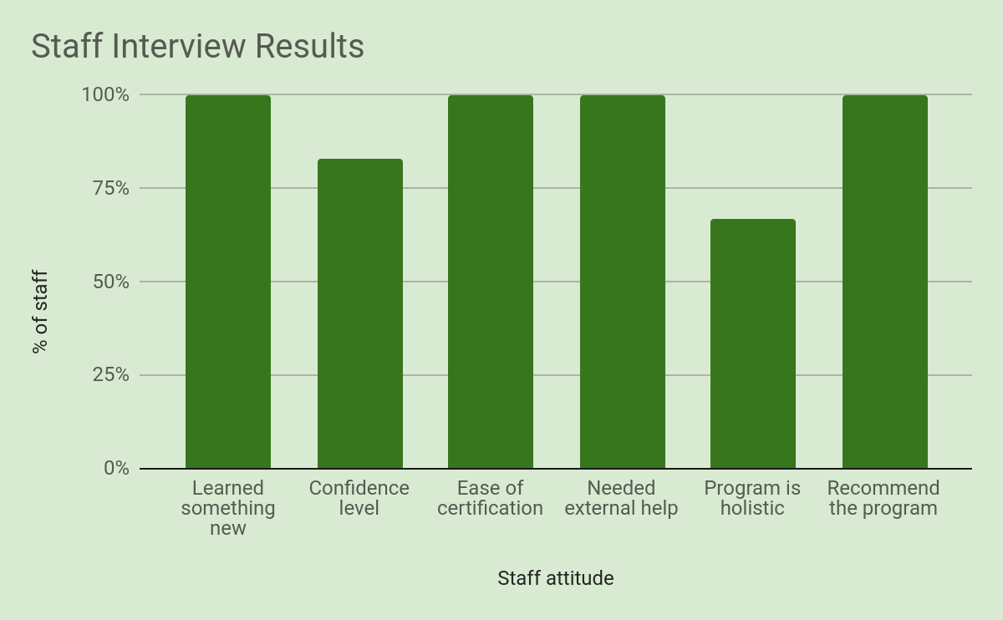
Winslow+Partners
Case Study
Notes:
What were the project outcomes for the client?
Go through each bar...

Slide 11

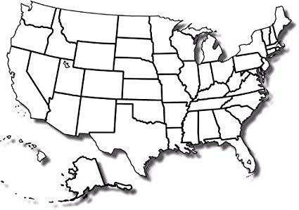
Research & Conversations with
Green Business Programs
Green Business Program Practitioner Guide
Literature review
Self-reflection questions
  Best practices
Notes:
What recommendations for my client?
“To further my analysis on green business programs, I conducted a literature review and summarized the critiques of green business programs, then I compared these critiques to 28 existing green business programs using publicly available information. I also interviewed 16 programs, which you can see as these map points above. Through these conversations and research, I’ve created a Green Business Program Practitioner Guide, which offers the literature review summary, self-reflection questions based on the literature review for program practitioners to reflect on and ask themselves, and then for each of the questions I have a best practice example. and each of these best practice examples highlights one of the 16 programs that I spoke with”
Green Business Bureau
Phoenix Green Business Leader Program
Clark County Green Business Program
Hawaii Green Business Program
The Institute for Green Business Certification
Austin Green Business Leader Program
Green Business Partnership
Certifiably Green Denver
B Corporation
Seattle Envirostars
Green Business Engagement National Network
Nevada greenUP!
Illinois Green Business Association
Portland Sustainability at Work
California Green Business Network - Napa County
Greshem Green Business Program

Slide 12

Reflections
Notes:
What did I learn/ major takeaways from a learning perspective?
-”I definitely think I came out of this project with a very thorough understanding of green business programs, as I looked at the program from all angles, including the perspective of the business going through the program, through publicly available information, and then through the perspective of the practitioners themselves.
-These programs can move the needle, but this requires a lot of support and hand holding from the program practitioners, and this was also exemplified in the Winslow+Partners case study; however, in order for the programs to actually move the needle and ensure continuous improvement from the businesses, these programs need more staff. All of the programs are understaffed, and I think this has huge implications for city departments because if cities are actually serious about meeting their sustainability goals, then they have to be on the ground engaging with businesses. So I think as these programs improve at measuring their impacts they need to focus on how to market their program to city leadership that they need a larger green business program team in order to meet city sustainability goals.
-Next, as usual this comes to policy. In the Sustainability Think Tank sessions I learned that many of the businesses in downtown Phoenix don’t pay their own utilities. Their energy and water bills are covered in their rent, so many businesses have no idea how much water and energy they are using. So for these hundreds of businesses, the financial incentive of the program and reducing their energy water use is almost nonexistent, so again this goes back to the need for regulations that support sustainability transitions”.
-The practitioners I spoke with were very open about their challenges and shortcomings, and very interested in seeing my final product. They gave me access to surveys, provided professional introductions, and wanted to keep a relationship with me. I was also invited to speak at the 2020 Green Business Engagement Network Summit. Their passion and willingness to share and improve gave me a lot of future for these programs moving forward. Thank you”.

Slide 13
Questions?
Ashley Weisman aweisma2@asu.edu
Notes:
Call to action
“If you would like to see my final deliverable, I would be more than happy to share them with you. Please email me and I ask that you send them out to anyone working in the green business or certification space”.

