Slide 1
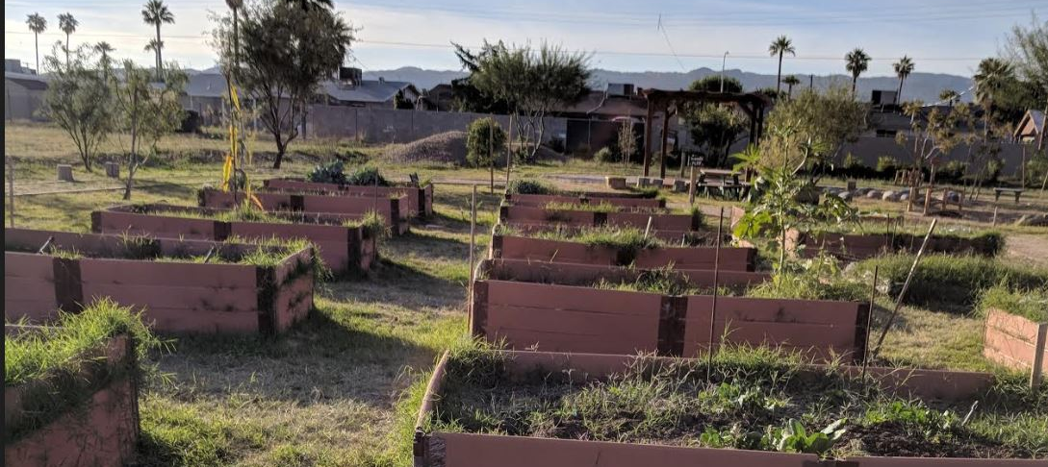
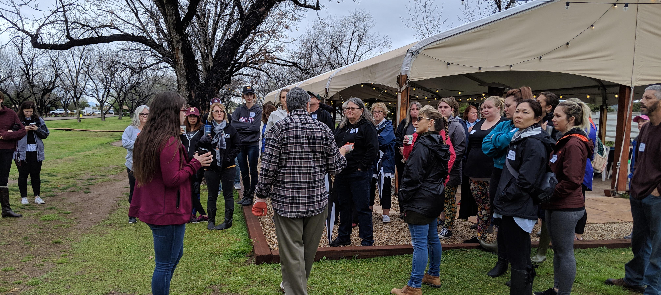
Cultivating Strategic Partnerships in Garden Based Learning
Matthew Waldman
Maters of Sustainability Solutions
Notes:
The purpose of Cultivating Strategic Partnerships in Garden-Based Learning was to help the Farm at South Mountain initiate educational partnerships with non-profit organizations, university entities, and local elementary schools.

Slide 2
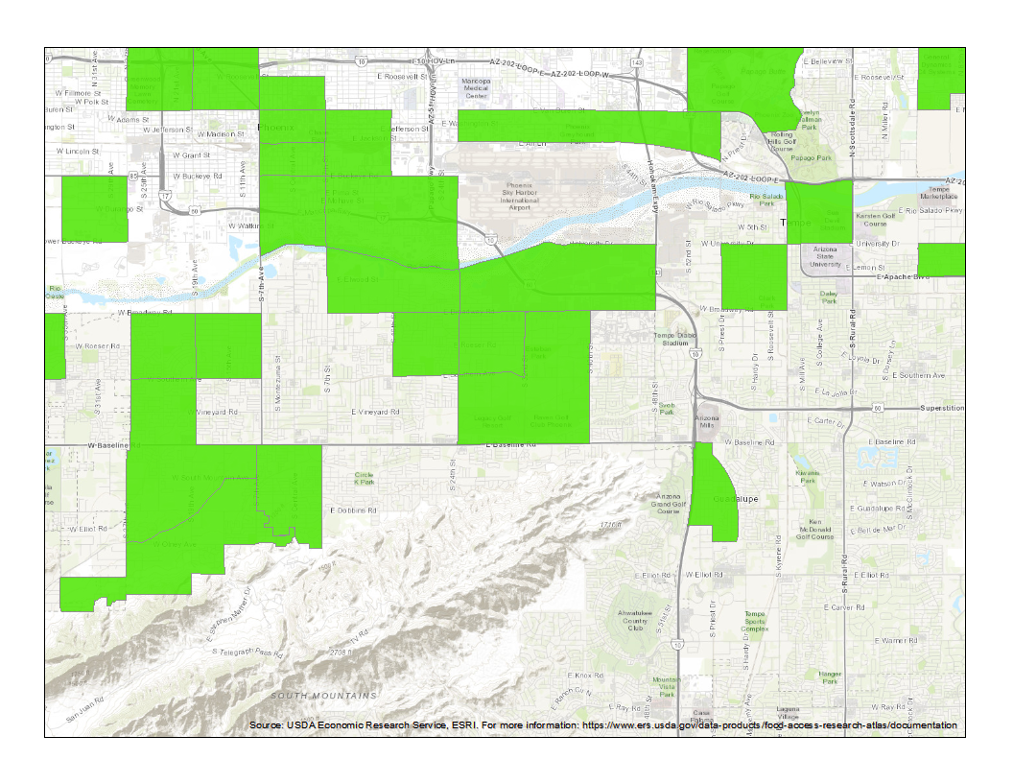
Problem Description
Food insecurity and food deserts in South Mountain Village
The typical lifespan of school and community gardens is approx. 2-3 years
The sustainability of school gardens is dependent upon its ability to retain physical and non-physical resources
Notes:
Food Deserts are low income areas with low access and availability to healthy and affordable food options, and a high presence of fast food restaurants and convenience stores
One in four children in Arizona struggle with food insecurity
Barriers to teachers and principals using gardens for educational instruction include time constraints, strict testing performance standards, lack of teacher interest, and lack of gardening experience or knowledge
The sustainability of school gardens is dependent upon its ability to retain physical and non-physical resources in the form of materials, committed people, instructional design, and funding sources
in the form of materials, committed people, instructional design, and funding sources

Slide 3
Project Stakeholders and Clients
The Farm At South Mountain: Gather And Grow
Martin Luther King Jr. Elementary School
The Sustainability Teacher’s Academy
University Of Arizona Maricopa County Cooperative Extension
Julie Ann Wrigley Global Institute Of Sustainability
Notes:
The primary clients in this project were the Farm at South Mountain and Martin Luther King Jr. Early Childhood Center. However, this project also entailed helping with the coordination and planning of a networking and workshop event on Arizona Gardens and Sustainability with the Sustainability Teacher’s Academy at the Farm at South Mountain.
The Sustainability Teachers Academy is a platform for educators to gain the knowledge and resources necessary to implement the science of Sustainability within the K-12 classroom. The academy provides professional development workshops to teachers and is involved with several schools around the valley. The academy is currently researching how to integrate and support garden-based learning in schools within the Phoenix Metro Area.
The work provided in this project helped the Farm establish and refine the scope of their new community outreach arm Gather and Grow.
The educational outreach and urban agriculture services provided by Gather and Grow aims to show a modern approach to farming to create scalable food options for families who live in the adjacent food desert.

Slide 4
Project Description
Mission: to work with the Sustainability Teachers Academy and the Farm at South Mountain to create a school garden network at ASU for schools in Maricopa County
Vision: to leverage South Mountain Village’s and Maricopa County's agricultural resources as an asset to enable garden-based education for teaching interdisciplinary topics
Notes:
The intervention points out that the client and the project identified were to provide experiential educational opportunities to help build the capacity of students, teachers and community members to engage in garden-based learning.
The desired outcomes from this project were to leverage the existing research and developments associated with educational gardens and urban farms in Phoenix as an asset for master gardeners and other professionals to collaborate and teach children and families concepts in sustainability and gardening through an applied experience.

Slide 5
Methods
The Garden Resources Environmental Nexus tool and score card was used to measure MLK ECC’s garden integration status through there relationship to these domains
Garden logistics | Student experience | School Culture
Components Garden care and upkeep Planning and establishing the physical space Characteristics of the physical space Crop vitality and diversity Budgeting and funding Networks and outside organizations | Components Connection with curriculum Time spent in the garden Activities Engagement Tasting opportunities Additional learning opportunities | Components Administrative support Organizational staff structure Volunteer and parent involvement Social events and activities Food environment and policies Evaluation and feedback
Notes:
The results of this project were derived from the garden integration score that was measured via the GREEN Tool matrix. The final integration score for Martin Luther King Jr. Early Childhood Center was based upon the summation of the domain scores in the matrix.
The domains span from resources and support, the physical garden, student experience and school community
The method of asset-based community development was also employed as an intervention to create strategic partnerships that were focused on building the capacity for the community’s existing assets.
In underserved communities, schools and institutions are invaluable assets that can be used to build alliances to create healthy school systems which turn reinforce the overall health of communities
The educational materials used during the 5 week long in class instruction were provided by the Sustainability Teachers Academy’s working group

Slide 6
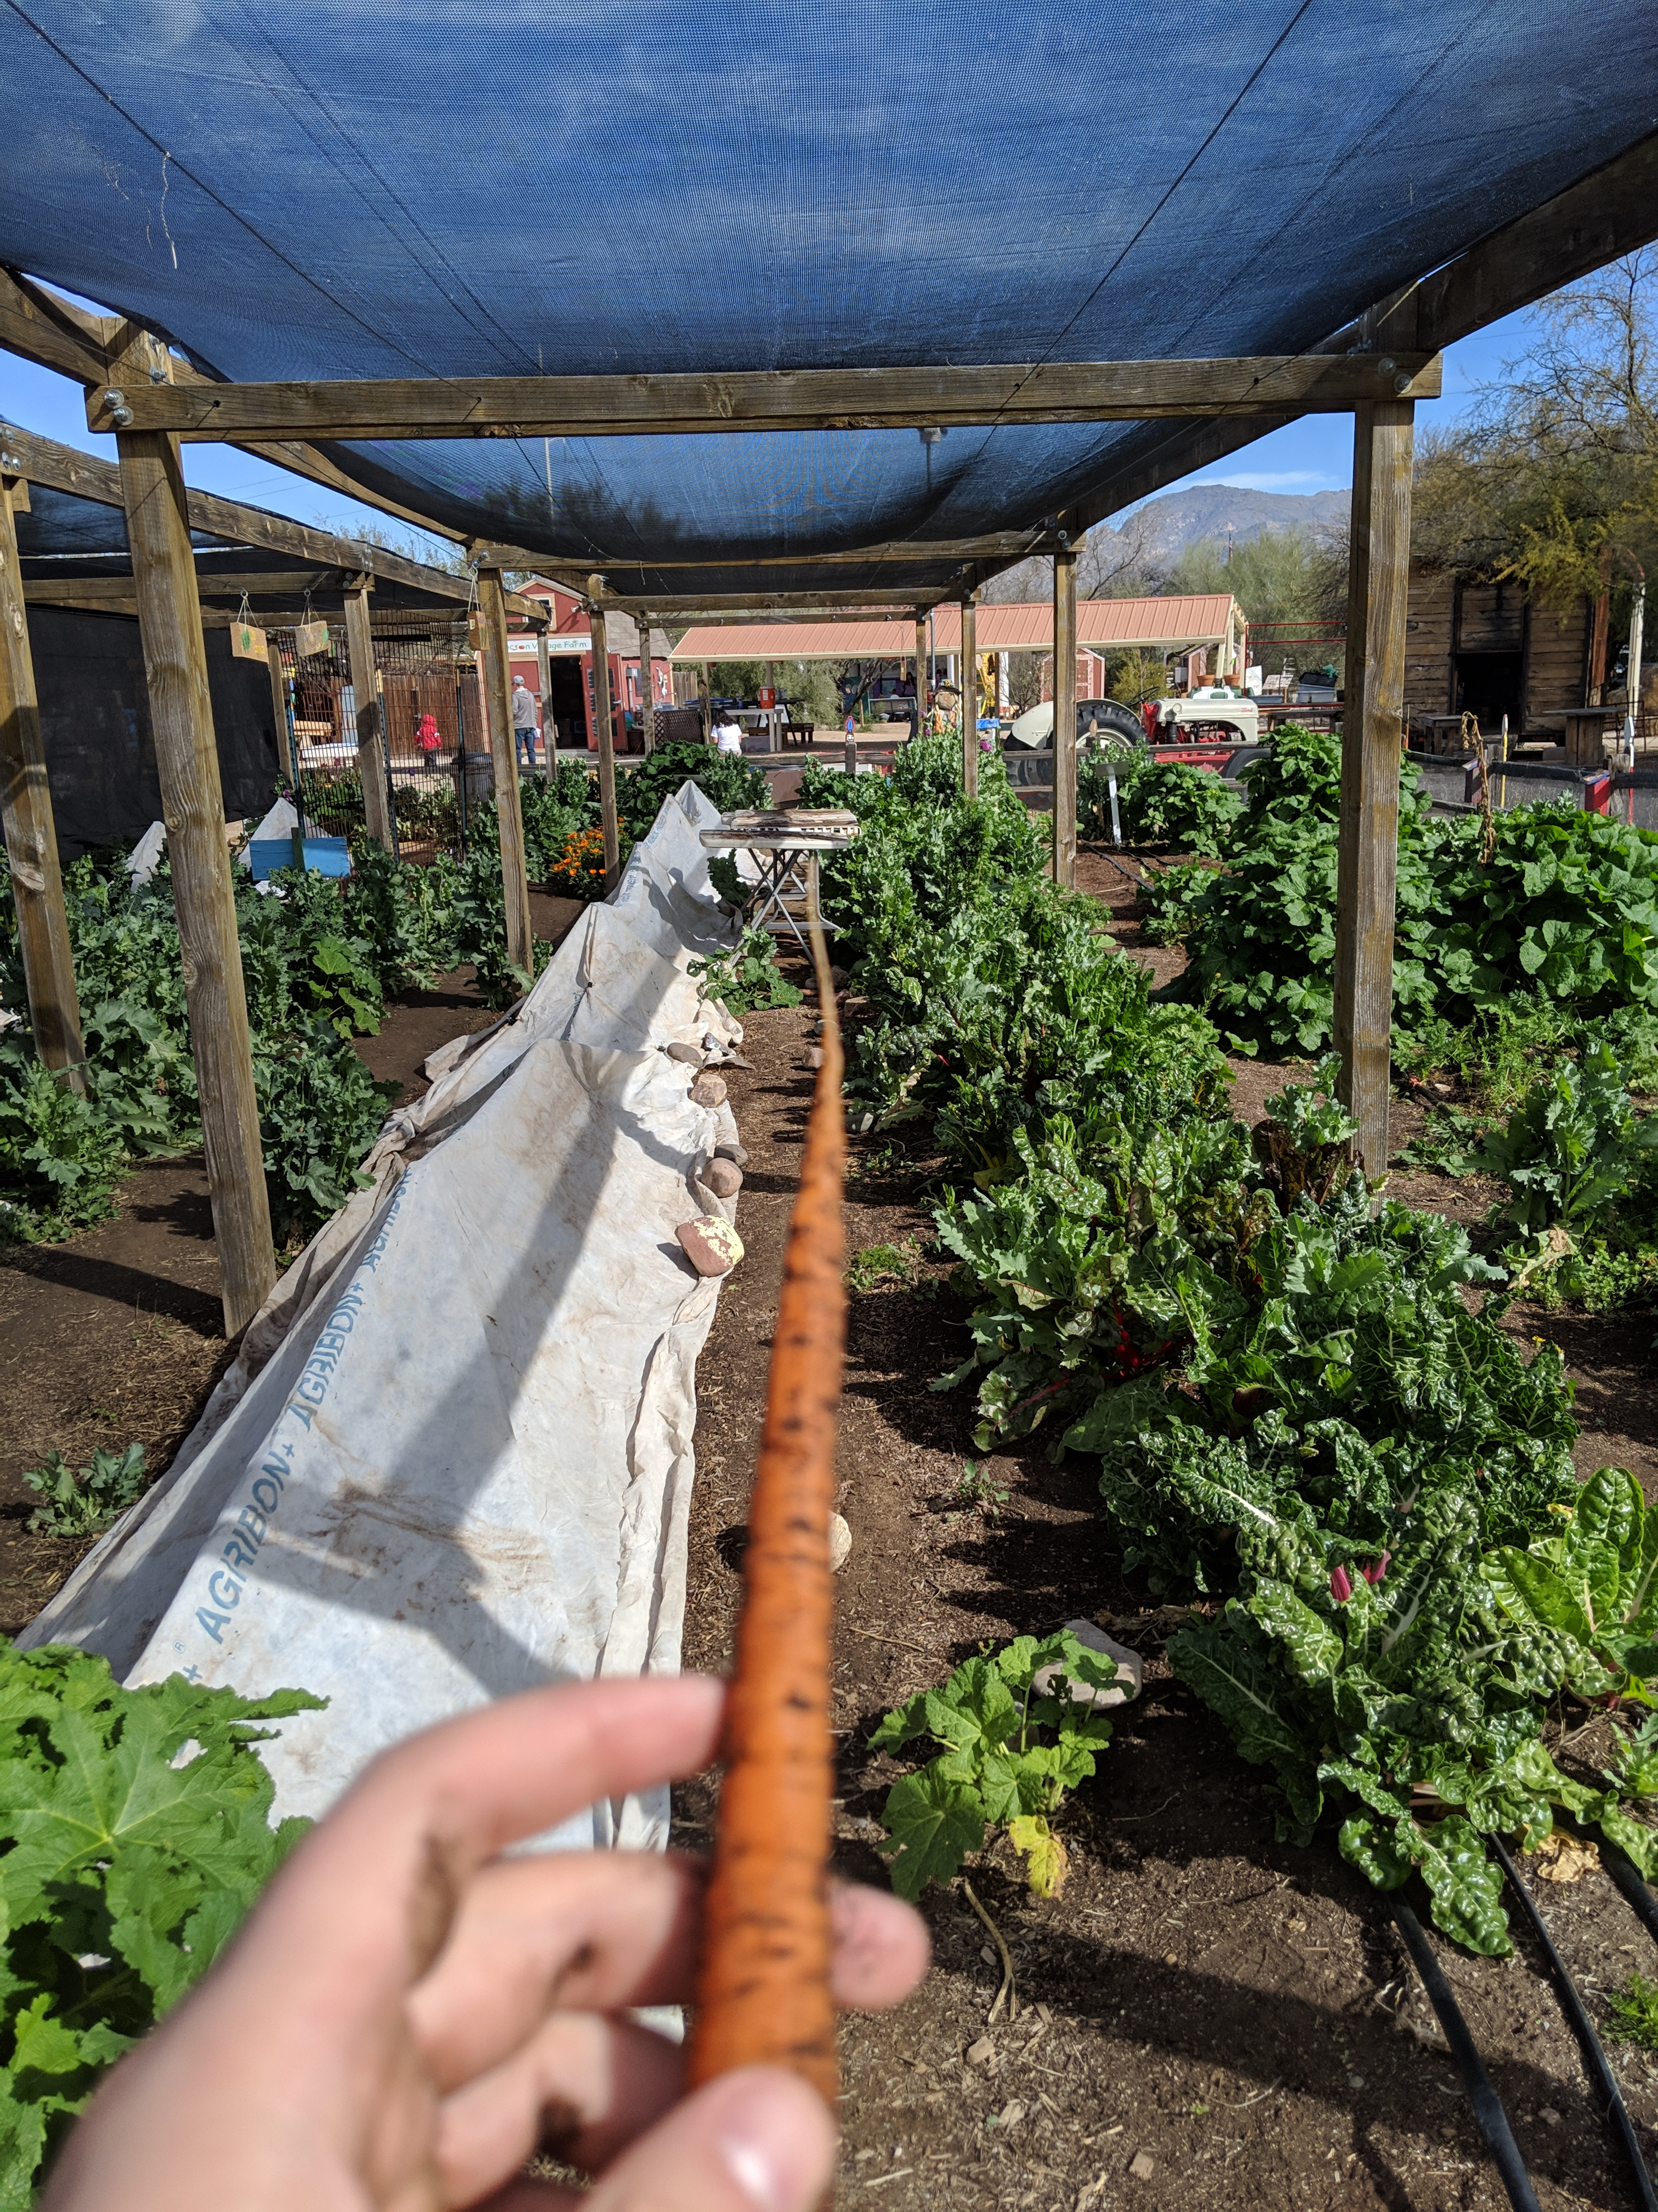
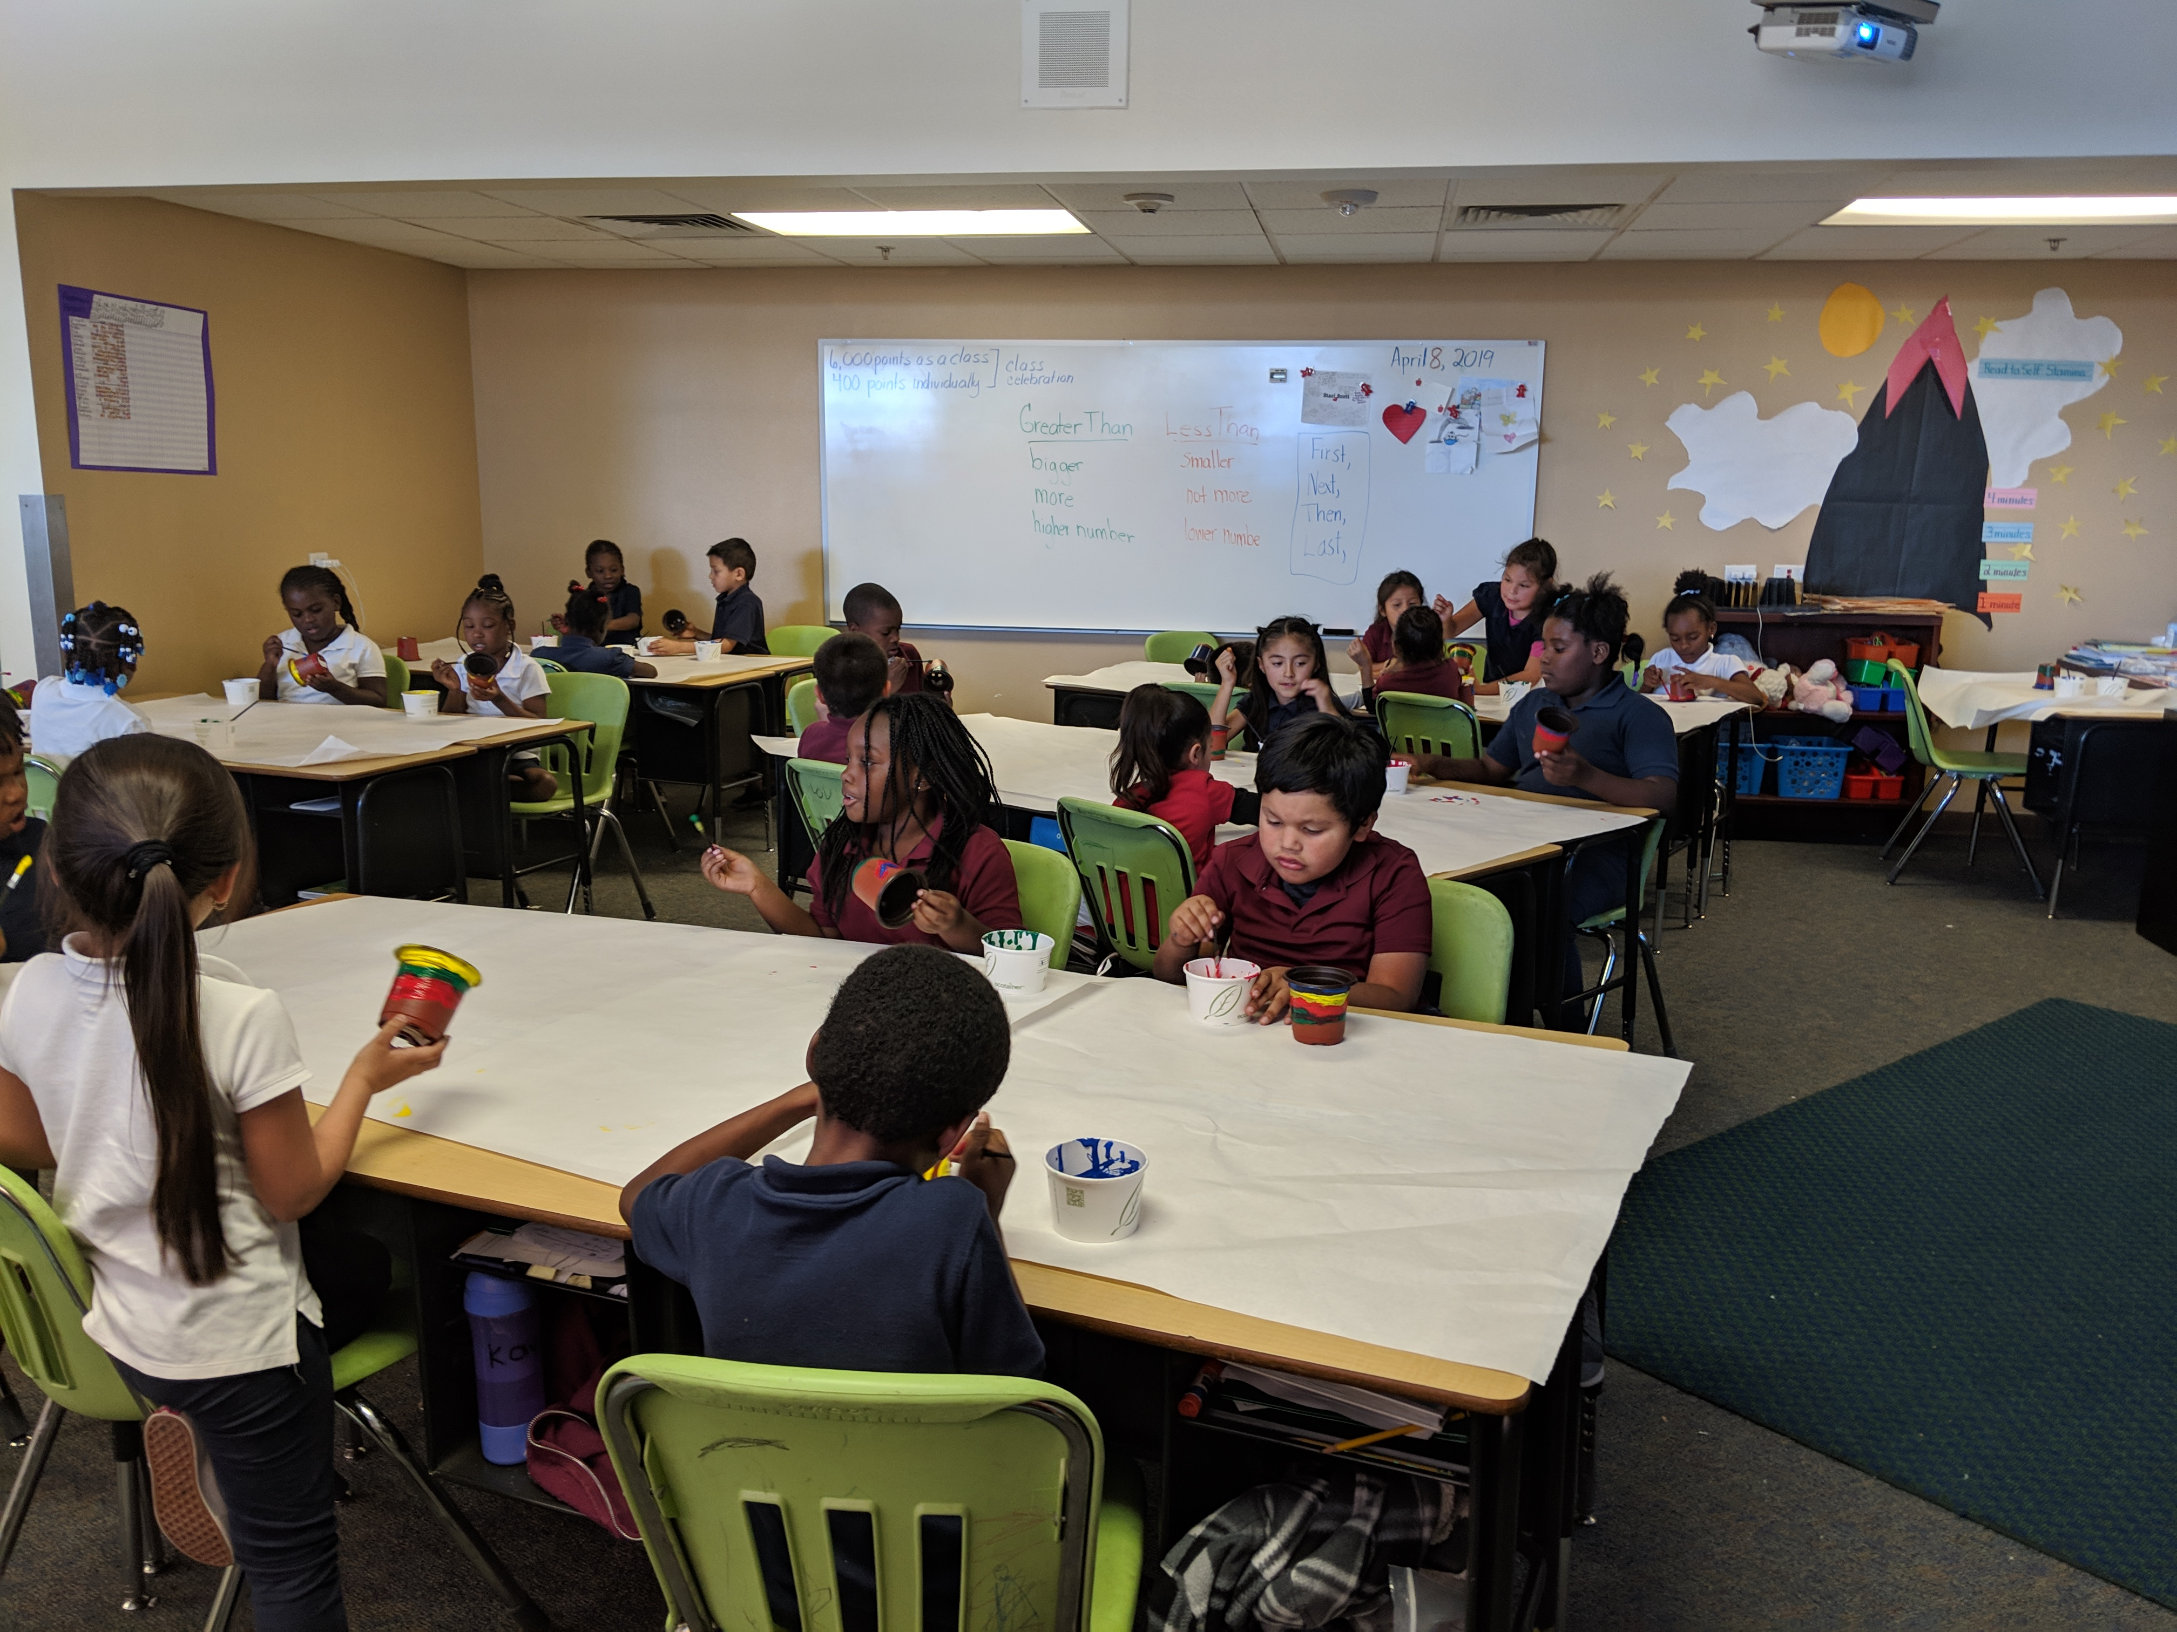
Methods II
Co-hosted a 2 day networking workshop (March 11-12) with the Sustainability Teachers Academy at the Farm at South Mountain
Tours of schools and educational gardens in Maricopa County and Tucson
Teaching garden-based learning at Martin Luther King Early Childhood Center
Asset-based community development map
Notes:
The asset-based community development approach allowed for the strengths associated with MLK ECC and the Farm at South Mountain to be mapped and visualized according to their networks
Involving the Sustainability Teacher’s Academy in the event allowed for teachers to receive professional development credits for attendance
Audience for event: Teachers, Garden Specialists, Arizona Department of Education Farm to School specialists, Childhood Nutrition Specialists, and organizations that support garden based learning such as Blue Watermelon at Slow Food Phoenix and the Sustainability Teachers Academy.

Slide 7
Results
Secured partnerships with the Farm at South Mountain, the Sustainability Teachers’ Academy, U of A Agricultural Extension, and Blue Watermelon Project by Slow Foods Phoenix
50 participants attended the workshop at the Farm with teachers and stakeholders in garden-based learning from across the valley
Garden tours reignited stakeholder engagement
The garden at Martin Luther King Early Childhood Center received a moderate garden integration status via the Green Tool
Notes:
Planned and executed an AZ School Gardens and Sustainability workshop at the Farm at South Mountain
Learned best practices from Tucson Unified school district

Slide 8
Recommendations
For ASU
Creating a professional development and internship network similar to U of A’s focused on garden based leaning
For the Farm at South Mountain
Creating a 501 3 c nonprofit entity for the educational outreach work associated with Gather and Grow
Applying for the producer education track with the Farm to School Network
Notes:
Partnerships with sustainability interns at local schools and the Sustainability Teacher’s Academy
Offering courses for students to study approaches to garden-based learning

Slide 9
Recommendations II
For Martin Luther King Early Childhood Center
  To continue their partnership with the Farm at South Mountain for educational fieldtrips and community outreach as they are a node for urban agriculture
  To Work with U of A co-operative extension to provide more educational resources and training on the subject of gardening for teachers and faculty
  To register online for the Edible School Yard Project for more curriculum integration resources
  Connect teachers interested in learning more about gardening to the Sustainability Teachers Academy for educational resources and support

Slide 10
Additional Projects
Assessment of the GREEN Tool after the garden at MLK ECC has finished its current developments
Finding inclusive ways to engage the community and neighborhood more in the school garden (rented or volunteer plots)
Developing a network within the School of Sustainability, the Sweete Center for Sustainability Food Systems and other schools at Arizona State University to help build the capacity of teachers and students interested in garden-based education
Developing a framework for schools interested in curriculum development for garden based learning

Slide 11
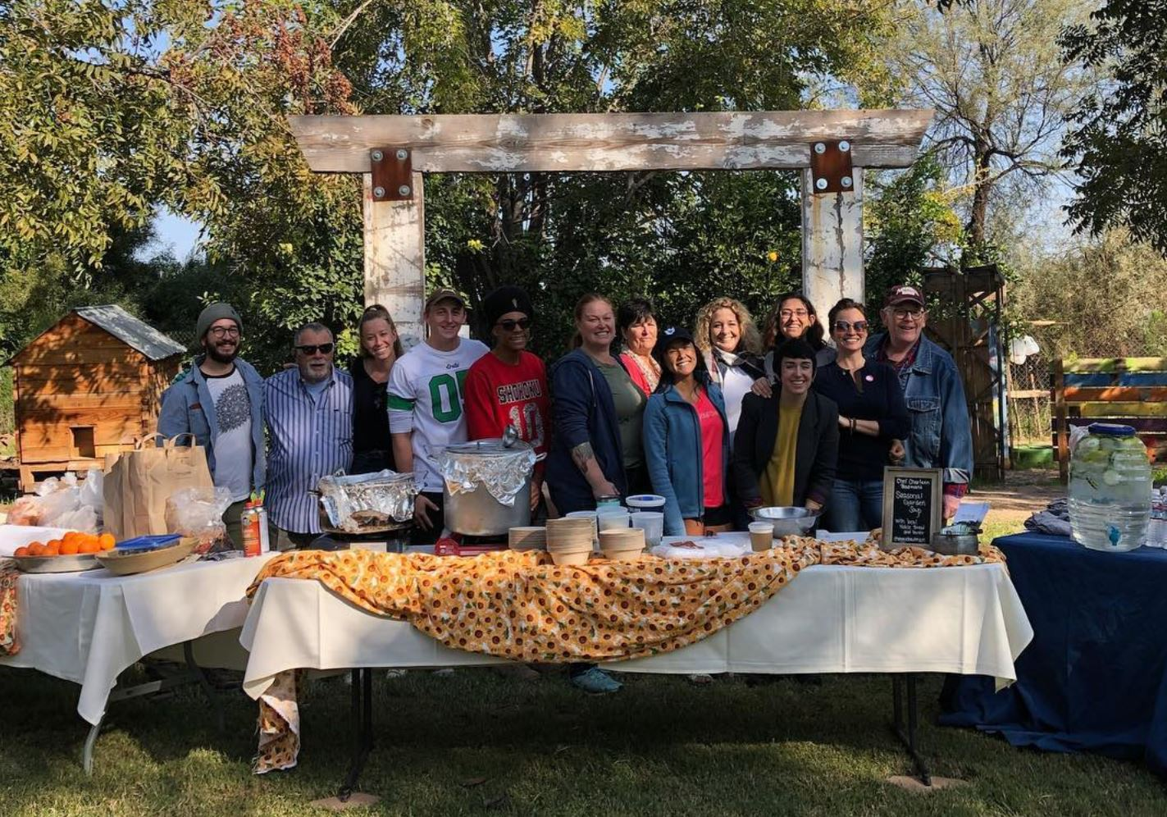
Questions?

Slide 12
Appendix A: GREEN Tool Matrix for MLK ECC

Slide 13
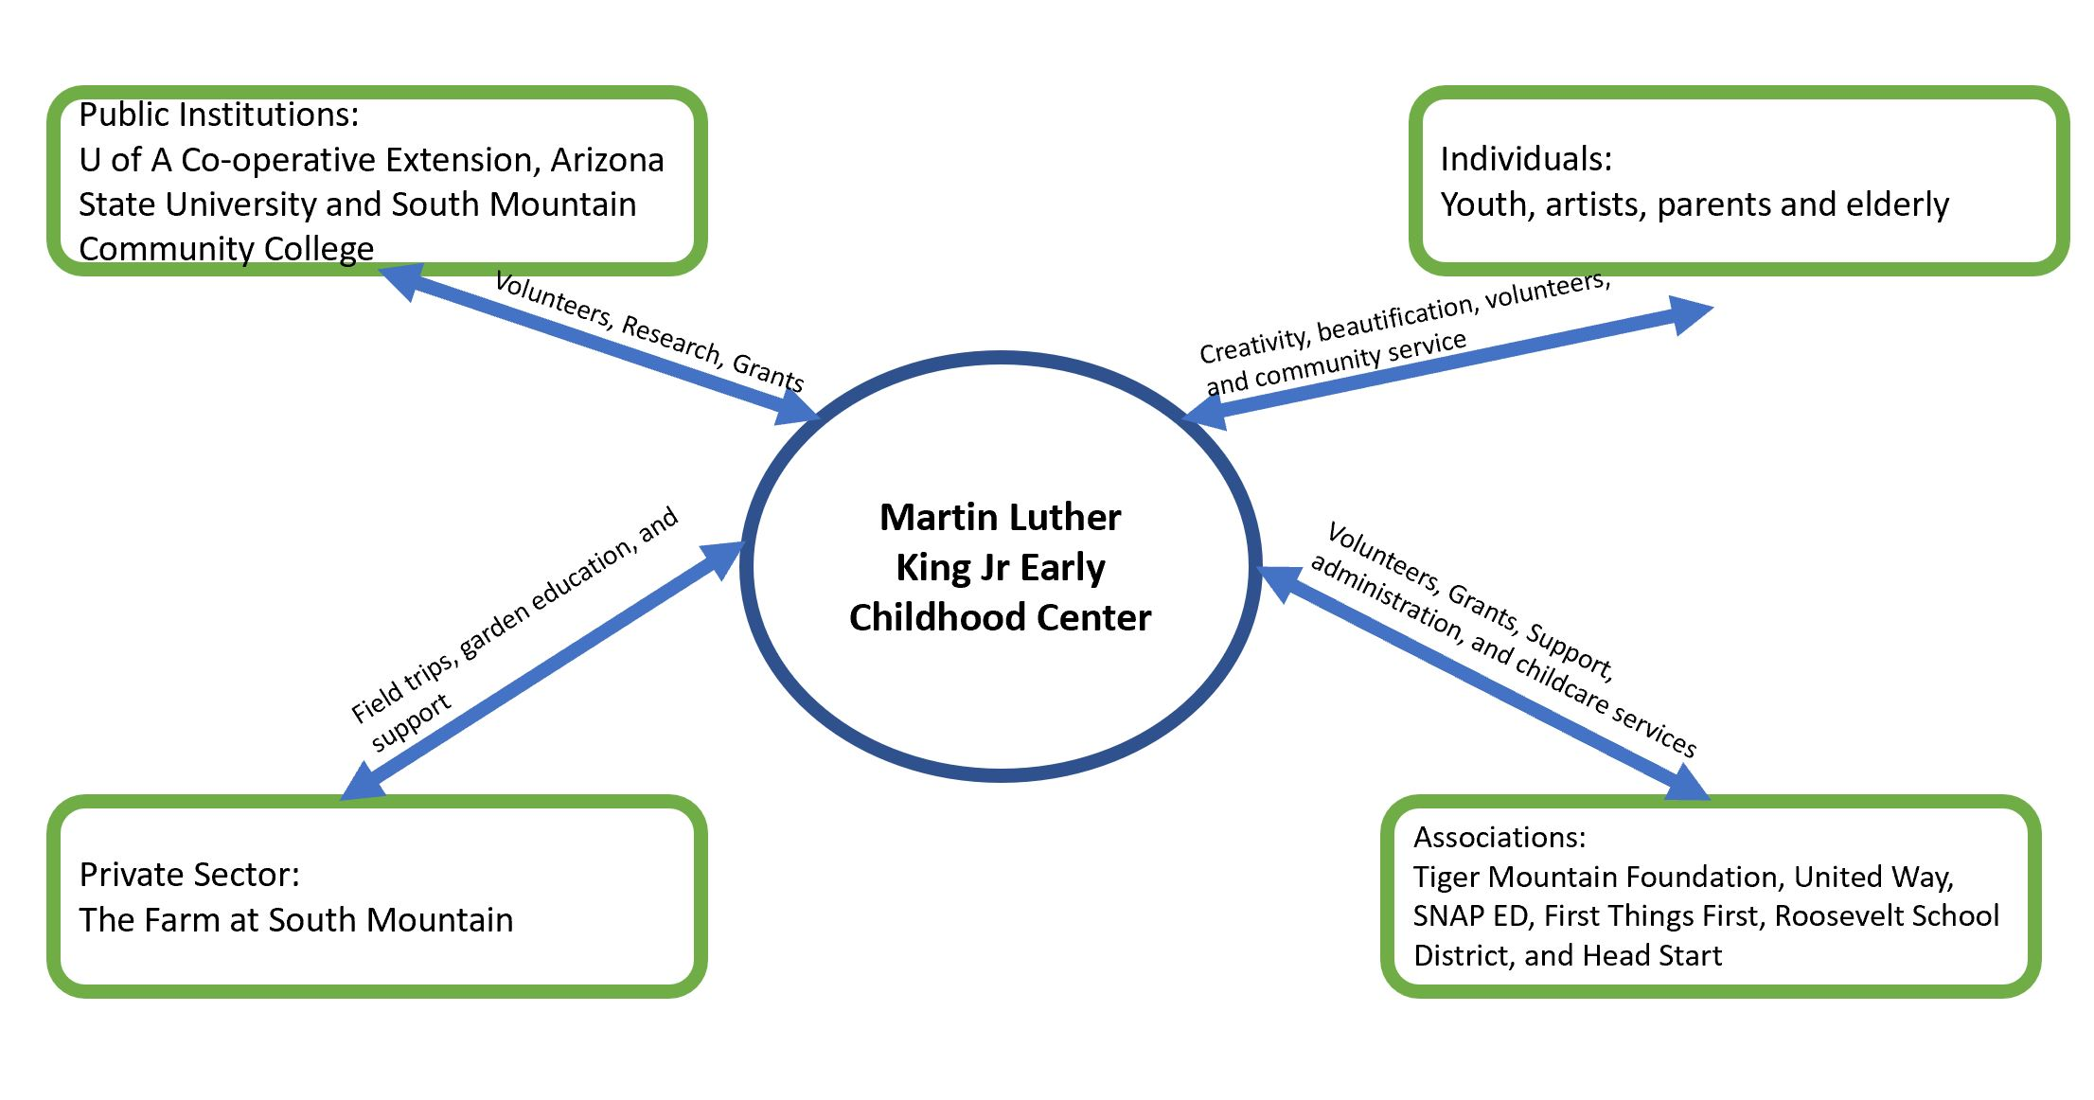
Appendix B: Asset Based Community Development Map for MLK ECC

Slide 14
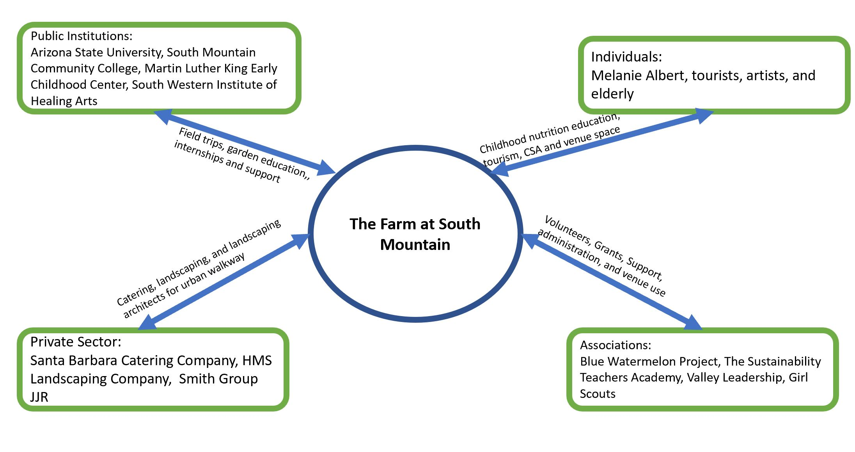
Appendix C: Asset Based Community Development Map the Farm at South Mountain

