Slide 1
MSUS Culminating Experience: The Bee Business
Determining the Practicality of Marketing Almond Honey for Bee Farmers that Participate in Almond Pollination
Kellie Rorex
Fall 2018
Notes:
Hello, my name is Kellie Rorex and my MSUS project is about determining the practicality of marketing almond honey for bee farmers

Slide 2
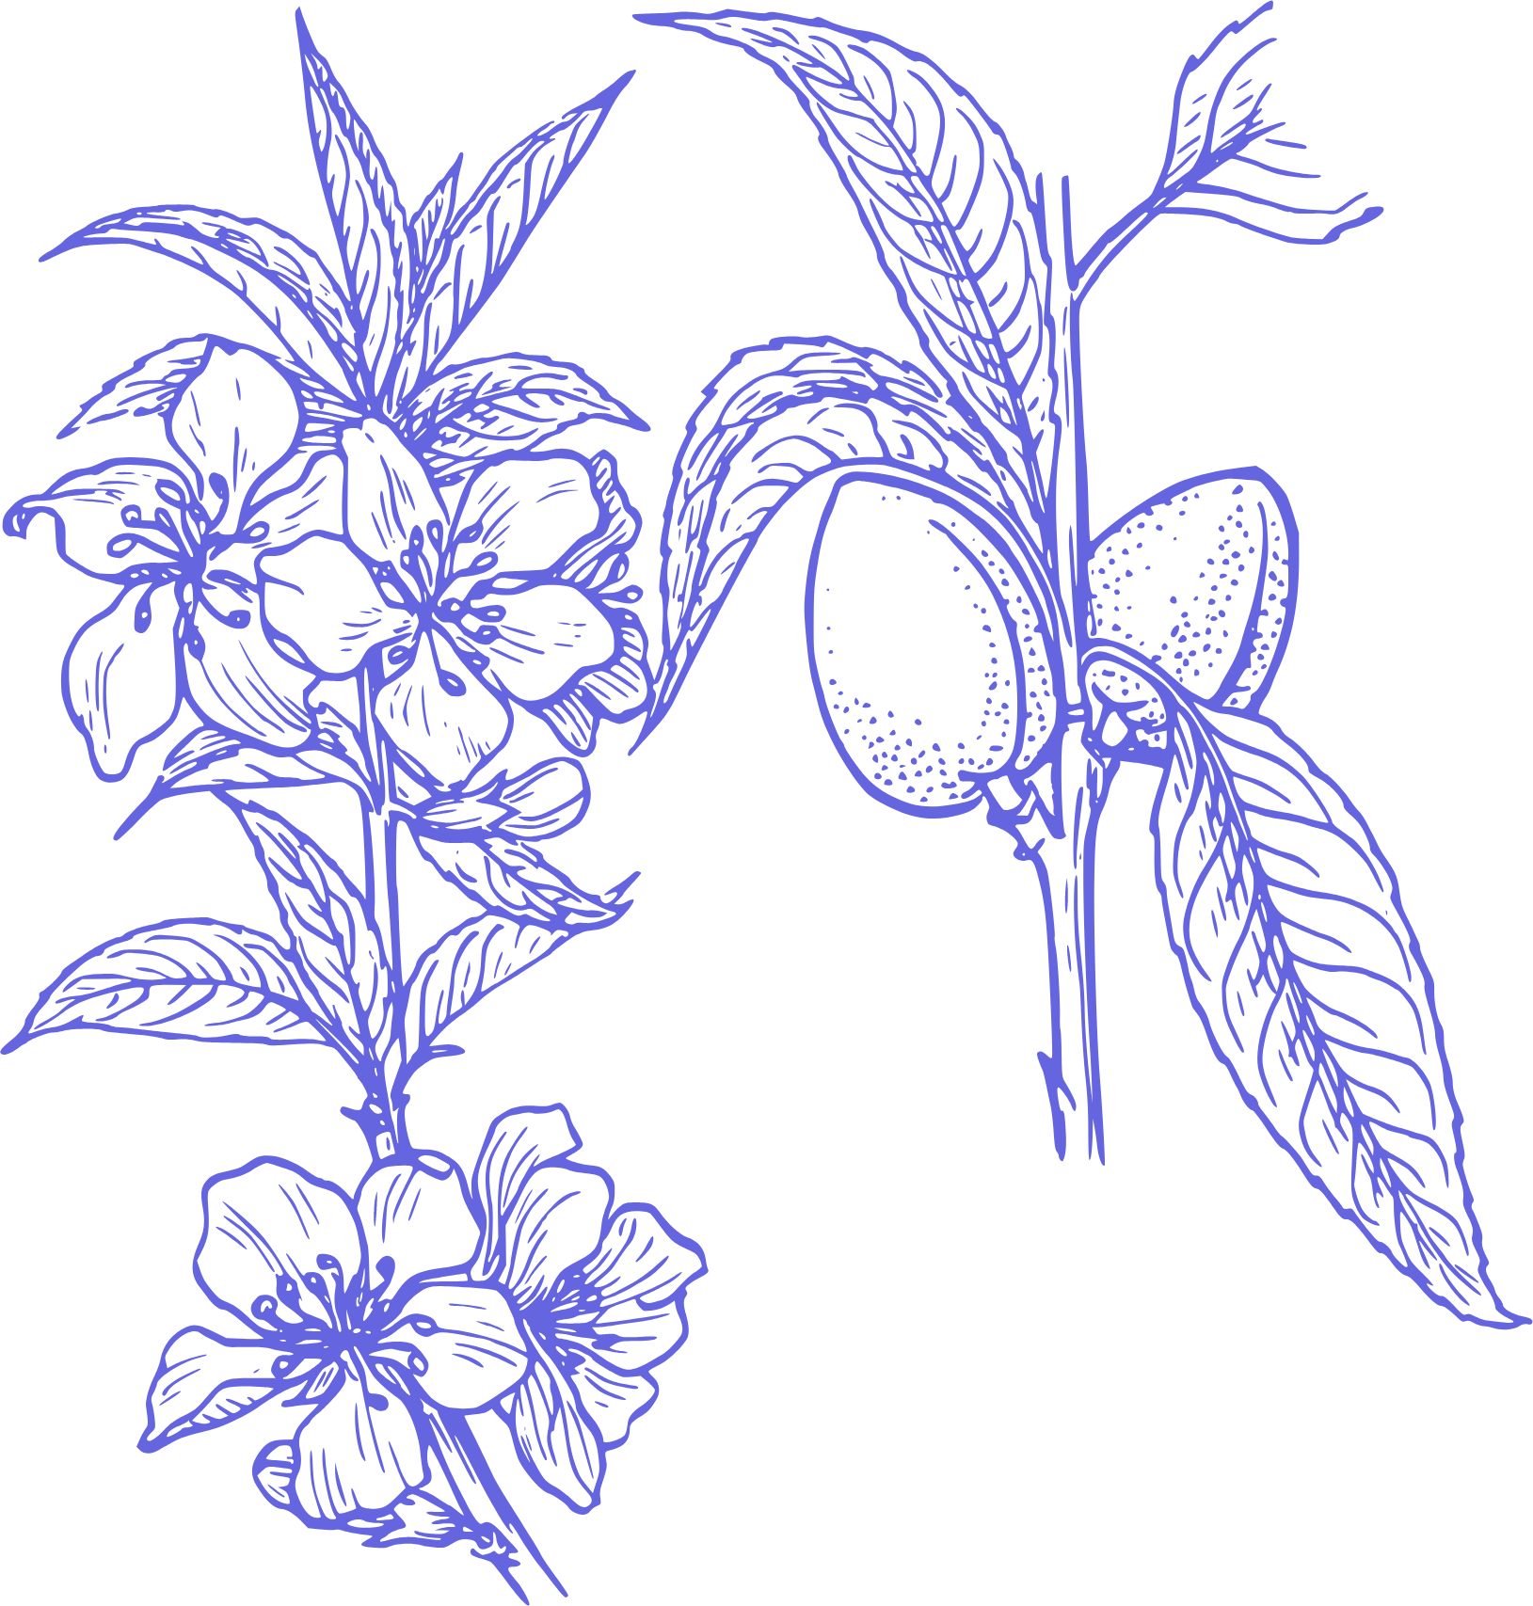
Sustainability Problem
Almond Industry
Honey Bees
Bee Farmers
Dependencies
Honey Waste
Unsustainable business model
Notes:
To start I wanted to discuss the dependencies within this project and the sustainability problem that I tried to solve.
The almond industry is dependent on honey bees in order to produce and maintain almond yields, but honey bees are actually dependent on the almond industry for conservation as well. Recently, colony collapse has been a big issue in the bee community and worldwide. It is believed that colony collapse occurs because of global warming, pesticide use, and habitat loss and with the loss in bee populations, the environment, the economy, and society are at a loss as well. This is because bees pollinate over 90% of the worlds natural vegetation and 30% of the worlds food system. During the peak of colony collapse, the agriculture business was losing 5.7 billion dollars a year. With lost profit, food prices such as on produce have gone up creating a social issue for low-income families and their access to healthy affordable food.
However, studies have shown that honey bee populations have increased as commercial bee keeping has grown due to the dependency almonds have on pollination services and the prices almond farms pay bee farmers to pollinate their trees. So honey bees become in a way dependent on bee farmers who are then dependent on the enormous pollination service fees by the almond industry.
Within this cycle though, bee farmers are creating a lot of honey waste because they cannot use or market excess almond honey due to its bitter taste and they are also dependent on an unsustainable business model with limited revenue sources outside of pollination service fees. So this project looked into figuring out how to produce less almond honey waste during almond pollination and how to market it so a bee farmers business model had more diversified revenue streams.

Slide 3
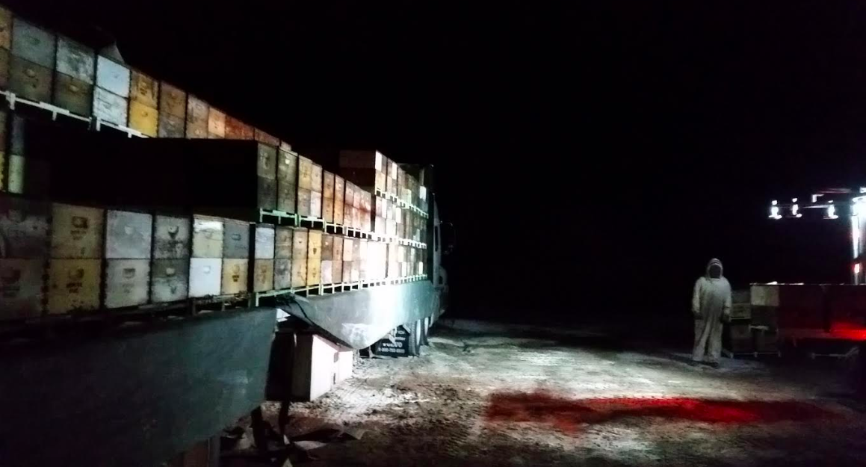
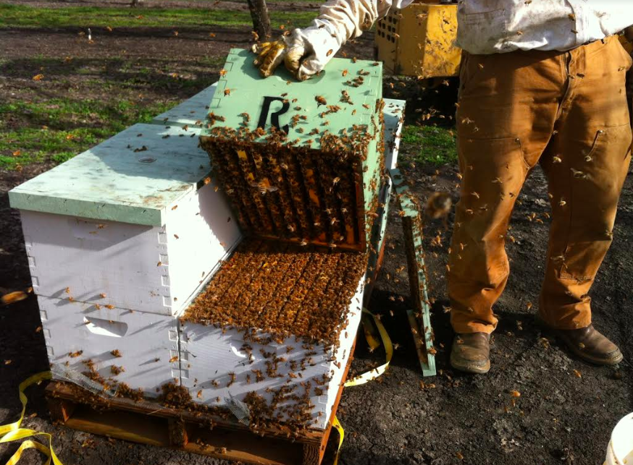
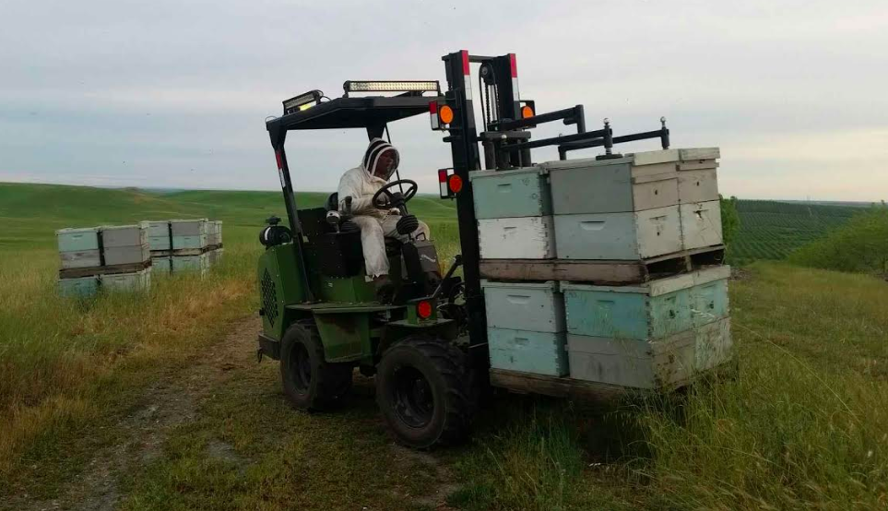
Notes:
To start I wanted to discuss the dependencies within this project and the sustainability problem that I tried to solve.
The almond industry is dependent on honey bees in order to produce and maintain almond yields, but honey bees are actually dependent on the almond industry for conservation as well. Recently, colony collapse has been a big issue in the bee community and worldwide. It is believed that colony collapse occurs because of global warming, pesticide use, and habitat loss and with the loss in bee populations, the environment, the economy, and society are at a loss as well. This is because bees pollinate over 90% of the worlds natural vegetation and 30% of the worlds food system. During the peak of colony collapse, the agriculture business was losing 5.7 billion dollars a year. With lost profit, food prices such as on produce have gone up creating a social issue for low-income families and their access to healthy affordable food.
However, studies have shown that honey bee populations have increased as commercial bee keeping has grown due to the dependency almonds have on pollination services and the prices almond farms pay bee farmers to pollinate their trees. So honey bees become in a way dependent on bee farmers who are then dependent on the enormous pollination service fees by the almond industry.
Within this cycle though, bee farmers are creating a lot of honey waste because they cannot use or market excess almond honey due to its bitter taste and they are also dependent on an unsustainable business model with limited revenue sources outside of pollination service fees. So this project looked into figuring out how to produce less almond honey waste during almond pollination and how to market it so a bee farmers business model had more diversified revenue streams.

Slide 4
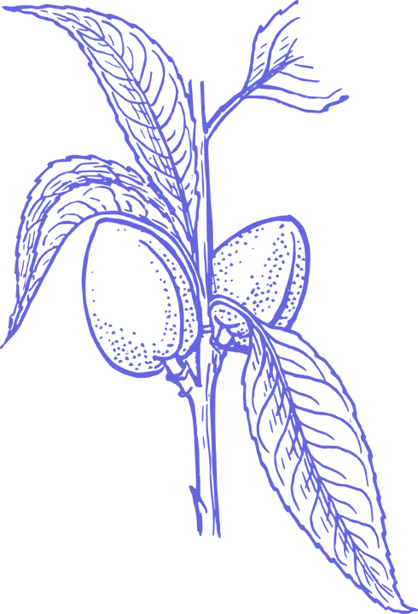
Solution
Sell Almond Honey
  Eliminate waste
  Diversify revenue streams for bee farming business model
Market towards beauty supply companies
Notes:
My solution was to market almond honey to beauty supply buyers who could use the honey in products for its antioxidant and antibacterial properties as well as to find a way to make it possible for bee farmers to extract almond honey in their busy pollination and nectar extraction season.

Slide 5
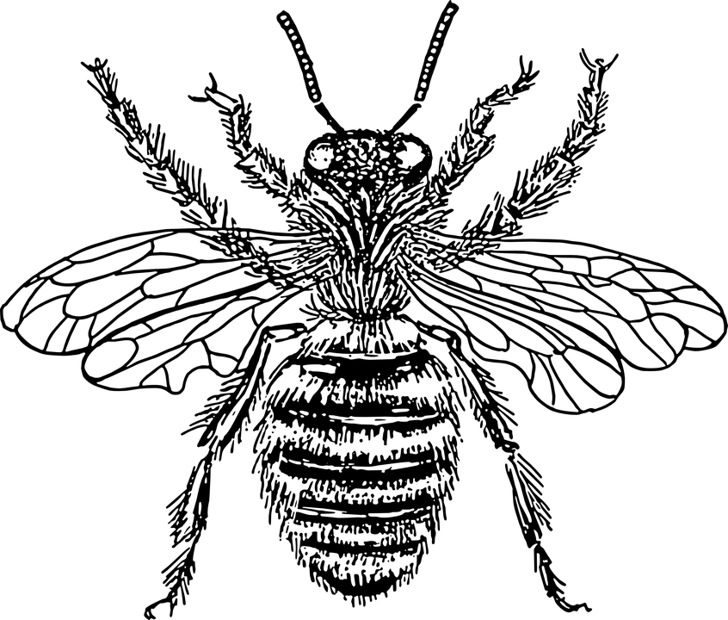
Tools Used
Typical Bee Farming Business Model
Cost-Benefit Analysis of Selling Almond Pollination
New Bee Farming Business Model With Almond Honey Sales
Business Process Management to determine sellers and process
Connect Buyers with Sellers
Notes:
To do this I built a typical bee farming business model with one of the project partner bee farmers. We then did a cost benefit analysis of selling almond honey to determine price of honey, and scenarios that make extracting almond honey doable by the farmer. Then built a new business model with new information and used a BPM to plan out how the farmer can eliminate almond honey waste by selling almond honey to beauty supply buyers.

Slide 6
Outcomes
Almond honey is not marketable for a price greater than edible honey
Most costs of almond honey extraction can be mitigated
Selling almond honey will lead to a 1% increase in honey sales
Waste would be minimalized but other early season crops (apples) create the same problem.
Beauty supply buyers are interested in testing out almond honey in their products.
Notes:
Outcomes:
Almond honey is not marketable for a price greater than edible honey
You couldn’t sell almond honey at a price more than regular honey because edible honey out competes almond honey in that it has more uses, even when almond honey is more expensive to extract with smaller yields
Most costs of almond honey extraction can be mitigated
Through the cost benefit analysis and BPM, techniques have been uncovered to mitigate extra expenses in almond extraction
Selling almond honey will lead to a 1% increase in gross honey sales
Because there is little almond honey to be extracted
Waste would be minimalized but other early season crops (apples) create the same problem.
Other honey is wasted as well
Beauty supply buyers are interested in testing out almond honey in their products.

Slide 7
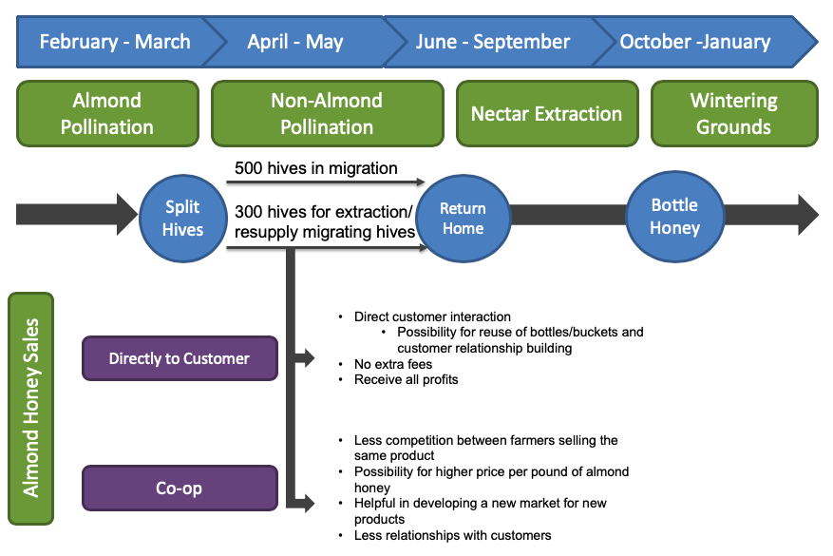
Recommendations to Farmer
800 hives
Notes:
Explain seasonal scenario starting with 800 hives and ending with selling directly to customer or starting/joining a co-op

Slide 8
Personal Project Outcomes
Connections with multiple commercial farmers
  Byproduct marketability
Experience working with a large complex industry
Experience working closely with a company that wants to work on finding alternative solutions to unsustainable practices.
  Travel costs - project opportunity
Notes:
Personal project outcomes
Connections with multiple commercial farmers
Byproduct marketability (peanut shells or pecan shells)
Experience working with a large complex industry (the bee business is extremely complex with different pricing on pollination services and nectar extraction and being seasonally confined)
Experience working closely with a company that wants to work on finding alternative solutions to unsustainable practices.
Travel costs - project opportunity (for future student. Migratory nature of job leads to large footprint)

Slide 9
Questions?
Thank you!
Kellie Rorex

