Slide 1

EXPLORING OPPORTUNITIES FOR WOODY BIOMASS UTILIZATION IN COCONINO COUNTY, ARIZONA
CAITLIN PAULUS
MSUS CULMINATING EXPERIENCE PROJECT
APRIL 26, 2019

Slide 2
TABLE OF CONTENTS
INTRODUCTION TO THE PROBLEM
PROJECT PARTNERS
METHODS AND APPROACHES
PROPOSED SOLUTIONS
PROJECT OUTCOMES AND TAKEAWAYS
LOOKING TO THE FUTURE
REFERENCES

Slide 3
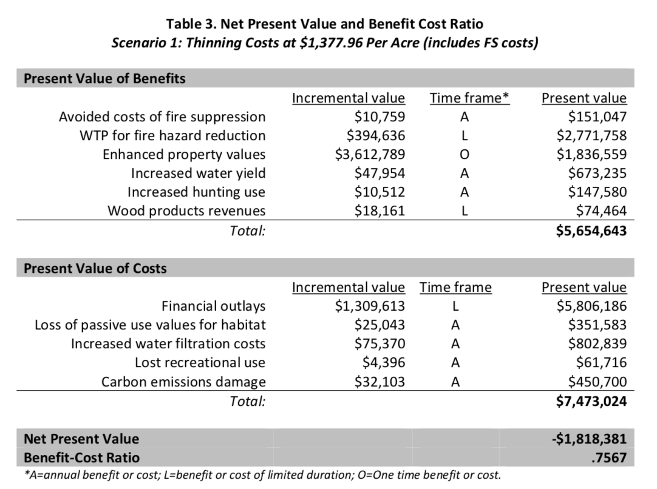
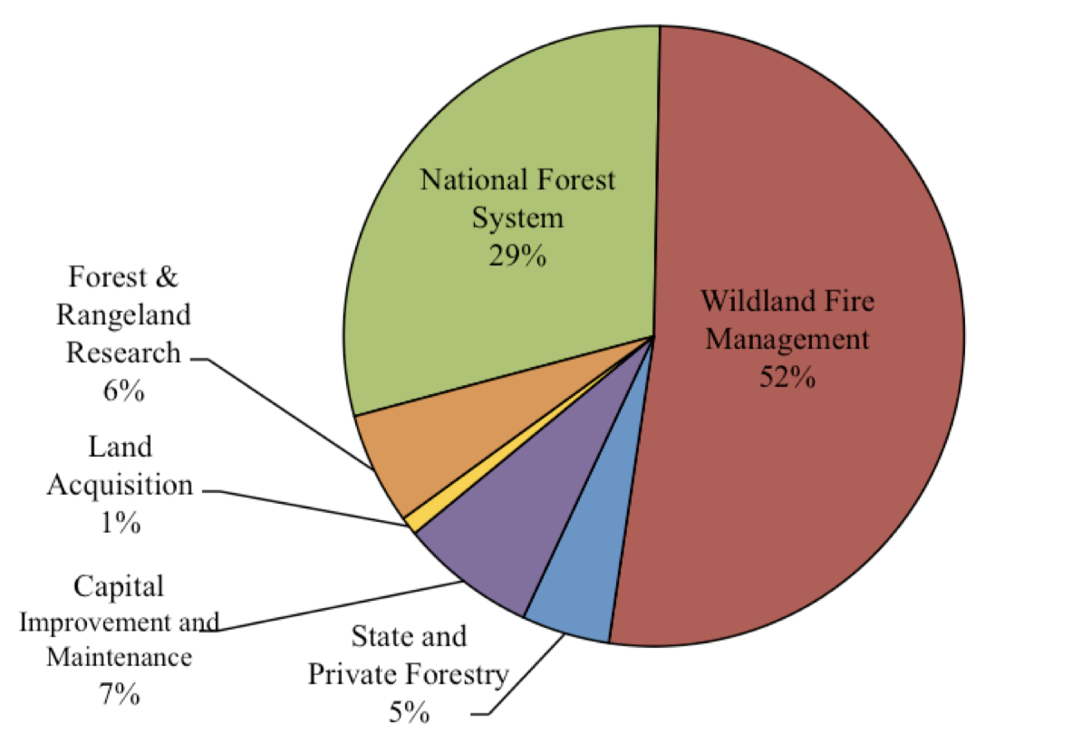
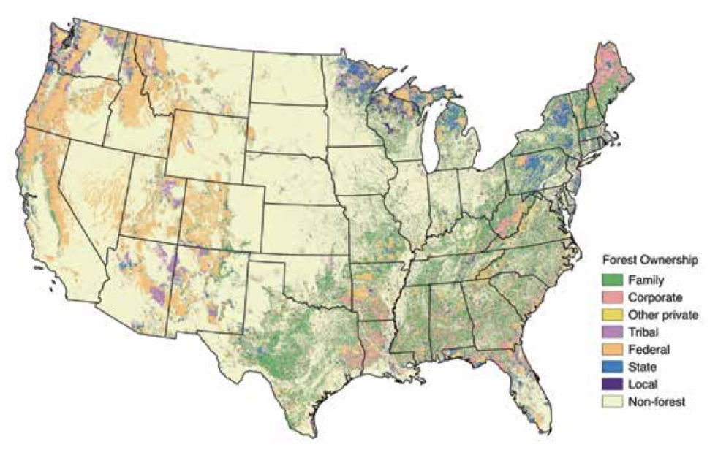
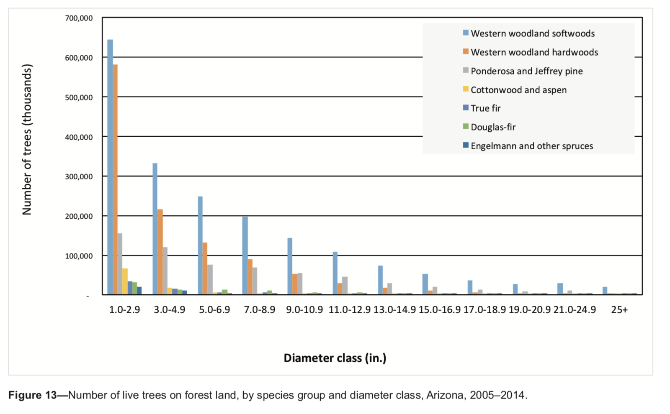
FOREST RESTORATION BARRIERS
IN COCONINO COUNTY
EXTENSIVENESS OF FEDERAL LAND IN THE REGION
THE MARGINAL VALUE OF STANDING TIMBER
THE LACK OF EXISTING SAWMILLS
THE LACK OF A BIOMASS PROCESSING INDUSTRY
RISING COSTS OF WILDFIRE SUPRESSION
FIGURE 2: DIAMETER OF LIVE TREES ON ARIZONA FOREST LAND
FIGURE 1: FOREST OWNERSHIP ACROSS THE UNITED STATES
Retrieved from “Forest Inventory and Analysis ” (2017)
FIGURE 4: FOREST SERVICE FY 2015 APPROPRIATIONS BY FUND
FIGURE 3: BENEFIT COST RATIO FOR RESTORATION IN NEW MEXICO
Retrieved from “Arizona’s Forest Resources” (Shaw et al, 2018)
Retrieved from “The Rising Cost of Wildfire Operations” (2015)
Retrieved from “Economic Benefits of Forest Restoration” (Talberth, 2018)
Notes:
Coconino National Forest surrounds flagstaff
The fast majority of forested land in AZ fall under federal jurisdiction
There are over 9 million acres of forested land that fall under “high fire risk” conditions in AZ

Slide 4
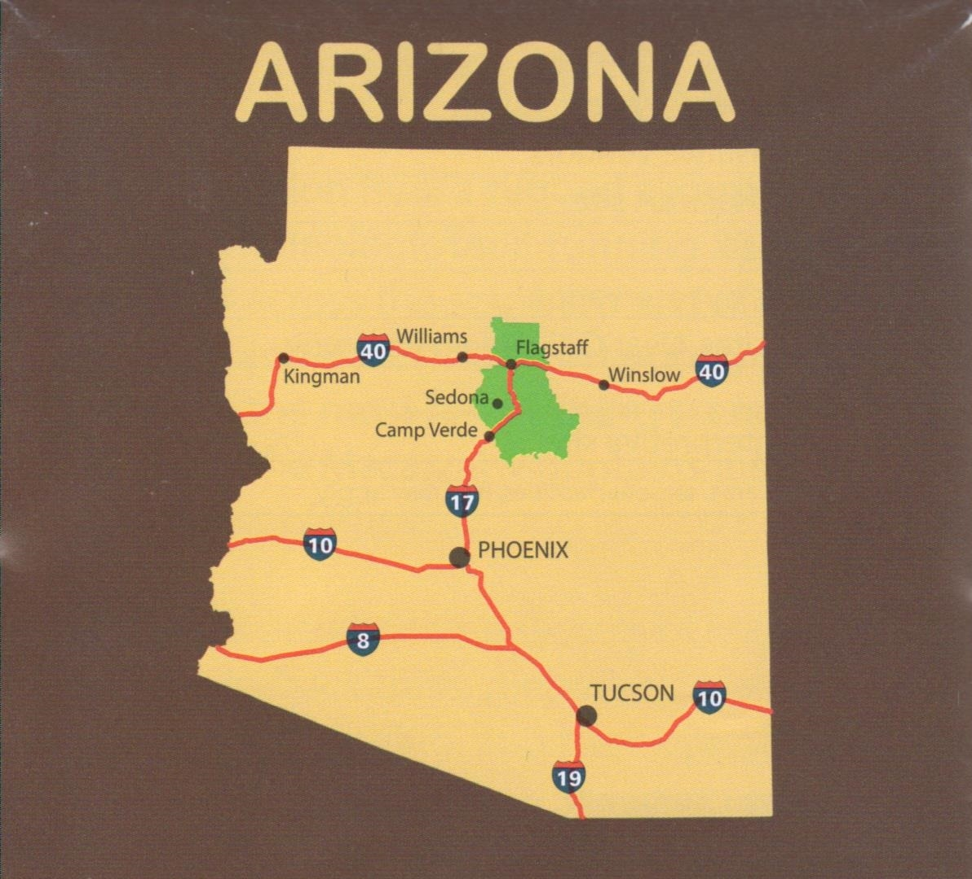
PROJECT PARTNERS
FLAGSTAFF WATERSHED PROTECTION PROJECT
FOREST STAKEHOLDERS IN COCONINO COUNTY
The City of Flagstaff Economic Development Department
The City of Flagstaff Sustainability Department
Flagstaff Watershed Protection Project
Northern Arizona University
Coconino County Forest Restoration Director
Natural Resource Advisors
Forestry Consultation Organizations

Slide 5
METHODS AND APPROACHES:
HOW TO AID FOREST RESTORATION IN COCONINO COUNTY
BIOCHAR
COMPOST
WOOD PLASTIC COMPOSITES
MUSHROOM CULTIVATION
PRIORITIZE LOW-TECHNOLOGY PROCESSING METHODS
FORM PARTNERSHIPS WITH LOCAL RESTORATION PROJECTS
UTILIZE PRIMARILY MILLING RESIDUALS AND SLASH MATERIALS
FOCUS ON LOCAL AND STATE MARKETS
CREATE PRODUCTS WITH GROWING MARKETS
PROMOTE MARKETING STRATEGIES THAT AID LOCAL RESTORATION EFFORTS
F
Notes:
I gained these insights from speaking with forest stakeholders in northern Arizona, as well as the literature

Slide 6
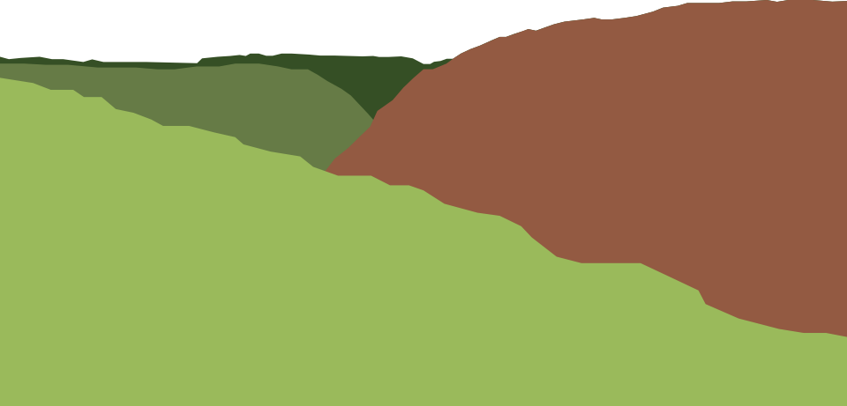
TRANSFORMATIONAL SUSTAINABLE ENTERPRISE (TSE) FRAMEWORK
ANALYTICAL COMPONENT: Systems Approach
EVALUATIVE COMPONENT: Questions & Criteria
Adapted to evaluate potential enterprises rather than established ones
Used to assess research gaps, identify alternative business models suited to each enterprise, and evaluate the overall sustainability of each suggested enterprise
ANALYTICAL COMPONENT
2
1
EVALUATIVE COMPONENT
1
2

Slide 7
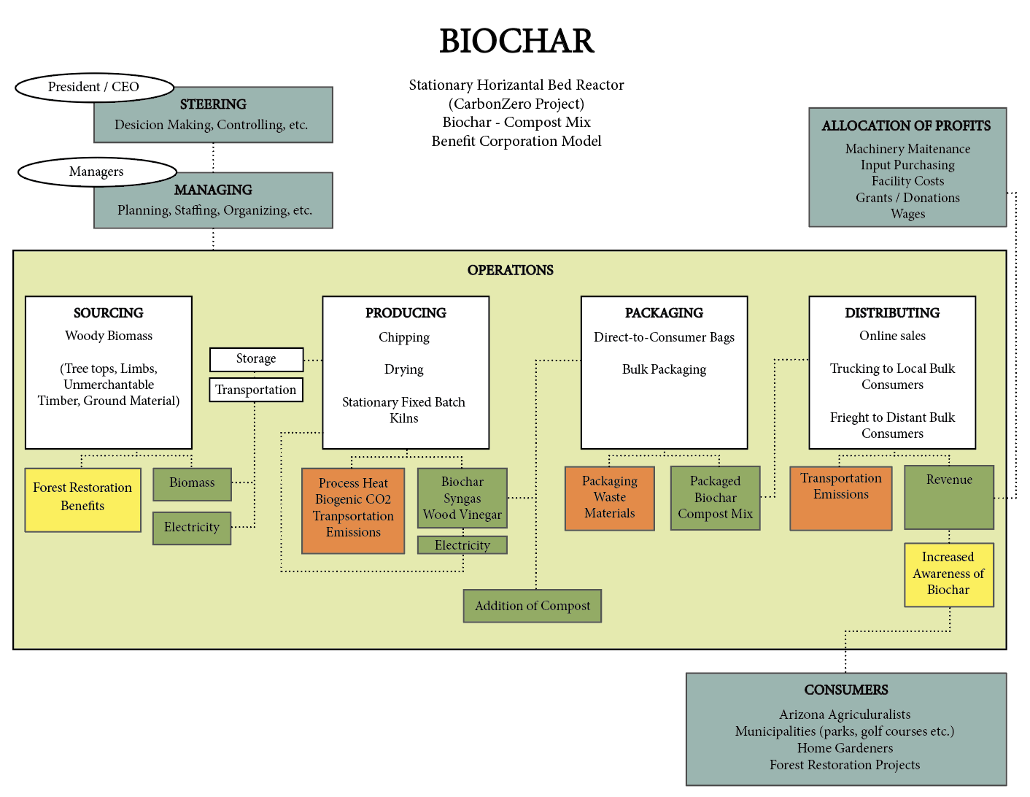

Slide 9
PROJECT OUTCOMES AND TAKEAWAYS
  A large-scale sawmill is critical for the success of forest restoration projects in the region
  Potential biomass utilization enterprises could benefit from working together and forming a “business cluster”
There was a high level of interest in this project in Coconino County; and similar endeavors are currently underway
There is an emerging body of literature regarding woody biomass utilization; but untested and expensive technologies have resulted in high capital costs

Slide 10
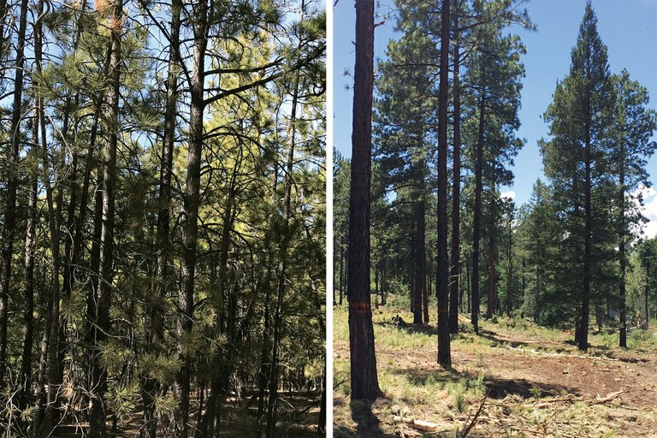
LOOKING TO THE FUTURE...
COLLABORATION AND INNOVATION ARE KEY
Notes:
Innovation and collaboration are key
The usfs doesn’t have the budget or the resources to address the amount of forest restoration needed alone
In order to address barriers to restoration in coconino county, new ideas need to be introduced in a traditional industry
I WILL BE PRESENTING MY REPORT IN MAY AT THE FLAGSTAFF CITY HALL, AND IN APRIL TO THE FIRE ADAPTED COMMUNITIES WOOD UTILIZATION COMMUNITY OF PRACTICE VIA WEBINAR: sparking innovation and collaboration hopefully!
- My final report includes more detailed information about each enterprise, preliminary market analyses, funding opportunities, etc.

Slide 11
QUESTIONS?

Slide 12
REFERENCES
Shaw, J., Menlove, J., Witt, C., & Morgan, T. (2018). Arizona’s Forest Resources, 2001–2014(Rep.). United States Department of Agriculture.
Talberth, J. (2009). Economic Benefits of Forest Restoration In the Signal Peak Assessment Area, Gila National Forest(Rep.). Retrieved https://sustainable-economy.org/wp- content/uploads/Restoration-Benefits-Final1.pdf
The Rising Cost of Wildfire Operations: Effect's on the Forest Service's Non-Fire Work(Rep.). (2015, August 4). Retrieved https://www.fs.fed.us/sites/default/files/2015-Fire-Budget-Report.pdf
THE STATE OF THE SIERRA NEVADA’S FORESTS: FROM BAD TO WORSE(Rep.). (2017). Retrieved https://www.nationalforests.org/assets/pdfs/1.30-Hoffman-State-of-the-Sierra-Nevadas-Forest-2017- Update.pdf
Western Water Threatened by Wildfire(Rep.). (2016). Retrieved https://www.forestfoundation.org/stuff/contentmgr/files/1/3d98bbe1b03a0bdf4c726534d438b0ab/ misc/final_fire_report.pdf

