Slide 1
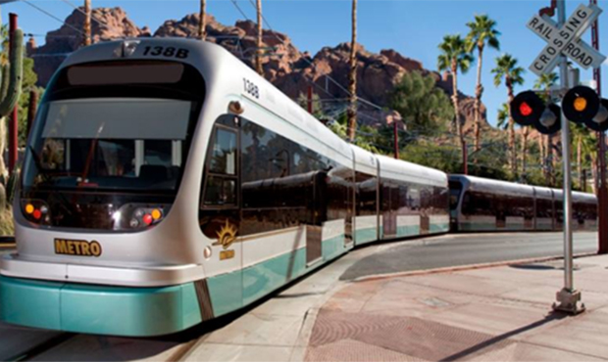
Five Year Sustainability at Valley Metro
Mackenzie McGuffie
Notes:
Good Afternoon everyone, my name is Mackenzie McGuffie.
I am very excited to be presenting to you all my culminating experience project, and before I get started I just wanted to say thank you to everyone here to taking the time out of your day to listen to my presentation

Slide 2
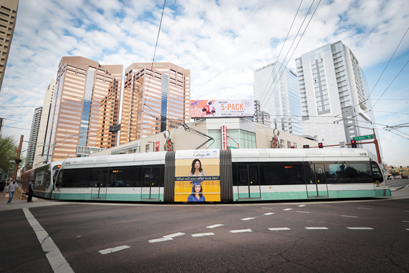
About Valley Metro
Connect communities and enhance lives
Regional public transportation authority
Services in 17 jurisdictions
Light rail, buses, and paratransit
Ridership of 66 million in 2018
APTA Sustainability

Slide 3
Valley Metro Sustainability in May 2018
1
No Active Sustainability Program
2
Not In Compliance with Sustainability Commitment

Slide 4

APTA Sustainability Core Principles
✔ Identify sustainability champion
✔ Undertake annual utility usage inventory
X Sustainability part of strategic objectives
X Outreach program
APTA: American Public Transportation Association
Notes:
Not in full compliance with APTA Sustainability Commitment
Signed onto commitment in 2011
Four Core Principles
Sustainability goals and objectives
Sustainability champion
Outreach program
Annual reporting
Silver recognition requires more sustainability action

Slide 5
Purpose of Project
Update Valley Metro’s Sustainability Objectives by Creating a New Sustainability Plan

Slide 6
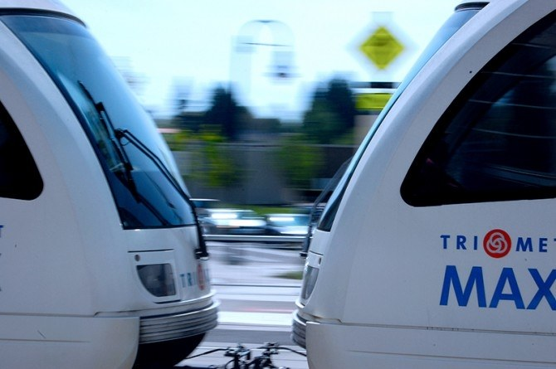
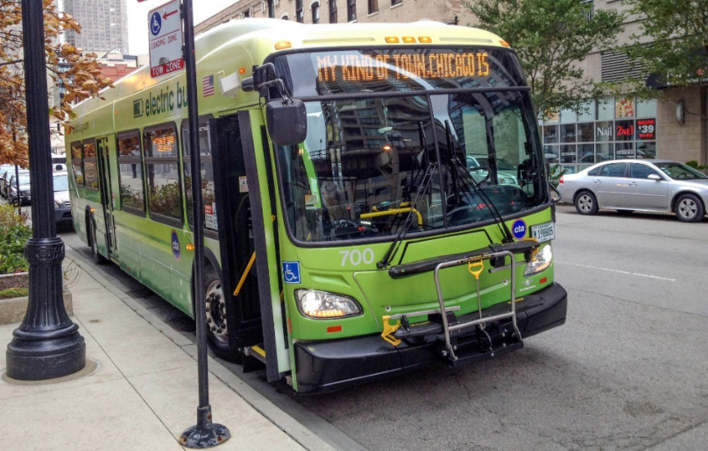
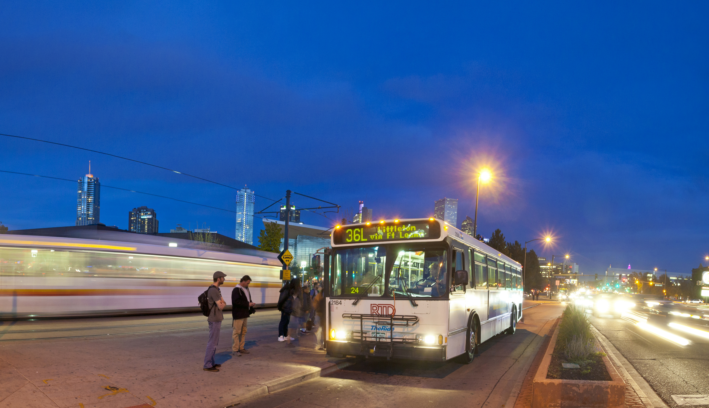
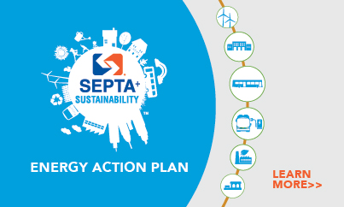
Transit Research
Member Cities & Agencies
Ten largest cities
Peer cities
Notes:
Member Cities/Agencies
All member cities have a sustainability program
8/18 Valley Metro member agencies have sustainability programs
9/10 largest transit agencies in the US have conducted sustainability projects in the last five years.
5/9 have regularly updated sustainability plans.

Slide 7
Survey Results
Do you feel that Valley Metro is reaching its potential as an environmentally conscious agency?
Are you aware of Valley Metro’s Sustainability Commitment?

Slide 8

Sustainability Team
Four meetings to discuss plan and vote on actions
Meeting protocol

Slide 9



Sustainability Goals
Waste Reduction & Diversion
Sustainable Infrastructure
Foster a Culture of Sustainability
Notes:
APTA Indicators – Waste, Recycling, Energy, Water, GHG
Recycle office supplies, packaging and at light rail stations
Decrease paper use through digitizing documents, tracking printing, and introducing mobile ticketing
Create supplies stock room to eliminate excessive purchasing
Switching to energy efficient appliances and methods
Researching ways to reduce water consumption
Create sustainable infrastructure
Continue to implement solar power into operations
Research frequently used and high volume materials to find more sustainable alternatives
Utilize the Greater Phoenix Low Impact Development Handbook
Continually update the Design Criteria Manual to include sustainable elements and reflect recent industry developments
Conduct a study to assess the feasibility of using regenerative braking as a way of reducing energy consumption for the light rail
Foster a culture of sustainability
Increase Obtain a Phoenix Green Business Certification
Integrate sustainability education into new hire orientations
Pursue ISO 14001 Certification
Develop a marketing campaign to educate transit riders on sustainability
Update agency website to showcase sustainability actions that Valley Metro has taken
Implement a component of sustainability into procurement

Slide 10
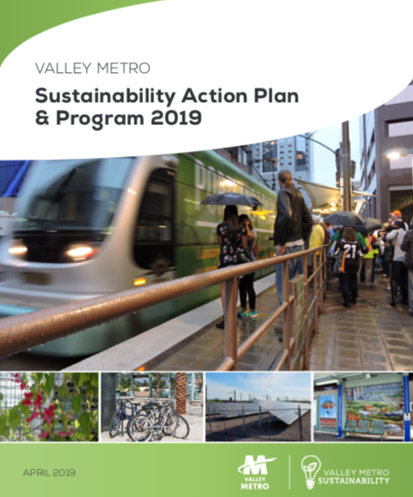
New sustainability plan with projects and goals
Valley Metro hired their first sustainability coordinator
More involvement in future city/regional sustainability
Results

