Slide 1
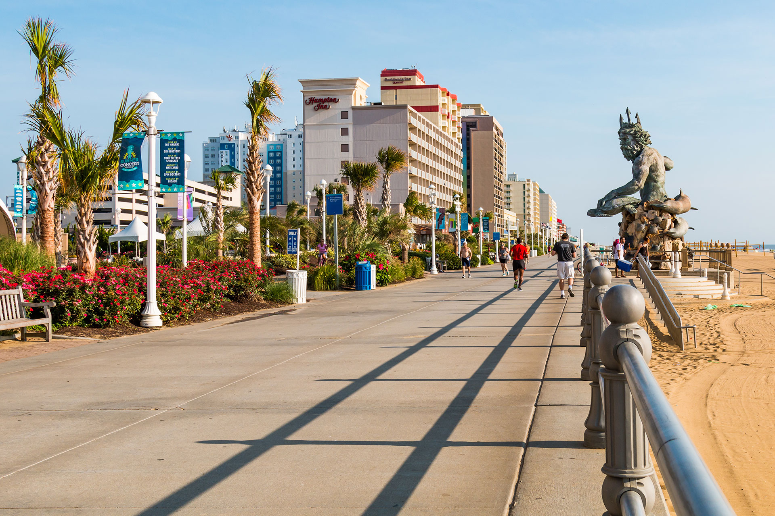
Cigarette Litter Prevention
at the Virginia Beach Oceanfront
Jacquelyn Lolos
Notes:
Good afternoon, my name is Jacquelyn Lolos and I am here to tell you a story about a prominent east coast city that is inundated with a substantial dilemma. Sometimes referred to as “Neptune City” or “The Resort City,” Virginia Beach is a costal city situated along the Atlantic Ocean and the Chesapeake Bay. The city had more than 19 million domestic visitors in 2017, accounting for $2.45 billion in revenue (VB Gov, 2018).
Image 1: Virginia Beach boardwalk at 31st street ft. King Neptune.

Slide 2
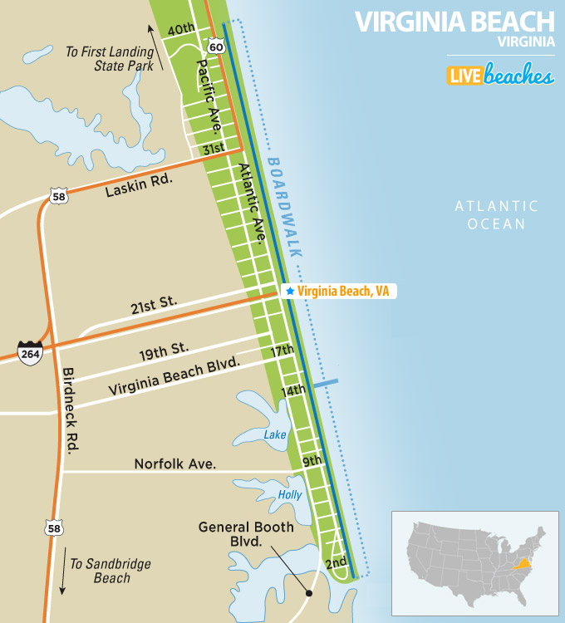
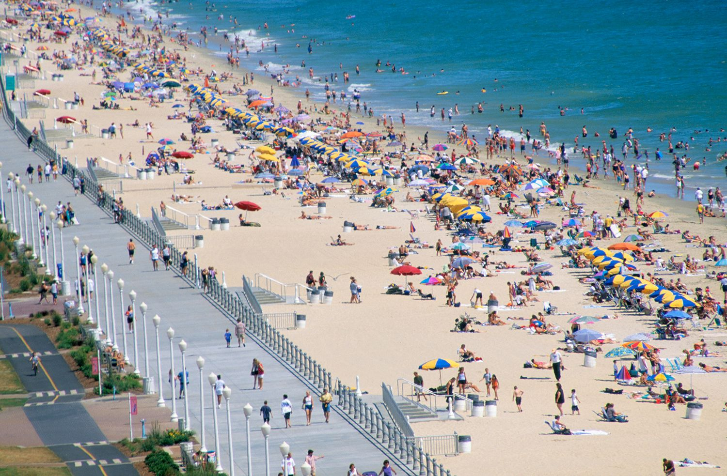
Virginia Beach, VA
Notes:
Virginia Beach boasts 38 miles of shoreline and 28 miles of public beach. When mentioning the “Virginia Beach Oceanfront,” this refers to the three-mile boardwalk and beach area along Atlantic Avenue, highlighted in the image above, which sits along the Atlantic Ocean. Three miles of beach, restaurants, bars, shops, and arcades, sounds like the perfect summer vacation, right? Remember I had mentioned that dilemma? Let's have a look…
Figure 2: Virginia Beach oceanfront map with the three-mile boardwalk highlighted in red, directly to the west of the Atlantic Ocean.
Figure 3: Aerial photograph of Virginia Beach, summer 2018.

Slide 3
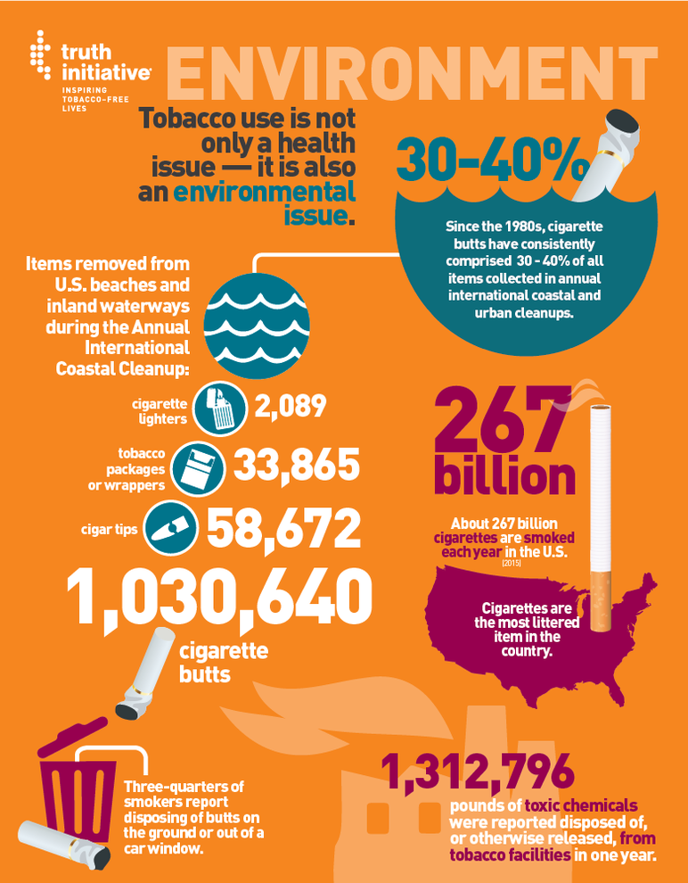
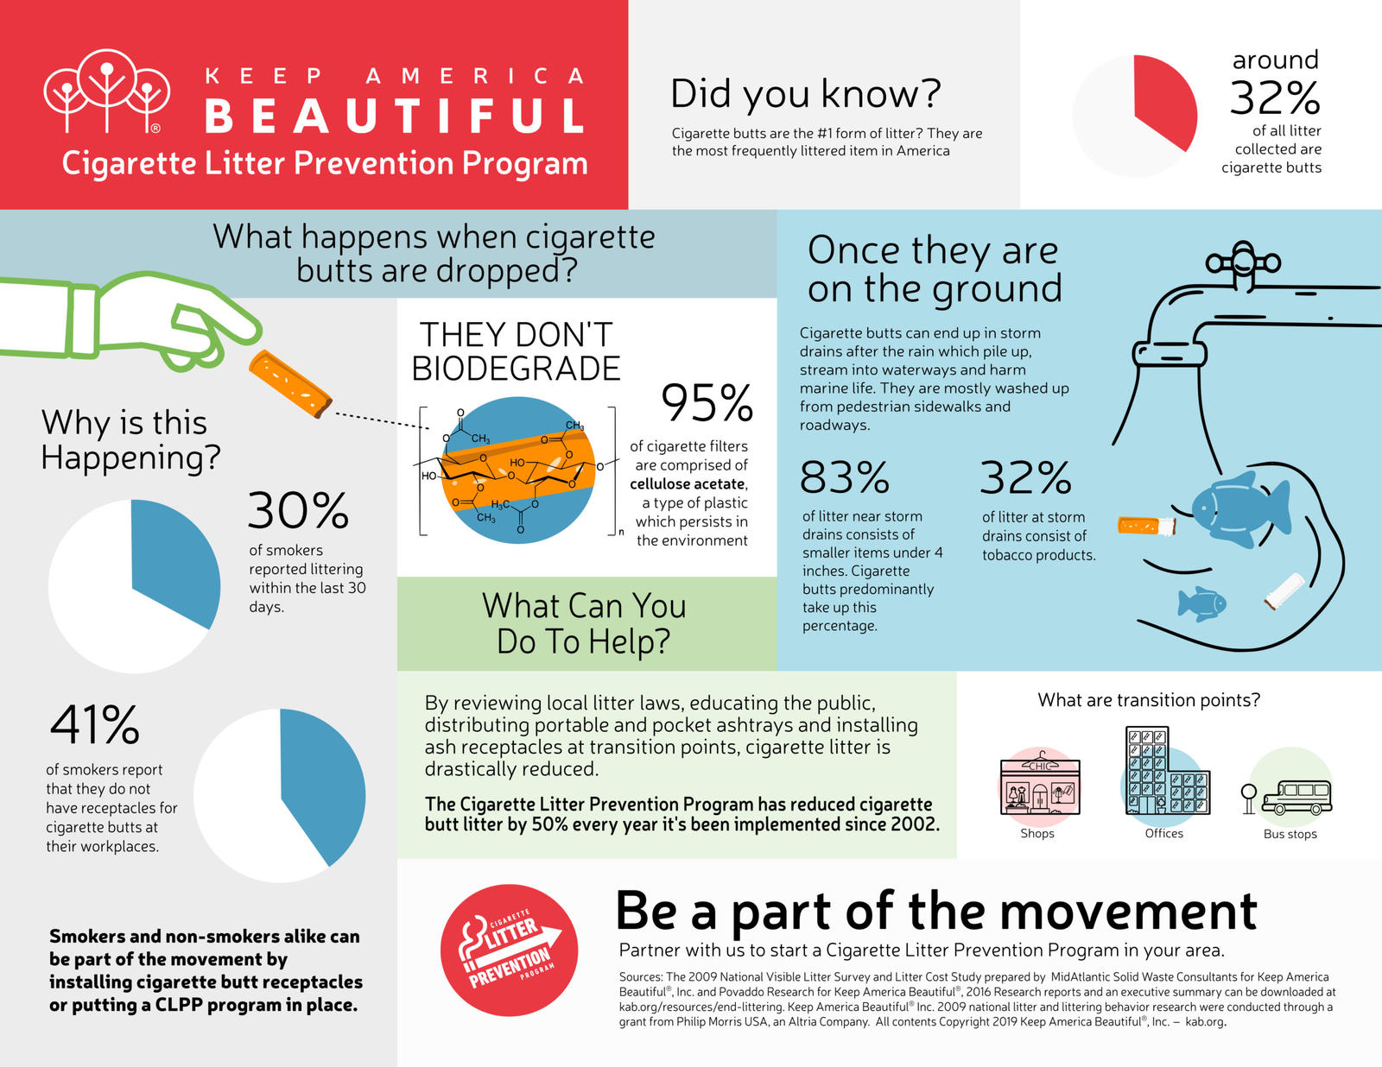
Introduction to the Problem
Notes:
Virginia Beach, like countless other cities worldwide, are facing a dirty issue – beaches, sidewalks, and parking lots are littered with cigarette butts. A non-biodegradable litter, cigarette butts often make their way to waterways via wind and through storm drains. Worldwide, more than 2.5 trillion butts are littered each year (Truth, n.d.). We can see here, according to KAB, on everage, 32% of storm drain litter consists of tobacco products.
Figure 4: Infographic from Keep America Beautiful regarding cigarette litter.
Figure 5: Infographic from Truth Initiative regarding tobacco and cigarette butt litter.

Slide 4
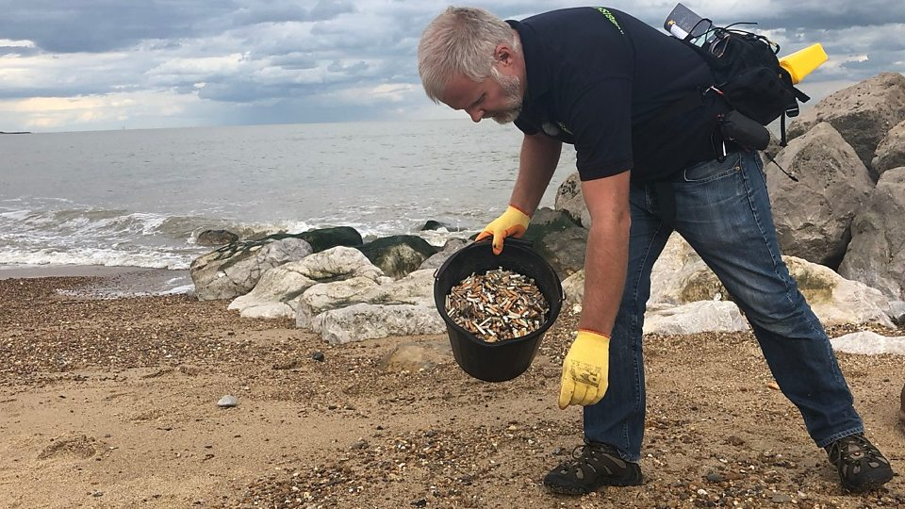
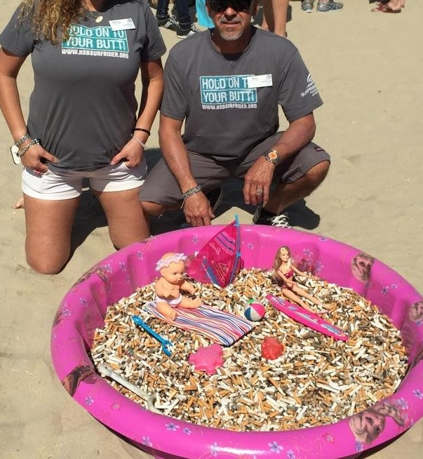
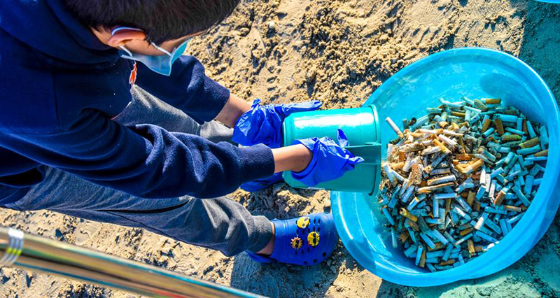
Introduction to the Problem
(continued)
Notes:
Both smoked and unsmoked cigarette butts, made of cellulose acetate, spew toxic chemicals like arsenic and lead into the air and water. These toxins can poison fish, birds, other marine wildlife and even children who mistake them for food. In addition to aesthetic and environmental consequences, butts are a costly burden to local economies. Whether it be due to lack of education and awareness on the smoker’s part, or the absence of ashtray receptacles, or both, there is no excuse for incessant cigarette litter.
Figure 6: Jason Alexander, founder of ‘Rubbish Walks’ collects butts from his local beach in Suffolk, U.K.
Figure 7: A young boy collects butts on a beach in Dubai, UAE.
Figure 8: An organized cleanup by the Surfrider Foundation.

Slide 5
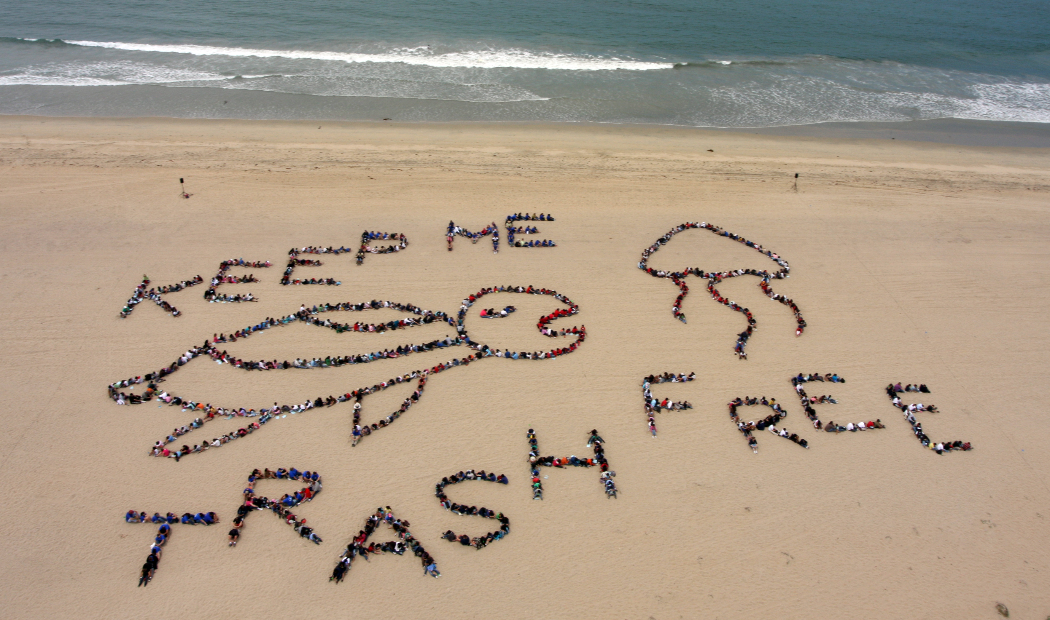
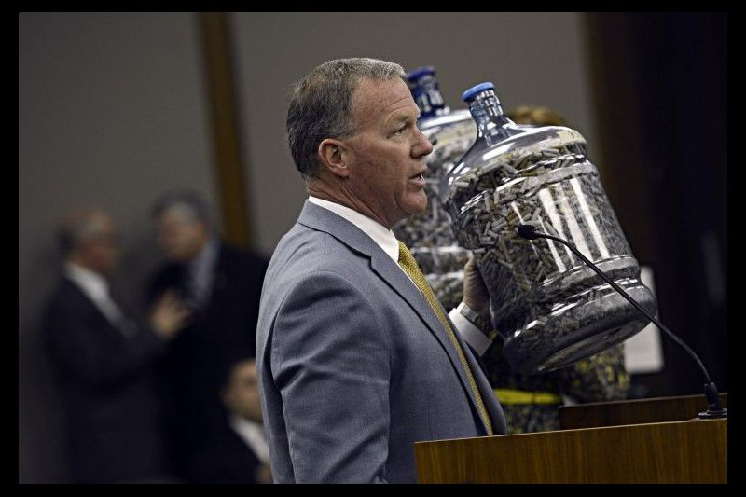
Opportunities
Notes:
The mission is clear: promote a healthier environment to include air quality and marine life and ecosystems, attract more beachgoers, and protect tourism revenue that the city relies on significantly.
Cigarette butts are costly to clean up – Truth Initiative estimates that cities spend between $3 and $16 million annually on cigarette clean-up – an average of $9.5 million that could be put back into the local economy.
The city can transform its beaches and boardwalks into something they can be proud of and something they can promote in marketing campaigns to draw in more tourists.
In 2009, Senator Tim Kaine signed legislation that banned smoking in bars and restaurants in Virginia – one of the first states to trade in the tobacco industry nearly four centuries ago.
Four years later in 2013, Virginia Beach resident Donny Damon, alongside now-Gov. Ralph Northam, introduced bill SB1253 to the House General Laws Committee, which would ban smoking in public parks and on public beaches. The proposal was approved by the Virginia Beach City Council, the Senate Local Government Committee, and the Senate, but was eventually shut down by the House. Damon testified to his frustration with litter along the Chesapeake Bay, holding up two water jugs filled with 16,000 cigarette butts he collected from Chics Beach.
Figure 9: Elementary school students line up for an aerial picture at Bolsa Chica Beach in California.
Figure 10: Donny Damon presents his case to the House General Laws Committee.

Slide 6
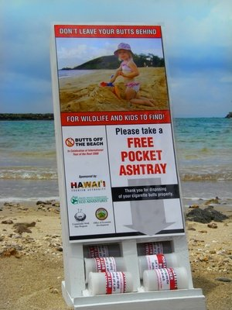
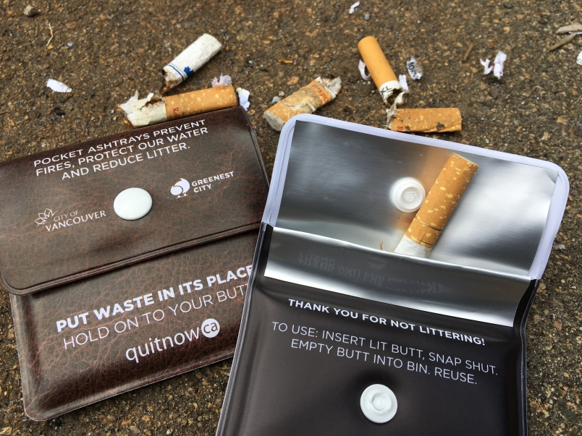
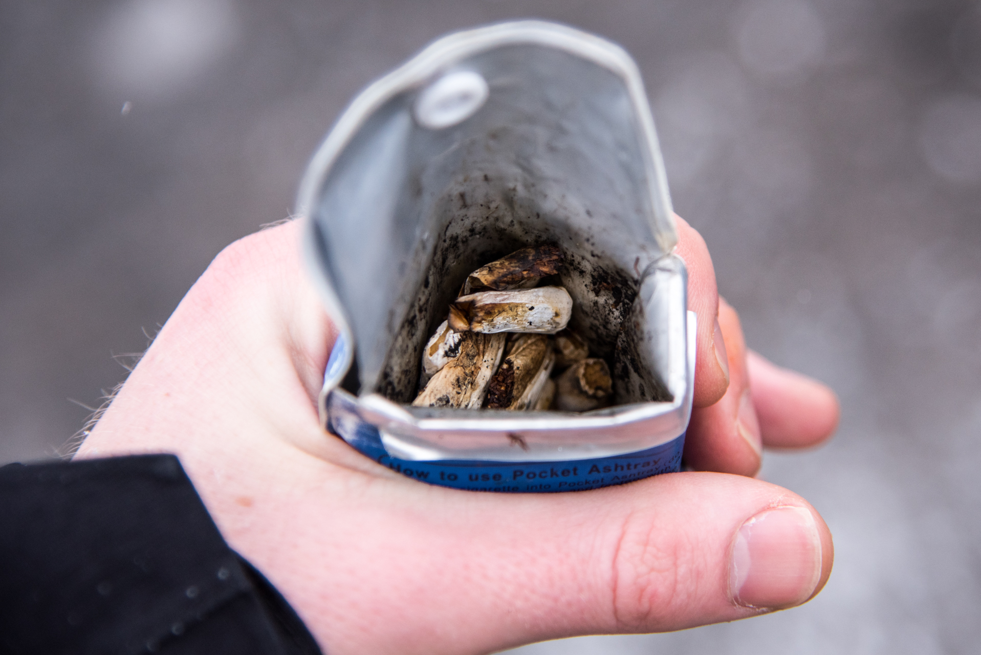
Solution(s)
Notes:
Litter is the result of individual behavior. Important factors that contribute to beach littering are that users feel no sense of ownership for beaches (Keep America Beautiful, 2006) and the existence of previous litter. Pocket or disposable ashtrays provide a way for smokers to safely discard their butts. Vancouver, Calgary, Maui, and Madison, Wisconsin, are a few examples of cities that distribute, or have distributed, free pocket ashtrays. Keep America Beautiful is a leading national nonprofit, inspires and educates people how to improve and beautify their communities. Keep America Beautiful has four proven, field-tested strategies for reducing cigarette butt litter:
1. Review local litter laws, including cigarette butt litter, and support enforcement.
2. Educate the public using public services messages and advertising.
3. Place ash receptacles at “transition points,” places where smokers must stop smoking before proceeding.
4. Distribute pocket ashtrays or portable auto ashtrays to adult smokers.
Figure 11: Pocket ashtrays.
Figure 12: Free pocket ashtrays in Maui, Hawaii.
Figure 13: Pocket ashtray.

Slide 7
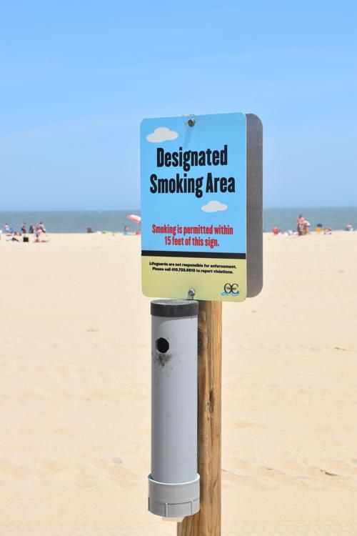
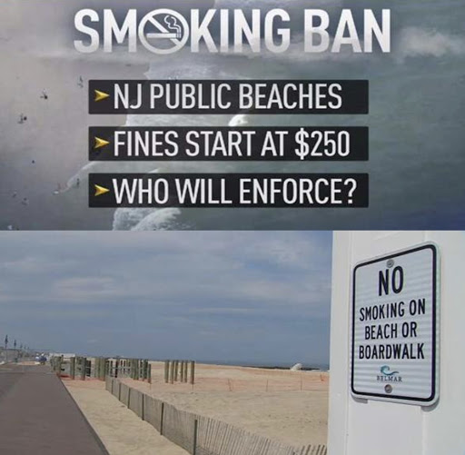
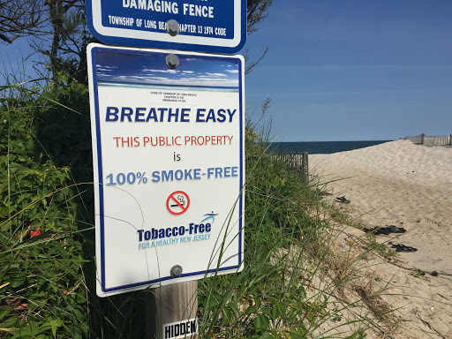
Solution(s) (continued)
Notes:
The first smoking ban in the United States was established at Hanauma Bay Beach in Hawaii in 1993 – and in 2003, Solana Beach, California became the first beach in the continental United States to establish the same (Ariza, Leatherman, 2012). Since then, Santa Monica and Venice Beach, California have followed suit. Additionally, New Jersey and Puerto Rico have issued statewide smoking bans on all public beaches. To date, about 100 local governments in the United States have established smoking bans on their beaches (Americans for Nonsmoker’ Rights, 2010).
Figure 14: New Jersey implements no smoking ban on all public beaches.
Figure 15: Designated smoking area on a public beach, accompanied by an ash receptacle.
Figure 16: Breathe Easy, tobacco-free beach in southern New Jersey.

Slide 8
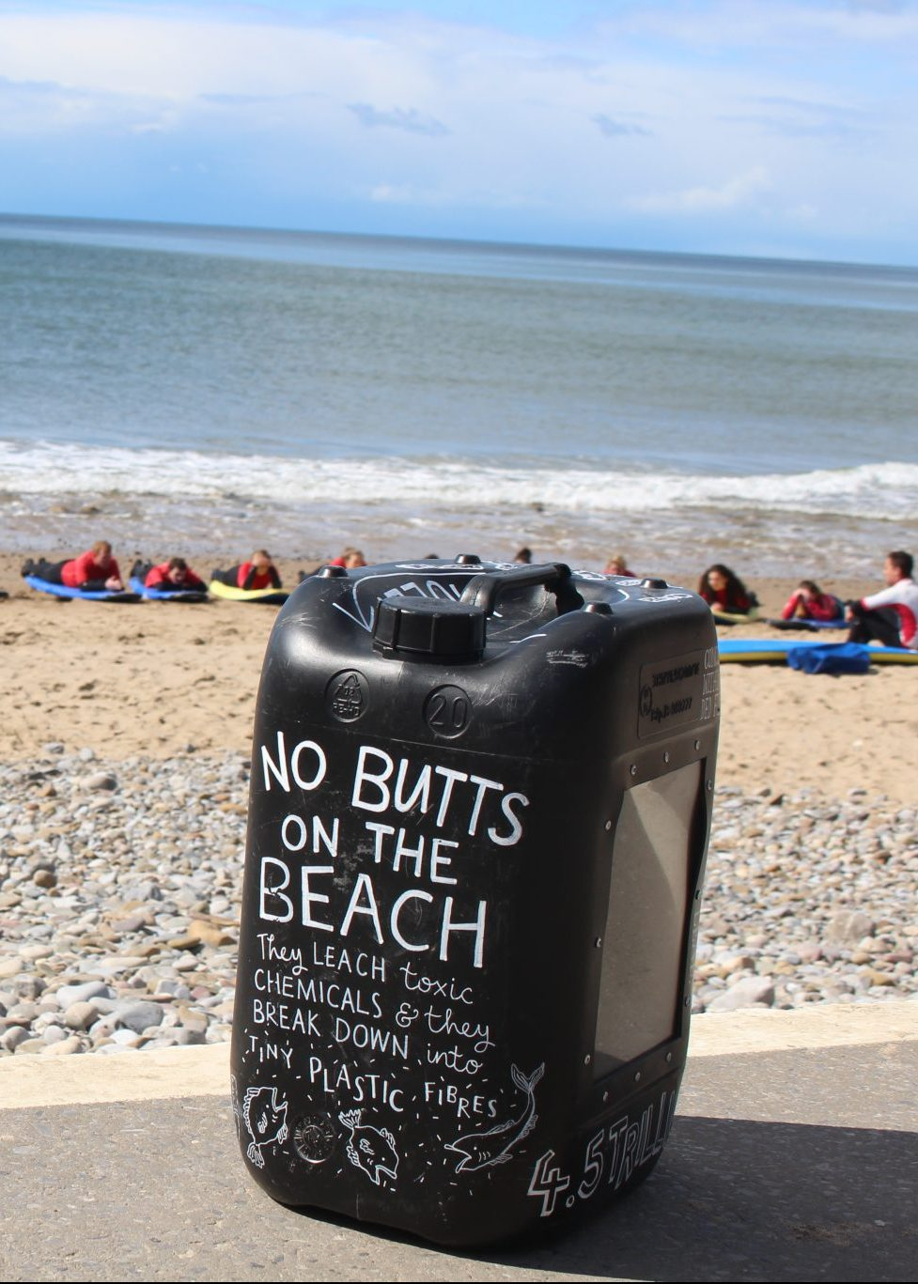
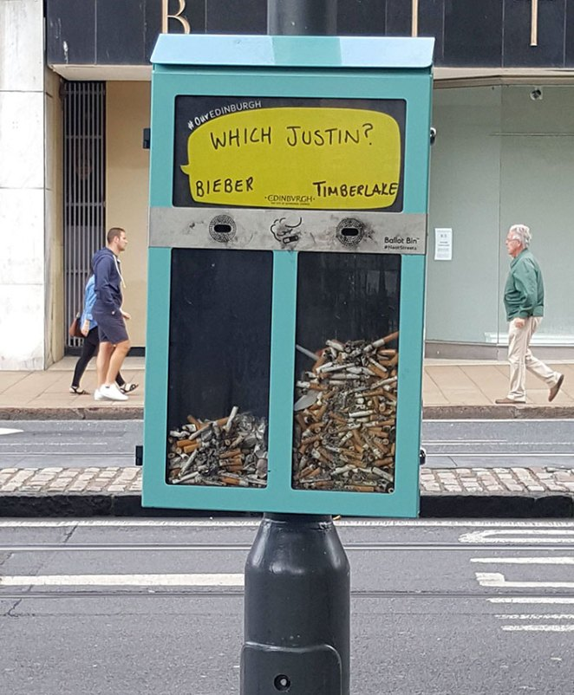
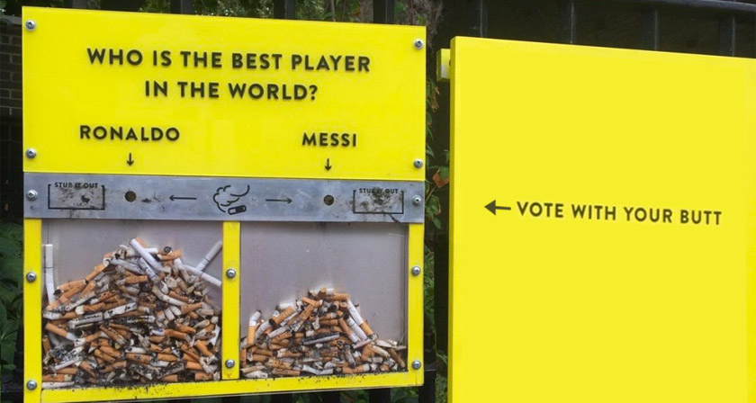
Objectives
Notes:
The main objective here is not to discourage people from smoking. There are several agencies that have tried to do this for years with little to no avail – for example, Truth Initiative is America's largest nonprofit public health organization dedicated to making tobacco use a thing of the past (Truth, n.d.).
Additional cigarette butt receptacles, enforcement by Virginia Beach Police Department, related penalties (community service, litter clean ups) in lieu of fines, and the effects on adjacent property owners and the economy must be taken into consideration when applying solutions and contemplating objectives.
Additionally, education, marketing, and outreach campaigns assist in catching the attention of the public and aid in organizing voluntary beach clean ups.
Figure 17: Creative butt receptacle on a beach in Wales, U.K.
Figure 18: Vote With Your Butt – Ronaldo vs. Messi.
Figure 19: Vote With Your Butt – Justin Bieber vs. Justin Timberlake.

Slide 9

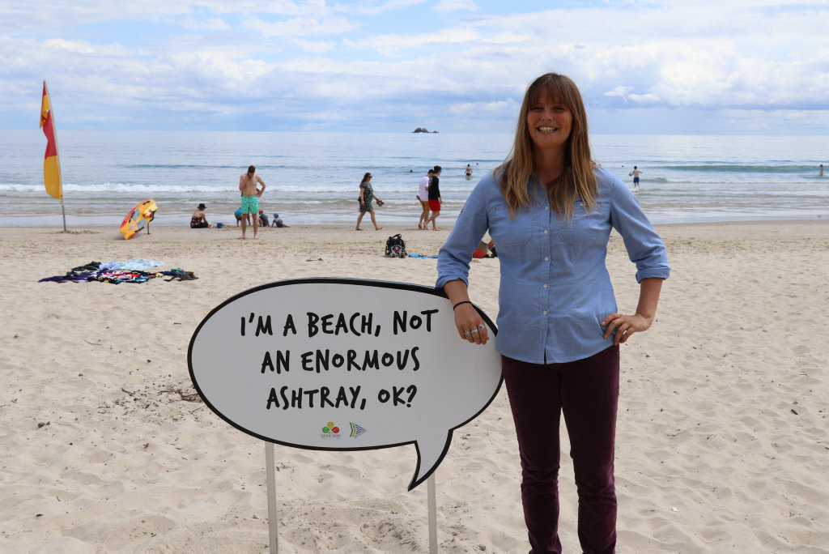
Why?
Notes:
Beach tourism is often the most important source of revenue for coastal cities, and surveys show that the foremost requirements for beachgoers are clean sand and clean water. Beach aesthetics is an important issue for the economy since unkempt beaches deter tourism (Ofiara, Brown, 1999). Cigarette butts degrade beach environments and have negative environmental consequences – for example, ingestion by birds, fish, and marine mammals. Additionally, as in any situation, secondhand smoke within such a crowded environment can also pose threats. It is important to add however, that the risk of secondhand smoke is significantly diminished in an open-air environment (New York City Citizens Lobbying against Smoker Harassment, n.d.).
Figure 20: Byron Beach, Australia, informative sign.
Figure 21: Advertisement for butt litter on Lake Tahoe, Nevada.

Slide 10
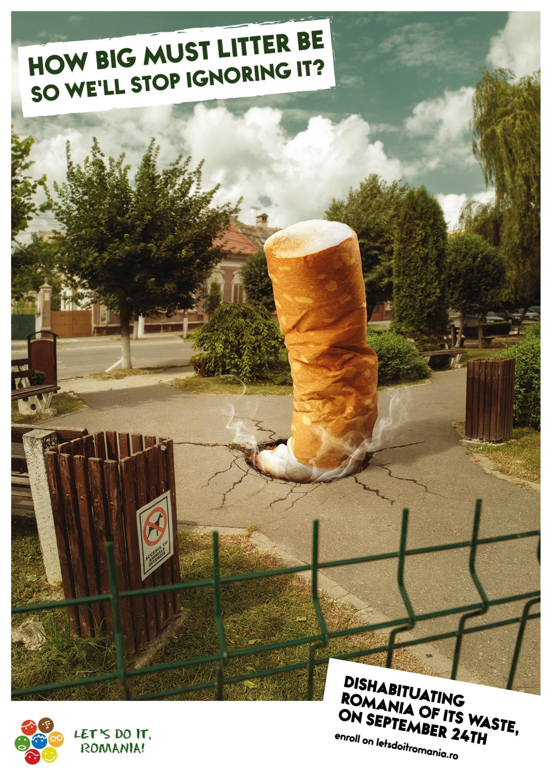
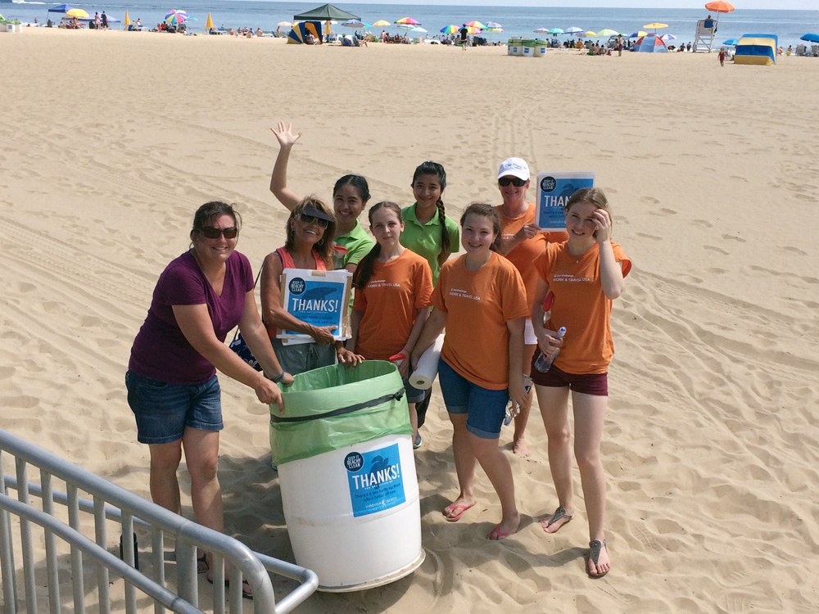
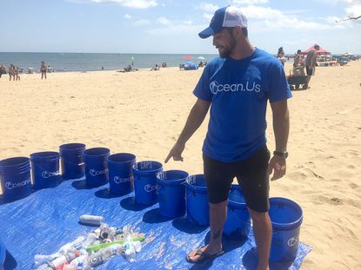
Expectations
Notes:
As I mentioned previously, the expectation of this project is NOT to discourage people from smoking or segregate smokers from non-smokers. The expectations are clean beaches, more visitors, advertisements and marketing campaigns like the one here from Romania, organized and voluntary beach cleanups, and heavier fines in the form of community service for those who do litter on the beach.
Figure 22: Volunteers clean up Virginia Beach.
Figure 23: Advert from Romania.
Figure 24: OceanUs performs a cleanup in Virginia Beach.

Slide 11
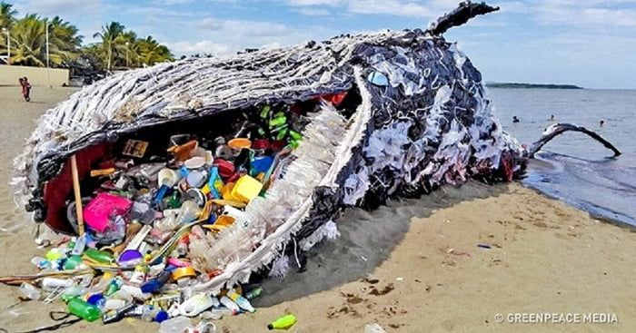

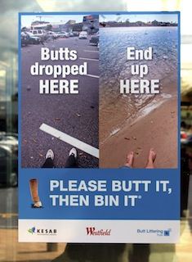
Timing
Notes:
Speaking with Robert Dean, 1989 founding member of Clean the Bay Day, he said “Changing the world begins with one cigarette butt at a time, so I’d say, especially to smokers out there, keep your butts off the beach.” Citing his inspiration for the dedicated day Dean said, “plastic bags, fishing line, cigarette butts, and heaps of other trash were defiling our waterways.”
Dean hopes to end Clean the Bay Day, wishing that people would take his advice to stop littering so that one day the annual cleanup will no longer be necessary. This project requires immediate attention and action. The consequences will continue to get worse for as long as this issue lingers.
One million seabirds are killed by marine litter every year - 100,000 turtles and marine mammals, such as dolphins, whales and seals, are killed by plastic marine litter every year around the world (Perseus, n.d.).
Figure 25: Stop littering sign from Safety Signs.
Figure 26: Greenpeace Philippines create a sperm whale out of trash. The inspiration came after a dead sperm whale washed up on the coast of Spain and revealed more than 64 pounds of trash in its stomach.
Figure 27: Impress Media Australia created posters to illustrate where butts inevitably end up.

Slide 12
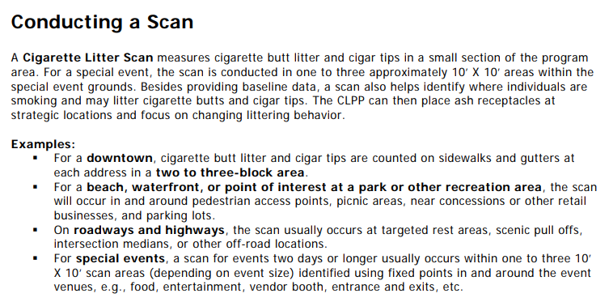
Measurements of
Success
Notes:
A Cigarette Litter Scan, developed by Keep American Beautiful, is a method to quantify cigarette butt and cigar litter in a target area – scans have been field-tested in downtown areas, beaches, parks, and at rest stops along roadways. Keep America Beautiful defines the scan as a “scanning methodology that involves an actual count of cigarette butt and cigar tip litter on the ground.” These scans are conducted in smaller, representative sections within the larger program area. They are used for periodic follow-up scans to assess long-term program influence and sustainability.
Additionally, KAB provides a Field Scan Document and allows for recordings from a preliminary scan as well as two follow up scans. It also provides space to record the location, number of butts, number of cigar tips, and number of ash receptacles in the designated location.
While KAB does not specify how often these follow up scans should be conducted, this is the ideal way to measure the success of the project and assess the impact of the project.
Figure 28: Keep America Beautiful’s instructions on conducting a cigarette litter scan.

Slide 13

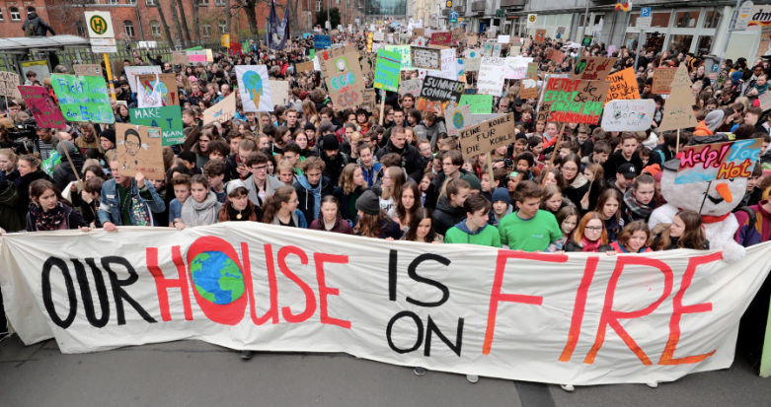
Call to Action (CTA)
Notes:
Act now – stop littering, protect our planet, save marine ecosystems and waterways, and volunteer to clean up if you can. The longer we allow this problem to persist, the worse the damage will get. Even without a ban on public beach smoking, we can put a stop to this through education and dissemination of pocket ashtrays and receptacles at transition points. The message is clear, stop littering. If you can, pick up litter. Educate others about litter. Volunteer. Help be part of the solution to this worldwide problem.
Thank you.
Figure 29: Advert for disposing of trash in correct bins.
Figure 30: Young adults march with Greta Thunberg to bring awareness to climate change.

Slide 14
References
Figure 1: Dagnall, Ian. (2018). Neptune Statue. [Photograph]. Retrieved from https://www.newsday.com/travel/beaches-with-great-boardwalks-1.18967643
Figure 2: Live Beaches. (n.d.). Virginia Beach, Virginia. [Map]. Retrieved from https://www.livebeaches.com/map-of-virginia-beach-virginia/
Figure 3: Gibson, Mark, E. (2019). Crowded Virginia Beach. [Photograph]. Retrieved from https://www.tripsavvy.com/things-to-do-virginia-beach-boardwalk-4172036
Figure 4: Keep America Beautiful. (2019). Cigarette Litter Toolkit. [Infographic]. Retrieved from https://kab.org/programs/cigarette-litter/resources/
Figure 5: Truth Initiative. (2018). Tobacco and the environment. [Infographic]. Retrieved from https://truthinitiative.org/research-resources/harmful-effects-tobacco/tobacco-and-environment
Figure 6: BBC News. (2019). Rubbish Walks. [Photograph]. Retrieved from https://www.bbc.com/news/world-europe-49263685
Figure 7: Dubai Municipality. (2018). Volunteers at the beach clean up activity. [Photograph]. Retrieved from https://www.constructionweekonline.com/article-47677-dm-removes-400000-cigarette-butts-from-beaches-in-2017
Figure 8: Surfrider Foundation. (2019). Butts collected at a clean up. [Photograph]. Retrieved from https://therevelator.org/cigarette-butt-litter-solutions/
Figure 9: The Orange County Register. (2018). Adopt-A-Beach cleanup. [Photograph]. Retrieved from https://www.ocregister.com/2018/05/21/kids-ocean-day-celebrates-25-years-of-educating-youth-to-keep-beaches-clean/
Figure 10: News Herald. (2019). Local artists paint storm drains. [Photograph]. Retrieved from https://www.news-herald.com/news/artists-paint-willoughby-stormwater-drains-promote-clean-water/article_b8ae7644-6d08-11e9-8256-dfe8829c4667.html

Slide 15
References (continued)
Figure 11: Toulgoet, Dan. (2019). Pocket ashtrays. [Photograph]. Retrieved from https://www.vancourier.com/community/no-butts-about-it-tossing-your-cigarette-on-the-ground-is-unacceptable-1.23859699
Figure 12: eTurbo News. (2008). Free pocket ashtrays in Maui. [Photograph]. Retrieved from https://www.eturbonews.com/5547/keep-your-butts-beach/
Figure 13: Snowboarder’s Journal. (n.d.). Portable pocket ashtray review. [Photograph]. Retrieved from https://www.thesnowboardersjournal.com/review/portable-pocket-ashtray/
Figure 14: Hudson County Coalition. (2018). NJ smoking ban advert. [Infographic]. Retrieved from http://hudsoncountycoalition.org/no-more-secondhand-smoke-at-the-beach/
Figure 15: Parypa, Chris. (2018). Designated smoking area. [Photograph]. Retrieved from https://mdcoastdispatch.com/2018/07/11/june-smoking-citations-up-1000-in-ocean-city/
Figure 16: Nee, Daniel. (2018). Breathe Easy tobacco-free sign. [Photograph]. Retrieved from http://lavallette-seaside.shorebeat.com/2018/07/murphy-signs-law-banning-smoking-on-all-n-j-beaches/
Figure 17: ash Wales. (2018). Creative butt receptacle. [Photograph]. Retrieved from https://ash.wales/battling-cigarette-butts-on-our-beaches-2/
Figure 18: Digital Sypnopsis. (n.d.). Vote With Your Butt, Ronaldo vs. Messi. [Photograph]. Retrieved from https://digitalsynopsis.com/buzz/hubbub-neat-streets-cigarette-butt-vote/
Figure 19: ScoopFun. (n.d.). Vote With Your Butt – Bieber vs. Timerblake. [Photograph]. Retrieved from https://scoopfun.com/snax_item/5113/

Slide 16
References (continued)
Figure 20: Akkerman, Kate. (2017). Advocate for smoke free beach. [Photograph]. Retrieved from https://www.northernstar.com.au/news/400000-cigarette-butts-we-need-smoke-free-beaches/3285627/
Figure 21: Take Care Tahoe. (n.d.) Please collect your butts. [Cartoon]. Retrieved from https://takecaretahoe.org/take-action/cigarette-litter/
Figure 22: Work & Travel USA. (n.d.). Beachy Clean in VB. [Photograph]. Retrieved from https://www.interexchange.org/articles/events/beachy-clean-in-virginia-beach/
Figure 23: Ads of the world. (2018). Romania litter ad. [Cartoon]. Retrieved from https://www.adsoftheworld.com/media/print/lets_do_it_romania_cigarette_butt?size=original
Figure 24: Virginian Pilot. (2019). OceanUs conducts a beach cleanup in VB. [Photograph]. Retrieved from https://www.pilotonline.com/life/columns/vp-bc-belote-oceanus-0922-20190919-gj6kcvyzcvblnfwsjv4sxqsa5y-story.html
Figure 25: Safety Signs. (n.d.). Stop littering sign. [Cartoon]. Retrieved from https://www.safetysign.com/do-not-litter-signs
Figure 26: Snopes. (2018). Sperm whale made from trash. [Photograph]. Retrieved from https://www.snopes.com/fact-check/sperm-whale-die-swallowing-64-pounds-plastic-debris/
Figure 27: Impress Media, Australia. (2012). Butts dropped here, end up here. [Advertisement]. Retrieved from https://www.impress.com.au/newsroom/innovation/395-footy-finals-reveal-butt-ugly-facts.html
Figure 28: Keep America Beautiful. (2019). Conducting a scan. [Text]. Retrieved from https://kab.org/wp-content/uploads/2019/11/Cigarette-Litter-Prevention-Program-Toolkit.pdf
Figure 29: Keep Australia Beautiful. (n.d.). Bin it. [Cartoon]. Retrieved from https://www.behance.net/gallery/10892717/Bin-it-You-know-its-the-right-thing-to-do
Figure 30: Youth Climate Strike. (2019). Protestors march. [Photograph]. Retrieved from https://www.nonviolent-conflict.org/blog_post/greta-thunberg-and-the-power-of-strategic-movement-messaging/

