Slide 1

MSUS Culminating Experience
Arizona State University:
Electric Vehicle Program
Kayla Kutter

Slide 2
Problem Statement
Baseline
Implementation
Timeline
Results
Next Steps
Overview: EV Program Progress
Notes:
For my project I reduced GHG emissions by identifying the largest barriers to electric vehicle adoption and trying to overcome a few known problems – initial cost, charging station availability, and increasing awareness – by working with dealerships to create incentives and advertising charging locations.

Slide 3
Part I: Problem Statement
Notes:
According to the EPA, 29% of all CO2 emissions come from transportation. CO2 emissions contribute to health problems and the urban heat island effect. To reduce those emissions, we must change the way we move from one place to another. Ideally, we switch entirely to non-emitting sources like walking and biking. When that is not an option, electric vehicles are a better alternative to internal combustion engine vehicles. ASU can help the transition to EVs by eliminating adoption barriers.

Slide 4
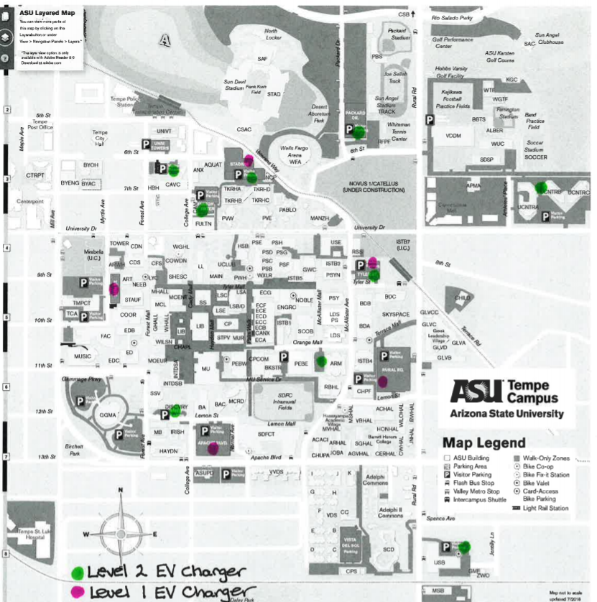
Part II: Baseline
Notes:
In March, I made a business plan to install ChargePoint charging stations across all four ASU campuses in collaboration with USP and P&T. (Note location of chargers) We currently have two Level 2 installed and operational and one Level 1 that needs to be calibrated. This weekend will see the installation of about 3-4 more. All the charging stations will be powered by solar electricity which reduces CO2 emissions through the charging process. Clean form of electricity.

Slide 5
Part III: Implementation
Install Charging Stations
Discover Barriers That Prevent EV Adoption
Provide Financial Incentives With Dealership Partnerships
Advertise Charging Station Locations and EV Incentive Program
Earth Day Celebration
Notes:
Include partnerships – I work for USP, P&T, ASU Communications, dealerships

Slide 6
Part IV: Timeline
Nov
Jan
Feb
March
April
Survey prep/IRB
Campus Interviews
Find dealership partners
Work with dealerships
Finalize incentives structure
Submit all deliverables
Survey
Writeup results
Submit - HR
Earth Day
Publish EVHE

Slide 7
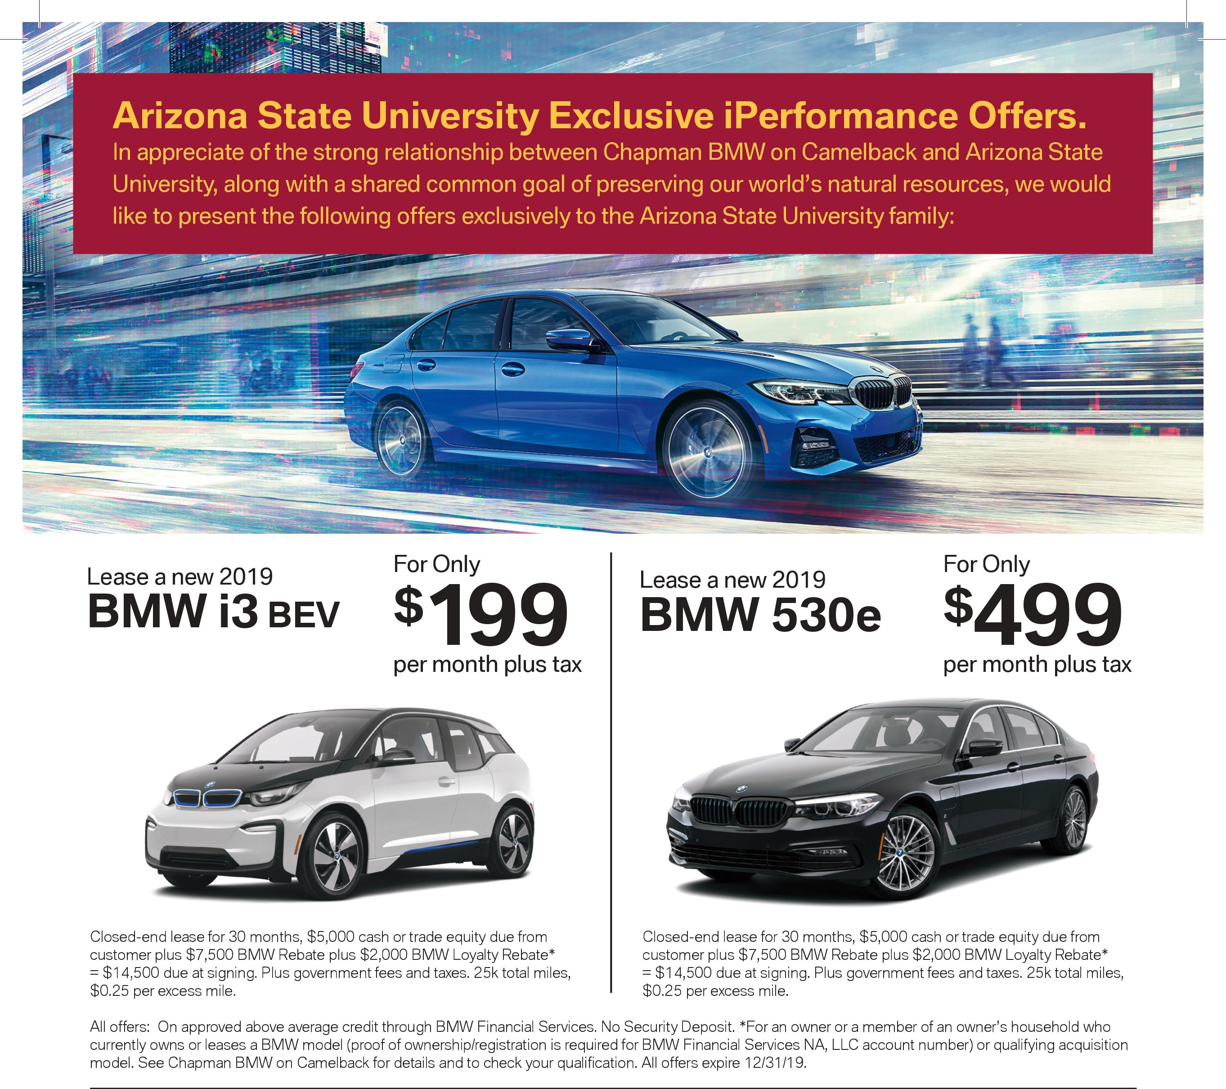
Part V: Results
Partners:
Chapman BMW
Chapman Chevy
LHM Nissan

Slide 8
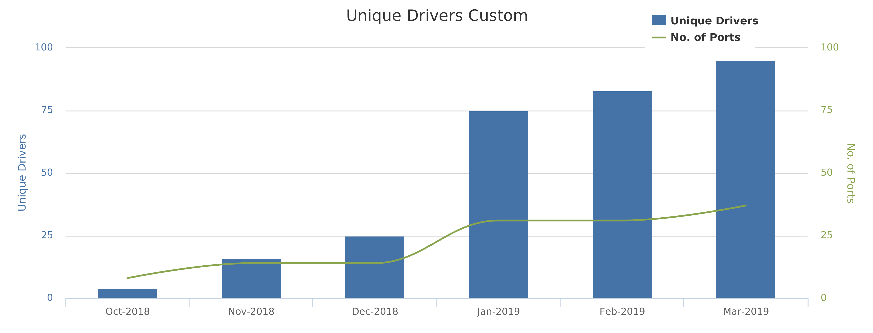
Part V: Results
Source: ChargePoint

Slide 9
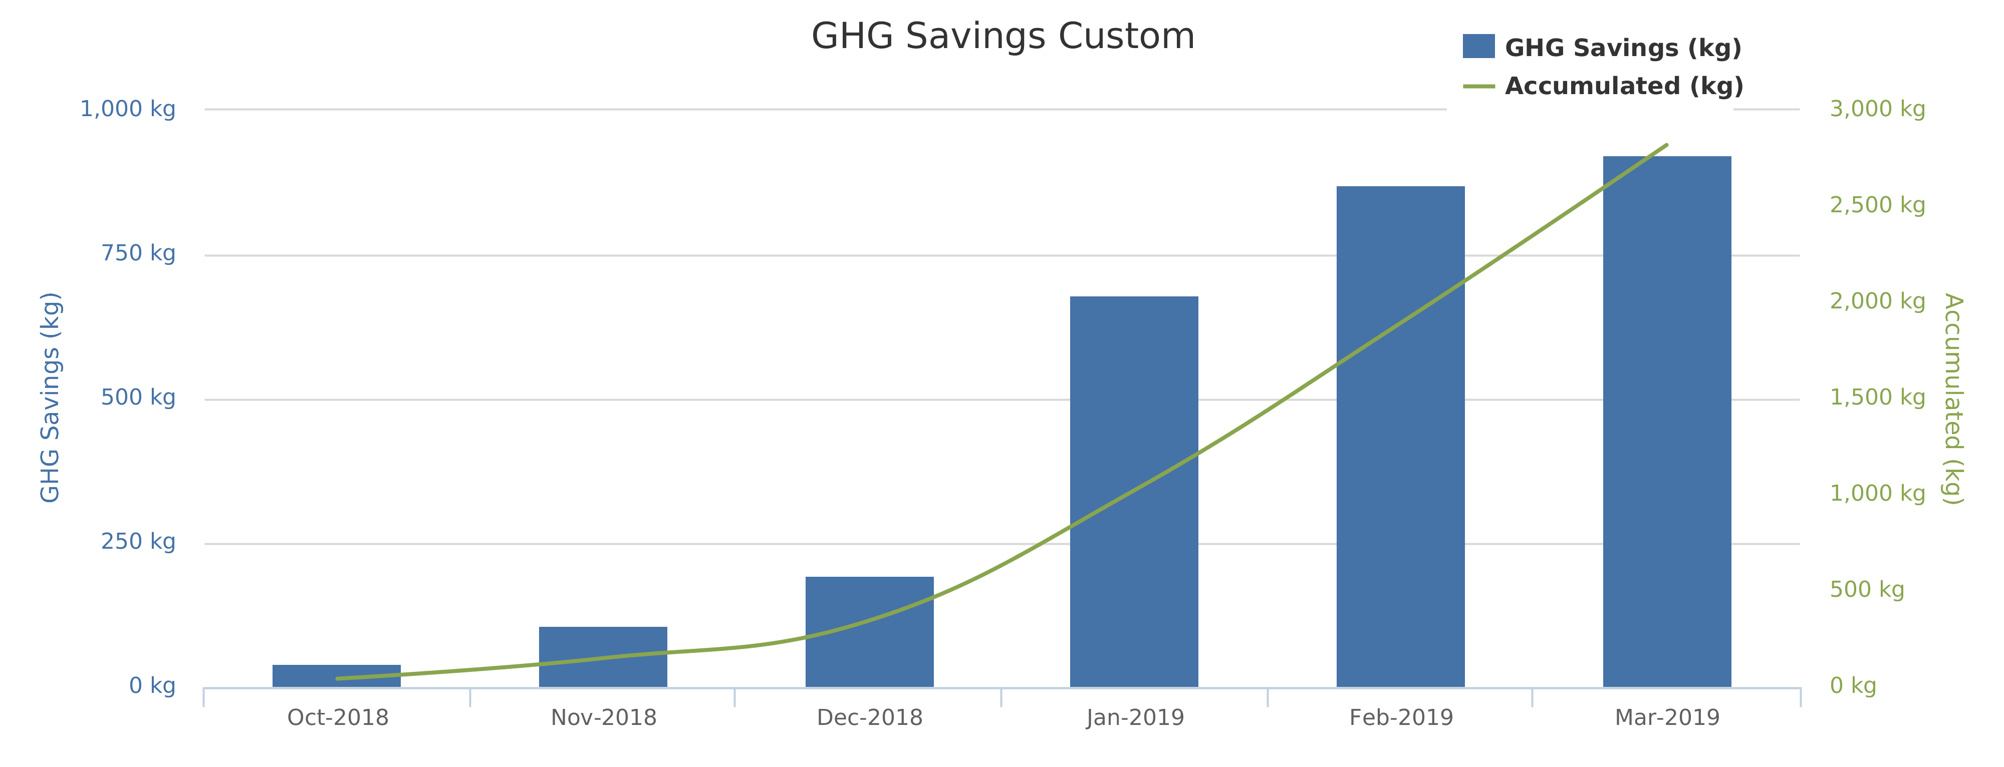
Part V: Results
Source: ChargePoint

Slide 10
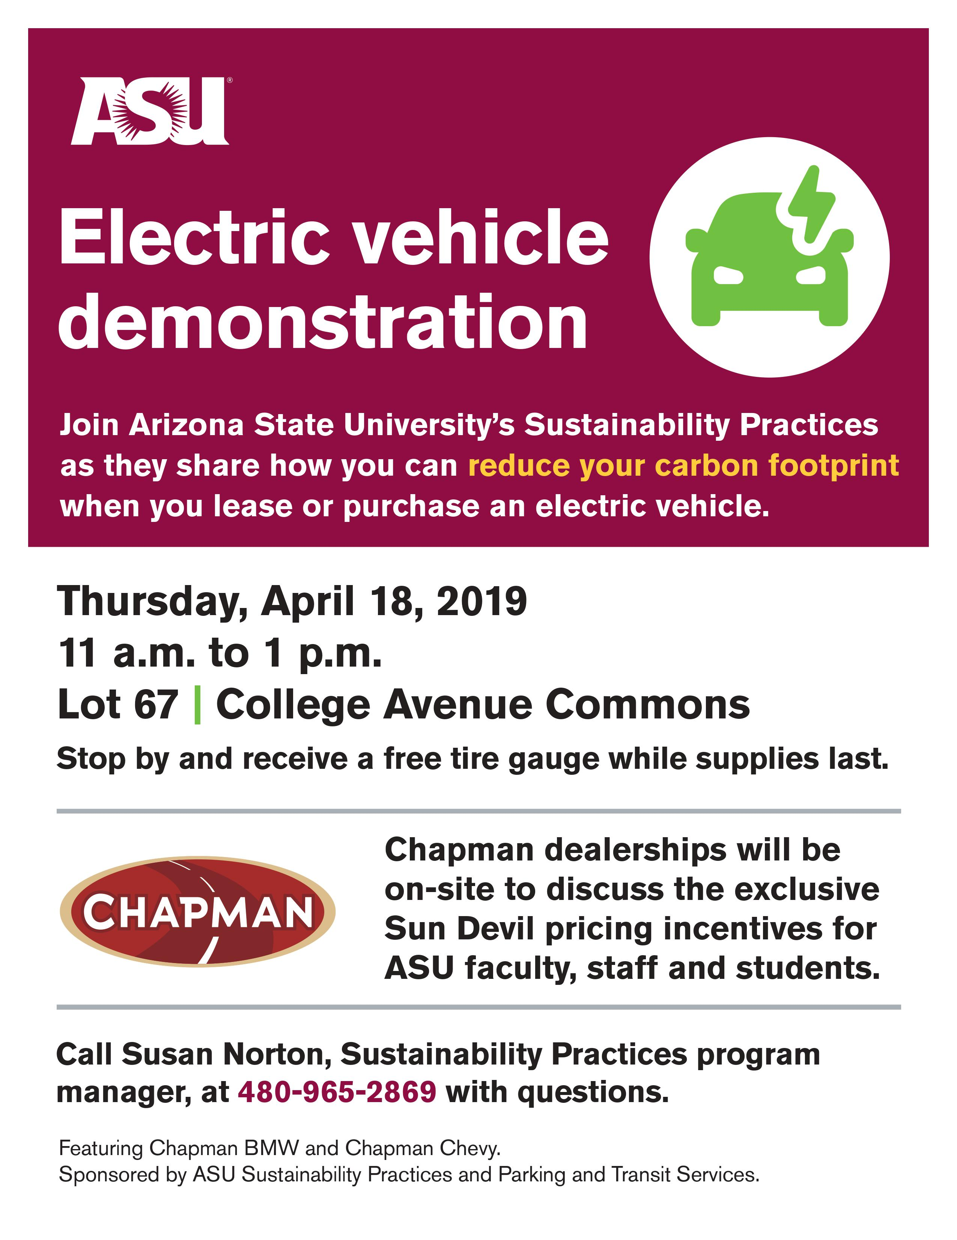
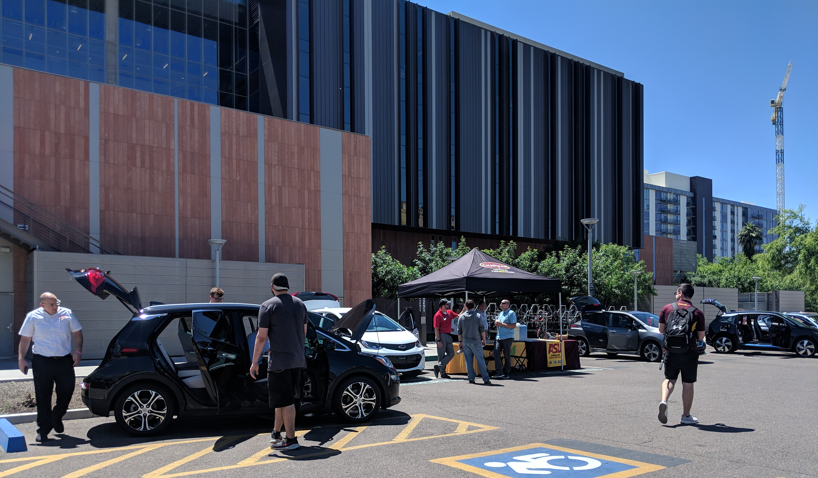
Part V: Results

Slide 11
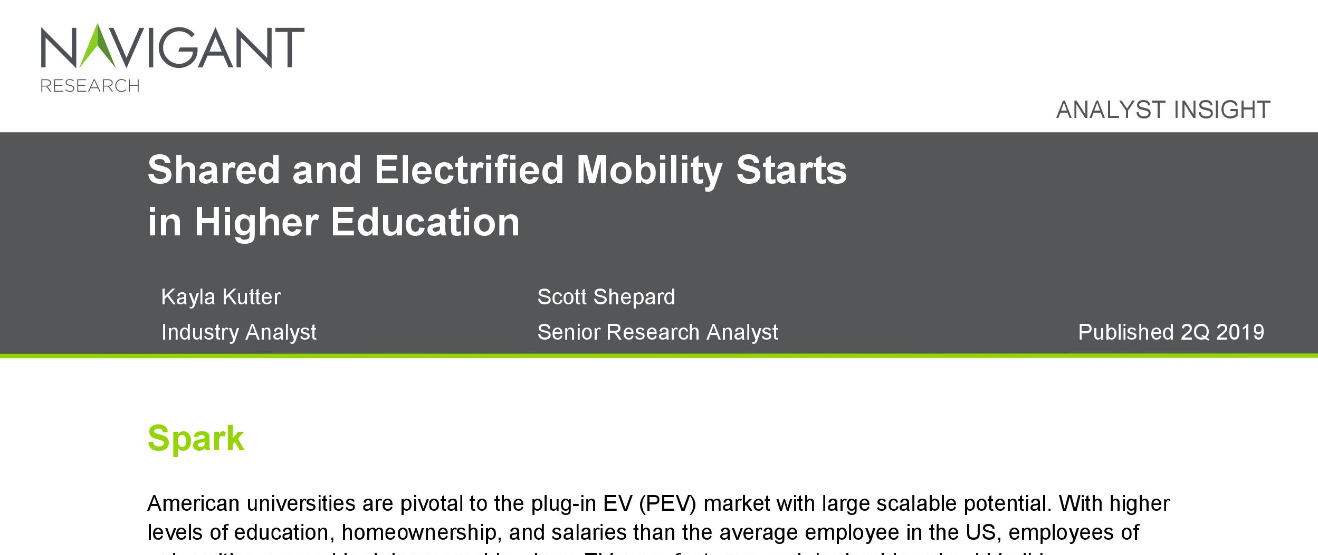
Part V: Results
Navigant – Electric Vehicles for Higher Education Report

Slide 12
Part VI: Next Steps
Evaluate Success of EV Program
Expand Incentive Partnerships
VGI Research Opportunities
Electrify ASU’s Fleet
Investigate electricity mix used

Slide 13
Thank you!
kkutter@asu.edu

