Slide 1
Sustainability
Creating ‘sustainable’
competitive advantage
Annie Hukill
Senior Sustainability Specialist
Notes:
Hello thank you all for being here today! My name is Annie Hukill and I am the Senior Sustainability Specialist at Stryker’s Sustainability Solutions. Today I am going to talk about how I created, implemented and maintained a cohesive sustainability strategy into the DNA of my organization.

Slide 2

Journey
Notes:
Creating, implementing and maintaining a sustainability charter was no easy feat! Change did not happen over night and this project absolutely challenged me in so many unexpected ways. While the journey was not ever easy, I am proud of the results and what it means for my organization.
Before I begin, I would like to give you some context as to my own personal journey with Stryker. I began working at Stryker as an intern in the summer of 2015. After I finished my internship, they offered me a full-time position on the Marketing team. Knowing that I loved the organization and the people I worked with I was ecstatic to start my career with Stryker. One of the reasons I was drawn to Stryker’s Sustainability Solutions was the environmental impact that the company was having on the healthcare industry. Since I was always passionate about nature and the environment, I asked management if I could create, lead and run an internal Green Team comprised of people from different functions of the organization. Being able to do this allowed me an outlet to focus on sustainability initiatives and sparked the idea to integrate a holistic sustainability strategy at Stryker.
This journey began after I took a critical look at how the business operates and what the company values in its mission and vision.

Slide 3
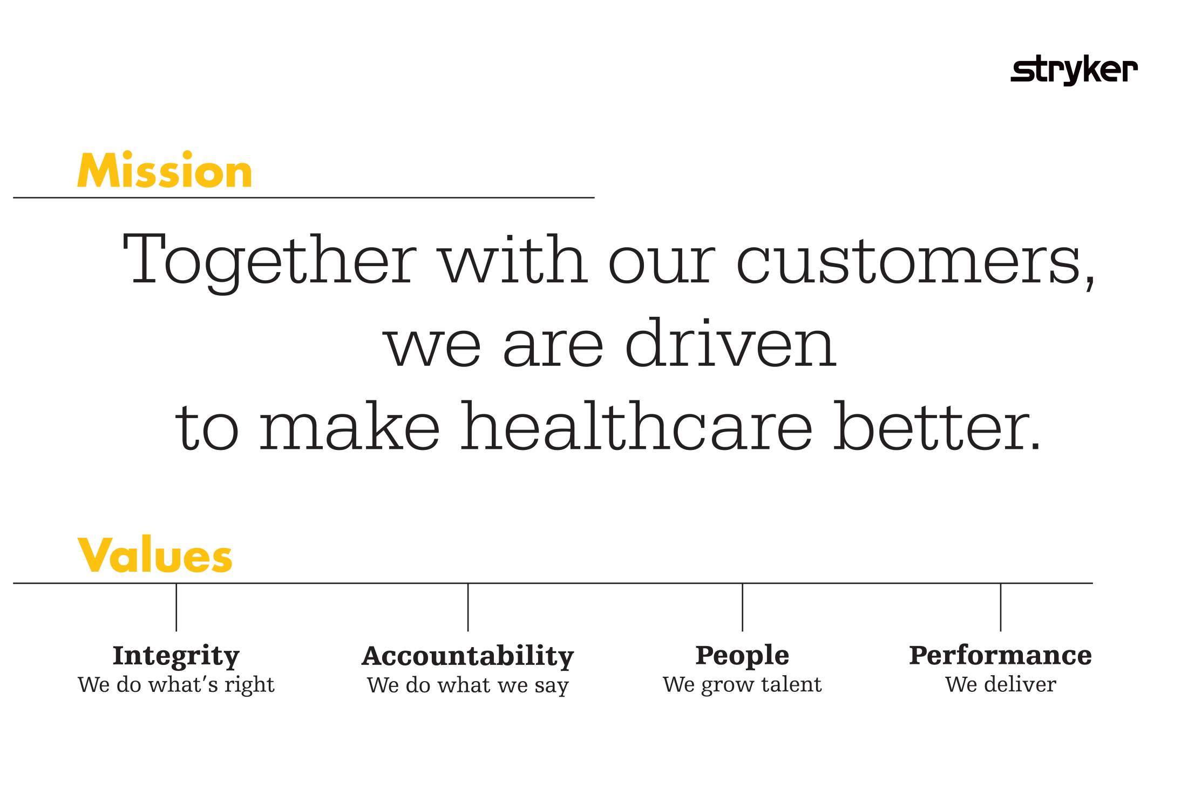
Notes:
Stryker’s mission is together with our customers, we are driven to make healthcare better. Early on I could clearly see how sustainability can align with this mission. To make healthcare better, Stryker must include the health of the environment in their actions since the health of the environment is directly connected to the health of the population. Physicians, surgeons and healthcare providers take an hypocritic oath to “first do no harm”, so to be fully aligned with customers, Stryker must make business decision that support environmental health.

Slide 4

Our vision - Who do we want to be?
To be the leading provider of sustainability
solutions in the global healthcare market.
Notes:
Through the actions of the division SSS strives to be the leading provider of sustainability solutions in the global healthcare market
It has been shown time and time again that those who are leaders in environmental sustainability are best positioned to realize corporate financial performance.
The problem we face today is that we do not use sustainability as a strategy in our organization and view it as an ad hoc initiative.

Slide 5

Opportunity
Notes:
What the vision and mission of the organization showed me was that there was an endless sea of opportunity. There was a glaring gap between what SSS was promoting to its customers and the every day business actions of the organization. If we could harness sustainably and use it as a strategic lens then it could help us become financially viable, increase engagement, strengthen our offering and create a competitive advantage.

Slide 6






J&J, Medtronic, Boston Scientific
vs. Stryker
ESTABLISHED FORWARD-LOOKING
SUSTAINABILITY GOALS
PUBLISH ANNUAL CORPORATE
SUSTAINABILITY PERFORMANCE REPORT
MEASURE AND AUDIT INFORMATION
RELATED TO SUPPLIER SUSTAINABILITY
ASSIGN RESPONSIBILITY FOR SUSTAINABILITY
TO THE BOARD OF DIRECTORS
FORM SEPARATE BOARD COMMITTEES
FOR SUSTAINABILITY
MAKE EXECUTIVE COMPENSATION A
FUNCTION OF ESG PERFORMANCE
Notes:
The first step in my journey to creating, implementing and maintain a sustainably charter that outlined goals for the organization to achieve by 2025 was doing extensive research. Research on the industry, the landscape, our competitors and other organizations that had the whole “sustainability” thing down. What I found was surprising. I learned that Stryker was lagging behind some of our biggest competitors. I learned that many other manufacturing businesses had been harnessing sustainability for decades. And most importantly I learned tactics and strategies to their success. The research was a critical step in the foundation of the sustainability charter, and it helped me get a better understanding of what was possible.
Understanding what issues were material for the industry proved to be a good basis for the goals and ensured that they would make the biggest impact. According to the Sustainability Accounting Standards Board (SASB), the material issues for healthcare manufacturers are energy, water, waste, chemicals, supply chain, and emissions (Lavigne-Delville, 2017). After conducting extensive research it was clear where SSS should focus its time and energy towards.
Reference: Lavigne-Delville, J. (2017). The Jury is In: Materiality Matters. The Sustainable Accountings Standards Board (SASB).

Slide 7




Creating the
sustainability charter
Resource efficiency
Process improvement
People development
Water
Waste
Energy
Chemicals
Design
Supply chain
Logistics
Training
Health and wellbeing
Notes:
Next, I had to create the charter. Having worked with a Sustainability consultant prior, I contacted them and asked for help developing a charter for the organization. After understanding SSS’s needs and wants, we were able to work collaboratively and outline the basis of the charter with year one recommendations for completing the goals. It was important to make sure the environmental goals in the charter were science-based and feasible for the organization to achieve. After I received that charter in a draft form, I socialized it with key individuals. Getting people exposed to the charter allowed them to have inputs into forming it and make suggestions. Having a cohesive plan and roadmap for the organization made the strategy tangible for others and aided in building a coalition.

Slide 8

Building
a coalition
Notes:
One of the most impactful steps of this initiative was building a coalition of employees and leaders who believed in the charter and would be champions for it. Picking people who had a lot of influence, were well respected, and passionate about sustainability led to the formation of the coalition. In an interview with Estrada, it was voiced that establishing a well-rounded coalition for an initiative will be instrumental in its success and allow progress to be made (n.d.). The Green Team at SSS served as a solid basis for the coalition. As mentioned previously, this team is comprised of passionate individuals who are dedicated to driving sustainable initiatives within the business. The executive sponsor of this team is the VP of Compliance, who sits on the Senior Leadership Team (SLT). Since she is a part of SLT, she has a lot of influence and decision-making power and is very passionate about the environment. Including the VP of Compliance in the coalition created a voice at the table with the Senior Leadership Team. After talking about the charter openly with employees at SSS, it was amazing how many individuals showed interest in the initiative and wanted to help. Having a diverse group allowed us to identify any areas for opportunity within the different departments.
Once the coalition was established, empowering them to take action was the next step. The coalition was filled with employees who naturally like to think creatively and outside the box. Those in Research and Development proved to the organization that when they use sustainability and innovation, they are more engaged and, therefore, complete projects faster. Another tactic that was explored was aligning the vision of the charter with the goals of the people in the coalition. By connecting the influencers and decision-makers ' goals to the sustainability charter, it made the path forward easier.
Reference: Estrada, L. (n.d.) Empower others to act. [Video File]. Retrieve from: https://asu.instructure.com/courses/24068/pages/module-3-viewings?module_item_id=2094955

Slide 9

Stakeholder
management
Notes:
Before presenting the charter to the Senior Leadership Team, stakeholder management meetings were conducted with each key stakeholder. The leaders that needed to be bought into the initiative for it to be implemented were the Senior Director of Marketing, Senior Director of Finance, Senior Director of Sales, Senior Director of HR, Senior Director of Operations, VP Customer Excellence, and the President. According to Scott and Esteves, there are five phases of sustainability adoption – not aware, waking up, compliance, operational efficiency, and strategic engagement (2013). While SSS and the stakeholders are typically within compliance, many were not aware of how sustainability could be used as a strategic tool and help them win as an organization. During the stakeholder management meetings, I discussed how sustainability could be harnessed as a strategic lens for the organization and what the financial benefit it brought. Bringing awareness and allowing them to wake up and realize the potential of sustainability was fundamental for their support. Ultimately, getting SSS to strategic engagement was the goal of the sustainability charter.
These stakeholder management meetings were very beneficial for both myself and the leaders of the organization. The meeting allowed the leaders to see the content before the presentation and could voice concerns or questions that I could address 1:1 with them. It also helped me identify where any gaps in the project were and allowed me to address them before the final presentation.
Resource: Scott, C., & Esteves, T. (2013). Leadership for Sustainability and Change.

Slide 10
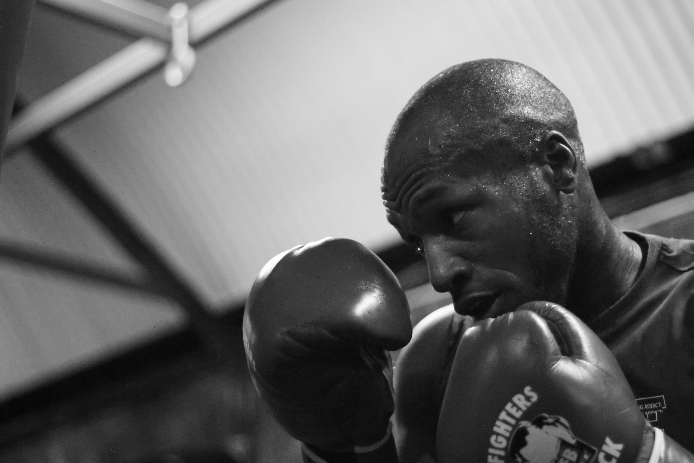
Preparation
Notes:
Extensive preparation was conducted to prepare for the Special Action Review (SAR) meeting, where I presented to the entire Senior Leadership Team. Making sure the presentation was constructed in a powerful, captivating, and engaging way was essential to capture the attention of the audience. Using lots of imagery to convey the message made the audience focus on what I was saying instead of reading words on a slide. Additionally, I practiced the presentation many times to ensure that I knew exactly what I was going to say.
To increase my influence during the presentation, two Directors of Marketing presented with me and spoke to different sections of the presentation. This brought a heightened sense of authority to the material, and the Senior Leaders knew that if the Directors of Marketing were presenting that they believed in it. Using my network, I received help from many departments to build out the presentation. For the financial ROI slides, I leveraged my relationships within Finance and Sourcing to create a five-year financial return. My audience was very data-driven and loved to see numbers, so knowing this, I made sure to illustrate what the economic impact would be. Understanding my audience allowed me to build a presentation that would garner the best results.

Slide 11

The BIG presentation
Notes:
The presentation was held on Earth Day, which added extra emphasis to the importance of sustainability. Right before the presentation I made sure my head was clear and took a few deep breaths to calm my nerves. During the presentation, it was communicated that a Sustainability Specialist position would need to be created in order for the successful implementation and continuation of the sustainability charter. Emphasis was put on how this new Sustainability Specialist would need to “read and predict through complexity, think through complex problems, engage groups in dynamic adaptive organizational change and have the emotional intelligent to adaptively engage with their own emotions associate with complex problem solving” (Metcalf & Benn, 2012).
Showing a commitment through signing the charter and creating the Sustainability Specialist job allowed the Senior Leadership Team to have a comprehensive strategy and someone to oversee the success of it. The meeting was only an hour-long, so I made sure the content of the presentation lasted 45 minutes and left 15 minutes for discussion and questions. Throughout the presentation, I engaged the audience by asking them specific questions and their opinions on topics. This helped the flow of the presentation and made the audience actively listen.
Reference: Metcalf, L., & Benn, S. (2012). Leadership for Sustainability: An Evolution of Leadership Ability. Journal of Business Ethics, 112(3), 369–384. doi: 10.1007/s10551-012-1278-6

Slide 12

Implementation
Notes:
After the SAR meeting, a follow-up meeting was requested to go into details of the year one ROI. This allowed the Senior Leadership Team to understand what the specific financial commitments would be and the return they would expect to see in year one. Since they wanted to see returns fairly quickly, it was best to focus on optimizing efficiencies with energy consumption.
After deliberation, the Senior Leadership Team decided open and fill the Sustainability Specialist role which I applied for and received. After I was in my new role for a a few weeks the Leadership team agreed to have me finalize and oversee a five-year sustainability strategy for the organization. Since these major decisions did not happen quickly, I made sure to stay connected with the Leadership team to make sure this initiative stayed relevant and top of mind. Once I filled the Sustainability Specialist role, the President of the company announced that sustainability was going to be a major strategic imperative for the organization which energized the entire organization.

Slide 13

Takeaways
Notes:
Creating, implementing, and maintaining a company-wide sustainability charter at a large organization does not happen overnight. It takes time, patience, know-how, networks, and grit to bring it to fruition. Staying the course and remembering the WHY of the initiative makes it all worthwhile. Sustainability is not a comfortable journey, but it is one that is rewarding beyond expectations.

