Slide 1

integrating agriculture into state climate EFFORTS
CULMINATING EXPERIENCE PRESENTATION
Anna Harmon, MSUS 2019

Slide 2
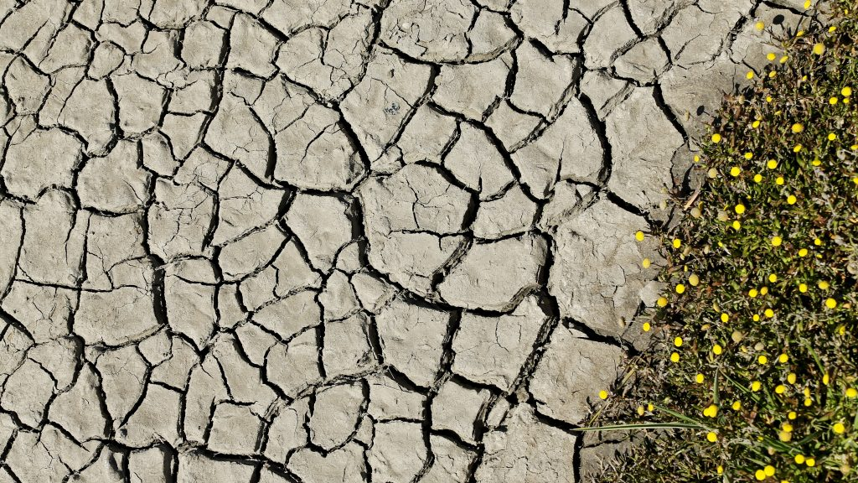
URGENT PROBLEM
CLIMATE
CHANGE
pbs.org/newshour/science/parts-california-begin-emerge-five-year-drought
Notes:
Urgent, has impacts across societies and generations, impacts ecosystems and livelihoods.

Slide 3
AGRICULTURE
CAUSE
VICTIM
PART OF SOLUTION
9% GHGs
in US (EPA)
Extreme heat
& weather, pests, drought (USDA)
250 million tons CO2/year sequestered in US (NAS)
+reduced GHG emissions

Slide 4


PROJECT
Phase 1 of an agricultural policy toolkit for U.S. states
Targeting state climate efforts
Partners:
Notes:
American farmland trust: “save the land that sustains us by protecting farmland, promoting sound farming practices, and keeping farmers on the land”
C-AGG: “works to create incentives and value for the agricultural sector to reduce greenhouse gas emissions and deliver ecosystem services at scale”

Slide 5
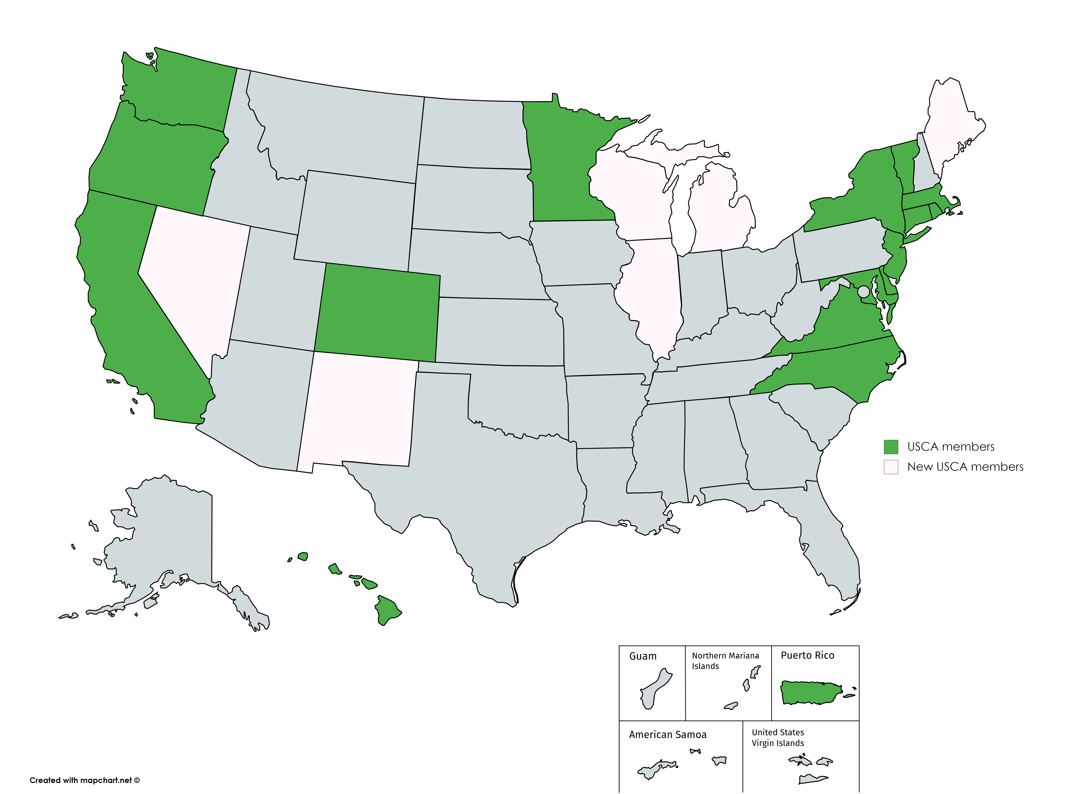
US CLIMATE ALLIANCE
U.S. Climate Alliance
  California
  Colorado
  Connecticut
  Delaware
  Hawaii
  Maryland
  Massachusetts
  Minnesota
  New Jersey
  New York
  North Carolina
  Oregon
  Puerto Rico
  Rhode Island
  Vermont
  Virginia
  Washington
  Original 17
  +6
Notes:
US Climate Alliance is committed to: Implement policies that advance the goals of the Paris Agreement, aiming to reduce greenhouse gas emission by at least 26-28 percent below 2005 levels by 2025,

Slide 6
TOOLKIT OVERVIEW
PROGRAM & POLICY OPPORTUNITIES
state, regional, federal
FUNDING OPPORTUNITIES
federal, private sector
QUANTIFICATION TOOLS
& METHODOLOGIES
overview, assessment
PHASE 1
PHASE 2
ONGOING: WRI

Slide 7
DELIVERABLES
Toolkit outline
Toolkit protocol
State profiles for 14 Alliance members
Comparative assessment (15 members)
Notes:
Initial deliverables determined by my interest in stakeholder engagement: state profiles, a comparative assessment, and interviews. I also committed to keeping a running list of “Toolkit 2.0” ideas, which also informed a toolkit outline. In the end my deliverables were an interview guide, fourteen state profiles, an initial comparative assessment of programs based on those profiles, the Toolkit 2.0 list, a toolkit outline, and a toolkit protocol to support the toolkit’s development going forward. The state profiles and comparative assessment are essential elements of the toolkit’s first phase.

Slide 8
State Profiles
DELIVERABLES :
Create baseline of what exists at each state
Example: Colorado
76 conservation districts, Colorado Carbon Fund, Colorado State University
Agricultural Energy Efficiency Program, Water Plan Grant Fund Program
State background: 31.8M acres, cattle & small grains, drought and other water impacts predicted
State Profiles
Refine and Update Profiles
Data Analysis
Draft Toolkit 1.0
Interviews with State Teams
Notes:
CA: 11 pages
PR: 3 pages
Water Plan Grant Fund—not much in terms of BMPS, but could be; room for growth on grasslands

Slide 9
Initial Results of Comparison
DELIVERABLES :
Notes:
Mention interview with NY, how climate resiliency program was a big part of conversation

Slide 10
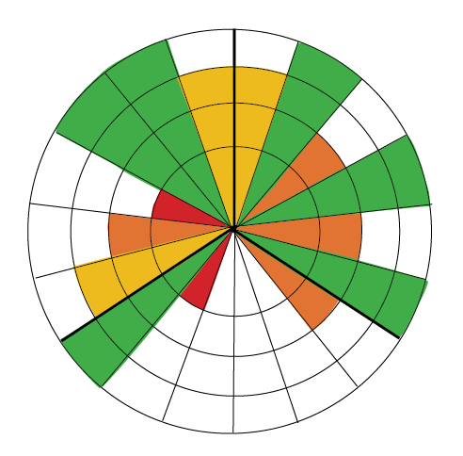
Highlights
ASSESSMENT :
Economics
Environment
“Circles of Sustainability” framework
Strongest in Environment, Economics, then Society
Recommendations: other stakeholders, representation in case studies, local food
Society (Politics & Culture)
Notes:
Weaknesses: Representation & Negotiation, Identity & Engagement, Gender & Diversity, Generations, Labor & Welfare
+reach out to additional stakeholders not already at the table
+case study w/ program engaging farmers of color, new farmers, or women farmers
+transportation, local food
Consider inclusion, disproportionate benefits … enclosure of the commons or disproportionately benefit one group
Re: built form & transport and biodiversity: consider it

Slide 11
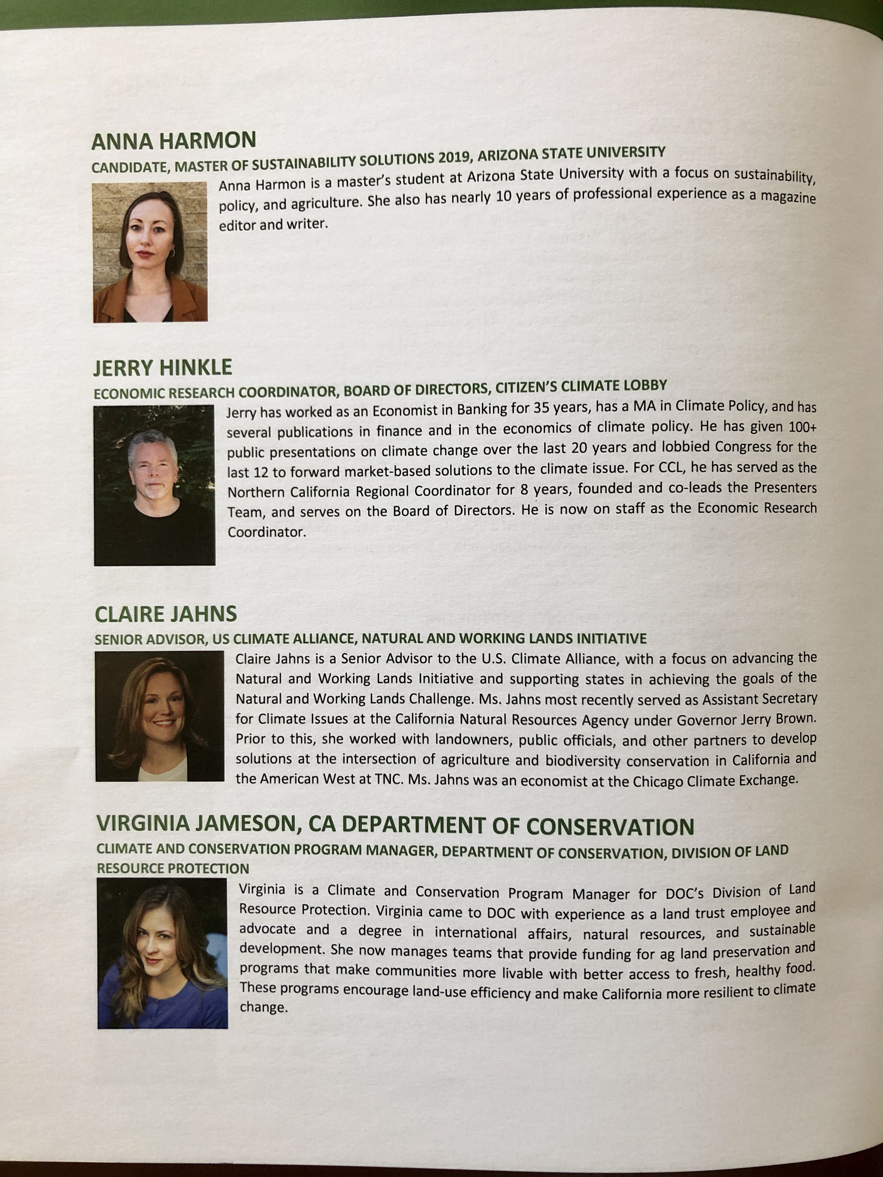
EXPERIENCE
Helped initiate and contribute to a multi-partner, nearly national project
Be flexible
Strive to maintain and communicate vision, manageable scope
Consider expertise and audience of new collaborators
Pursue stakeholder engagement and feedback
Notes:
A decent amount of time dedicated to phone calls, emails, setting groundwork, and research for a strong foundation. indicative of the start of any project.
Be flexible: at start, but also as stakeholders come on board
Alliance improved deliverables and provided motivated direct audience

Slide 12
FUTURE WORK
Social sustainability
Regenerative agriculture, forestry
Completing toolkit
Notes:
focus on final steps such as design, communication, distribution, and engagement.
for students also interested in soil carbon sequestration: regenerative agriculture and forestry for carbon sequestration

Slide 13
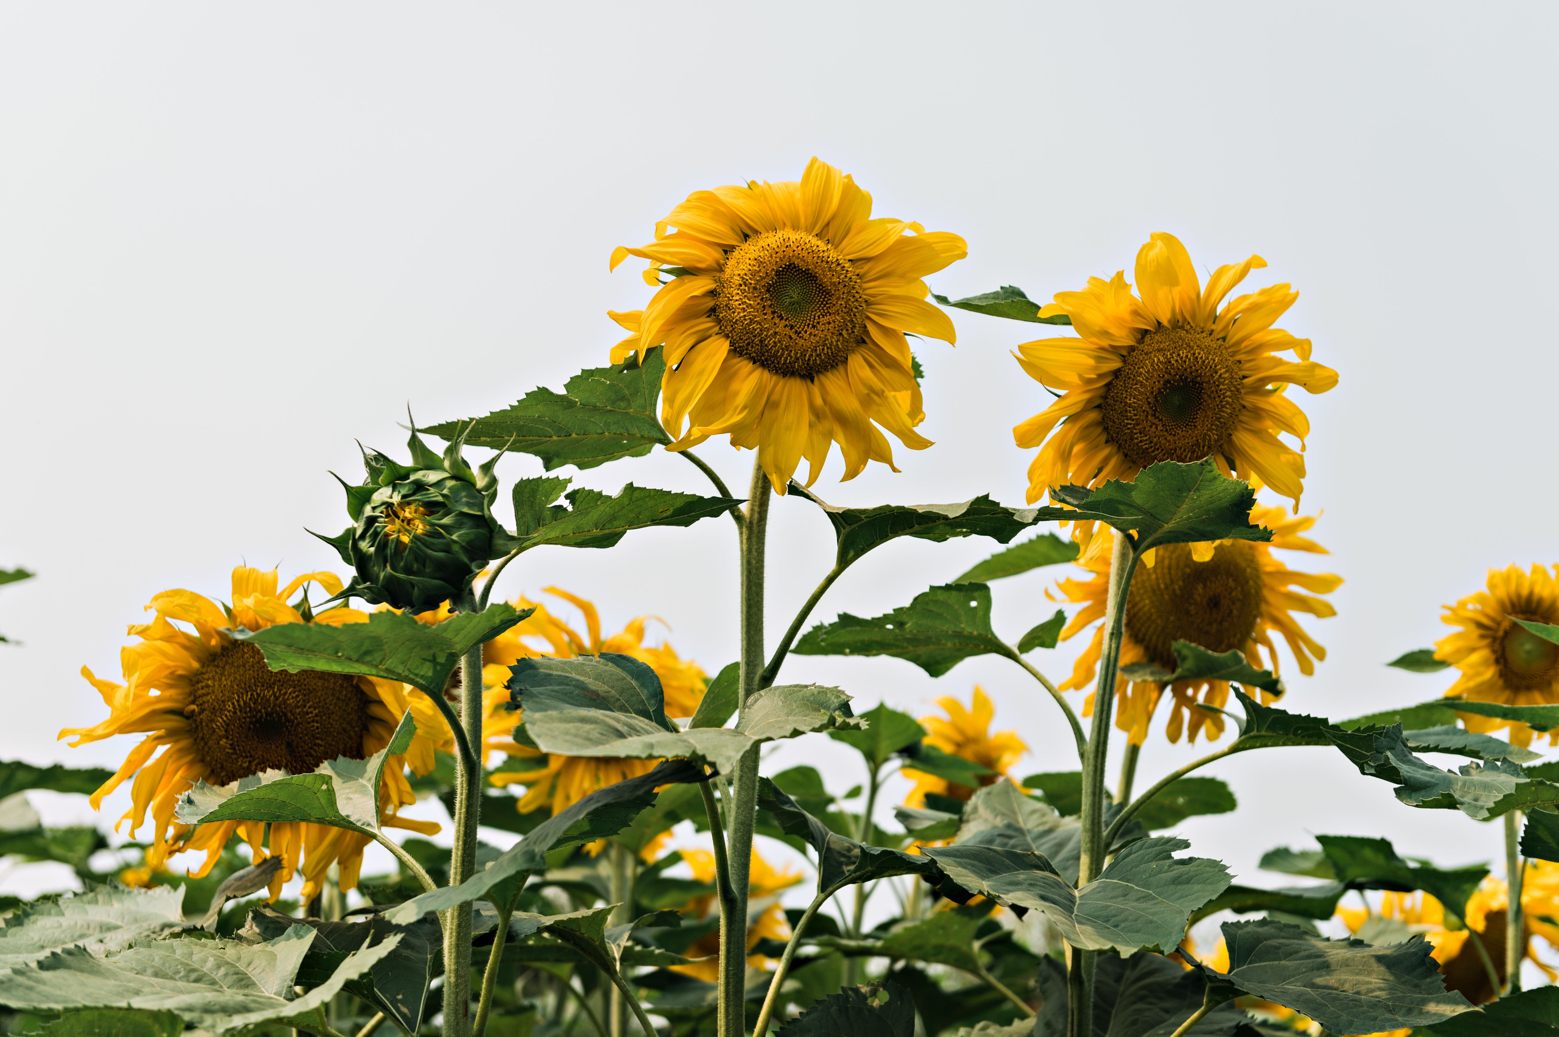
CONCLUSION
THANK YOU
aharmon3@asu.edu
flickr.com/photos/usdagov
Notes:
https://www.flickr.com/photos/usdagov

