Slide 1

MSUS Culminating Experience Presentation
Engaging with Food Recovery
at Devour Culinary Classic
Lexie Fields-Austin
Spring 2019

Slide 2
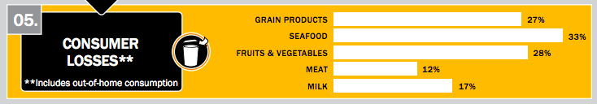
Our Food System is Wasteful
40-50% of all food in the supply chain goes uneaten
Americans are throwing out the equivalent of $165 billion each year
Reducing food losses by 15% could feed 25 million every year
60% of food waste comes from the consumer side,including restaurants
Notes:
Approximately 4 to 10 percent of food purchased by restaurants becomes kitchen loss, both edible and inedible, before reaching the consumer.57 Another significant portion is served but never eaten. Other drivers of waste in food service include large portions, inflexibility of chain-store management, and pressure to maintain enough food supply to offer extensive menu choices at all times.58 In addition, staff behavior and kitchen culture can contribute to food waste. Plate waste is a significant contributor to losses

Slide 3
Sustainability Problems:
Food Waste contributes to:
Methane emissions
Landfill size
Increased energy, water, land used in food production
Meanwhile, one in six Americans lack a secure supply of food to their tables
Notes:
16 of methane emissions!!!!!

Slide 4
Project Questions
How can we use excess food as an input to feed hungry people?
Is there a way to reach a large number of restaurants at once?
What impact can we acheive from food festivals?
Notes:
16 of methane emissions!!!!!

Slide 5
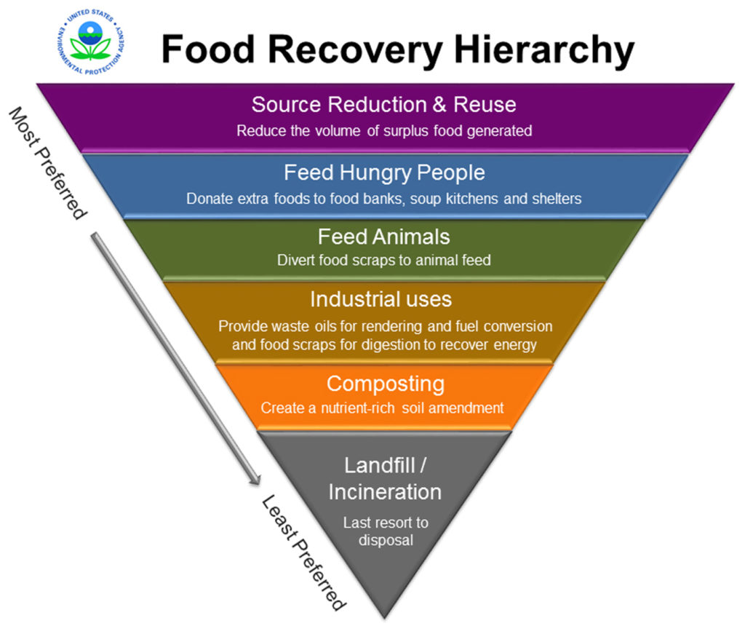
Food Recovery is...
collecting unspoiled, healthy food and donating it to our neighbors in need
feeding people
supporting local communities
saving money

Slide 6
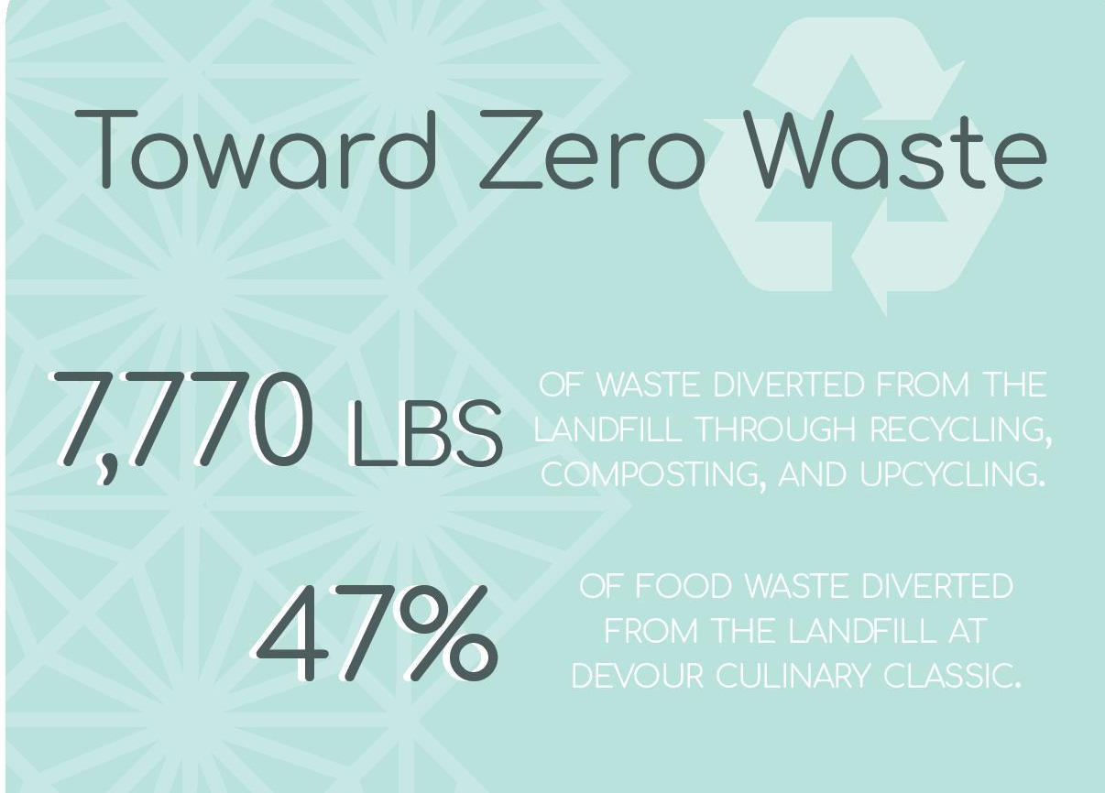

Creating change at food festivals

Slide 7
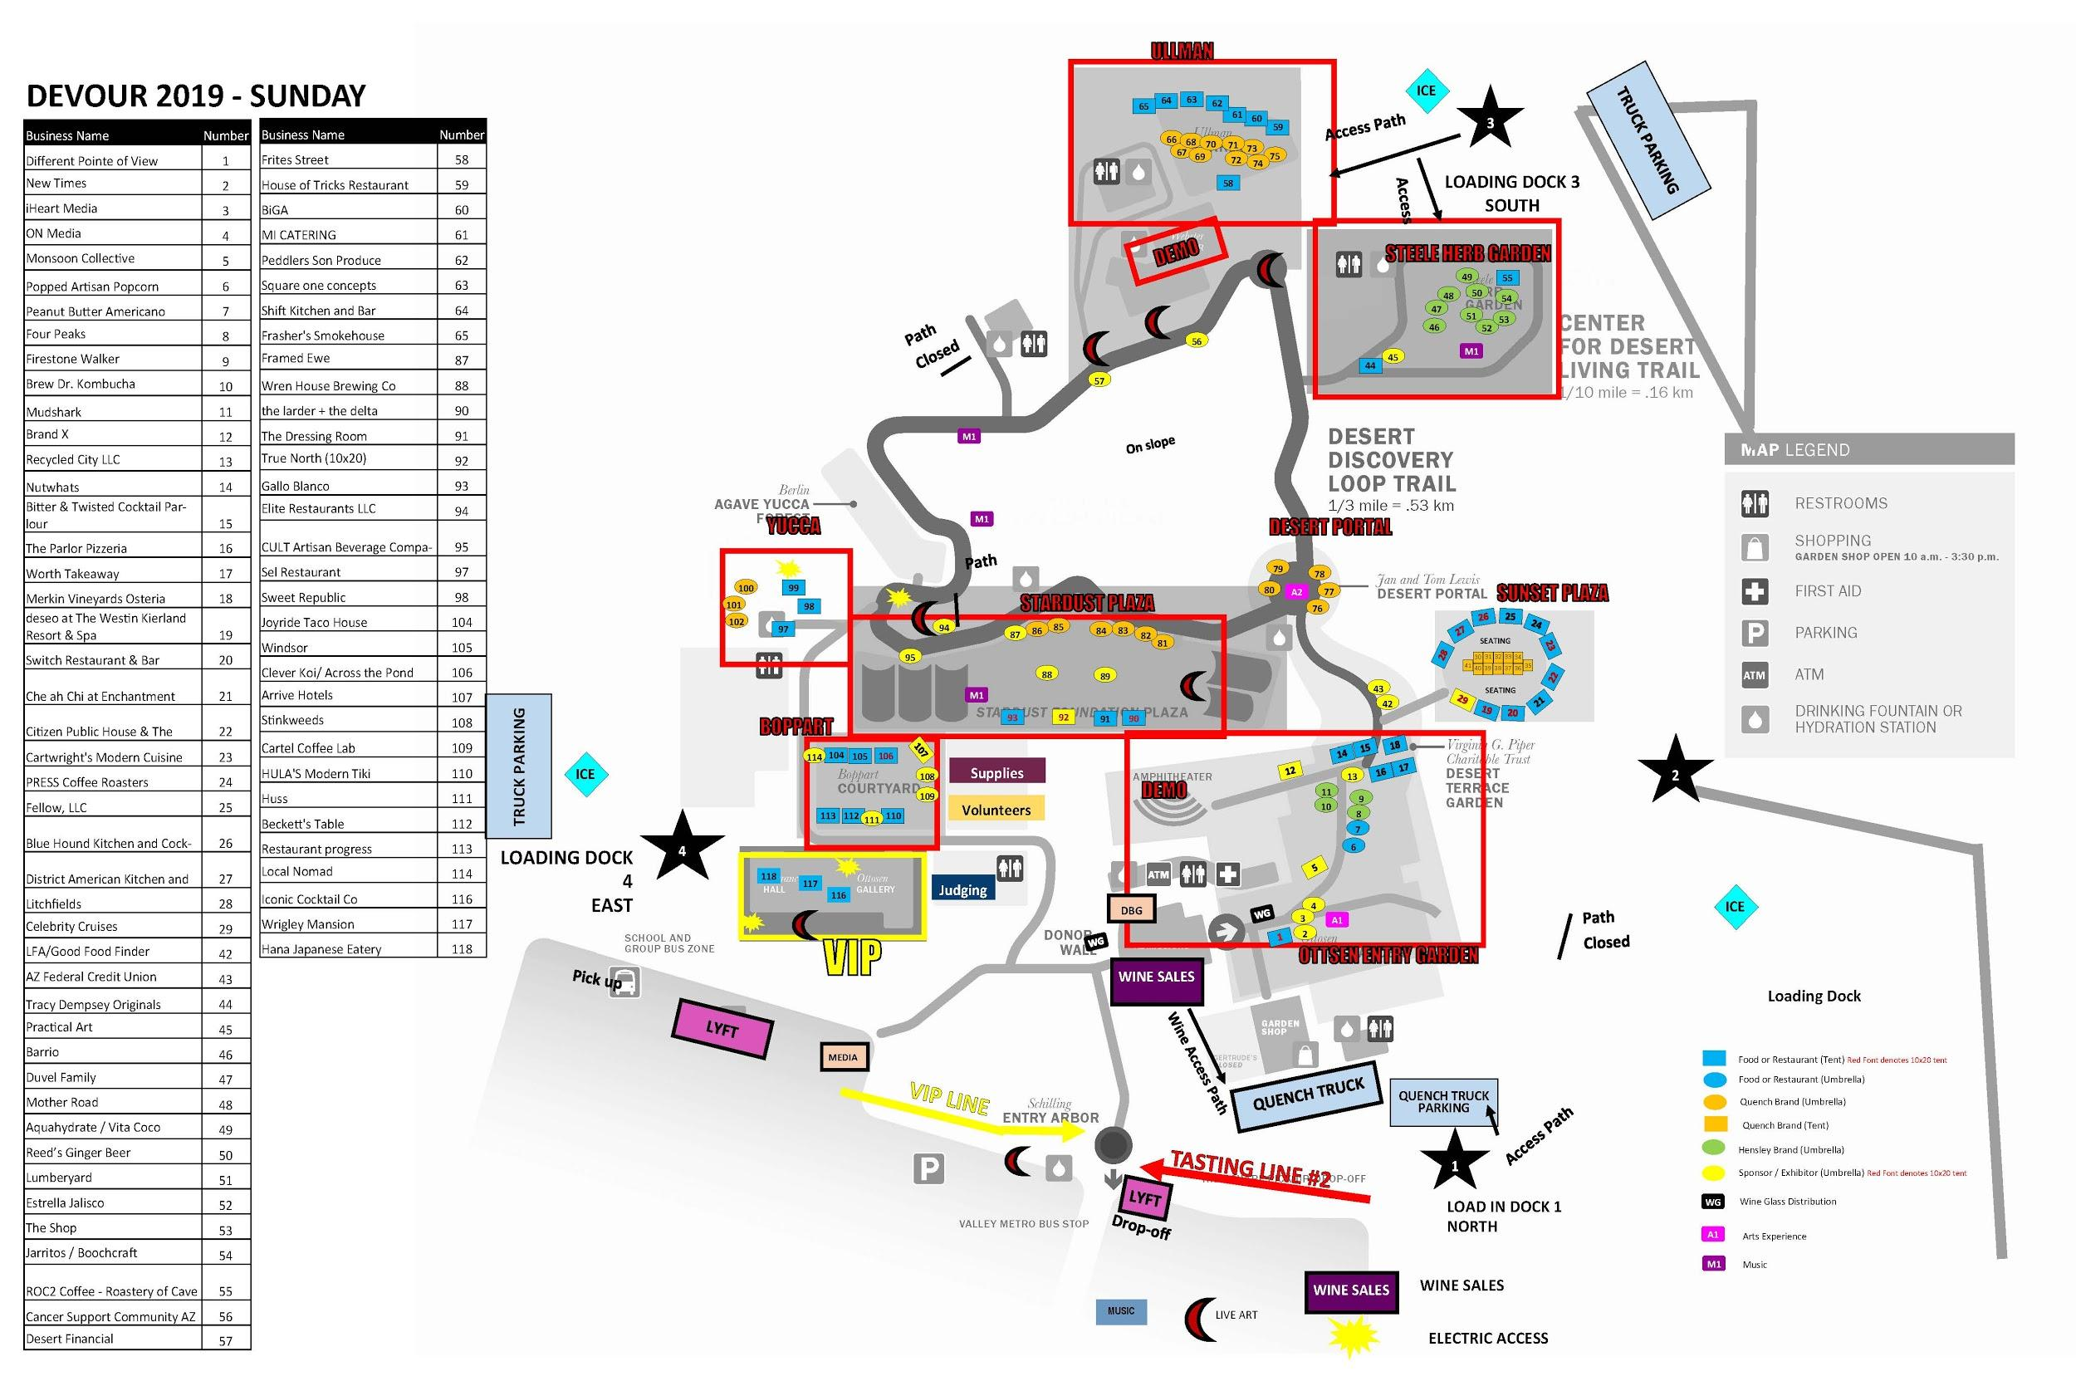
Managing the Project
Planning for the Unexpected
Restaurants cancelling due to bad weather
Bees
No dedicated supply cart
Volunteer dropouts

Slide 8




Partnerships for Success
Engaged with over 70 restaurants at the event
Notes:
pluralistic Jewish group that provides a forum for Jews in Arizona to collaborate and foster social justice within the state

Slide 9
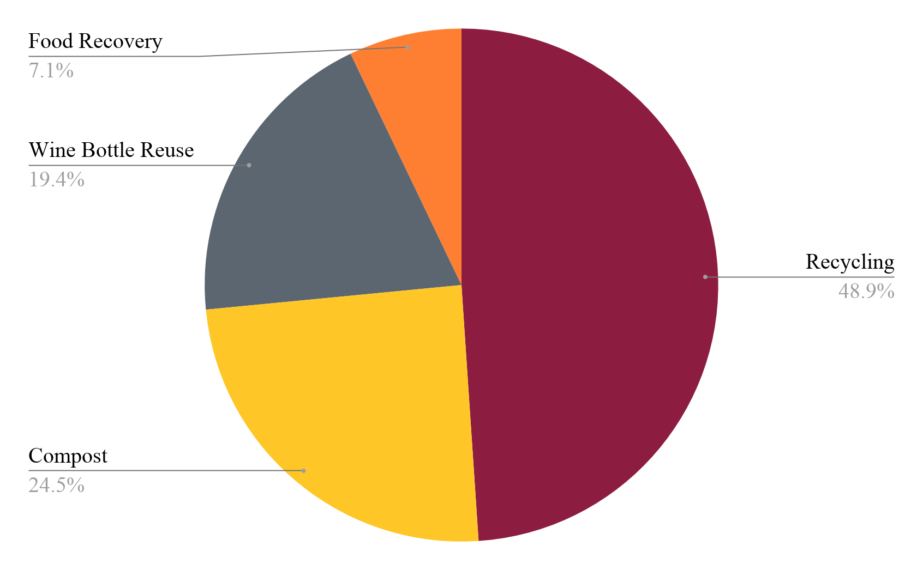
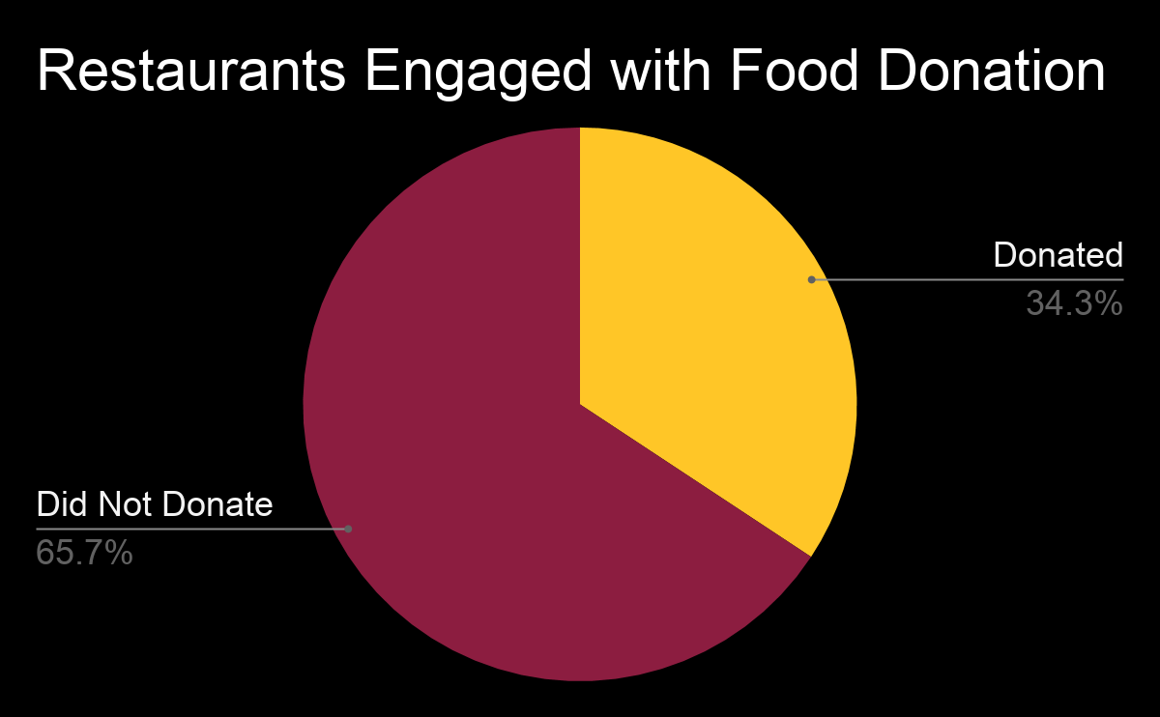
Outcomes
Total Waste: 15570 lbs
Total Waste Diverted: 7030 lbs
45%
Total Food Donated: 500 lbs
431 lbs C02-e or 2.5% of the average American household’s food consumption

Slide 10
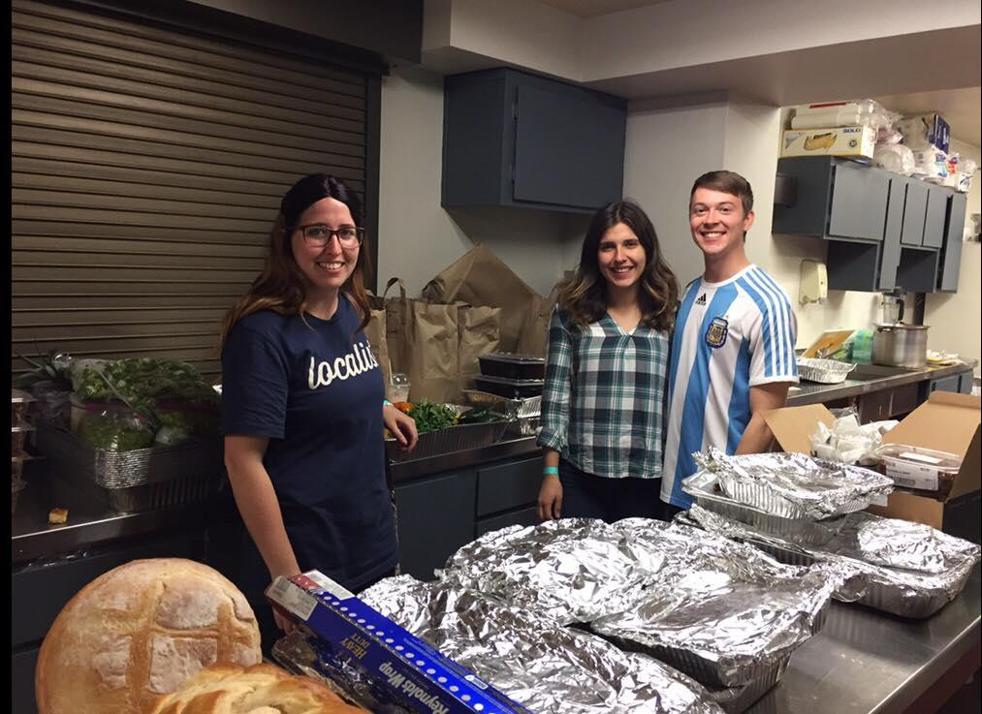
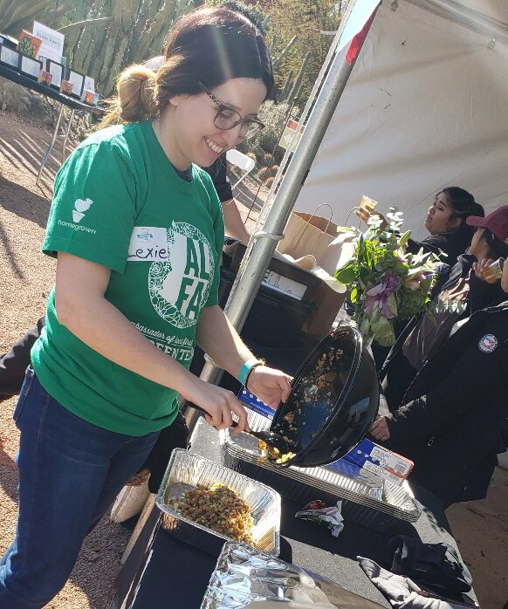
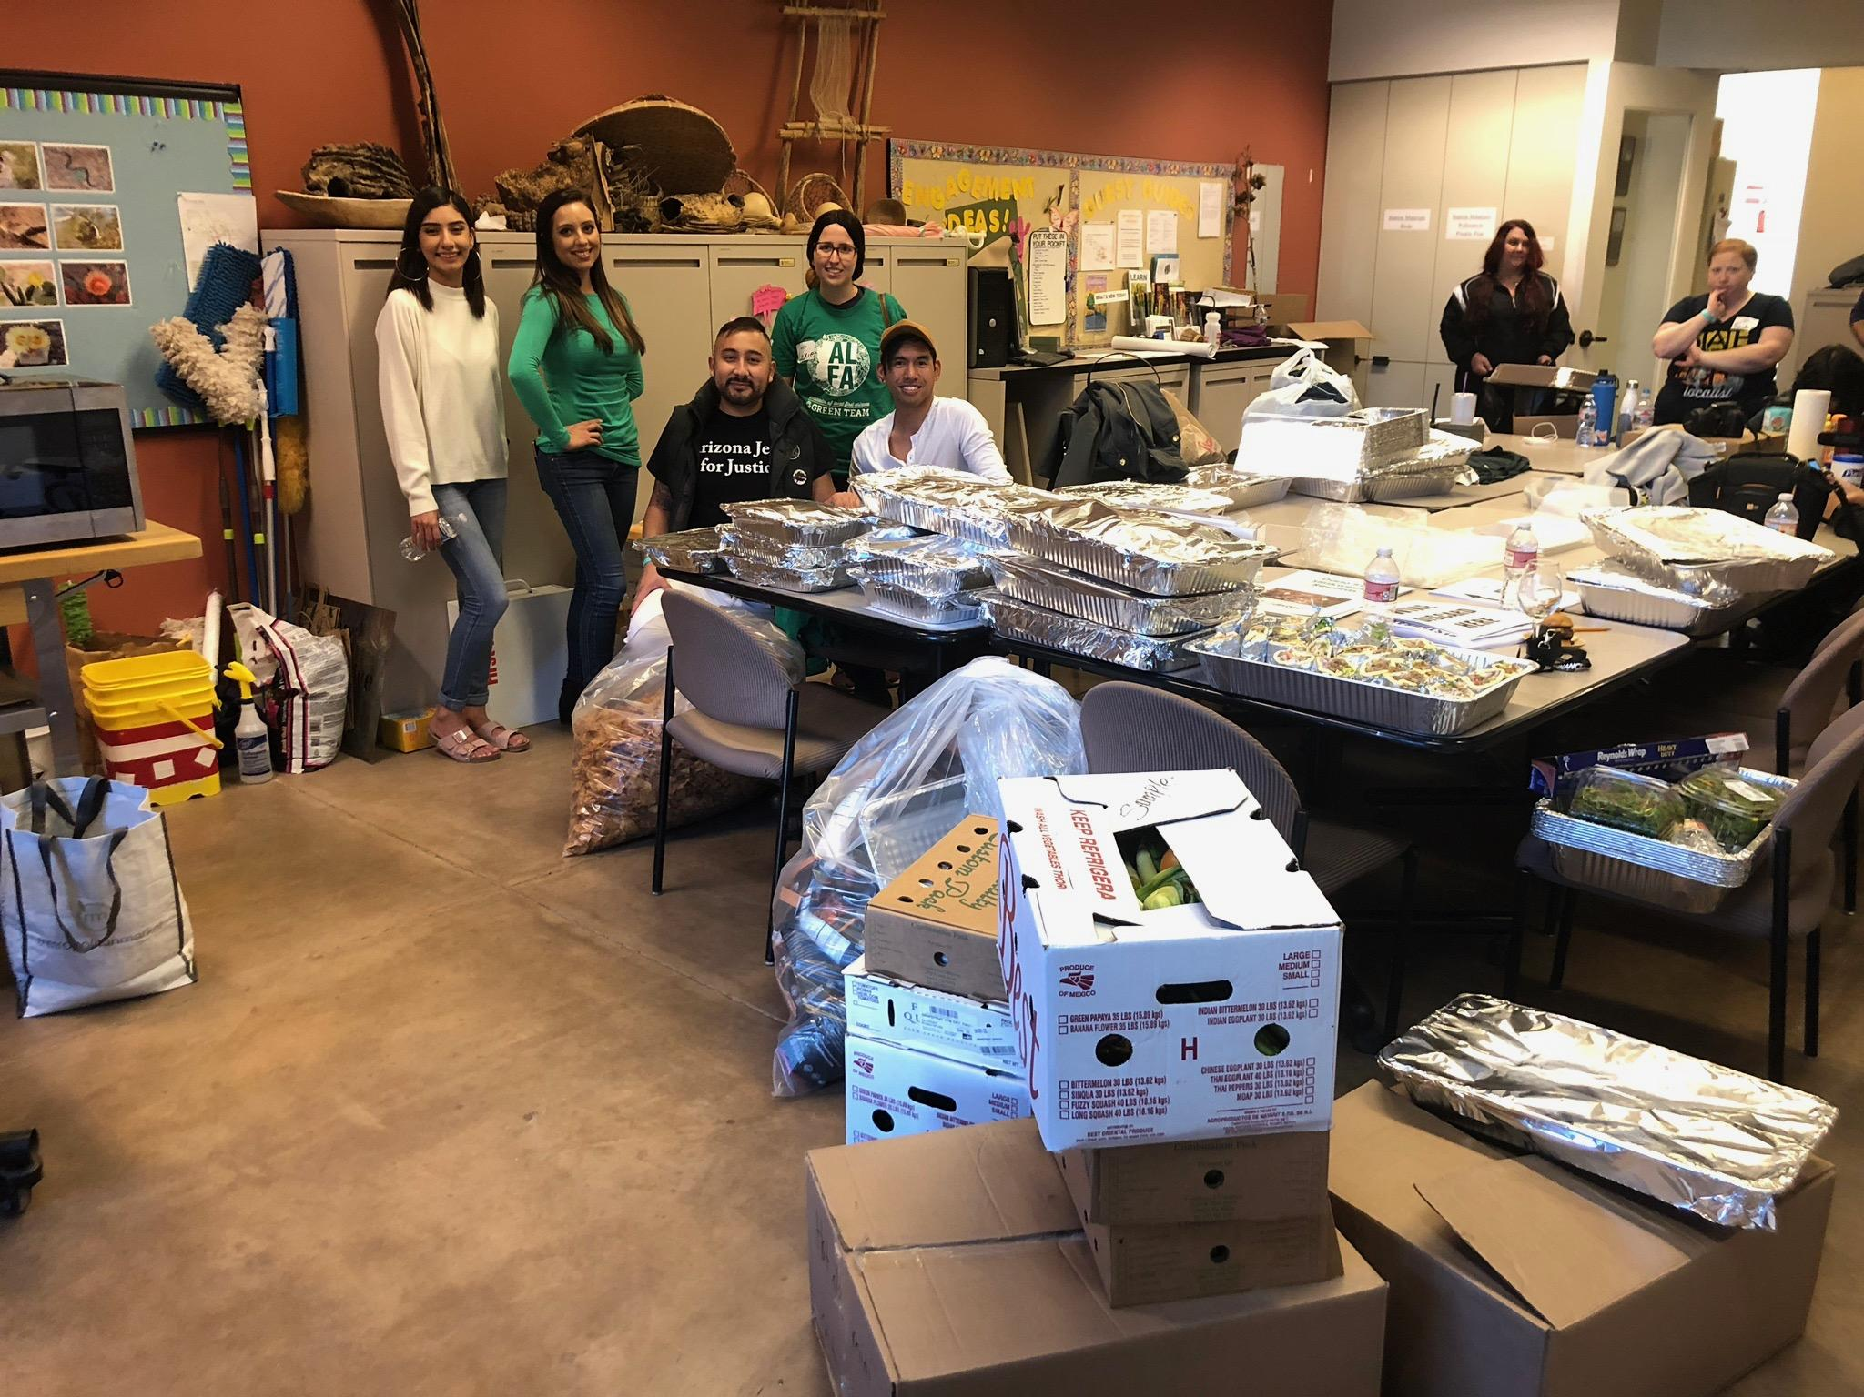
Outcomes
Provided food for over 100 refugees recently released from ICE care
Supplied approximately 6 meals (3 meals/day for 2 days)
Save AJJ $5,000 on food costs

Slide 11
Zero Waste Events
Overall Impact
Overview of results
Reasons for non-participation
Percentage of waste
Client Recommendation Categories
Organizational Structure
Logistics
Communication
Financial
Marketing
Sustainability
Work Breakdown Structure
How to implement this project in future years

Slide 12
Recommendations
Organization and Logistic | Marketing | Communication | Financial | Sustainability
Integrate food recovery into Green Team Activities | Give restaurants who donate a sticker on DCC website | Ensure a dedicated walkie-talkie to food recovery lead | Find partners willing to make in-kind donations | Invest in reusable dishes and lids
Ensure dedicated cart for transportation | Give restaurants who donate a DCC/LFA sticker to go on their website | Ensure all volunteers have the project lead’s phone number |  | Use partners close to the event to minimize transportation impacts
Ensure access to loading dock | Take pictures of the recovered food for promotional purposes

Slide 13
Educating Restaurants
Diffusion of Innovation
Information, Capital, Skills, Education
Bill Emerson Good Samaritan Food Act
Removes liability from restaurants who donate food
Restaurants and chefs do not know their protections

Slide 14
Educating Restaurants
Food Pantries vs. Soup Kitchens
Food pantries accept non-perishable goods
Soup kitchens and shelters accept cooked food and premade meals
Infrastructure to Donate
Waste Not is a local non-profit that collects food from businesses to donate to shelters

Slide 15
Future Steps
Scale up food recovery at zero waste events
Partnerships with Local First Arizona, Desert Botanical Gardens, or AZBCA
Understanding barriers
Comprehensive data on barriers restaurants face
Create solutions to overcome those barriers

Slide 16
References:
https://www.nrdc.org/sites/default/files/wasted-food-IP.pdf
https://static1.squarespace.com/static/58e4061c197aea34f5405d98/t/596ff25ae45a7c43fc71be6d/1500508766281/DevourAnnualReport2017_FINAL2.pdf
https://www.epa.gov/sustainable-management-food/food-recovery-hierarchy
https://devourphoenix.com/images/devour-culinary-classic-logo.png
Thank you!
lfieldsa@asu.edu

