Slide 1
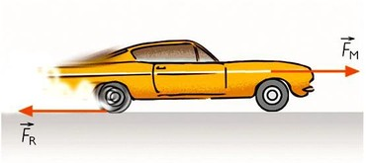
Driving Sustainable Behavior in the Office @
SOS 593 Spring 2019
David E Faught

Slide 2




Project Description and Sustainability Problem/Opportunity
Sustainability problem
Project Recap
How Sustainability Opportunity Addressed.
.

Slide 3
Outcomes
Survey Results
Metadata and Key Numbers
Analysis Strategy
Other Results
Focus Groups
Interview
How and Why
 | Job Role | Age Range | Time at ASU | Office Size
Definitely Yes | (Leadership) 31.82% | (55-65) 38.10% | (0-6 yr) 31.82% | (11-25) 40.91%
Probably Yes | (Other) 34.48%; (Supervisor) 27.59% | (26-34) 44.83% | (0-3 yr) 41.38% | (11-25) 37.93%
Maybe | (Other) 43.59%; (Supervisor) 28.21% | (26-34) 46.15% | (0-3 yr) 51.28% | (11-25) 48.72%
Probably Not | (Other) 54.55%; (Entry level) 27.27% | (26-34) 45.45% | (0-3 yr) 45.45% | (11-25) 40.91%
Definitely Not | 0 responses | 0 responses | 0 responses | 0 responses
Notes:
how I analyzed it (like qualtrics and what numbers tell us
then recommendations created

Slide 4
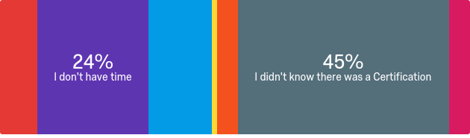
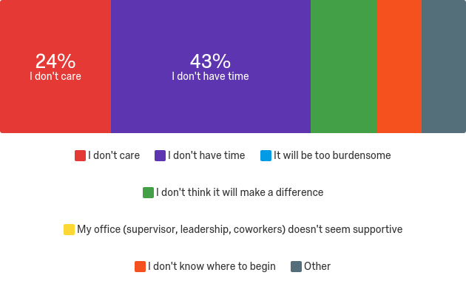
Outcomes Continued...
If interested, why haven’t you pursued yet?
If not interested, why?

Slide 5
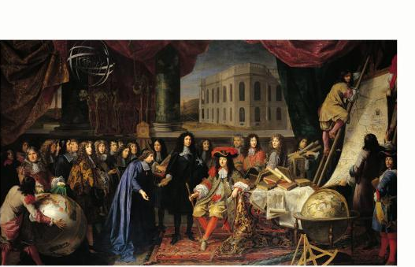
Conclusions:
Knowledge Gap
Uncertain Enthusiasm
Perception of Burden

Slide 6


Final Recommendations
and Future Actions for USP & ASU
Improve Survey Performance
Address Specific Audiences
Enhance Certification Performance
Conduct Formal Outreach
Educational Toolkit
Pursue Top Down Efforts
Miscellaneous
Where can future efforts build on my project?
Reaching the next level

Slide 7

What I learned and Final Takeaways
Lessons learned about the project and sustainability
Personal strengths and areas for improvement

Slide 8
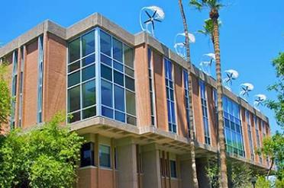
Thank you!
School of Sustainability

