Slide 1
Externalities
Revealing Hidden Natural Costs Through Legislation on Product Labeling
Bryan Armbrust

Slide 2


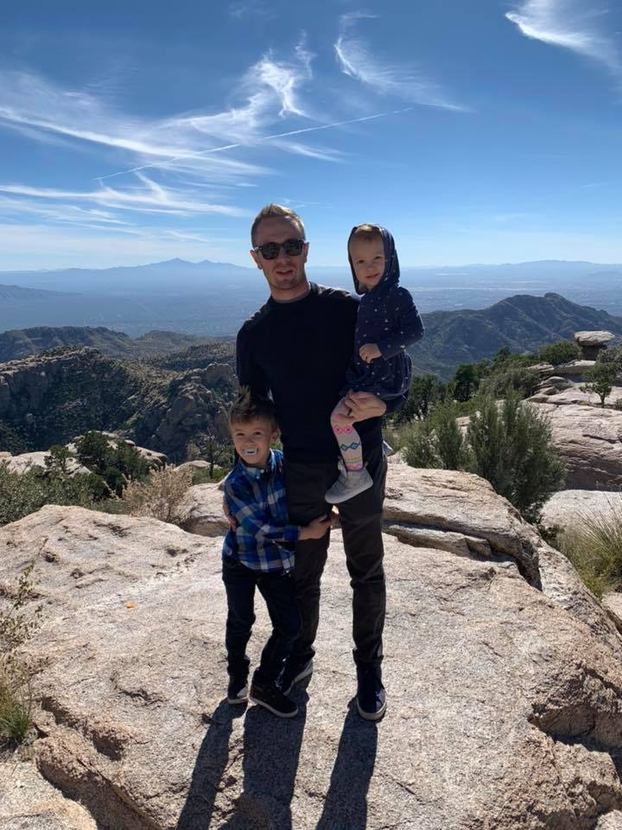


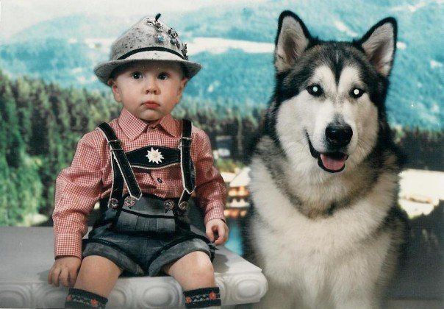

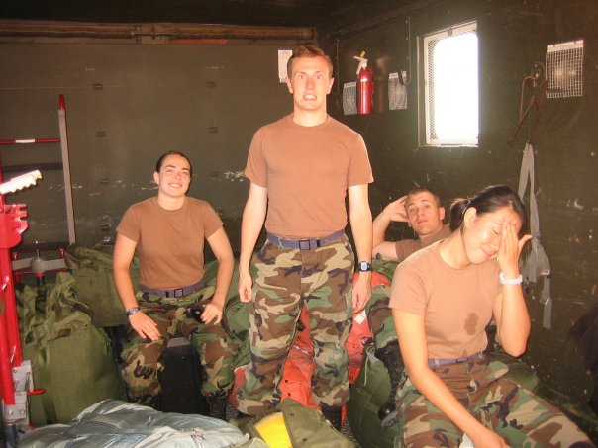
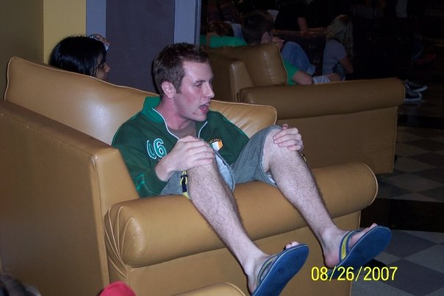


Who Am I
Notes:
Who is this guy, why am I talking to you today?
I have had a decently privileged life; I was afforded many opportunities and I breezed through much of school.
I didn’t take much seriously growing up, aside from my hobbies.
Even when I joined the workforce, I was still goofing around.
Things started to change as I grew, however. In 2013, my son was born.
This changed everything. I started to realize what was necessary as an adult, as a father, as a human.
I was starting to understand how I fit into the world around me. I couldn’t coast anymore. The life that had formerly been laid out before me now was following the path I chose.
In 2016, my daughter was born. Another layer of responsibility. My children’s names reflect how their existence guides my life. They provide the love and meaning I need to find my place in the world.
As they grow, I grow with them, always trying to better understand how we all fit together.
This brings me to today, a father of two, doing what I can to be good for and care for them.

Slide 3
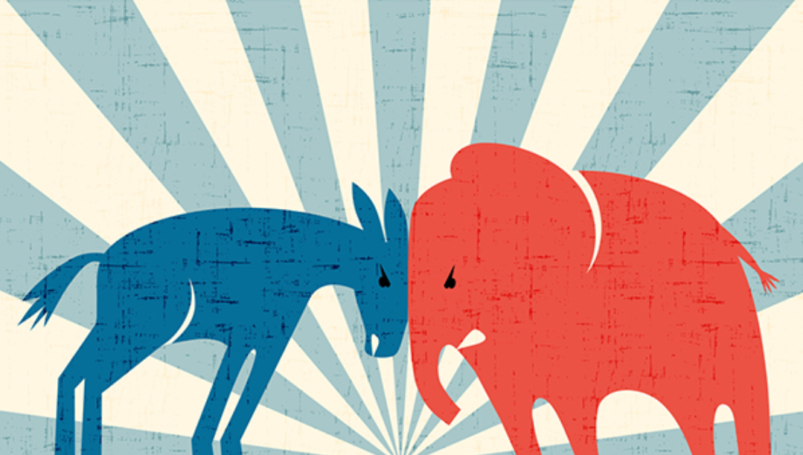

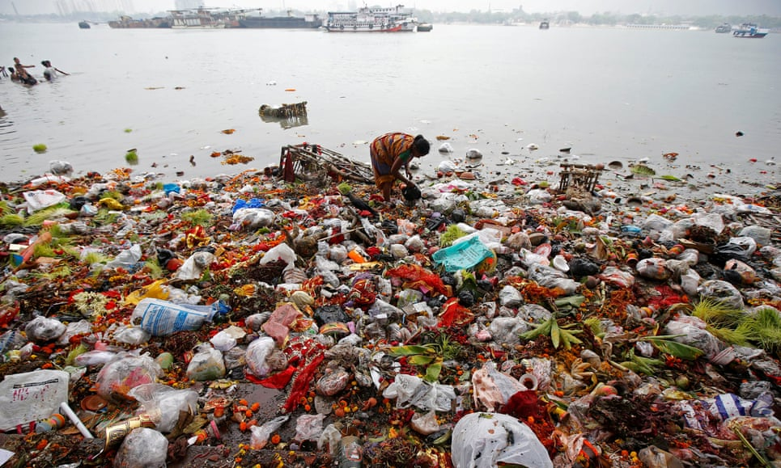

The Realization
2016… and since.
Notes:
It was in 2016, though, when I realized the universe doesn’t go according to any kind of “plan” at all.
As I watched our political system fray, it brought my attention ever more to the state of our environment, the world around us.
Disasters the world over and our absolute disregard for the biosphere. We are on track to end the Anthropocene, the age of man, with a mass extinction event and a hot house earth that could literally bring about the end of our species.
The more I learned the scarier it got and the more distressed and depressed I became, especially as I understood and still understand my role in life as a father.

Slide 4

Why Am I Talking To You
Notes:
But the world doesn’t stop turning. Time inexorably marches on. So why am I talking to you today? It took me some time, but I started to find my way out of the dark. I realized I can’t just fret. If I am going to be a productive human, I need to do something about it. I am not ok with those kids encountering that world, and if you have children and are listening to this, I don’t expect you do either.

Slide 5
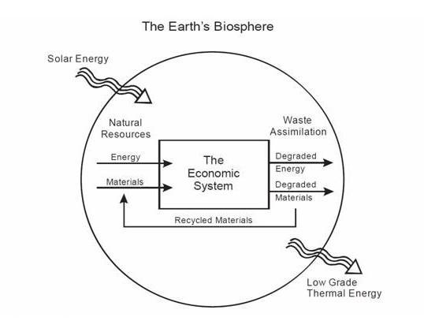
Problem
Externalities
Notes:
Through my research I have come to find that an ENORMOUS contributing factor to the state we find our environment in today is the concept of externalities. Aside from the energy from the sun and the gravity of the moon, the world and everything on and in it is a finite resource. The mortal sin is that many economic models do not properly account for the cost to the earth as we extract its resources for our use. They are calculated as a given. Greenhouse gases, effects to habitats and biodiversity, social implications of indigenous and disadvantaged populations, many of these costs are hidden, be it inadvertently or on purpose. Consumers know precious little of what goes into products and services. Production practices are largely opaque. Collectively speaking, we have very little understanding of interaction with the world around us, the hidden cost of our choices and purchases of products and services. As a result, our environment largely soaks up these costs.

Slide 6
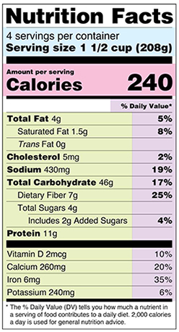

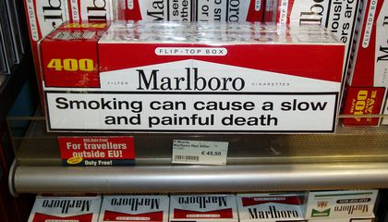
Solution
Reveal hidden costs; extinguish externalities
Enable consumers
Notes:
An ambitious systemic change must take place in how we consider the production of our products and services. We can only face these truths through education of consumers.
Only through transparency can we abolish the concept of externalities and understand the price of our planet and WE ultimately pay for our choices. We have to do away with the entire concept of externalities. This solution relies on hope and trust, that we as a species can take some measure of responsibility.
Here we get to a potential fork in the road of economic and political philosophy. People get jobs from businesses, and if we hamstring businesses, people ultimately suffer, right?
There are aspects of this that are true, but this is largely a myth. Are any of you familiar with the court cases involved in making tobacco companies take responsibility for their false advertising and the cancer and health issues that untold millions experienced through tobacco use? People still smoke, of course. We didn’t take away the freedom of choice. But now every time someone buys a packet of cigarettes, they are reminded of the potential results of their choice. An externality was vanquished. It ate into big tobacco’s profits, of course, but life continued, and many people’s actual LIVES continued as a result.
Does anyone do low carb diets? Keto, Atkins, that kind of thing? Look at these nutritional facts. Nutritional facts were not always required. And certain portions of the food economy take that to great advantage, especially the sugar industry. The food pyramid is nonsense, breakfast is not the “most important meal of the day,” and sugar is enormously addictive. The sugar industry and food industry have carried on just fine since we required nutrition facts, but now you and I can make a conscious decision towards safeguarding our health. Without these labels, we would have very little method of knowing what we are putting into our bodies. Entire industries have arisen through this simple process of labeling transparency.
Energy Star started with tracking and reducing energy consumption of computers in the US in 1992, and has since expanded worldwide to over 60 industries, saving over an estimated 150 million megatons of greenhouse gases annually. Everyone knows what Energy Star is, what it means, and that it is designed not only to save energy, but to put money back in the pockets of consumers.
Consumers are enabled when they know the true price (not only monetary) of goods and services, and what goes into them. Industry will carry on, people and the economy will still exist, but as it relates to the effects on our environment, we must identify, report and label all products and services to include what has been previously ignored through externalities. It will keep businesses accountable, as well as ourselves.

Slide 7

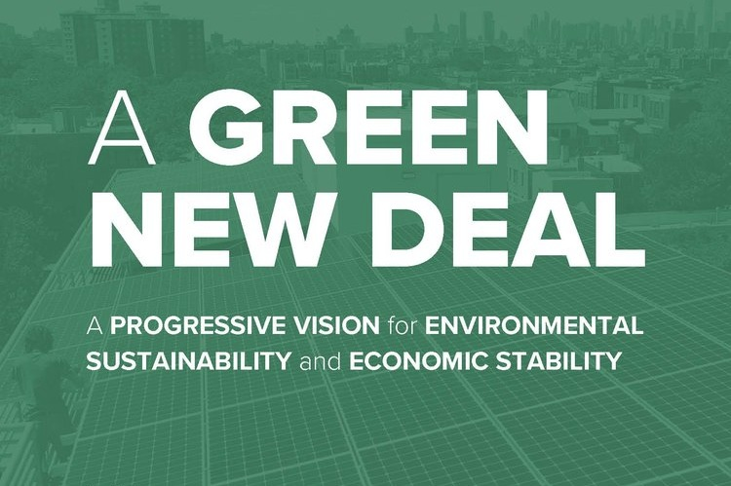
Solution Strategy & Tactics
Governmental legislation
Integration in systemic policy
Notes:
Unfortunately, businesses that would volunteer this information and effort are few and far in between. Rare is the boardroom that would lay profit as a secondary motive for business decisions. The only way to instigate this is through public policy. Governmental legislation must be drafted to mandate labeling and reporting of externalities, such as carbon footprints and impacts on habitats and biodiversity.
I put together a team of subject matter experts in supply chains, logistics, natural capital, environmental management, and finally legislative experts and elected representatives to draft a piece of legislation mandating businesses to report or label their externalities on all their products and services.
Trying to work with legislators and push this as a singular regulation COULD be successful but it would also be easily overlooked or ignored. It holds a better chance if integrated into a larger parent bill with an over-arching systemic outlook. A landmark bill that could provide a warm fuzzy feeling for businesses and people to trust transparency is maintained and corruption will be avoided. For example, the bill should include provisions that ensure jobs with family-sustaining wages, providing resources and training for Americans moving into new jobs, repairing and upgrading infrastructure, spurring growth in clean manufacturing, and ultimately providing Americans with (i) high-quality health care; (ii) affordable, safe, and adequate housing; (iii) economic security; and (iv) access to clean water, clean air, healthy and affordable food, and nature.“
These provisions sound pretty good, right? Do they sound sound familiar?
This is again where the polarity of the current political climate makes for a tricky proposition. I just described the provisions of the Green New Deal.
“Successful integration will mesh this notion with “a new national, social, industrial, and economic mobilization on a scale not seen since World War II” that will “ensure that the Federal Government takes into account the complete environmental and social costs of emissions through existing laws and new policies and programs.”
This verbiage is direct from the bill, and it is specifically describing the reveal of those externalities, but not in as many words. It’s missing the HOW.
Market forces would fight this hard, especially this provision, as when taken to its logical conclusion, it fundamentally attacks a major concept of profit in modern markets. An enormous emphasis must be put on how this concept will actually enable consumers. This attempts to capture positive positions from BOTH partisan sources
An awareness campaign for this project through supporting elected representatives in the House and Senate is being pushed through social media to bring attention to this new provision of the GND that will further enhance its vision. It is the vote that matters, however, that the American citizen can find it in themselves to bring about this necessary change.

Slide 8

Timing
NOW
Notes:
Hopefully avoiding the cliché, the time is NOW. The crisis is no longer in front of us, we have been wading into it for decades.
Public consciousness strengthens daily, to the point of idealist legislative attempts, as seen in the GND.
This specific policy provision could act as a compromise in the principles of such legislation, as it does not force consumers to do anything, it’s not a tax, it only further enables their freedom of choice.
And again, this is not ultimately about you and me. It’s those little hands, right there.

Slide 9
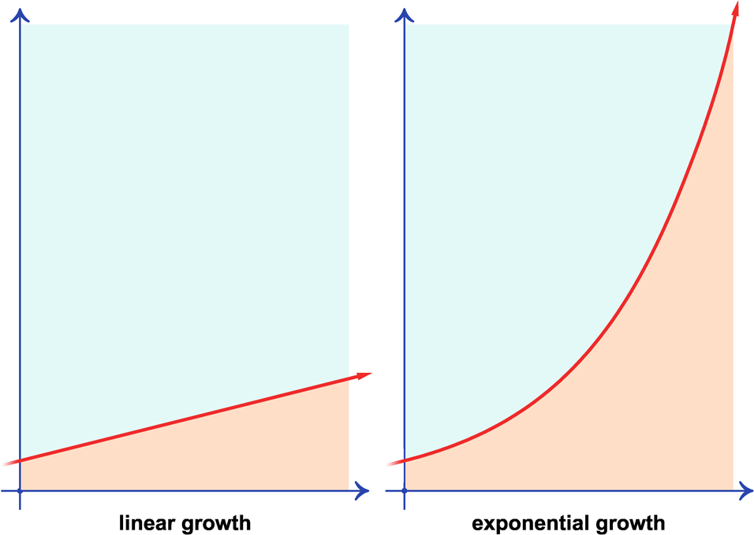
Impact
Shift in economic models, potential slowing of growth
Notes:
We have seen exponential growth over the last two centuries, in terms of capital and population and everything associated. Successful implementation of this legislation would result in a full and clear reevaluation of how businesses consider their economic models and what is acceptable growth (i.e. market placement, supply chain, profit and growth calculation/motivation). The concept of linear growth is manageable, exponential is not as it relates to externalities and the negative impacts on our environment. It becomes a runaway effect, wherein we cannot address the issues as they accelerate, escalate, and crash down upon us.
The primary driver of this economic reshaping would be consumer choice, based on transparent acknowledgement of true product and service cost.

Slide 10
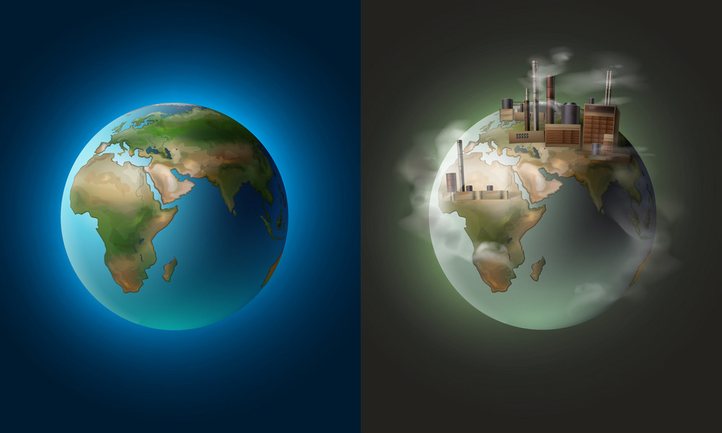
Success
What we choose is what we deserve
Notes:
The beauty of this project is that it relies on all of us collectively. This concept is grounded in trust, optimism and ideals. If provided the truth of externalities and the influence of vested interests in the status quo can be mitigated, I believe we will collectively choose the future we deserve. No matter the end result, this is something I will continue to pursue for my babies, because I believe they deserve a life as good or better than the life I have lived, and I think that is a decent aspiration for anyone. Thank you for your time.

