Slide 1
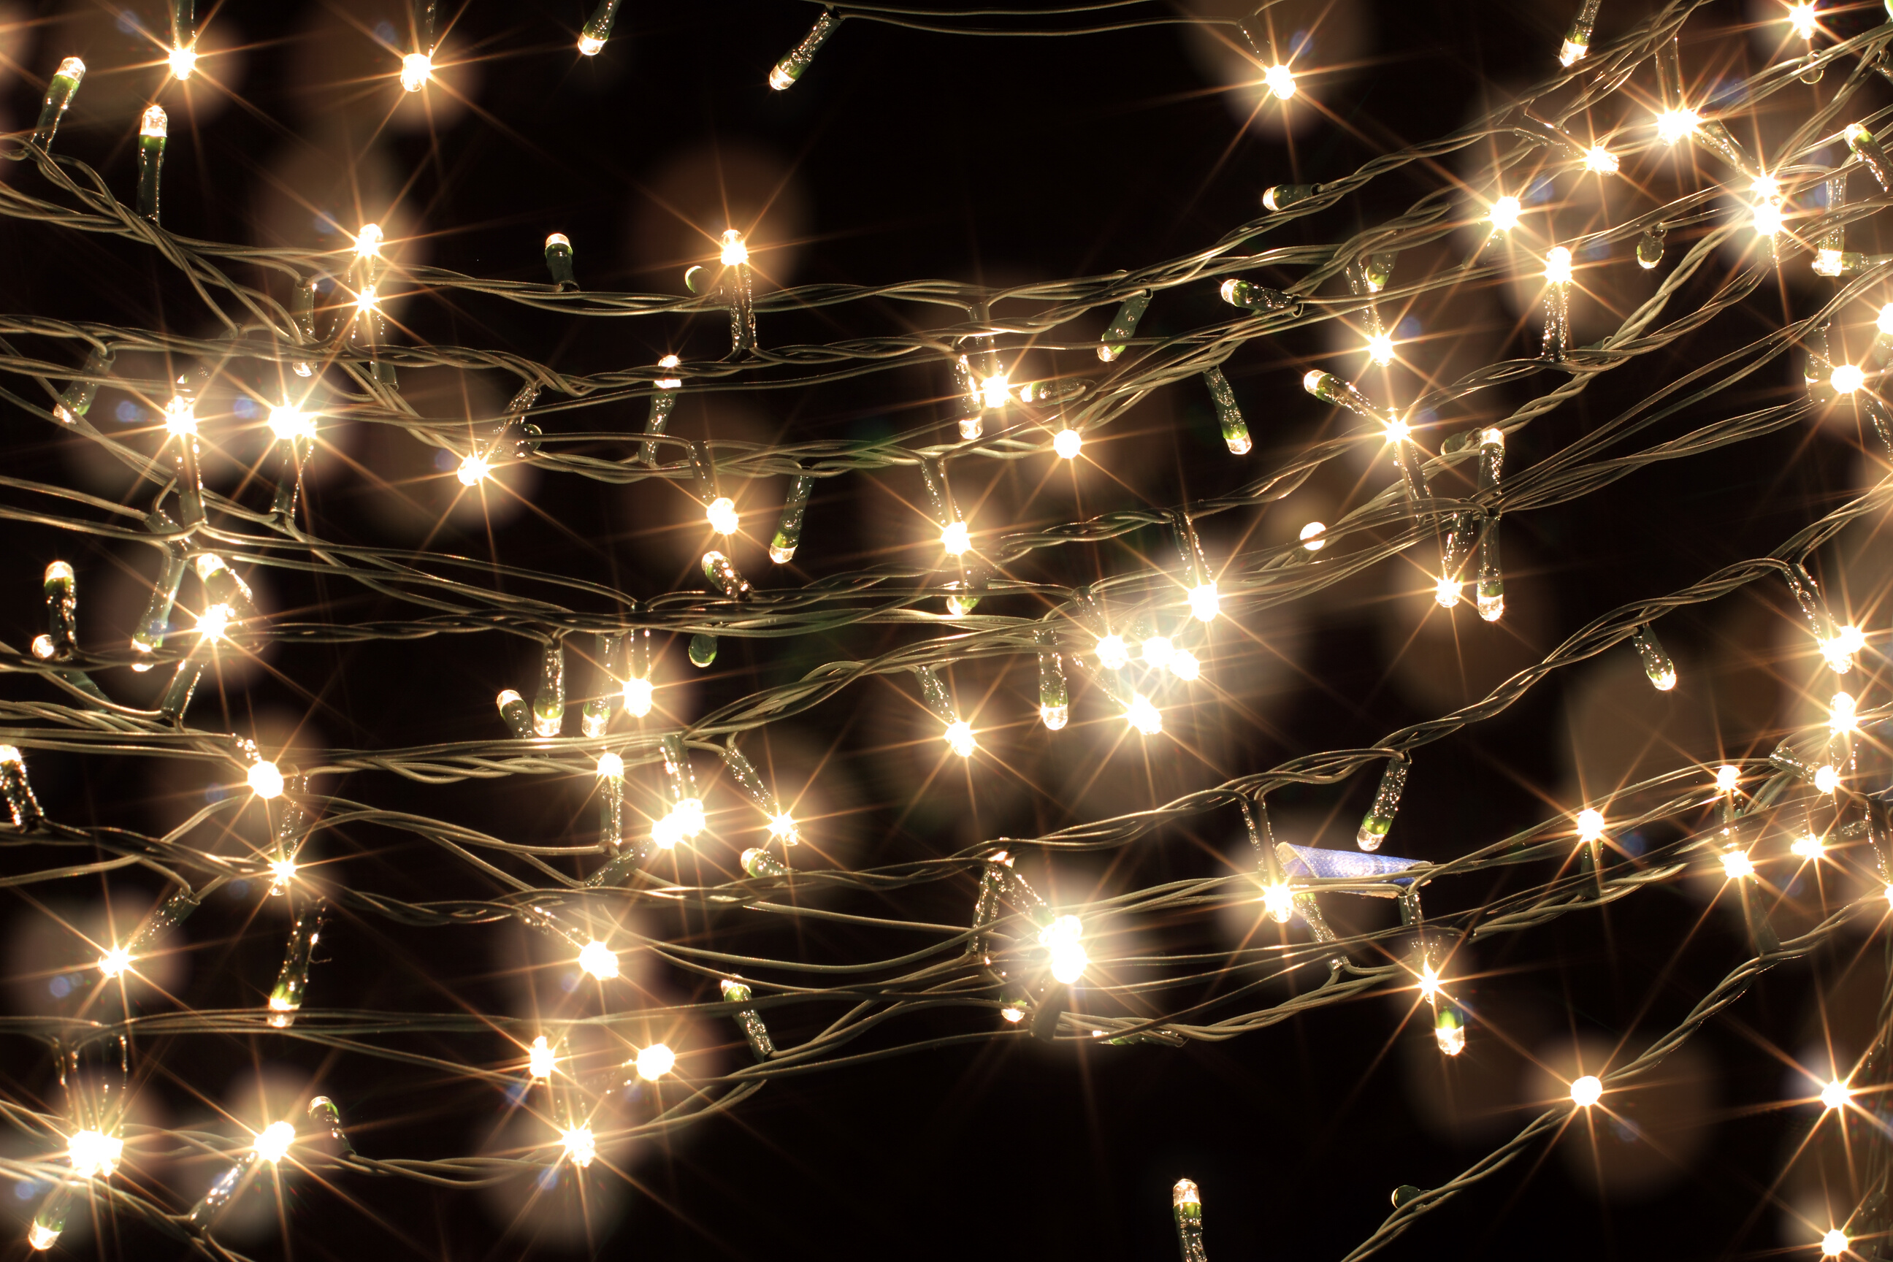
Greener Home Toolkit: Connecting the Community with Energy Solutions
Emma Massick
Notes:
Thank you for joining me today. I am going to tell you about the do it yourself energy toolkits that are available at the Johnson City library for you to check out!

Slide 2
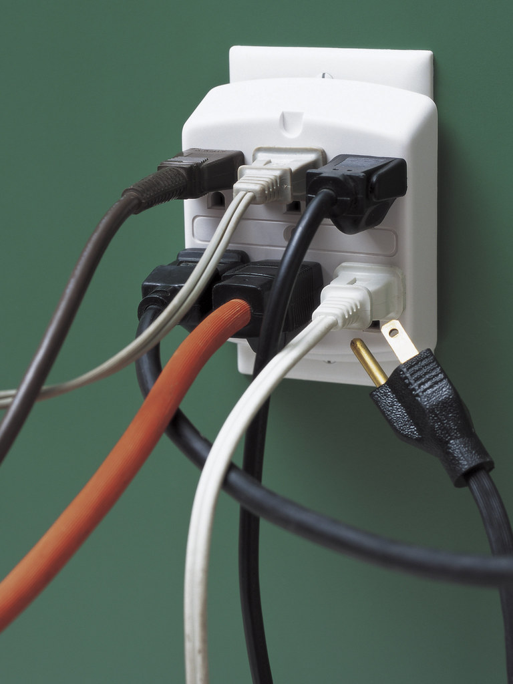
Tennessee ranks
50th
in average monthly electricity consumption per household in the United States .
Source: ThinkTennessee, 2018
Notes:
Energy use is a huge problem in Tennessee. On a scale where ranking in lower numbers means a higher success rate, for example scoring 1 though 5 would be most ideal, Tennessee ranks 50th in average monthly electricity consumption per household in the United States. According to ThinkTennessee, we are also significantly lagging behind in energy efficiency, solar energy, wind energy, and a focus on renewable energy opportunities for corporate entities.

Slide 3


Notes:
Not only do Tennessee residents consume a lot of energy per month, we also historically pay some of the highest electricity bills in the entire country. ThinkTennessee reports that we pay nearly $240 more than the average American household annually, even though our state ranks 9th in the price of electricity. Investing in energy efficiency upgrades, even simple and cost-effective ones, could save single-family homes up to 26% of their annual energy use, which equals hundreds of dollars in utility bills, yet this is something that not many companies or people are addressing currently (ThinkTennessee, 2018). This is where the ‘Our Greener Home’ toolkit project and the library have come into play.

Slide 4
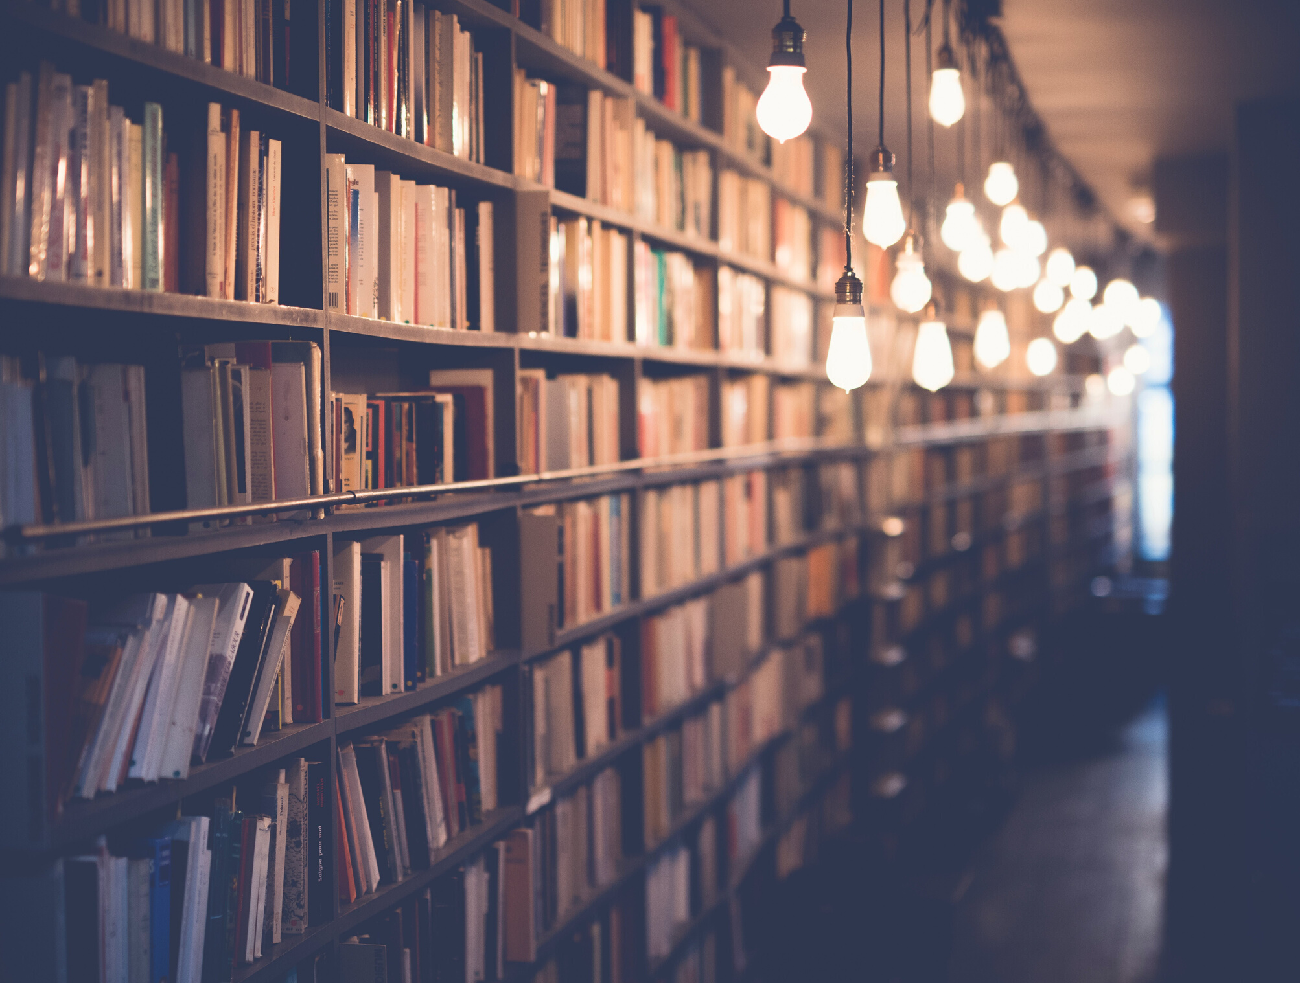
The Library
Notes:
Libraries have been places of knowledge and community gatherings for many years. I can remember countless hours that I spent at my local libraries as I grew up, and being in a library still brings me a strong sense of calm. Libraries are truly an important part of any community. Recently however, nationwide library patronage has been dwindling. This shows that it is important to come up with modern ideas, events, and opportunities that will bring community members inside time and again. The library was the perfect organization to collaborate with for this project because it is already known and trusted in this community and it is established as a place where people can go to learn and become better. I had a modern, innovative and useful solution to a large problem and found a great way to merge this place of knowledge with a great opportunity for learning that will grow the community.

Slide 5


Notes:
An idea is often depicted as a lightbulb in cartoons and comics. Well, just like the famous cartoon characters, I had a lightbulb moment. If Tennessee residents need more education about their energy resources, and libraries have been homes for resources, why not bring the two together! The Our Greener Home energy toolkit has been designed to bring energy efficiency knowledge to the community of Johnson City to help save your wallets and reduce the impact of energy use to your homes, and beyond.

Slide 6

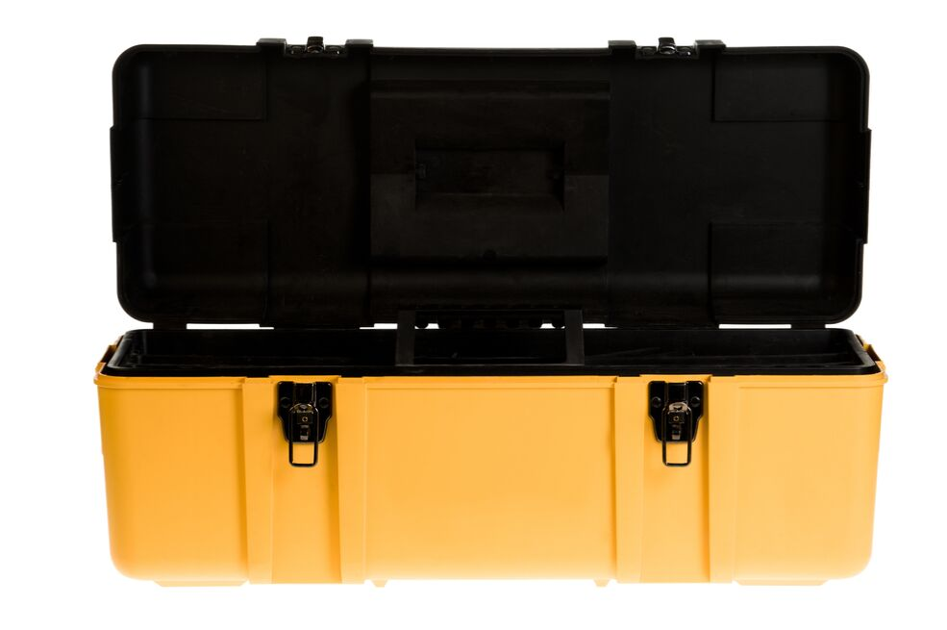









Notes:
The Our Greener Home energy toolkit is a toolbox with a mixture of items that helps community members make their homes more energy-efficient. It has some items that you are allowed to keep, such as weather-stripping materials and energy-efficient lightbulbs. It will also include items that need to be returned to the library, such as a light meter, measuring tools and an energy efficiency workbook.
The workbook in this kit helps residents save money on their energy bills every month, while also educating them about the actions they can take to monitor and control their future energy use. This workbook is available onlineat www.ourgreenerhome.org and can be printed if you prefer a hard copy.
By our partnership with the library, the toolkits are available for checkout to the public. The tools available for check out in this kit allow residents to take their energy use into their own hands by teaching them about the resources they have the ability to conserve and what it means for their households as well as the environment. This echoes our mission and vision statements.

Slide 7

Mission
To connect community members to reliable information about household energy savings for use today.
Vision
A community empowered to take their energy use into their own hands
Notes:
Our mission statement is “To connect community members to reliable information about household energy savings for use today”.
This reflects the outcome that project organizers are aiming to create at the close of the project. It reflects the goals of the project and highlights the projected impact of the project.
Our vision is “A community empowered to take their energy use into their own hands”.
Keeping these important statements in mind will help team members and stakeholders keep a focus on what they are striving for with the completion of this project. A good mission and vision statement tells the public what an organization does and reminds the people within the organization what they are doing, and I believe that our mission and vision statements do this for us.

Slide 8

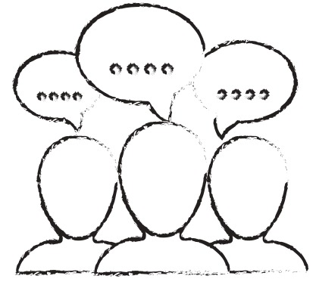

Opportunities
Collab Space Central Pitch Deck
Notes:
There are several opportunities that have come out of this partnership. By collaborating with the library and BrightRidge energy, we have been able to share talents and resources, we have made a bigger impact by joining and working together, we have expanded the outreach of the libraries programs, and we are always creating community connections. Already, by the end of this year, we have impacted many homes in our community by bringing energy saving tools into our community.

Slide 9
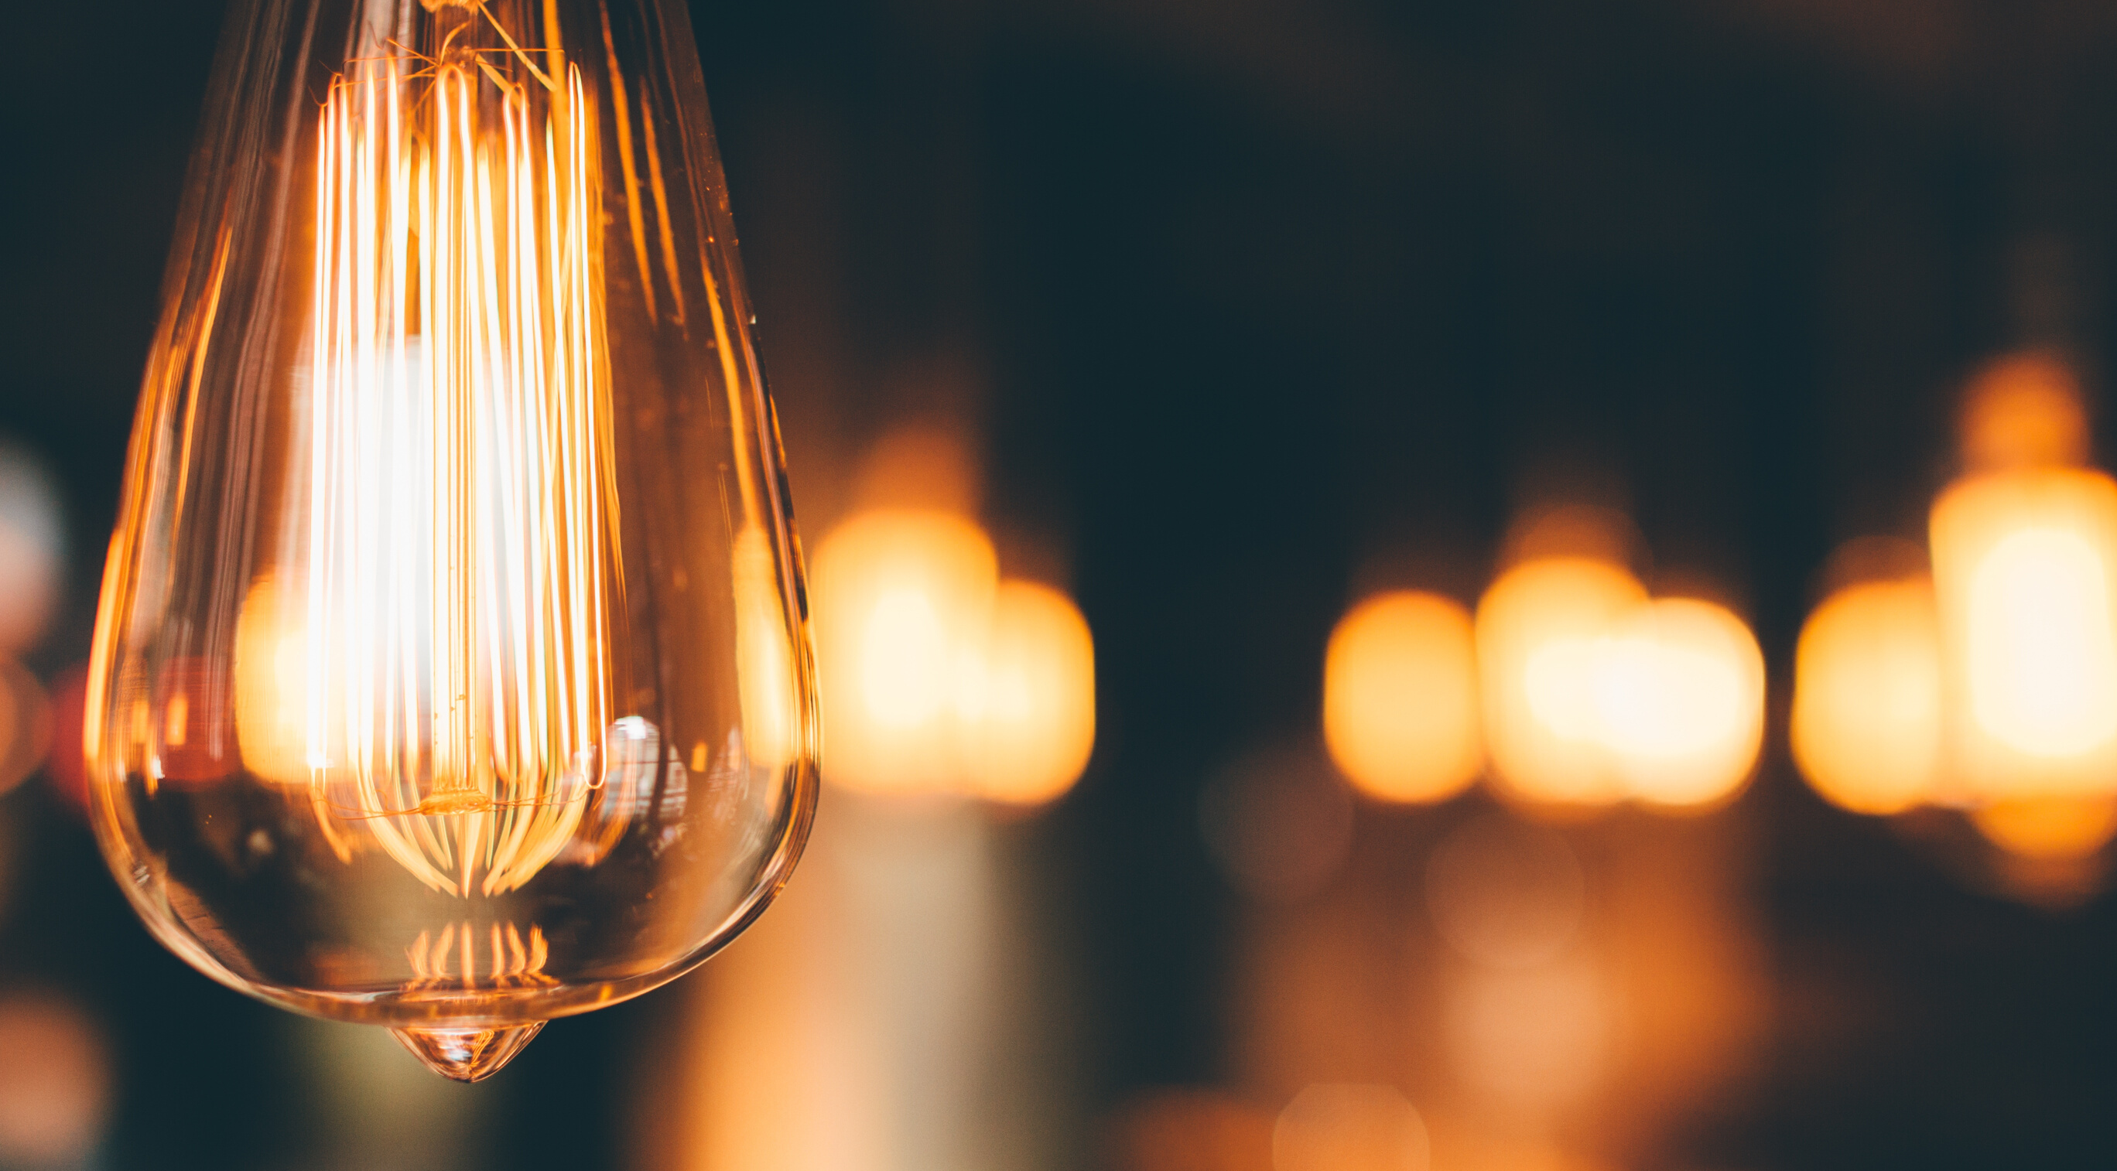

Sustainable Development Goal #7
Sustainable Development Goal #4
Sustainable Development Goal #13
Notes:
According to the sustainable development goals website, "3 billion people rely on wood, coal, charcoal or animal waste for cooking and heating" if we continue to rely on nonrenewable resources like this, we will eventually run out whether you believe in global warming or not. Through this partnership, we have already begun to educate the community and help lower the total number of people worldwide who rely on nonrenewable resources for their cooking, heating, and other daily uses.
Sustainable development goal #4 talks about promoting lifelong learning for all. By providing this energy saving toolkit to all ages at the library, again, we are educating the community about their options. We are doing this without putting a limit on who can learn or what stage of life they are able to learn.
Finally, SDG number 13 urges us to take action to combat climate change and its impacts. By educating the public about clean energy options, we are building an opportunity to combat climate change and make a large impact on not only Johnson City and Tennessee, but we are making a dent in the global climate change crisis

Slide 11

Notes:
.

Slide 12

The combination of hard work and smart work is efficient work.
Robert Half
Notes:
Thank you for listening, I would like to leave you with this quote by Robert Half, "The combination of hard work and smart work is efficient work." We have worked hard in a smart way and are creating efficient work processes that with your continued cooperation will carry on successfully in the future.

Slide 15
Enter website here
Notes:
Please visit www.ourgreenerhome.org to find out how you can get started boosting your own energy efficiency today, or check out the toolkit at your local library. Thank you!

