Slide 1
Defining Sustainable Scenarios of Development in San Martin, Peru
Shelbie Draper
MSUS Culminating Experience
SOS 593 Applied Project
25 April 2019

Slide 2

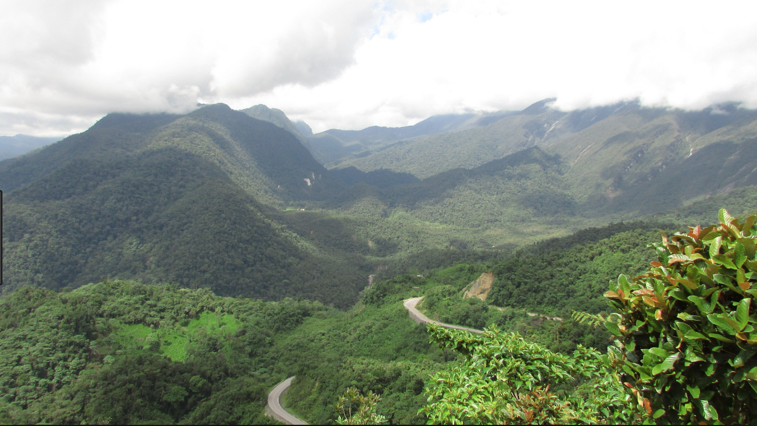
Coffee in Peru

Slide 3
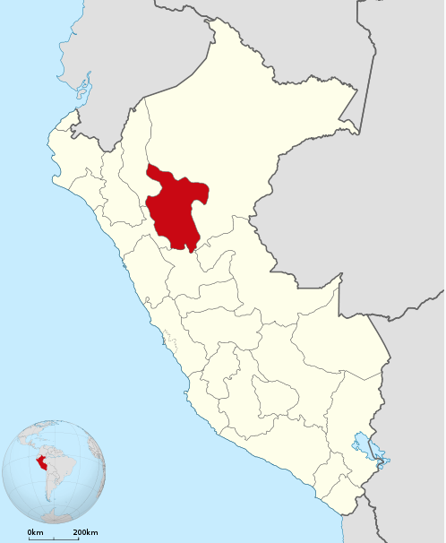
The Sustainability Problem
Unsustainable farming practices
  Deforestation
Local farmers and communities
Protection zones
Maintaining Livelihoods

Slide 4
Project Intentions
Scenario Workshop
  Agenda for the Workshop
Conservation International
  Miroslav Honzak & Percy Summers

Slide 5
Project Outcomes
Designated date and location
Agenda for the workshop
Finalized stakeholder questions

Slide 6
Lessons Learned
Difficulty of securing a date due to outside forces
The need for project and time management
Event-planning
Notes:
Overall a good experience

Slide 7
Call to Action
Student work after the workshop
Monitoring and evaluation
Continued support and action in the region

Slide 8
Thank You

