Slide 1
ReEnvision Waste at SRP
Maddy Doyle
Sustainability Policy & Programs

Slide 2
Intentions
Problem
Long term reduced financial burden
Environmental benefit
Addressing SRP 2035 goals
Community collaboration and room to build on sustainable programs
Scalable employee engagement
Notes:
SOS problem:
Sig harmful
Urgent
Unsolvable by a simple solution
Complex
Dispersed effects
Reducing what SRP sends to the landfill will reduce costs in the long term as well as provide decreased environmental impact to our planet. In addition these efforts will help make progress toward SRP’s corporate sustainability goals known as SRP 2035.
While SRP and many other have done recycling projects, this project is going to be focused on the community collaboration and employee engagement into the idea of “ReEnvisioning” waste and reducing and recycling wherever possible, this meant creating a unique approach for each facility I worked at. Further I will be working to build a scalable and adaptive model for employee engagement in future sustainability efforts.

Slide 3
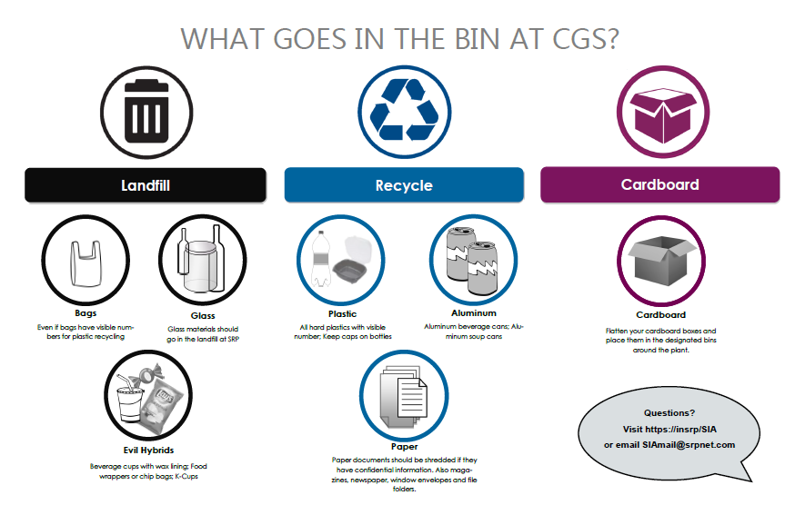
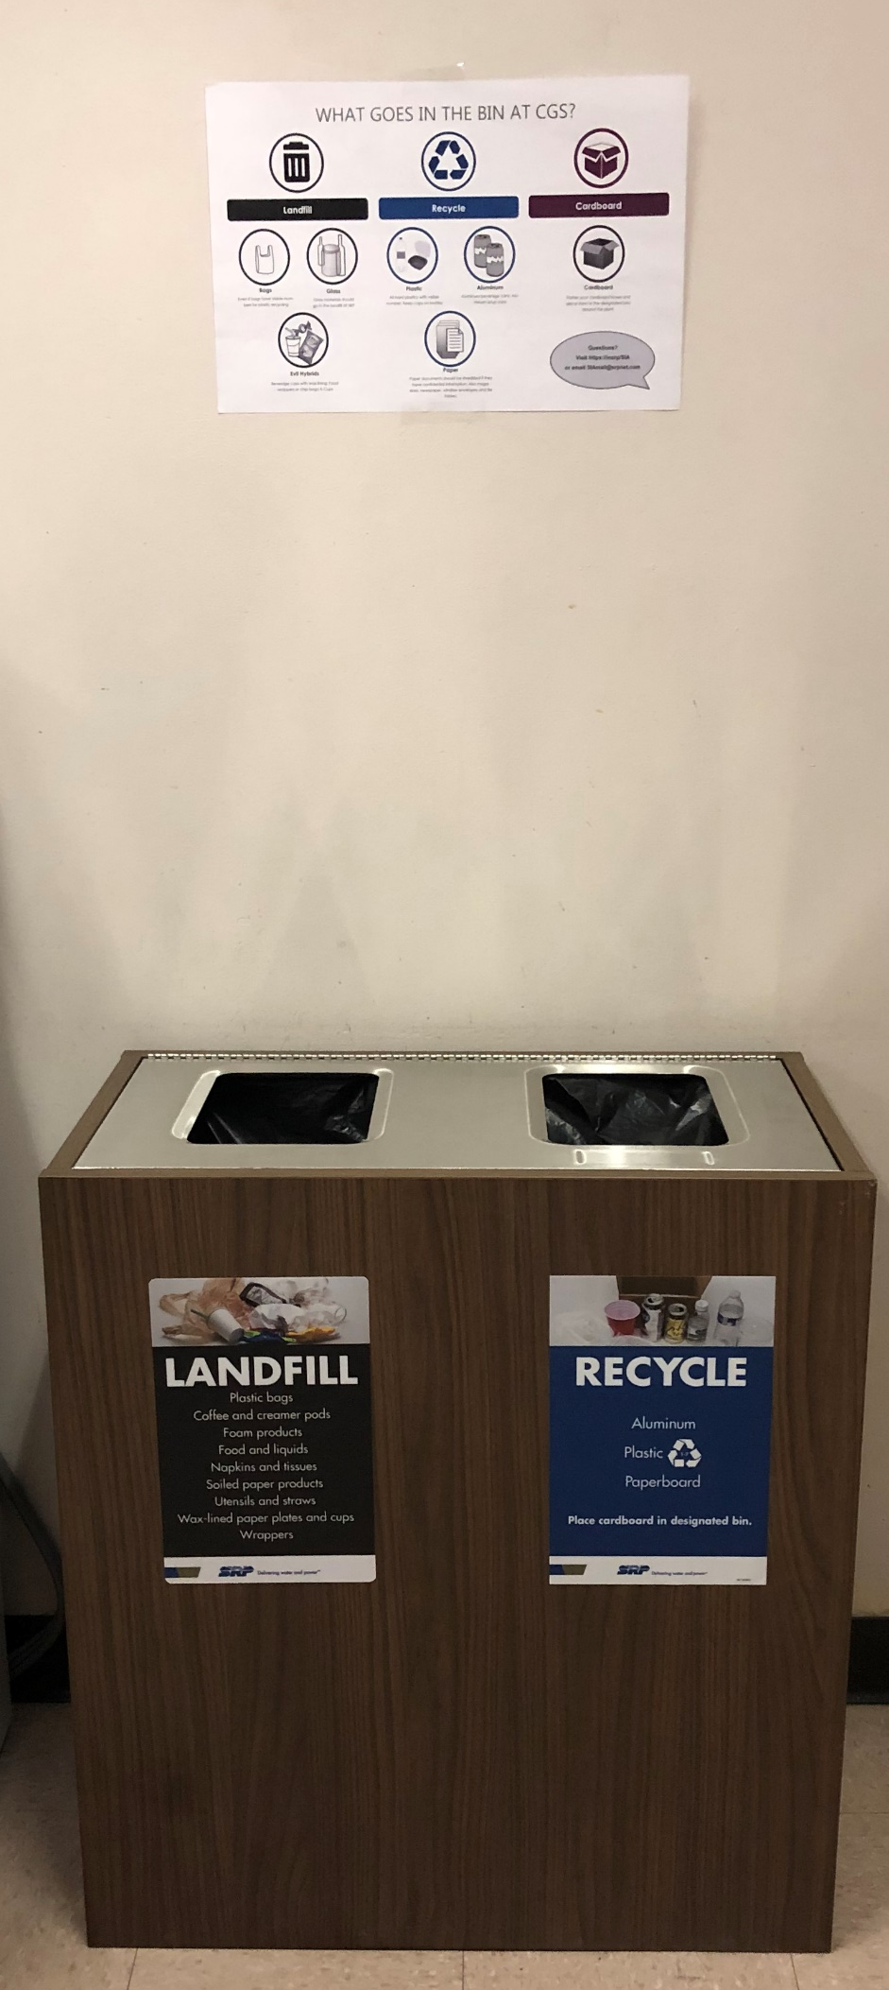

Coronado Generating Station
Notes:
CGS: $425 per month = $5,100 annually

Slide 4

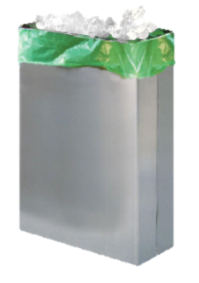





PERA Club- Skills Training Center
only
Compost
1. Toss your compostable goods in the labeled bin
3. The content of the bags are
composted
locally!
2. Our partners, Marsden-West and Recycled City work to collect the paper towels
Notes:
STC: $45 a week = $2340 a year for composting program

Slide 5
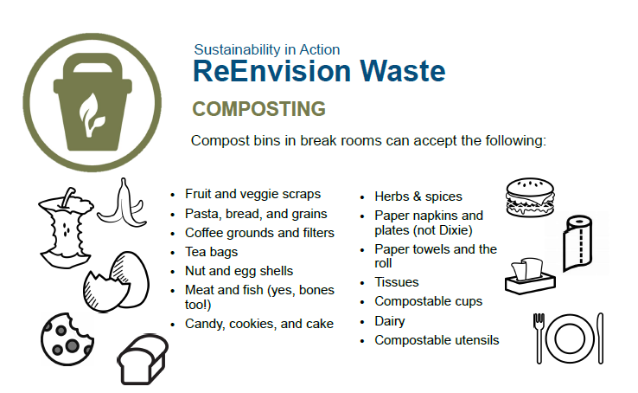

Slide 6

Green Team
Facility | Green Team members | Representation of total facility
PERA | 6 | 20%
CGS | 11 | 6%

Slide 7
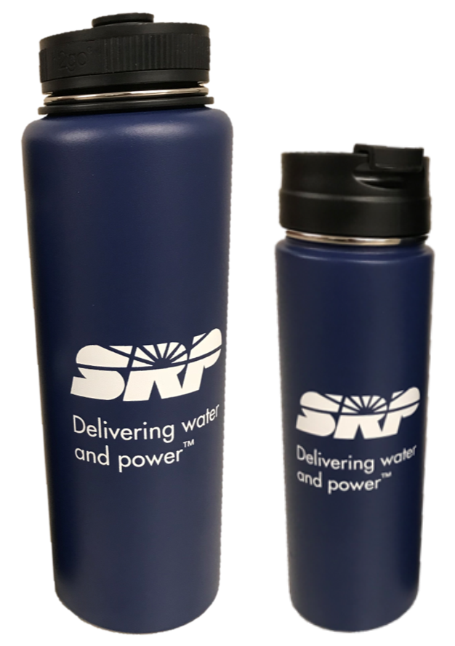
The Bring Your Own Bottle
Challenge
1 facility pledge = 336 bottles a day
12 PERA STC employees
5 PERA administration employees
24 CGS employees and counting!
$71,022 savings per year!
Notes:
Program overall cost:
STC: $45 a week = $2340 a yea
CGS: $425 per month = $5,100 annually
$1,148 in bottles
Work done in this project overall SRP saves $62,434

Slide 8
Notes:
Update with CGS information
Interaction with the programs are High
71/100 for CGS
83/100 for PERA
There is positive sentiment around how well waste is addressed at the facility
43/100 for CGS- there were mixed feelings at CGS with multiple 100 answers as well as multiple 0 answers
75/100 for PERA
Sorting confidence is overall high
86% for CGS
92% at somewhat confident or above
Communication is well rated but will need continued reinforcement
3.0/5 for CGS
3.83/5 stars for PERA

Slide 9
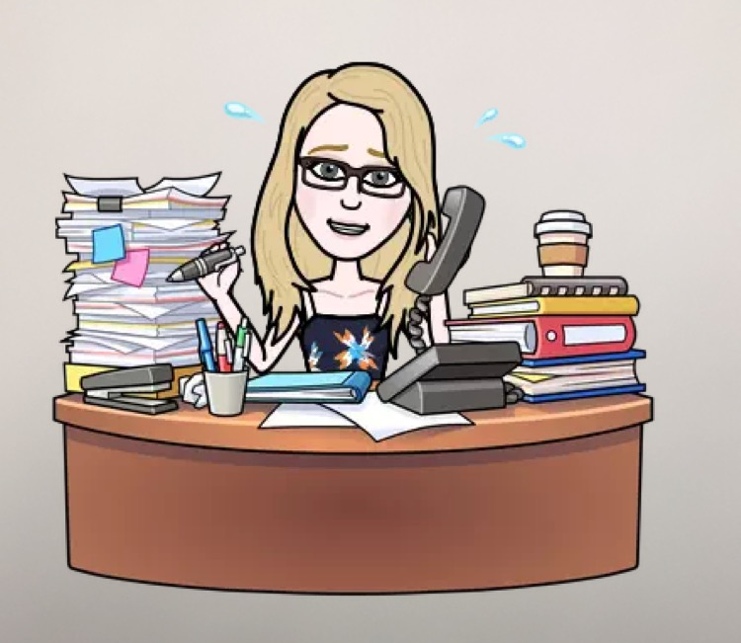
Lessons Learned
SRP 2035
Notes:
The SRP 2035 goals set the groundwork for this project and garnered executive support. Having waste goals in place meant that I was able to make a fluid transition and garner executive support from site managers, they were excited to get working on these rather than defensive.
The second major successes of the project is what I like to refer to as the power of the individual. I believe that having myself dedicated to this work and getting it done in a timely manner was a major reason that these programs were implemented in a successful way.

Slide 10

How can you ReEnvision waste?
Notes:
Finally, the community collaboration and the ability to bounce ideas off of one another was a major success of this project. Allow this space for education and innovation is one way that SRP will be able to create sustainable change long term.
Thank you to all those who helped me along the way including my team mates at SRP, the Committee and many many more.

