Slide 1
Sustainability Consultation Report: Shepley Bulfinch
Tari Wager
Notes:
8-10 minutes + 6-8 questions, 2 minutes transition time. We will be recorded on zoom - people can login to watch.
George Basille’s favorite question is about frameworks, was this really an applied project?
Brief Introduction outline and problem statement - Who’s your client, what problem trying to solve
What solution you proposed, what methods you used to solve the problem - why you chose those methods
What the outcomes were - outcomes for client
What did I learn? - Major takeaways
What recommendations for client
Call to action - how could someone follow up on what I’m doing, advance the solution, continue this work

Slide 2
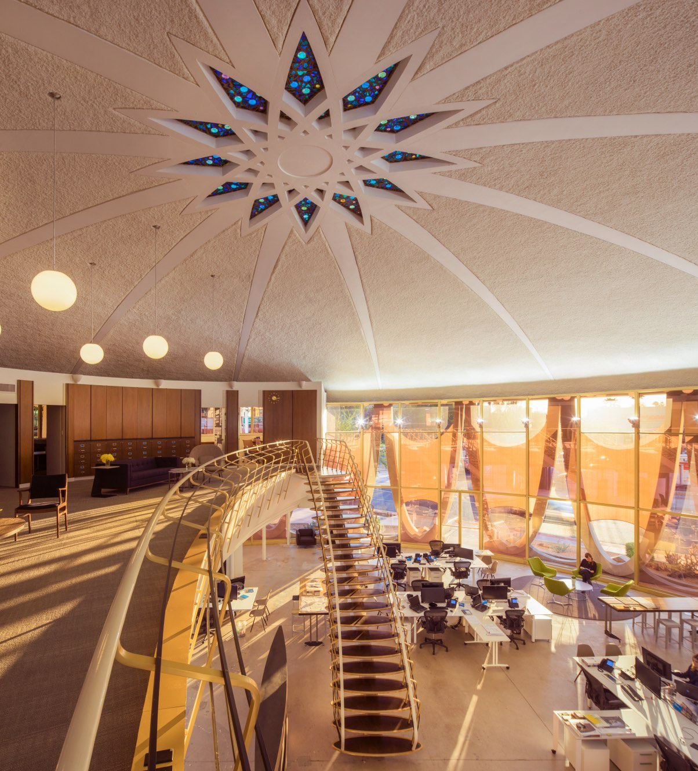
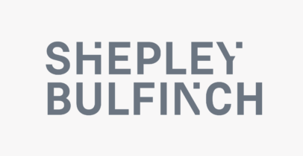
Introduction
1
2
Notes:
Image: /
Brief Introduction outline and problem statement - Who’s your client, what problem trying to solve
The building industry plays an important role in satisfying the needs of society, enhancing the quality of life, and contributing to the economic growth of a country. However, it has been heavily criticized for being a major contributor to carbon emissions, environmental degradation, and global warming due to its utilization of a large proportion of natural resources and energy consumption (Doan, 2017).
Opportunities for the greatest gains in sustainable development begin with design professionals like my project partner, Shepley Bulfinch, a national architectural firm.

Slide 3

Proposed Solution
Business Sustainability Assessment
Sustainability Engagement Session
Sustainability Consultation Report
3
Notes:
Image: collaboration.html
What solution you proposed, what methods you used to solve the problem - why you chose those methods
Business Sustainability Assessment
Sustainability Engagement Session
Compilation of information along with Recommendations and Resources into Consultation Report

Slide 4
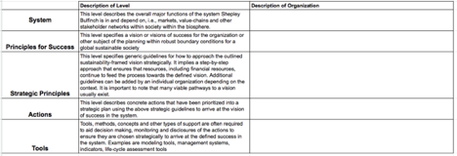
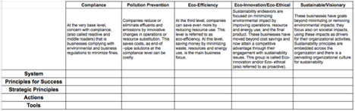

Methods: Business Sustainability Assessment
Five - level Organizational Map
2. Current Implementation Assessment
3. Application of FSSD
Notes:
What solution you proposed, what methods you used to solve the problem - why you chose those methods
I met with Paul Prosser, and then Dr. Shirley-Ann Behravesh to determine an effective way to assess the sustainability of Shepley Bulfinch.
Three-part business sustainability assessment which included:
Five-level organizational sustainability systems map
Systems
Principles for Success
Strategic Principles
Actions
Tools
Assessment of current sustainability implementation
Compliance
Pollution Prevention
Eco-Efficiency
Eco-Innovative/Eco-Ethical
Sustainable/Visionary
Application of a Framework for Strategic Sustainable Development (FSSD) (Broman, 2017).
Three peer firms were assessed using the same method for comparison
Lake | Flato
Gensler
WRNS Studio

Slide 5
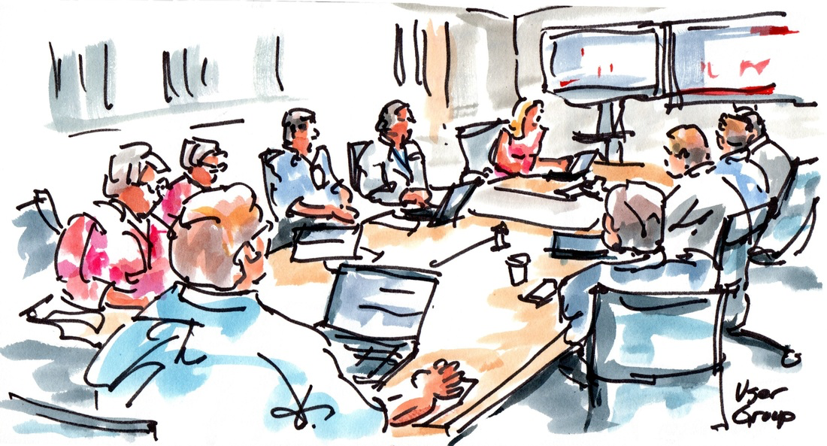
Methods: Sustainability Engagement Session
4
Notes:
Image: construction
What solution you proposed, what methods you used to solve the problem - why you chose those methods
A stakeholder engagement session was held at Shepley Bulfinch’s Phoenix office using the ABCD-procedure of the FSSD (Broman, 2017).
The purpose of the session was to:
Create a vision of a “Sustainable Shepley Bulfinch”
Identify current challenges and assets
Possible solutions
Form a strategic plan

Slide 6



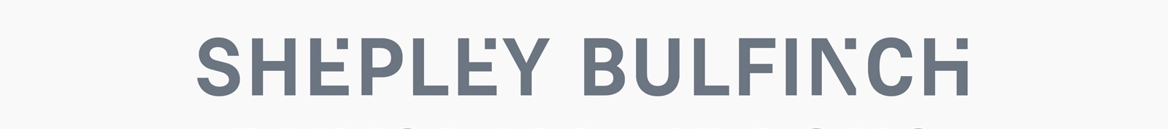
Outcomes: Business Sustainability Assessment
5
6
7
8
Notes:
Lake Flato logo /
Gensler Logo gensler.com
WRNS Studio Logo wrnsstudio.com
Shepley Bulfinch shepleybulfinch.com
What the outcomes were - outcomes for client
If we were to rank the assessed firms in terms of sustainable operations and design practice, Lake | Flato would be the clear winner. Sustainability principles are integrated into the very fabric of the firm. The website very clearly states their commitment to sustainability and outlines how the principles are practiced in every project. They strive for innovative design with their eco-conservation studio (Seward, 2019). Gensler, and WRNS would be a close second and third. Gensler has a global presence and a wide range of services. With over 700 projects LEED certified, sustainability is a part of the firm culture. Taking it a step further, Gensler has developed innovative practices to mitigate the effects of climate change and combat its root causes (Gensler, 2019). WRNS considers sustainability to be under their stewardship. With their sustainability champion leading the way, they seek to link academia with practice and advance the architectural experience. WRNS also values transparency and social equity as evident by their Just certification (WRNS Studio, n.d.).
Shepley Bulfinch would be fourth in comparison to these peer firms. One big difference is the appearance of commitment to sustainability. On their website, the only mention of anything related to sustainability is a small note that Shepley Bulfinch is a corporate member of the U.S. Green Building Council and a signatory to the AIA 2030 Challenge (Shepley, 2019). While sustainability may be implied in more discreet ways in the description of firm history and culture such as “the firm has a notable legacy of challenging convention, pioneering visionary design ideas, and collaborating with clients who seek to drive measurable change” (Shepley, n.d.). There are additional resources for sustainable design available to employees, through the company intranet and the Sustainable Design Leadership Group. The business sustainability assessment has brought to light some great examples of sustainability in other firms, and opportunities for improvement.

Slide 7

Outcomes: Sustainability Engagement Session
Vision
Assess Current Situation
  Challenges
  Assets
Possible Solutions
Strategic Plan
9
Notes:
Image: effective-brainstorming-session
What the outcomes were - outcomes for client
Part A: Vision
Sustainability integrated in all levels of projects
Part of the culture, part of ethos, across all practice groups
Higher ed/libraries – pushed to greater degree (clients come with higher level of knowledge)
Shepley Bulfinch leading the conversation
Shepley Bulfinch being a leader in the construction and design industry
Sustainability obvious part of the firm identity
Transparency
People can easily tell “They care about sustainability”
Thinking on a regenerative level, what can we be doing to make this project support the community it is nested it – better for the people and the planet.
Positive conversation
Part B: Assess Current Situation
Challenges
Employees are comfortable, conditioned, and have an “it’s good enough” attitude
It’s too hard, overwhelming to try and change
Lack of knowledge at leadership level
Fear of change/failure/risk
Doesn’t appear to be a priority in branding/marketing/HR
Lack of transparency
Assets
LEED Building projects
People:
Sonja Bochart
Matthew Gifford
Carol Wedge
Diverse work/portfolio
LENS/Consulting services
Language that we use in explaining to clients in a way they can relate
“sustainable” vs “resilient”
Highlighting stories
LEED Platinum project - Austin Public Library: Sid Bowen, Jim Chambers – how process worked partnered with Lake | Flato
Smith College: Siiri Julianus - materials
Groton School
Part C: Possible Solutions
Better consultants – field leaders in sustainability
Better partnerships
Leverage Sonja’s contacts
LBC
Leverage local resources
Community participation
AIA
Motivate Leadership
Engage all staff
Attend conferences
Invest in education of employees
Accreditation/Continuing education
Market what we have
Diagram more
Update website to reflect sustainability goals/principles
Part D: Strategic Plan
Reigniting the AIA 2030 commitment
Surveys to all employees to gauge understanding of and commitment to Sustainability
Create Shepley Bulfinch Sustainability Action Plan
Include SDLG initiatives:
Wellness Framework
Well-thy Initiative
Elevating Proposals/Interviews
Include sustainability principles and strategies when seeking for jobs
Firm-wide engagements
Finch Posts
Presentations
Workshops
Include sustainability commitment in hiring process
Candidate Interviews
On-boarding
Marketing/Branding
Show sustainability commitment in culture
The results of the business sustainability assessment, and the sustainability engagement session were combined into a Sustainability Consultation Report and given to Shepley Bulfinch

Slide 8

Lessons Learned
Perseverance
Flexibility
Communication
Business Operations
Sustainability & Design
10
Notes:
Image https://www.knowledgehut.com/blog/project-management/10-characteristics-of-a-good-project-manager
What did I learn? - Major takeaways
Perseverance - My culminating experience project this semester was not the project that I planned for last semester. Things outside of my control led to the necessity of me creating a new project. Giving up wasn’t an option for me. I wanted to finish this program strong an work on a project that could bring value.
Flexibility -
Communication - was crucial to the project. Communication with Paul and my committee members, as well as consistent and persistent communication with my partners at Shepley Bulfinch.
Business Operations and Sustainability & Design - I was able to look at design from a business and operations perspective and a design process

Slide 9

Recommendations
Company Culture
Education
Marketing/Branding
Business Operations
11
Notes:
Image: best-qualities-of-a-project-manager-characteristics-of-a-good-project-manager
What recommendations for client
Company Culture
Create a company culture that has sustainability integrated at every level. Lead the conversation and truly ‘design beyond.’
Develop a Sustainability Action Plan to include sustainable business operations, AIA 2030 Commitment, and design tools and processes
Support Sustainable Design Leadership Group (SDLG) Initiatives:
Wellness Framework
Well-thy Initiative
Have all projects report necessary data for AIA 2030 goals
Pursue JUST Certification
Education
Support employees in learning about sustainability tools and practices through a variety of opportunities.
Firm-wide engagements:
Finch Posts
Presentations
Workshops
Support for employees seeking and maintaining accreditations (Such as LEED AP and WELL AP)
Lunch and Learns/CEUs
Invite Manufacturer Reps to present on the sustainable qualities of their products
Webinar viewing opportunities on sustainable building strategies
Support and host community events related to sustainability
Marketing/Branding
Make it very clear to everyone that Shepley Bulfinch is a firm that cares about people and the environment and is striving to lead the way to sustainable, regenerative design.
Shepley Bulfinch Website
Add sustainability commitment and principles to firm description page
Include accreditations (such as LEED AP) on employee pages
Highlight how many projects have received certifications
Elevate project proposals and Interviews by including sustainable design solutions in all proposals and having the conversation in interviews in a way that is natural and inspiring
Business Operations
Lead by example by integrating sustainability into company culture, business operations, and design development
Green Business Opportunities
Align business operations with sustainability principles by working with an organization such as the Green Business Bureau (Vertuous, 2016).
Or have each office certify separately. The City of Phoenix Green Business Leader program (City of Phoenix, 2018) for example, would be a good starting point.
In addition to these focus areas, I would suggest that Shepley Bulfinch continue to seek input from all employees to help guide the mission and future of Shepley Bulfinch. Clearly define what the priorities are (for business operations, and the design processes) and articulate them plainly. Dive deeper into strategic partnerships and use the influence as a successful firm to help create positive change in the building design and construction industry.

Slide 10

Next Steps
Deeper Dive into Business Operations/Design Process
Sustainability Action Plan
12
Notes:
Image:https://mountainx.com/seedling-in-hands/
Call to action - how could someone follow up on what I’m doing, advance the solution, continue this work
Deeper Dive into Business Operations/Design Process
Energy monitoring
Sustainability Action Plan
AIA 2030 guidelines

Slide 11
Thank you!
Notes:
Thank you!
6-8 Minutes for Questions from Audience/Committee

Slide 12
Citations
1. Shepley Bulfinch. (2019) Shepley Bulfinch Logo [Digital image]. Retrieved April 19, 2019 from http://www.shepleybulfinch.com
2. Baruch, R. (2017, June 2). Shepley Bulfinch Phoenix Office/Studio [Digital image]. Retrieved from http://javamagaz.com/?p=3480
3. University of Virginia Office for Sustainability. (2018, July 6). Collaboration [Digital image]. Retrieved from https://sustainability.virginia.edu/about/overview/collaboration.html
4. Brigham, Stephen. (2017, April 16) A user group session [Digital Image]. Retrieved from http://stephenbrigham.net/sketching-stories--blog/category/construction
5. Lake | Flato. (2019) Lake | Flato Logo [Digital image]. Retrieved April 19, 2019 from http://www.lakeflato.com
6. Gensler. (2019) Gensler Logo [Digital image]. Retrieved April 19, 2019 from http://www.gensler.com
7. WRNS Studio. (2019) WRNS Studio Logo [Digital image]. Retrieved April 19, 2019 from http://www.wrnsstudio.com

Slide 13
Citations
8. Shepley Bulfinch. (2019) Shepley Bulfinch Logo [Digital image]. Retrieved April 19, 2019 from http://www.shepleybulfinch.com
9. Hayes, Rosie. (2019, January 9) Brainstorming [Digital image]. Retrieved from https://www.theukdomain.uk/effective-brainstorming-session/
10. Gray, Alena (2018, December 20) Project Manager [Digital Image]. Retrieved from https://www.theukdomain.uk/effective-brainstorming-session/
11. Celestial Media. (n.d.) Project Manager [Digital image]. Retrieved April 20, 2019 from best-qualities-of-a-project-manager-characteristics-of-a-good-project-manager
12. Mountain Xpress. (2015, July 14). Seedling in hands [Digital Image] Retrieved from https://mountainx.com/seedling-in-hands/

