Slide 1

Sun Devils Together
Student in Need Training
Identify, Address, Act Together

Slide 2
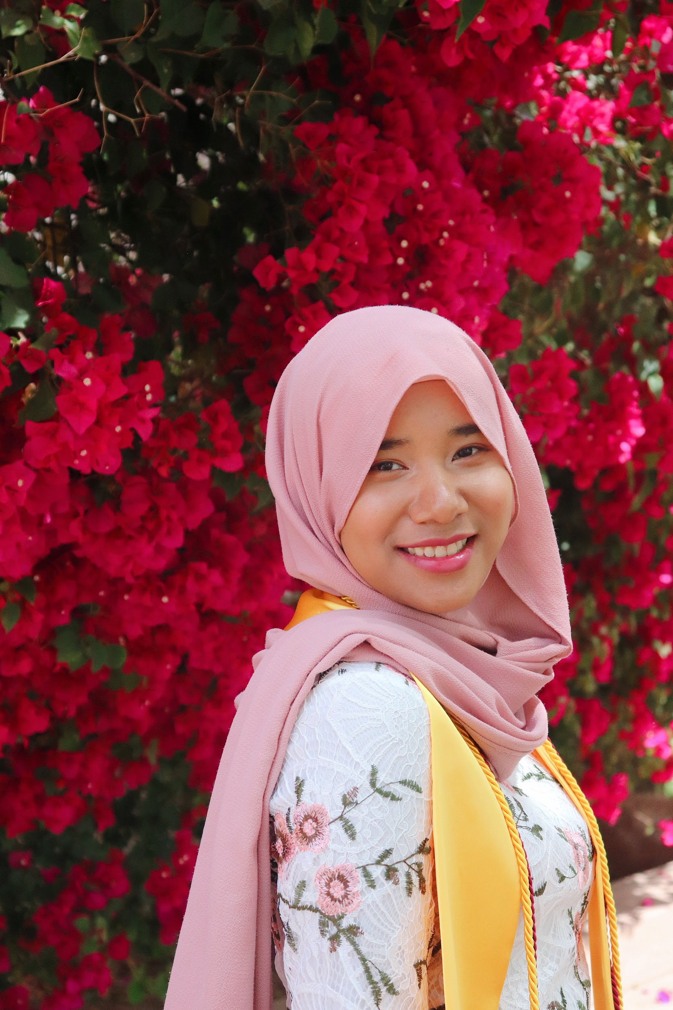

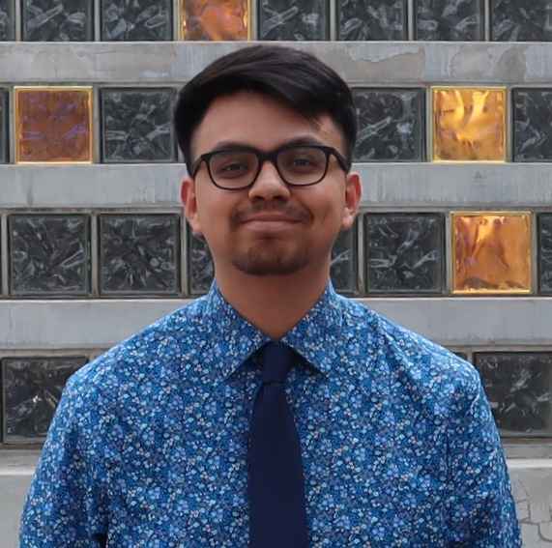
About Us
Maryam Abdul Rashid
Skyliana Dosier
Omar Sanchez Marquez
Notes:
We are a team of Masters from the School of Sustainability and we worked on a project in collaboration with the Dean of Students that aimed to address student homelessness on campus. Therefore, based on our research, we have developed a training to better equip staff and faculty to help students in need.

Slide 3
Learning Outcomes:
Identify students & their needs
Next steps to take as staff
Know the resources: Communicate with each other & Dean of Students Office
Notes:
At the end of this training, we hope that you take away with three learning outcomes which consist of identifying a student in need, know what the next steps to take as a staff/faculty member and finally know the proper procedure and resources to direct students to. We also hope that our staff & faculty members would be able to communicate effectively to each other about at-risk and homeless students and direct them to the Dean of Students Office.
Learning outcomes:
-how to identify students
-what to do once you you find these students
-know resources

Slide 4
ASU is a comprehensive public research university, measured not by whom it excludes, but by whom it includes and how they succeed; advancing research and discovery of public value; and assuming fundamental responsibility for the economic, social, cultural, and overall health of the communities it serves.
Notes:
Why you should care
One section of the ASU charter states that we should assume fundamental responsibility for the economic, social, cultural and overall health of the
communities it serves. One part of this community are our ASU students. However, based on our research and personal experience, most departments at ASU
are not able to help direct students to the different resources available on and around ASU campus. Thus, not meeting the needs of the students. This happens
due to the lack of communication between departments on what each respective department is doing and the overall lack of awareness that this problem is
even happening in the first place and we hope that this training becomes the starting point for change to happen. That’s where you come in as ASU
professionals. After this training, we hope that you would be able to create a culture of empathy and understanding between the staffs and students in order to
build a community of trust where students are comfortable in opening up and reaching out for help when they need it.

Slide 5
Impact:
52%
University Students experience
needs insecurity
61,880
ASU students are at-risk or experiencing needs insecurities
=
HOPE Lab (2019).
Notes:
University students are becoming homeless at an alarming rate. According to the Wisconsin HOPE Lab, 52% of students attending 4-year universities experience a basic needs insecurity like access to food, housing, and healthcare. To bring it back to the ASU context, according to ASU Now, we currently have a total of one hundred and nineteen thousand students. 52% of these students shows us that sixty one thousand eight hundred and eighty of ASU students are at-risk or already experiencing some sort of needs insecurity
https://asunow.asu.edu/201908221-sun-devil-life-asu-first-day-largest-diverse-first-year-class (119, 000 students)
explain the term, and all the scope that go under term (needs versus homeless)
*title impact, what does this mean
-ties back to def slide, these are what students are facing

Slide 6
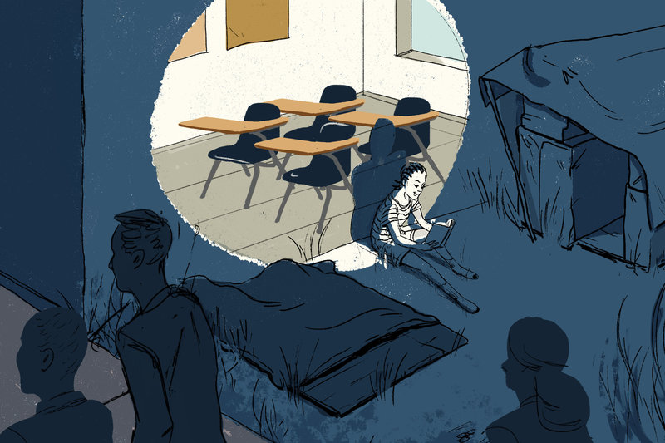
“These students are sleeping in cars, university libraries or other buildings with public access, camping in nearby wooded areas, and ‘couch surfing’ with friends and fellow students”
Paden, 2012.
Kindred (2016).
Notes:
def of students are student homeless
mention project goes beyond housing insecurity as it includes food and healthcare
what are the different needs insecurities :
-homeless: sleeping in cars, university libraries, Couch surfing
-food
-healthcare
→ ask in activity, What needs are you facing?

Slide 7
Part I: How to identify & next steps

Slide 8


1. Be aware of behavioral, emotional, academic, or hygienic changes
Your student or tutor is quieter, more tired than usual, or is wearing the same clothes
You notice that they are struggling with their classes, or they might have pending suspensions
Notes:
Do you notice any changes from their normal self or how they normally interact within the tutoring space
for example …

Slide 9

2. Ask caring and open ended questions
“I notice that you are more tired today, are you getting enough sleep?”
“How are you feeling today? You seem a little off? Did something happen?
Would you like to talk about it?”
Notes:
When your approaching a student and asking questions, make sure you are approaching them with respect. Try to rephase circumstances and avoid words like homeless.

Slide 10

3. Identify and support student in accessing resources
Refer Resource Pamphlet
You may need to walk a student to the correct department
Immediately inform supervisor
Notes:
The dean of students and student advocacy department has specific processes for aiding students for the long term. Because of this, all students should be given the option to go to the dean of students. However, students should also be aware of other resources on campus if they need immediate help or do not want to go the dean's office.
You only have a short window to help a student before they leave. In this time, you need to help the student immediately and inform your supervisor. You or your supervisor may need to walk the student over to the respective resource and inform the dean of students office.

Slide 11
Part II: Activity
Notes:
Part 1:
For this activity, you will learn how to empathize with students experiencing insecurities on ASU’s campus. Part 1 of this activity requires you to put yourself in the shoes of a student and reflect on your experience navigating around campus resources under the given circumstance. Be careful not to use your knowledge and experiences as a professional staff while navigating. The activity is based on our team’s personal experience attempting to find resources and processes that would help a student in need.
Part 2:
In the second part of the activity, you are a professional staff at the Academic Success Center. In this activity, you will be able to use the insight you’ve gained from Part 1, the steps outlined in the presentation, and the resource pamphlet that has been provided for you to help direct a student to the most effective resources on campus.

Slide 12

Reflection & Summary
Notes:
What where your main takeaways? Did anything stand out to you? What did you learn/feel through this process?

Slide 13
Thank you!

