Slide 1
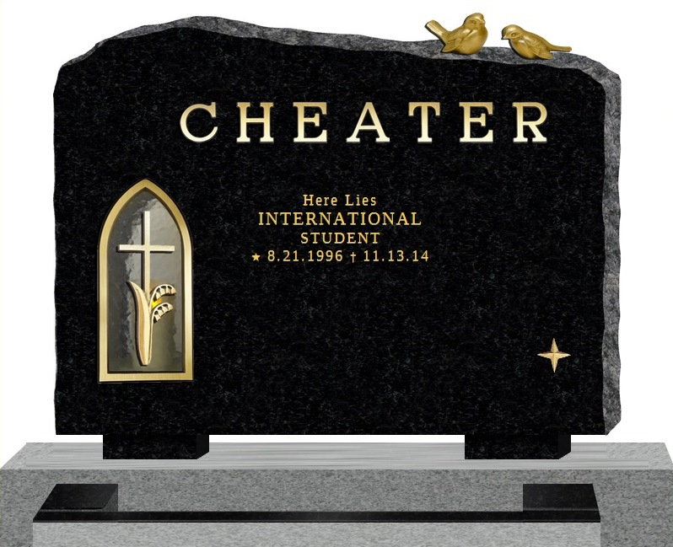

Slide 2
What is Plagiarism?
So many kids don’t really know.
Cultural issues are in play.
It’s about the IDEA, not the words!
Begin by demonstrating what that means!

Slide 3
Queen Bey
“Single Ladies” video
http://youtu.be/4m1EFMoRFvY
“Mexican Breakfast”
http://youtu.be/7pZW9uXJxGE
Thanks Jean Cook! (University of West Georgia)

Slide 4
American Democracy
Clicker technology
Talking points
Concrete examples
No judgment zone

Slide 5
What is Plagiarism?
Using someone else’s work and passing it off as your own
Not citing your sources
A disease passed on by rats
Copying and pasting

Slide 6
A Man Called Tshepo
Discussion of article on plagiarism
Article from South Africa
This is a WORLD problem
Generally not done on purpose

Slide 7
Works Cited
Batane, Tshepo. "Turning to Turnitin to Fight Plagiarism among University Students." Journal of Educational Technology & Society 13.2 (2010): 1-12. Academic Search Premier. EBSCO. Web. 10 Nov. 2014.

Slide 8
I Shot a Man in Reno…
Marc Mason
Undergraduate Services Associate
Arizona State University Libraries
Marc.Mason@asu.edu
Thank you for listening!

