Slide 1
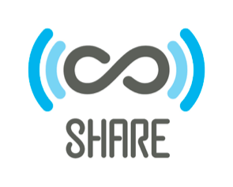
Research Discovery Through SHARE
Research Data Access & Preservation Summit 2017
Seattle, Washington
April 19, 2017
Matthew Harp
Arizona State University
Cynthia Hudson-Vitale
Washington University in St. Louis
Notes:
Hello, my name is Cynthia Hudson-Vitale and I’m a visiting program officer with the Association of Research Libraries working on SHARE. I’m here to introduce you to Matthew Harp, Digital Projects Librarian at Arizona State University - to talk about SHARE, research discovery through SHARE, and a new project launching at ASU that utilizes the SHARE data set.

Slide 2




SHARE
Funded by:
Built by:
SHARE is a free, open dataset of research and scholarly activities across the research life-cycle.
Notes:
SHARE is a free, open dataset of research and scholarly activities across the research life-cycle. Funded by IMLS and the Alfred P. Sloan Foundation, share was co developed by the Association of Research Libraries and the Center for Open Science.

Slide 3
SHARE dataset
146+ data sources
Registries (e.g. CrossRef, DataCite)
Disciplinary repositories and preprint services
Data repositories
Institutional repositories
Agency repositories (e.g. DOE SciTech Connect)
24.6 million metadata records
https://share.osf.io
Notes:
SHARE harvests millions of metadata records from hundreds of sources

Slide 4
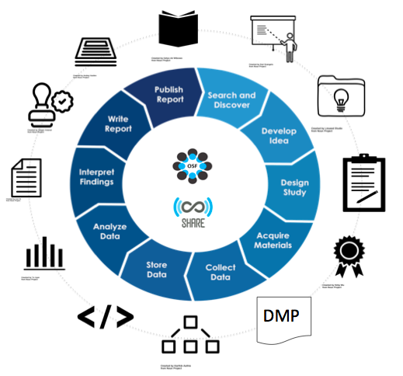
Collecting the Research Lifecycle
Notes:
Anything that has been made public and available through an open API - SHARE can create a harvester and transformer to aggregate the metadata.

Slide 5
Meta(data) records by type
Dataset
Patent
Poster
Presentation
Publication
Repository
Retraction
Software
Notes:
800,000+ data sets
15,000+ patents
12.2 million publications
5,400+ software scripts
If published and accessible SHARE can harvest it

Slide 6
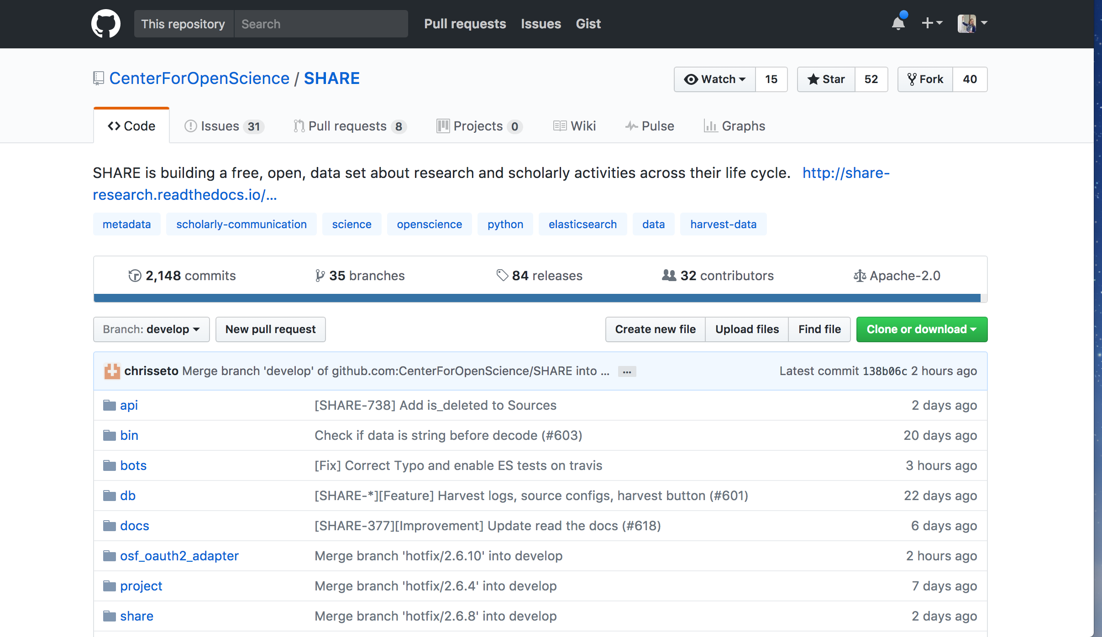
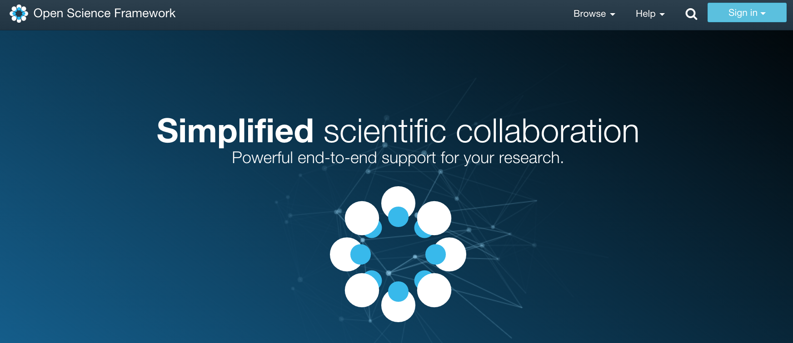
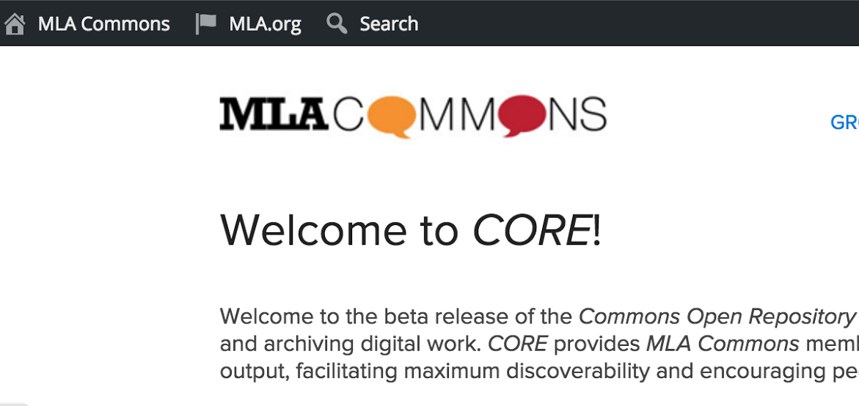
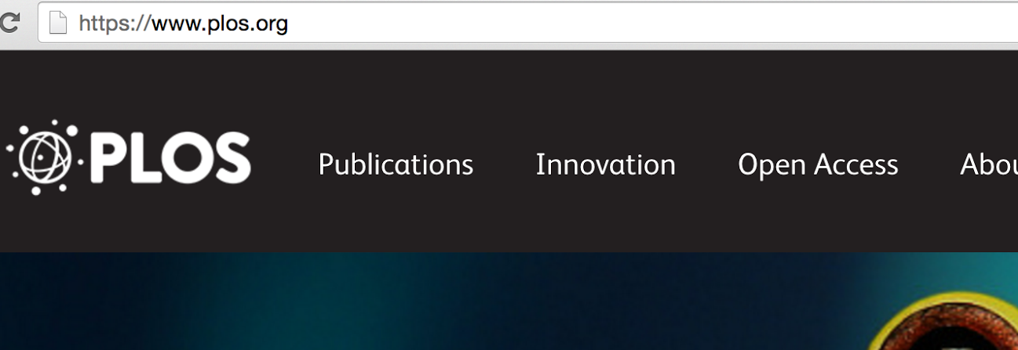
Open science, open scholarship, open source
Notes:
So, why does share exist? SHARE, the Center for Open Science, and the Association of Research Libraries are strong supporters of open science, open scholarship, and open source projects.
Supporting openness fosters collaboration, builds community, and supports the greater good.
It is the value of contextual materials, the interest in replication, the notion that failed or negative experimental results might save someone time or as funders, resources, that is part of what is fueling open science practices, publications, and tools within the research community.
It’s also the understanding that the published report is both a summary of the science and the end of the research process and that there is a fundamentally unnecessary inefficiency in waiting for that published report to engage potential collaborators or advance a finding.
Herbert Von De Sompel, writing in D-Lib in Nov 2015: we are “well into the transition of the research process itself from a largely hidden activity to one that becomes plainly visible on the global network.”http://www.dlib.org/dlib/november15/vandesompel/11vandesompel.html

Slide 7
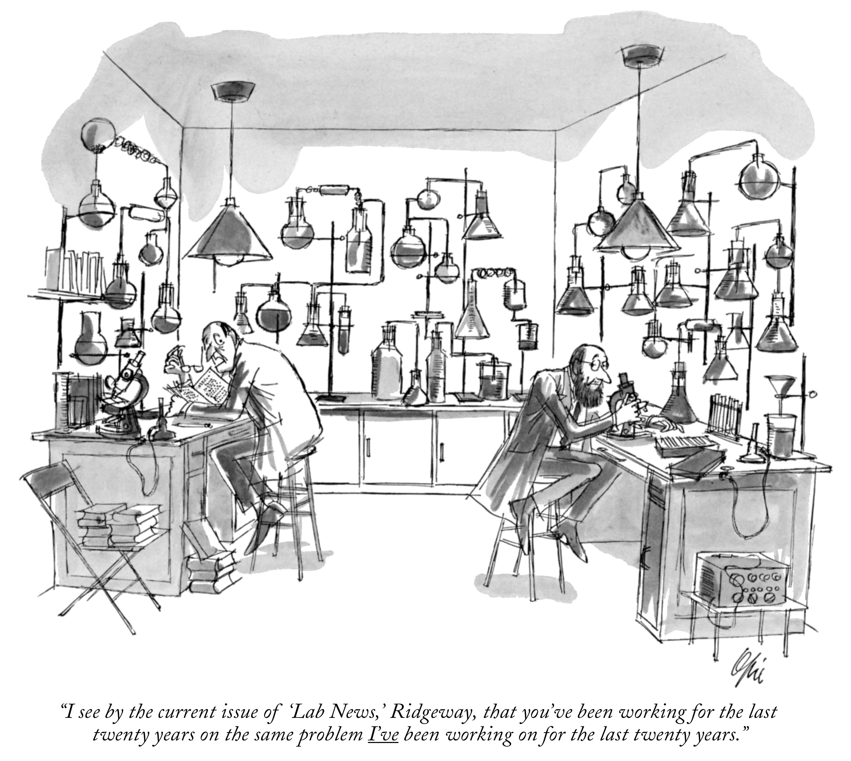
Notes:
What is the problem this grassroots open science movement is solving? It’s humorously represented in this cartoon

Slide 8
Everett Opie The New Yorker Collection/The Cartoon Bank, 1976
Notes:
From 1976, well before the World Wide Web. How much better are we doing now? What tools and what infrastructure are we offering our researchers to overcome this ridiculous situation?

Slide 9
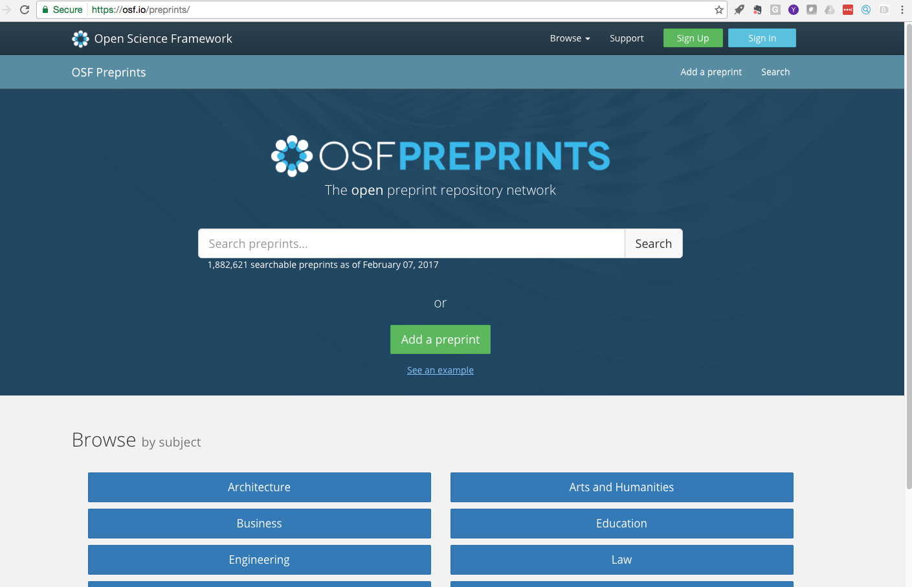
SHARE API powers new discovery services
Notes:
In addition to the discovery interface, the value of SHARE lies in it’s powerful API that allows applications to be built upon and developed.

Slide 10
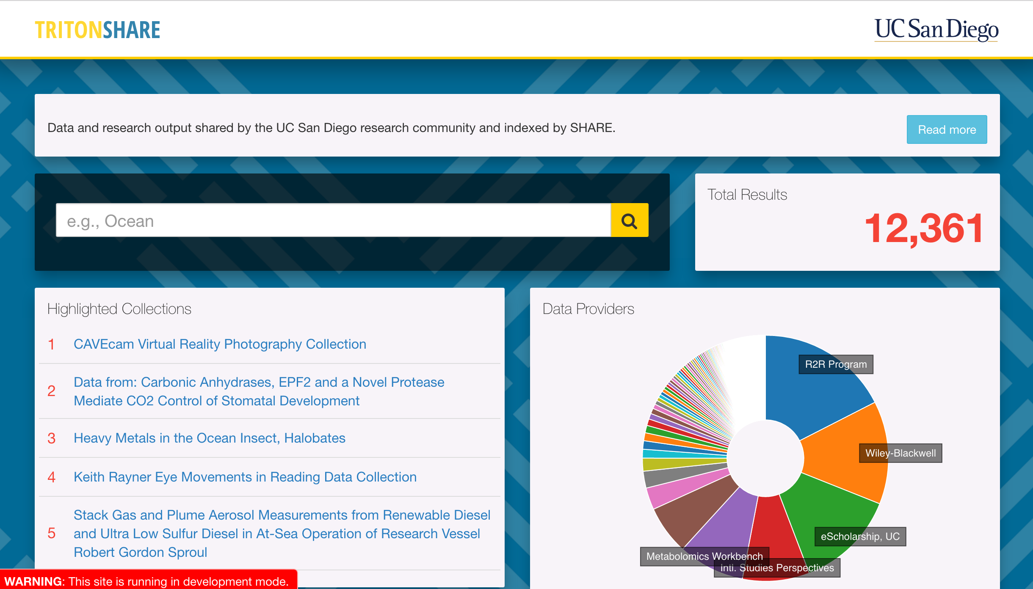
tritonshare.ucsd.edu
Notes:
This is a prototype of how the SHARE API can be put to use. There will be additional polish to the interface but UCSD wants the start using this information now
tritonshare.ucsd.edu
All code is available online and reusable at: https://github.com/cos-labs/share-analytics
With institutionally-contributed data on affiliation, SHARE API can be used to visualize:
Research types
Awards
Highlighted collections
Top contributors
Top subject tags

Slide 11
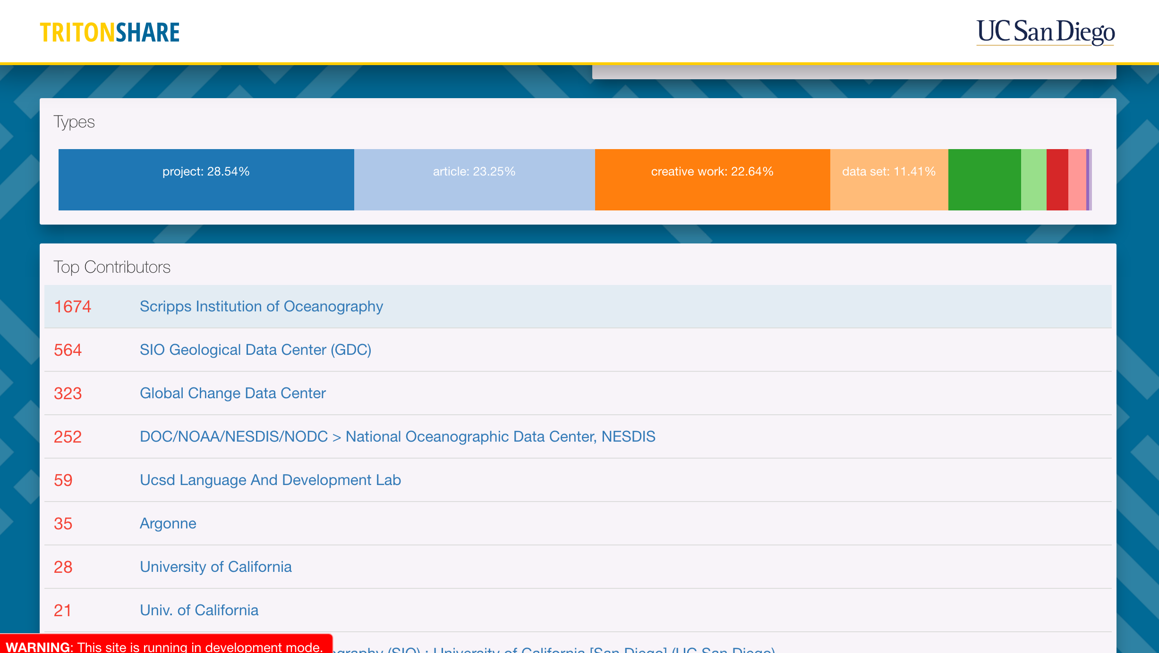
Notes:
SHARE data allows for quick deep diving into detailed information on projects, awards, publications and available research data

Slide 12
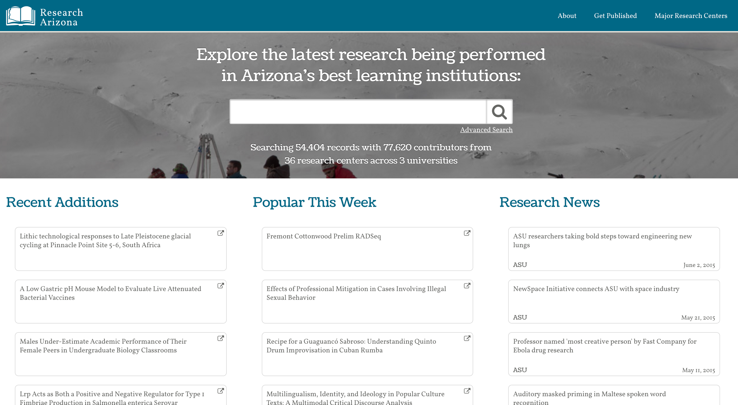
Notes:
Responding to the emerging funding mandates and the 2013 White House Office of Science and Technology Policy (OSTP) research data access requirements, the Arizona Board of Regents launched the LiveData Initiative, a tri-university initiative to improve research data management within the Arizona public university system.
Phase one include the creation of a discovery layer that combines the research and scholarly outputs of all three universities through a web application developed by a local arizona firm. The results were limited to scholarship from university IRs and included limited data sets and no funding or award information. It is a proprietary one-off representing a sliver of our output.
We need something better..

Slide 13
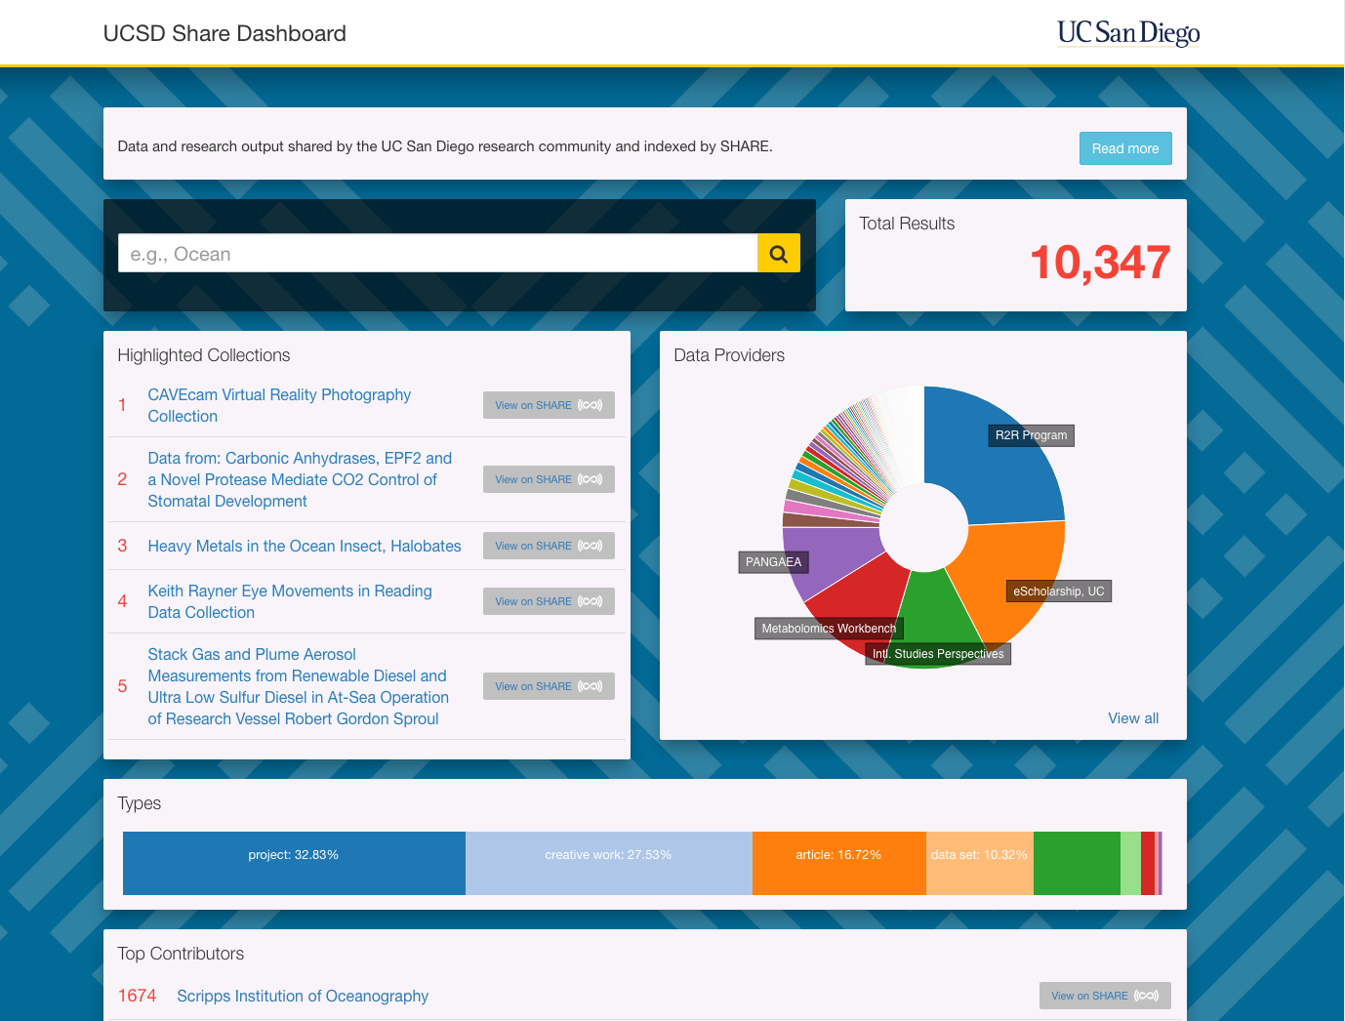
In Development
Research Arizona (2.0)
SHARE Technology
Statewide Tri-University Effort
Combined Data Dashboard
Replaces stand alone website
Notes:
And thus we are partnering with SHARE and the Center for Open science to develop a dashboard similar to UCSD representing the three Arizona Institutions. It’s open technology, reproducible, and will have far greater functionality than the previous web application. It is a much greater return on investment for us.

Slide 14
Get more information
www.share-research.org/updates
@SHARE_Research
Get involved!
info@share-research.org

