Slide 1
Academic Library Streaming Video
Revisited
deg farrelly – Arizona State University
Jane Hutchison Surdi – William Paterson University
American Library Association Annual Conference, 2016 - Orlando Florida

Slide 2
Introduction
Follow-up to 2013 survey
Investigate changes since original survey
Collect new areas of information
Method
Opt-in survey
Invitations sent to listservs
Variety of incentives – to be awarded by random drawing of respondents
Notes:
VideoLib
Video Roundtable - ALA
Media-L
ACQNet
CCUMC
CollDev
CollLib
ARL Directors listserv

Slide 3
Scope of Survey
The survey collected information on 14 different areas:
Demographics
Streaming video selection
Funding for video acquisitions
Streaming acquisition and licensing
Total titles subscribed / licensed
Total title purchased / licensed in perpetuity
Notes:
So much here that it takes 2 screens

Slide 4
Discovery and access
Captioning
Format conversion / replacement
Digitization on request
Technical infrastructure
Hosting
Workflow

Slide 5
Demographics
260 valid responses
Breakdown by:
Institution type
Enrollment
Public/Private
ARL

Slide 6

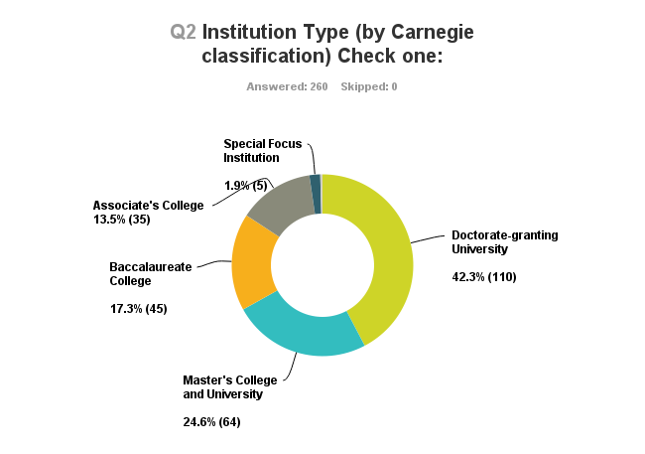
Q2 Institution Type (by Carnegie classification

Slide 7
Q2 Institution Type (by Carnegie classification
42
ARL Libraries

Slide 8
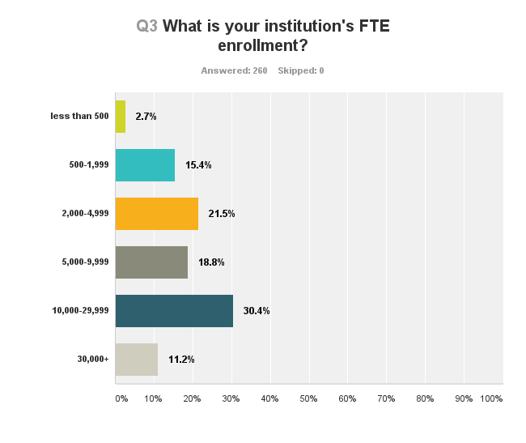
Q3 What is your institution’s FTE enrollment?

Slide 9
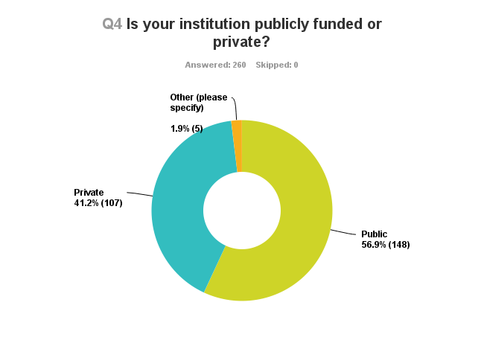
Q4 Is your institution publicly funded or private?

Slide 10

Q5 Does your library have a media librarian?

Slide 11
Definition of Media Librarian
…a library employee who has primary responsibility for audiovisual media
in the library’s collection, beyond circulation and/or maintenance of the
collection.
These responsibilities may or may not include selection, licensing, cataloging,
processing, production, etc.
The media librarian also may have responsibilities beyond media.

Slide 12
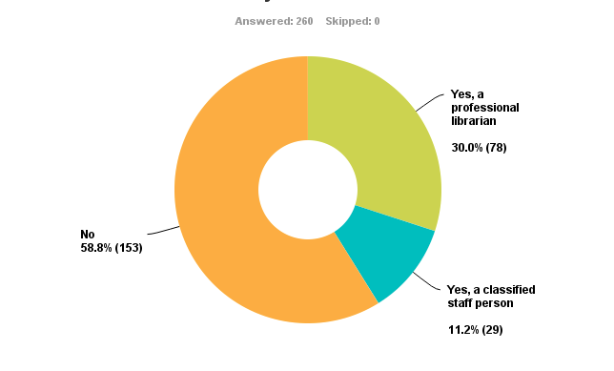
Q5 Does your library have a media librarian?

Slide 13
Comparison to ARL study in 1993
Brancolini, K.R. & Provine, R.E. Video collections and multimedia in ARL libraries:
Changing technologies, ed. Laura A. Round. OMS Occasional Paper, (19).
Published in 1997
Responses from 68% of ARL academic libraries
60 responses
58% have one or more media librarians

Slide 14
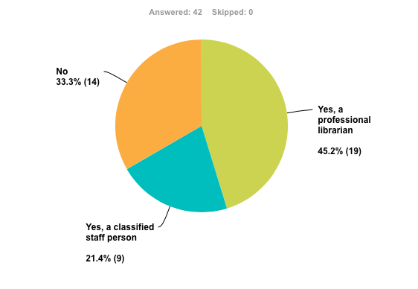
Comparison to ARL study in 1993
Brancolini, K.R. & Provine, R.E. Video collections and multimedia in ARL libraries:
Changing technologies, ed. Laura A. Round. OMS Occasional Paper, (19).
Published in 1997
Responses from 68% of ARL academic libraries
60 responses
58% have one or more media librarians
ARL
2015

Slide 15
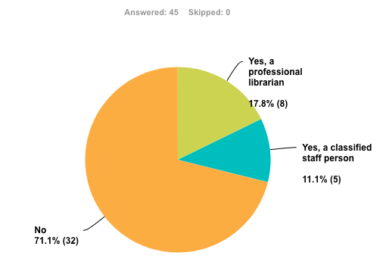
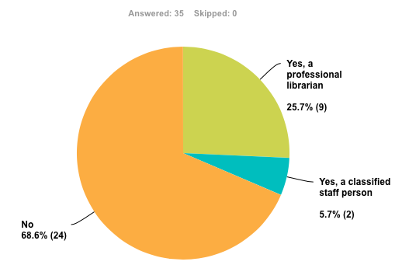
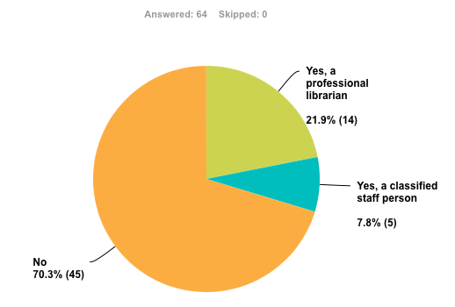
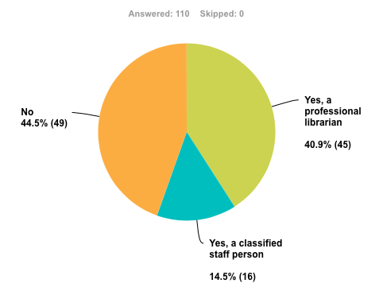
Comparison by Carnegie Classification
Associate
Baccalaureate
Masters
Doctoral / Research

Slide 16
Comparison by Carnegie Classification
Associate
Baccalaureate
Masters
Doctoral / Research

Slide 17
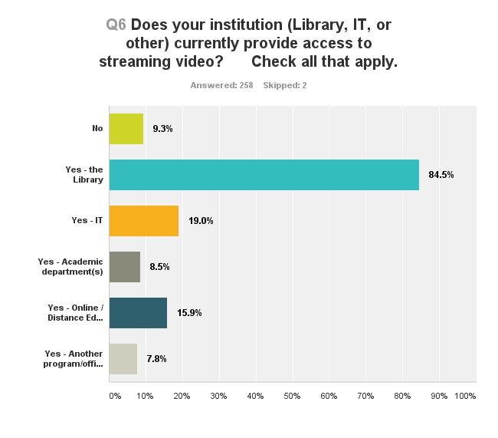
Q6 Does your institution currently provide
access to streaming video?

Slide 18
Comparison by Carnegie Classification
 | 2013 | 2015
Aggregated (all libraries) | 70% | 84.5%
Associate | 70% | 88.25%
Baccalaureate | 56% | 82.2%
Masters | 68% | 79.7%
Research / Doctoral | 78% | 89%
ARL Academic Libraries | 92% | 96.2%
2013 Question:
Does your institution stream video?
Notes:
The response to Special Focus and Tribal college was so low that we do not have data to report

Slide 19
Funding & Expenditure

Slide 20
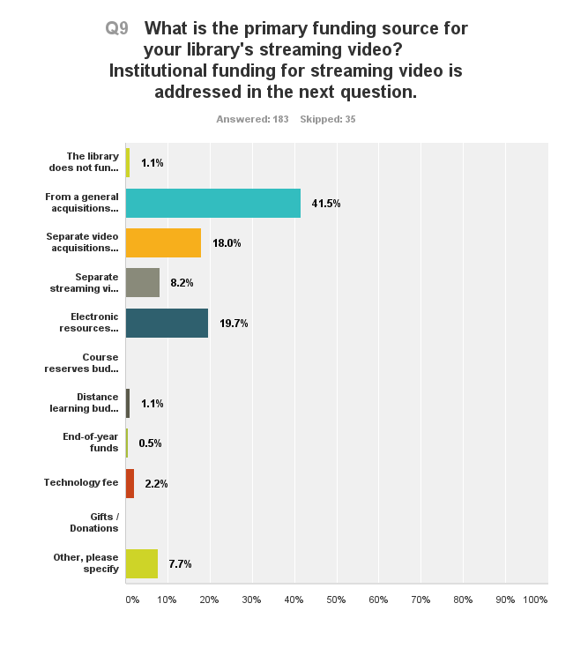
Q9 What is the primary funding source for
your library’s streaming video?

Slide 21
Q9 What is the primary funding source for
your library’s streaming video?
2013
N = 210
49%
13.8%
7.1%
14.3%

Slide 22
Q9 What is the primary funding source for
your library’s streaming video?
2013
N = 210
49%
13.8%
7.1%
14.3%

Slide 23
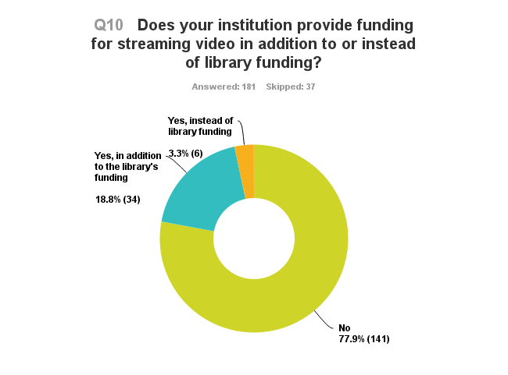
Q10 Does your institution provide funding for
streaming video in addition to or instead
of library funding?

Slide 24
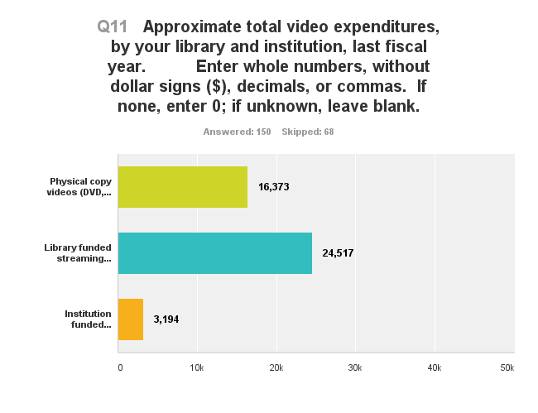
Q11 Approximate total video expenditures by your library
and institution last fiscal year.
Notes:
2013 Spend was 26K for streaming 20K for physical

Slide 25
Q11 Approximate total video expenditures by your library
and institution last fiscal year.
2013
$20,000
$26,000
Notes:
2013 Spend was 26K for streaming 20K for physical

Slide 26
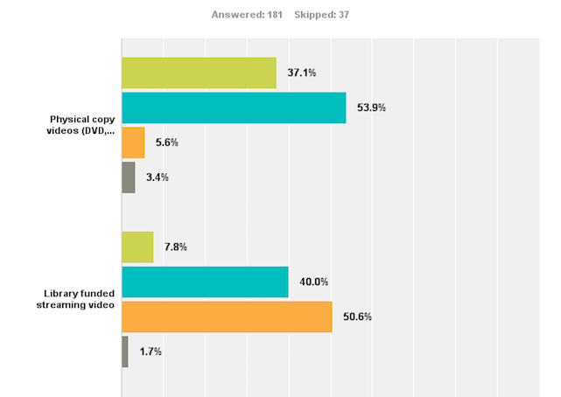

Q12 In the next fiscal year do you anticipate spending
less, about the same, or more for video acquisitions?
Notes:
Notes about 2013 hard copy about the same, increase in expectaion of same and increase in expectation of more
Separated by subscription and individual in 2013, but 2015 combined…. 2013 was 42 and 46 for more and 26 and 41 for same

Slide 27
Acquisition & Licensing

Slide 28
Acquisition & Licensing
Subscription collections
Purchase collections
Purchase individual titles
Term license individual titles
Term license for course reserve

Slide 29
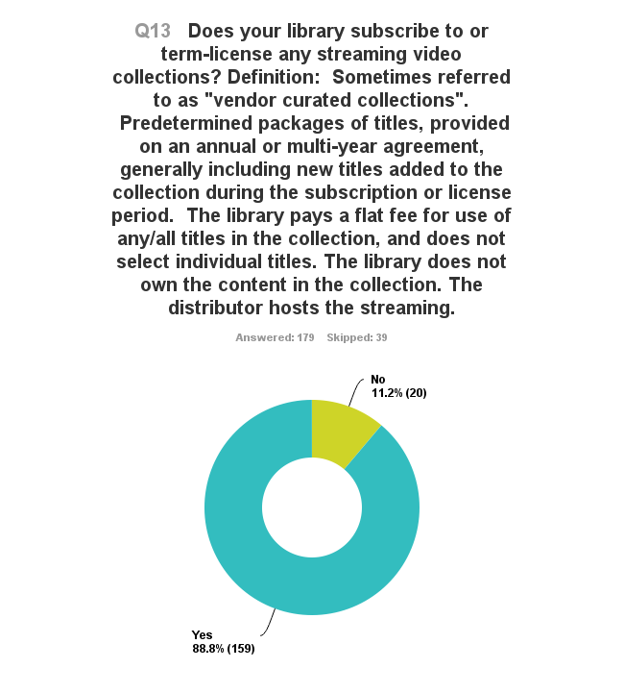
Q13 Does your library subscribe to or term-license
and streaming video collections?
Notes:
Comparable to 2013 where we found 90% of libraries with streaming video subscribe to at least one collection

Slide 30
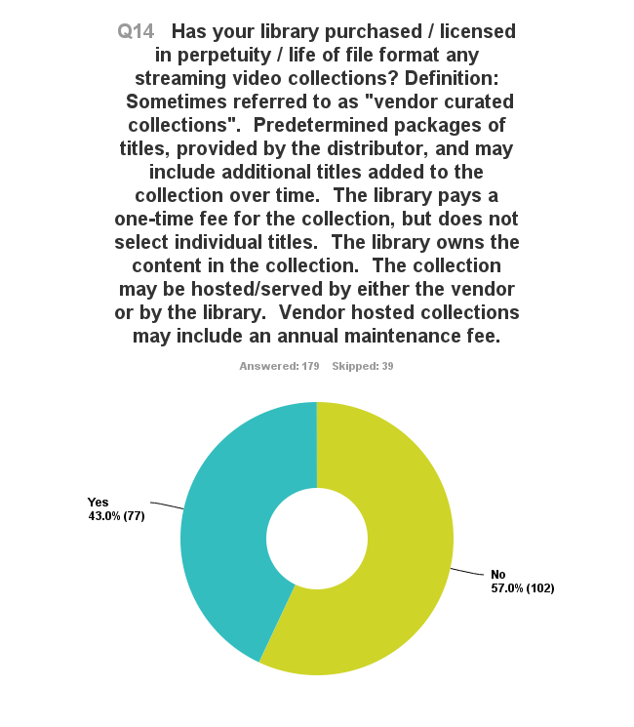
Q14 Has your library purchased / licensed in perpetuity /
life of file format any streaming video collections?
Notes:
Comparable to 2013
42% Yes and 58% No

Slide 31
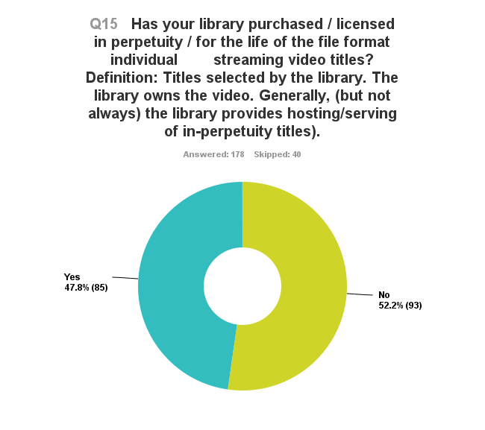
Q15 Has your library purchased / licensed in perpetuity /
for the life of the file format individual streaming
titles?
2013
Yes
47.9%
No
52.1%
Notes:
Slight increas f rom 2013 2013 44 and 56%

Slide 32
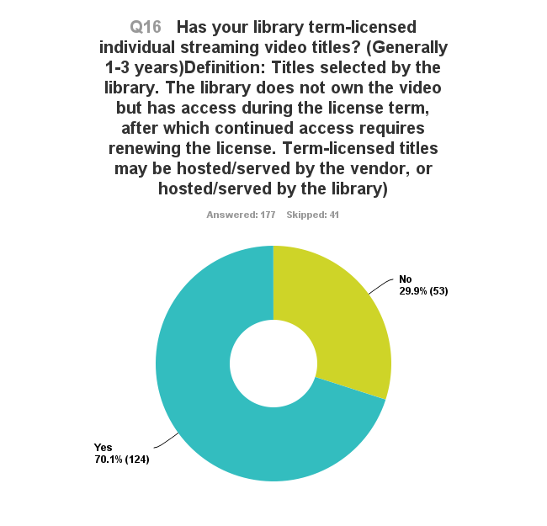
Q16 Has your library term-licensed individual
streaming video titles?
2013
Yes
28.6%
No
71.3%
Notes:
Increase from 2013 Yes 66% No 34%

Slide 33
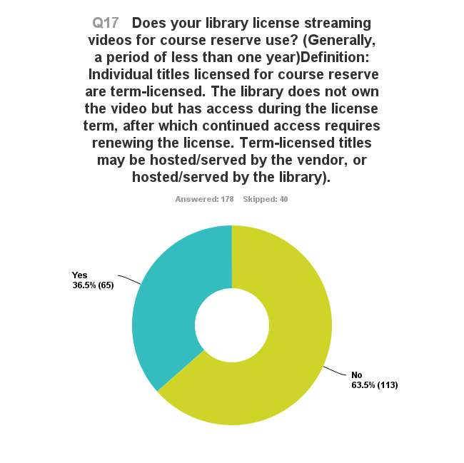
Q17 Does your library license streaming videos
for course reserve use?
2013
Yes
29.4%
No
70.6%
Notes:
When limited to libraries that stream in 2013
Incread from 2013 --- 23 Yes and 77 No
Aggregated data for all who stream
Need to compare to libraries with local hosting…....

Slide 34
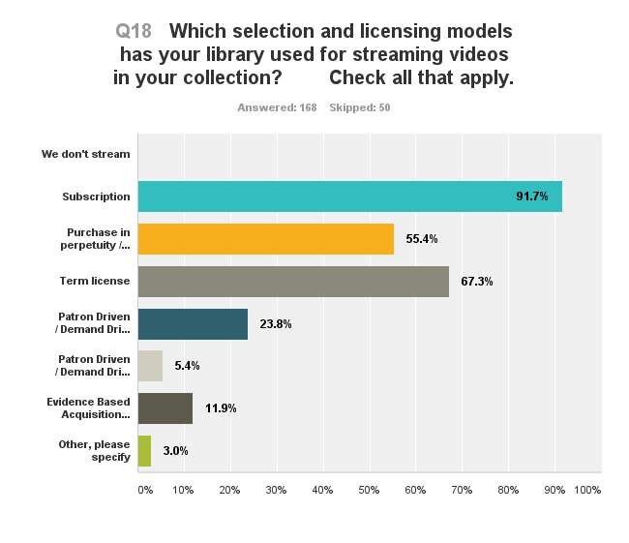
Q18 Which selection and licensing models has your
library used for streaming videos in your collection?
Notes:
Failure to SPSS

Slide 35
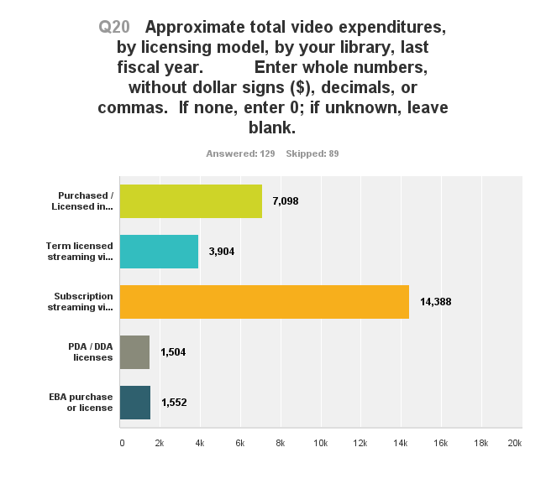
Q20 Approximate total video expenditures by your
library, by licensing model, last fiscal year
Notes:
Data not collected in 2013 so 2013 spend on individual titles was $3500 almost tripled from 2013 and subscription roughly the same 16,700 in 2013
But half as many responses on this question…..

Slide 36
Q20 Approximate total video expenditures by your
library, by licensing model, last fiscal year
Total Aggregated Average
$28,446
Notes:
Data not collected in 2013 so 2013 spend on individual titles was $3500 almost tripled from 2013 and subscription roughly the same 16,700 in 2013
But half as many responses on this question…..

Slide 37
Q20 Approximate total video expenditures by your
library, by licensing model, last fiscal year
Total Aggregated Average
$28,446
2013
Total Aggregated Spend
$20,249
Notes:
Data not collected in 2013 so 2013 spend on individual titles was $3500 almost tripled from 2013 and subscription roughly the same 16,700 in 2013
But half as many responses on this question…..

Slide 38
Collection Size
Notes:
He had hoped to collect overall size including PDA access and subscrription but our data is dirty and takes more work than we had been able to address to clean up

Slide 39
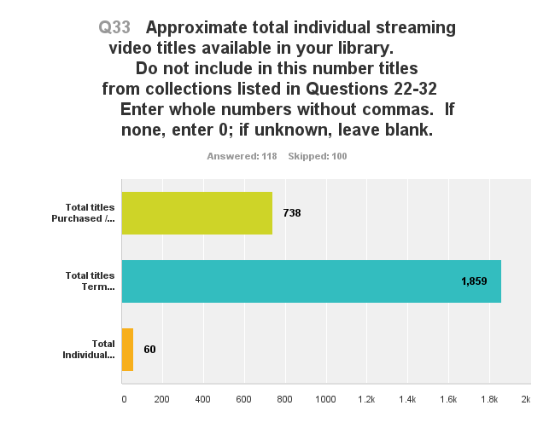
Q33 Approximate total individual streaming video
titles available in your library
(excluding titles in collections)
Course Reserve

Slide 40
Discovery & Access

Slide 41
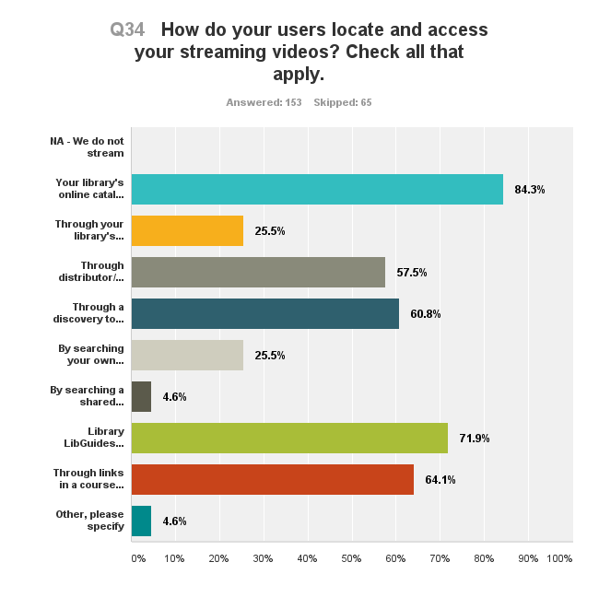
Q34 How do your users locate and access
your streaming videos?

Slide 42
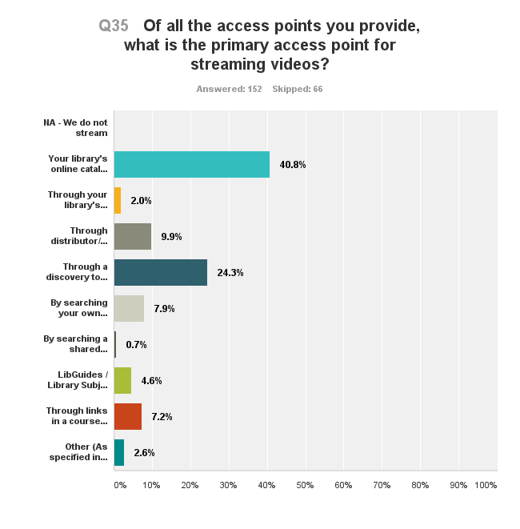
Q35 Of all the access points you provide, what is the
primary access point for your streaming videos?
Notes:
Still the library catalog… but only 40% for catalog,,,, 24 for discovery 7% in 2013

Slide 43
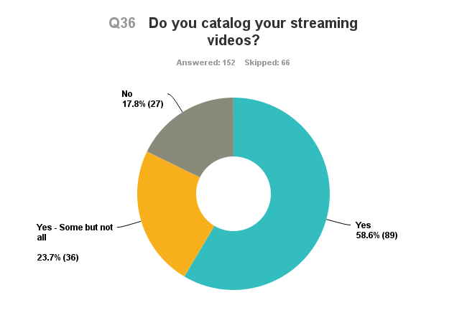
Q36 Do you catalog your streaming videos?

Slide 44
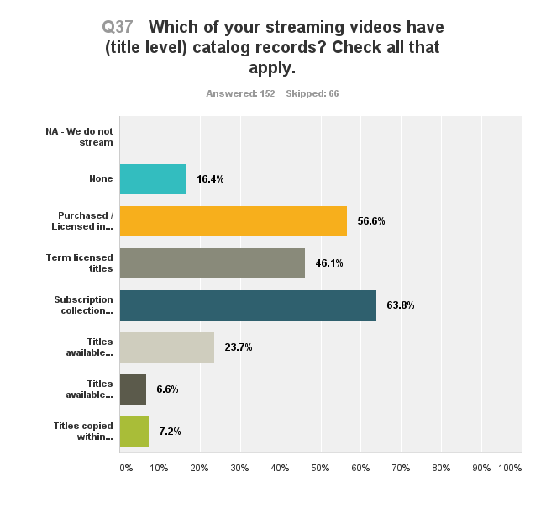
Q37 Which of your streaming videos have
(title level) catalog records?
N = 200

Slide 45
Q37 Which of your streaming videos have
(title level) catalog records?
2013
N = 200
22%
46.%
34.5%
57.5%

Slide 46
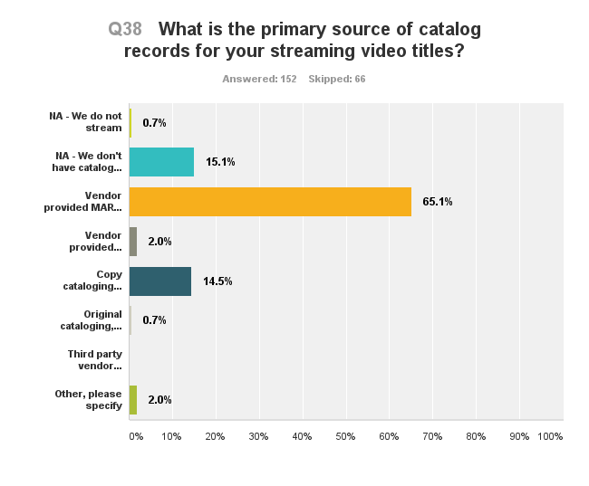
Q38 What is the primary source of catalog
records for your streaming video titles?

Slide 47
Q38 What is the primary source of catalog
records for your streaming video titles?
2013
N = 200
59%
20%
36.5%
29%
4.5%

Slide 48
Captioning
Notes:
Series of questions not asked in 2013… but since then a large lawsuit against MIT and Harvard

Slide 49
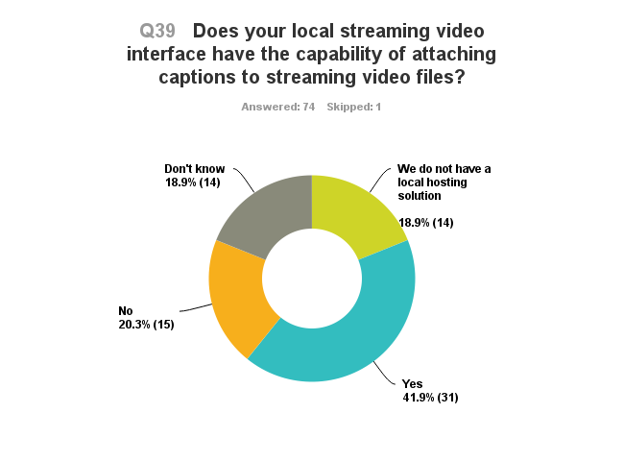
Q39 Does your local streaming video interface
have the capability of attaching captions
to streaming video files?
Notes:
Chart limited to response from libraries with a local hosting option

Slide 50
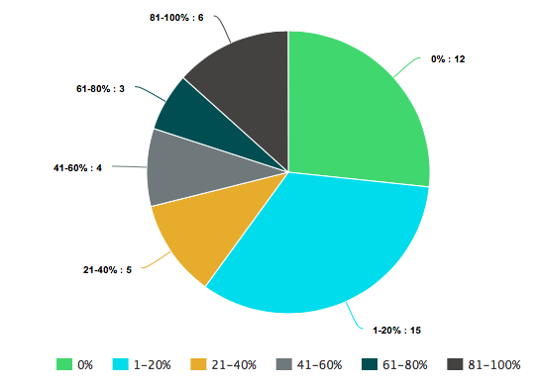
Q40 Approximately what percentage of your locally
hosted streaming videos have captions/subtitles?
N = 45
13.3%
26.6%
6.6%
8.8%
11.1%
33.3%
Notes:
VERY small sample, problem with the data, because already filtered for not having a local hosting system, 1/3 of the respondents indicated NA…. So this data is regenerated from what he have.
Important note, even with this sample size, captioning of local hosted video is virtually not existent

Slide 51
Q41 If captions/subtitles are not provided by the vendor
do you generate a caption file for locally hosted
streaming videos?
Subtitles generated?
No | 70.2%
Some titles | 26.3%
All titles | 3.5%
Notes:
Couldn’t generate a graphic for this….Again a small data set, 57 responses.

Slide 52
Format Conversion & Replacement

Slide 53
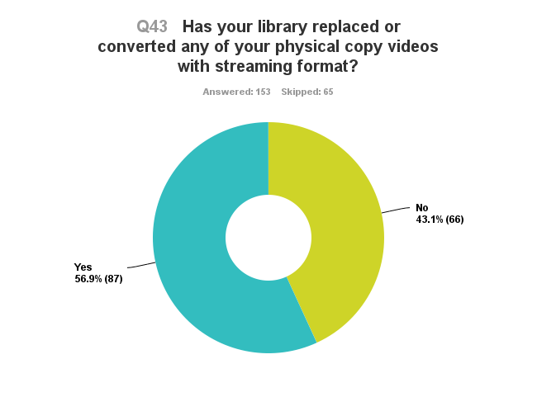
Q43 Has your library replaced or converted
any of your physical copy videos with
streaming format?
2013
Yes
63.2%
No
36.8%
Notes:
In 2013 63% and 36%
Is this the smaller sample,

Slide 54
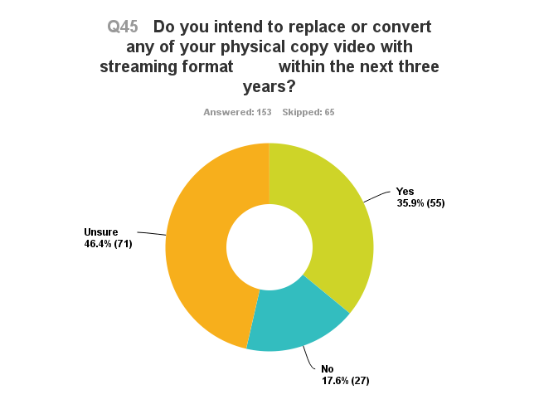
Q45 Do you intend to replace of convert any of your physical copy
video with streaming video within the next three years?
2013
Yes
63.4%
No
36.6%

Slide 55
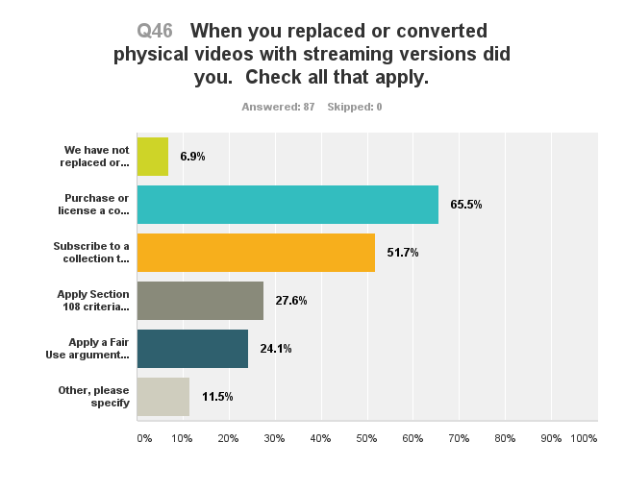
Q46 When you replaced or converted physical videos
with streaming versions did you…?
Notes:
More detailed….

Slide 56
Q46 When you replaced or converted physical videos
with streaming versions did you…?
2013
In-house
digitization
52.1%
Licensed
Digital copy
80.2%
Notes:
More detailed….

Slide 57
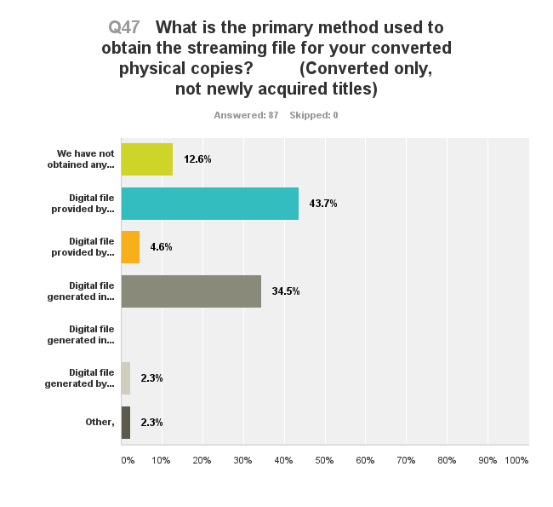
Q47 What is the primary method used to obtain the
streaming file for your converted physical copies?
Vendor hosted
Hosted locally
In house from owned copy
In house from loaned copy
Third party

Slide 58
Q47 What is the primary method used to obtain the
streaming file for your converted physical copies?
Vendor hosted
Hosted locally
In house from owned copy
Licensed?
In house from loaned copy
Third party

Slide 59
Digitization on Request
Notes:
We asked this question with trepidation in 2013… the AIME v UCLA case was still percolating thru the courts. But with the case dismissed we wanted to see if the practice had changed.

Slide 60
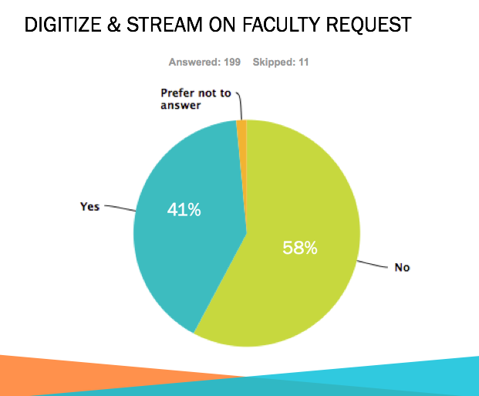
Digitization on Request
2013
Notes:
The original question was directed to the library.
In 2015 the question was slightly revised to inquire as to whether the library or any one else in the institution digitized on request.

Slide 61
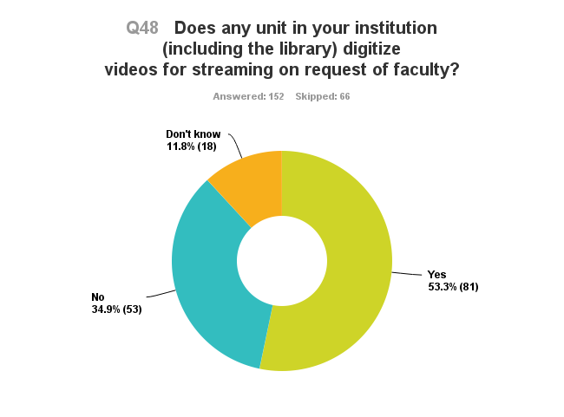
Q48 Does any unit in your institution (including the library)
digitize videos for streaming on request of faculty?
Notes:
Here we see a shift that flips the overall response from NO to Yes.
But the difference is much more dramatic if we limit the responses to institutions that have a local hosting solution.

Slide 62
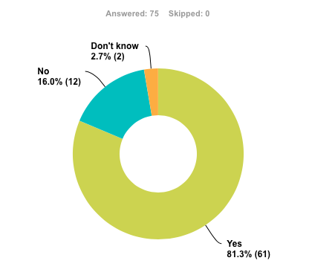
Notes:
When limited to an institution that has a local hosting solution we see a dramatic increase

Slide 63
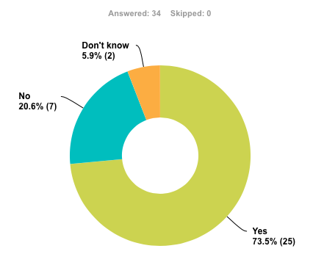
Notes:
And also a dramatic increase when limited to institutions in which the library provides the hosting solution.

Slide 64
2013
Yes
41%
No
58%
Notes:
And also a dramatic increase when limited to institutions in which the library provides the hosting solution.

Slide 65
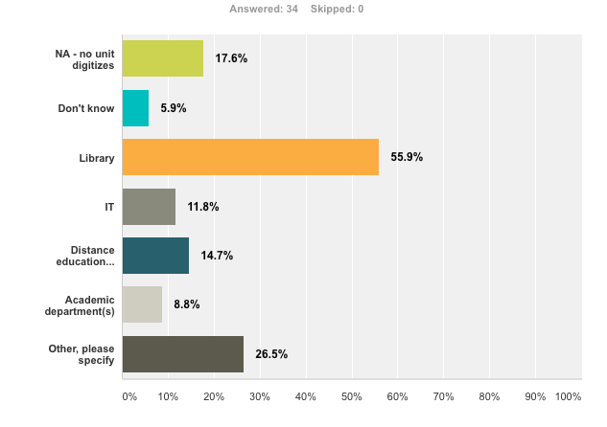
Q49 What unit(s) in your institution digitize videos
for streaming on request?
Notes:
The results here are limited to institutions in which the library has a hosting solution

Slide 66
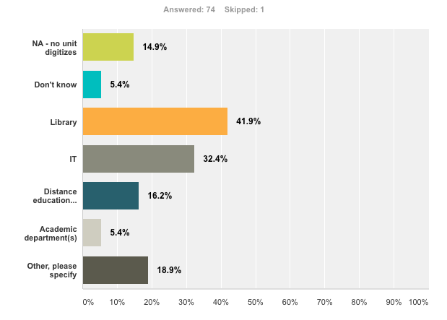
Q49 What unit(s) in your institution digitize videos
for streaming on request?
Notes:
When broadened to include any hosting solution in the institution, the library’s role is much smaller, assumed more by IT and distance ed.
When asked about the volume of digitization on request, numbers varied wildly…. Form a low of 5 to a high of 400
Still staying with libraries that digitize and provide a hosting solution….. We asked about the purposes for which they will digitize

Slide 67
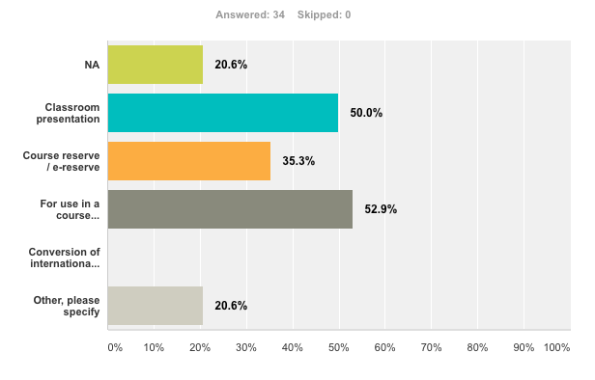
Q51 For what uses are videos digitized on request?
Notes:
Still staying with libraries that digitize and provide a hosting solution….. We asked about the purposes for which they will digitize
This is a check all that apply question so the numbers total greater than 100%
They do not vary greatly from the numbers when the response is not limited to the library as the hosting agent.... 49% for classroom, 35% for reserve, 58% for course management shell
The one difference is the inclusion of conversion of international format (PAL or SECAM to NTSC) 2.8%

Slide 68

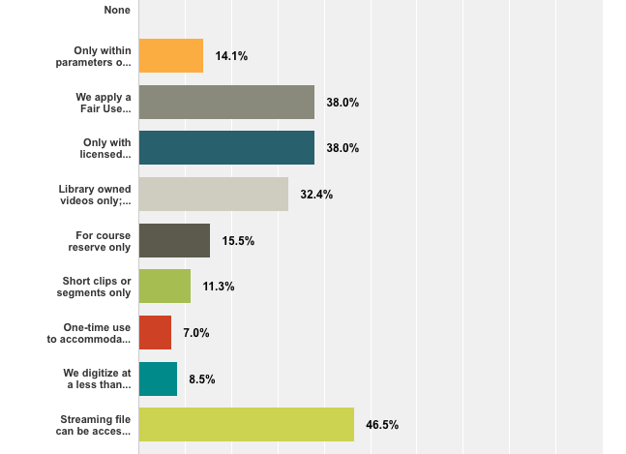
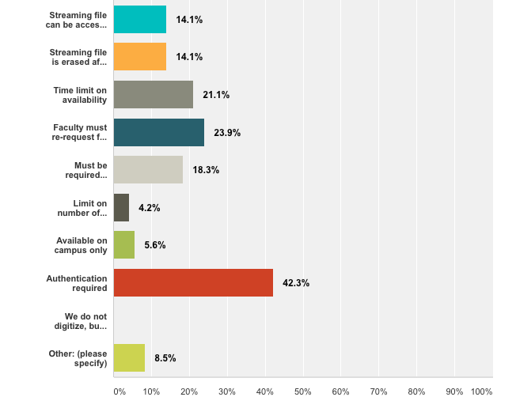
Q52 What limits or legal precautions do you apply when
digitizing on request?
Notes:
As you can see….. Many many many permutations of limitations.... These are the ones that we identified for the survey. And still respondents had others

Slide 69
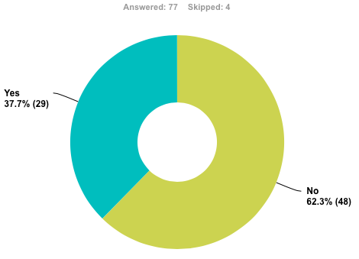
Q53 Do you have written policy statements on
digitization for streaming?
Notes:
Slightly higher YES among libraries that are the hosting agent

Slide 70
Q53 Do you have written policy statements on
digitization for streaming?
2013
Yes
39%
No
61%
N = 80
Notes:
Libraries that digitize on request, comparison of 2013 data

Slide 71
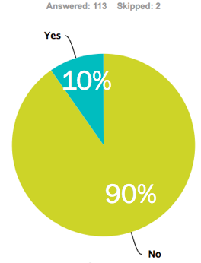
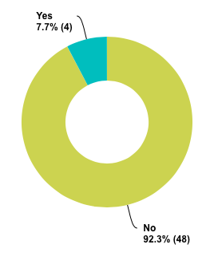
Written policy statements for libraries that do NOT digitize on request
N = 52
2015
2013

Slide 72
Technical Infrastructure
Notes:
Already referenced this and have applied this data to filter a number of questions.

Slide 73
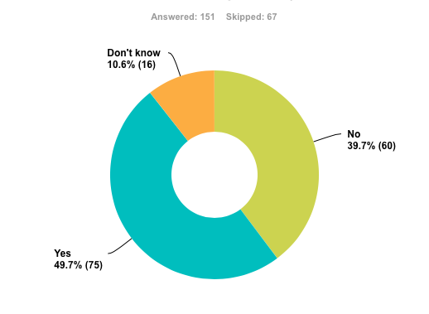
Q54 Does your institution (the library, IT, or any other unit)
currently provide a technical infrastructure for
streaming video? (A local hosting option)

Slide 74
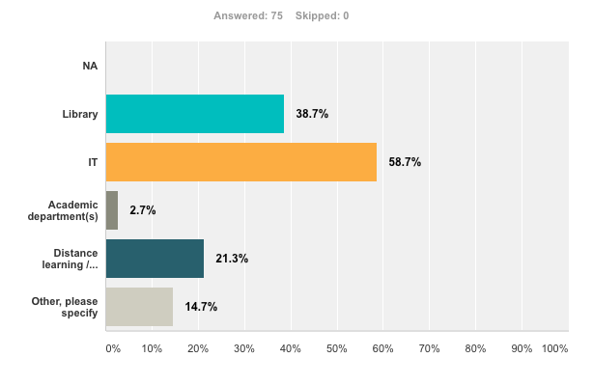
Q55 Which unit(s) in your institution provide(s) a technical
infrastructure for streaming video?

Slide 75
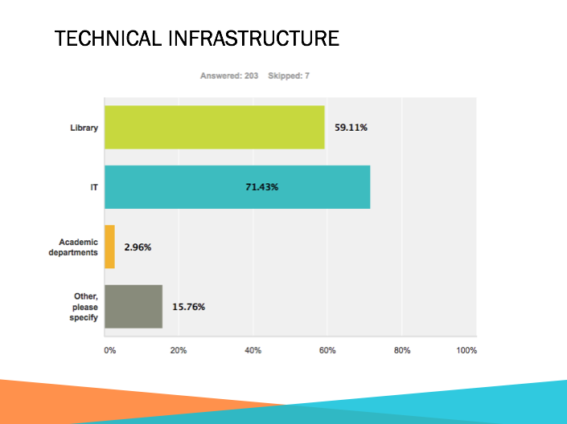
Q55 Which unit(s) in your institution provide(s) a technical
infrastructure for streaming video?
2013

Slide 76
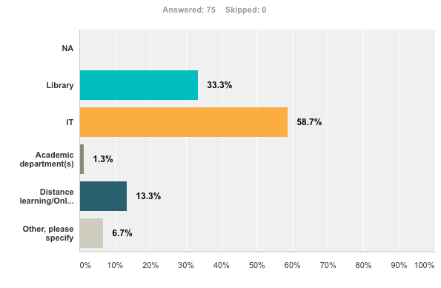
Q56 Which unit in your institution has primary responsibility
for the technical infrastructure for streaming video?
Notes:
These two questions are VERY similar but not exactly the same as questions we asked in 2013. But the response is QUITE different.

Slide 77
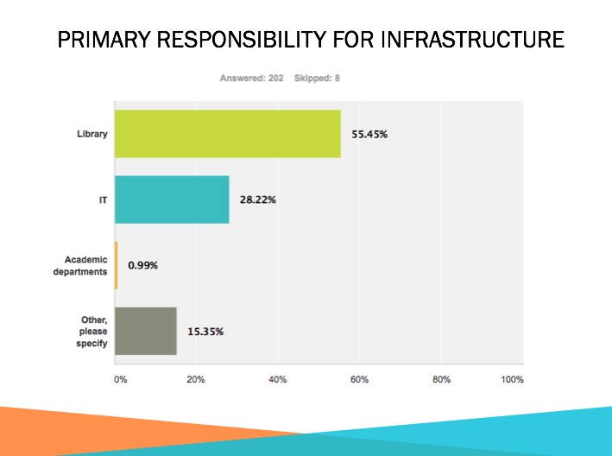
Q56 Which unit in your institution has primary responsibility
for the technical infrastructure for streaming video?
Notes:
These two questions are VERY similar but not exactly the same as questions we asked in 2013. But the response is QUITE different.

Slide 78
Hosting
Notes:
We asked questions about percentage of content hosted locally or via a distributor. The data was so convoluted and difficult to illustrate we have left it off this presentation.

Slide 79

Hosting
Notes:
We asked questions about percentage of content hosted locally or via a distributor. The data was so convoluted and difficult to illustrate we have left it off this presentation.

Slide 80
Workflow
Notes:
We asked a number of questions related to personnel responsibilitiies and workflow issues… questions about licensing, generating digital files, captioning, and time commitment

Slide 81

Q60 Who in your library is primarily responsible for negotiating
streaming video licenses?

Slide 82

Q60 Who in your library is primarily responsible for negotiating
streaming video licenses?
Notes:
Note that this work load changes dramatically if there is a media librarian

Slide 83

Q61 When you need to generate a digital file from a hard copy
video, where does the digitization occur (usually)?

Slide 84

Q62 If digitization from hard copy occurs in the library, which
unit usually generates the digital file?

Slide 85

Q63 When you need to generate a caption file for a streaming
video, where does the captioning occur (usually)?

Slide 86

Q64 If captioning processes occur in the library, which
unit generally generate the digital file?

Slide 87

Q65 Do you have a written workflow document for
handling streaming video assets?
Notes:
This is not a question we asked in 2013.
This is really misleading, since 25 responses are NA, we don’t stream.

Slide 88

Q65 Do you have a written workflow document for
handling streaming video assets?
N = 123
30.9%
69.1%
Notes:
This is closer to reality….

Slide 89

Q66 Approximately how much personnel time in your library
is dedicated to licensing, digitization, ingestion, metadata
and other processes for your streaming video?
Notes:
Lastly, we asked about amount of staff time dedicated to streaming video work.
Here we specified that the functions may be performed by one or more units and/or personnel throughout the library, and asked for an aggregated estimate.

Slide 90
Q66 Approximately how much personnel time in your library
is dedicated to licensing, digitization, ingestion, metadata
and other processes for your streaming video?
2013
42.3%
17.1%
11.7%
4.5%
24.3%
Notes:
Lastly, we asked about amount of staff time dedicated to streaming video work.
Here we specified that the functions may be performed by one or more units and/or personnel throughout the library, and asked for an aggregated estimate.

Slide 91
Summary Points
Streaming video is well established as an academic library service.
The “vanishing” media librarian is real. This topic deserves greater investigation.
Academic libraries are not captioning their streaming videos.
Term licensing exceeds licensing in perpetuity; libraries hold more than twice as many term licensed titles as purchased titles
Send?
Cataloging of streaming video has increased

Slide 92
Summary Points
In general libraries are not adding captions to their locally hosted streaming video.
Format conversion has slowed, but continues to be handled predominantly as repurchased content.
Digitization on request has flipped
Libraries apply a broad range of limitations on digitization on request
Primary responsibility for technical infrastructure has shifted from the library to IT
There is a lack of written documentation for streaming video work flow

Slide 93
Questions Unasked
Collection development policies
Availability of a discovery layer
Behavioral data
  Satisfaction
Return on investment
  Cost per use

Slide 94
Access to survey info
Summary document of 2015 survey data available on written request
This presentation posted to ASU Libraries Repository
Survey instrument (2015) available in ASU Libraries Repository
https://repository.asu.edu/items/39010
Presentation on 2013 survey data available in ASU Libraries Repository
https://repository.asu.edu/items/18973
Summary of key findings from 2013 survey
farrelly, d. and Hutchison, J. (2014). Streaming video in academic libraries: Ten key
findings from a national survey. Against the Grain, 26(6), 73-75.
https://repository.asu.edu/items/39057

Slide 95
Contact
deg farrelly
Media Librarian
Arizona State University
deg.farrelly@asu.edu
Jane Hutchison Surdi
Associate Director Instruction & Research Technology (Retired)
William Paterson University
surdij@wpunj.edu

Slide 96
Questions?

