Slide 1
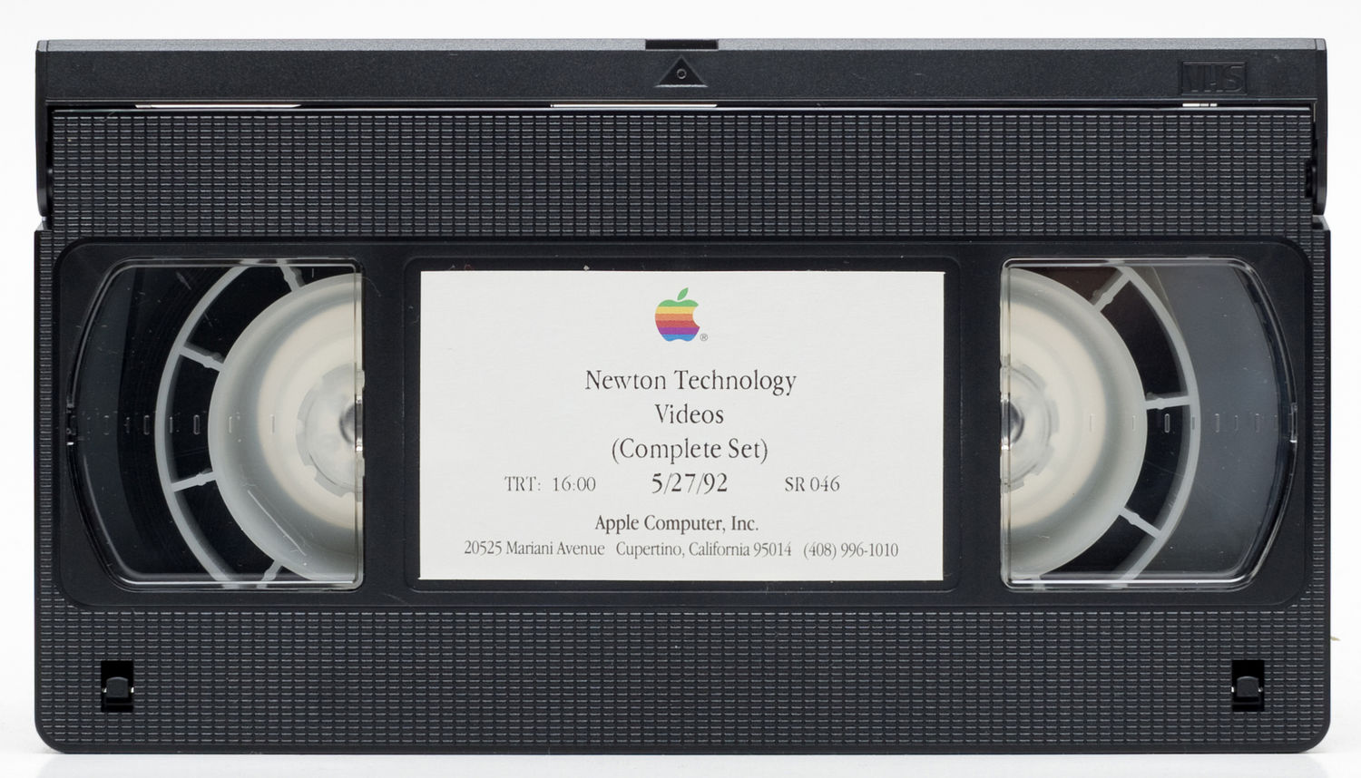
Academic Library Streaming Video
Revisited
VHS
A Running Start:
A Crowd-Sourced Database
of Due Diligence
to Invoke
Section 108
deg farrelly – Arizona State University
Jane Hutchison Surdi – William Paterson University
deg farrelly – Arizona State University
Charleston Conference – November 4, 2016
American Library Association Annual Conference, 2016 - Orlando Florida

Slide 2
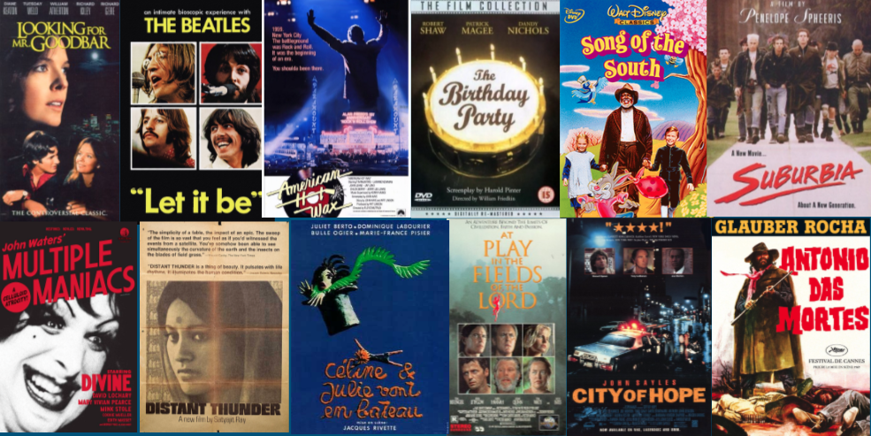
Scope of the Issue
Notes:
Third revolution in media collection.
Advent of home video in mid 1970s and the concomitant rise of media libraries and librarians changed the game
Later came DVD with added benefits and issues
Now streaming is a dominant form of collection.
Comments on how video changed collection development in academic and public libraries
In the aggregate

Slide 3

Scope of the Issue
= 500 VHS Tapes
Average
3413
Associate
1449
Baccalaureate
2126
Masters
2255
Doctoral
5325
ARL
8328
Source: farrelly, d. & Hutchison, J. (2013) Survey of academic library streaming video [Data file].
Provided by authors
Notes:
This data is an average of all responses, by Carnegie classification of 2013 survey of streaming video in academic libraries. Total responses – 320
CONSERVATIVE estimates are that 15-28% of titles in typical academic library are no longer available in the marketplace

Slide 4
17 U.S. Code – Section 108 – limitations on exclusive rights:
Reproduction by libraries and archives.
What does is allow?
What does it require?
What are the limitations

Slide 5
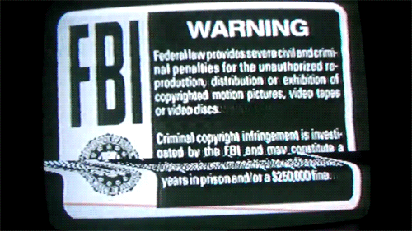
Section 108
Notes:
Despite this common warning the law does allow unauthorized duplication

Slide 6
17 U.S. Code § 108 - Limitations on exclusive rights: Reproduction by libraries and archives
https://www.law.cornell.edu/uscode/text/17/108
(c) The right of reproduction under this section applies to three copies or phonorecords of a published work duplicated solely for the purpose of replacement of a copy or phonorecord that is damaged, deteriorating, lost, or stolen, or if the existing format in which the work is stored has become obsolete, if—
(1) the library or archives has, after a reasonable effort, determined that an unused replacement cannot be obtained at a fair price; and
Notes:
This is what the law states….. It states a lot of other things too.... But this particular law is the librarians’ friend

Slide 7
In Brief
You can make up to 3 digital copies of items that are:
Lost
Damaged
Stolen
Deteriorating
Obsolete format

Slide 8
Provided…..
You have conducted:
A reasonable search
For an unused copy
At a fair price
Notes:
These are the basics
Copyright office does not define reasonable or fair

Slide 9
Limitations of Section 108
3 copies
Digital copies cannot be:
  (c) (2) … made available to the public in that format outside the premises of the library or archives in lawful possession of such copy.

Slide 10
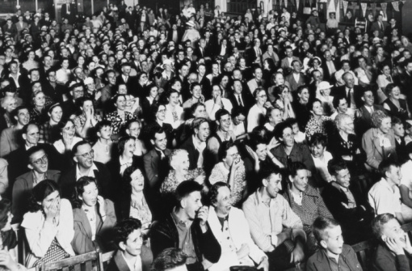
Notes:
Question? What constitutes “Public”
The law doesn’t specify, legal opinions differ, some assert that the college/university population is NOT “the public”

Slide 11
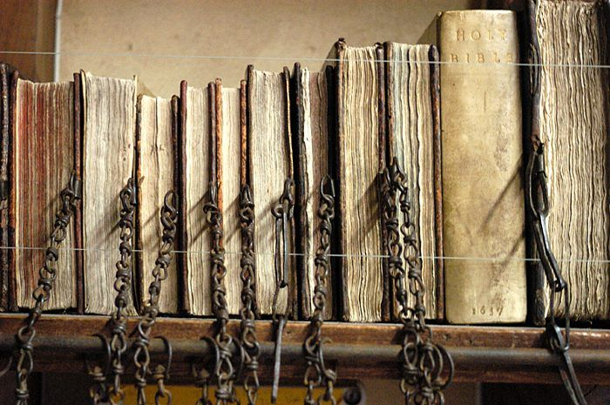
Notes:
What constitutes “Premises” Also a contentious issue, especially now that libraries are largely digital with authenticated access authenticated.
We certainly don’t want to return to an era of Chained Books

Slide 12
But…
(f) Nothing in this section—
(4) in any way affects the right of fair use as provided by section 107…
Notes:
We’re not going to belabor fair use. It is reasonable to make a fair use claim for use of duplicated videos in the classroom.
As emphasized in Section 108, the right of fair use is unaffected by section 108. A fair use argument can still be considered if the conditions of Section 108 aren’t met. Because there has been no functional market for commercial VHS videotapes or over a decade, VHS content that hasn’t been re-released in current formats is at-risk of permanent loss and should be protected.

Slide 13
Deteriorating or Obsolete?

Slide 14
Section 108 defines “obsolete”
(c) (2) …a format shall be considered obsolete if the machine or device necessary to render perceptible a work stored in that format is no longer manufactured or is no longer reasonably available in the commercial marketplace.

Slide 15
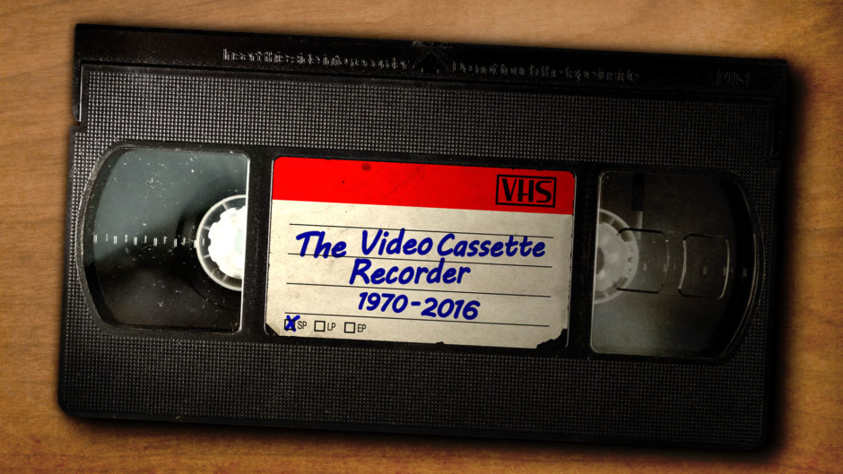

Last manufacturer of VHS players - Funai Corp discontinued production in July 2016
Notes:
Funai-licensed brands include: Emerson, Magnavox, Philips, Sanyo, Sylvania, Symphonic
Funai is also the supplier for Denon, Sharp, Toshiba
As of Oct. 23, 2016, Walmart only listed a couple refurbished models. Amazon lists just one new Sanyo model.
In addition to the low-grade players finally being discontinued, there haven’t been industrial-grade VHS players available for years and along with that, there has been a lack of replacement parts and repair technicians.
The players at Walmart will be gone by the time you complete your inventory of what you need to digitize. Or they will be soon after. If necessary start digitizing but wait until you are convinced the last player on the shelves is gone before making access DVD copies.
It’s a gamble that 3D printers will be capable of duplicating finely machined nylon or rubber parts, much less, playback heads or burned out motors.
If you have thrown in the towel and decided you cannot feasibly afford to salvage your collections, do not discard them. Be sure to make their availability known to peer institutions.

Slide 16
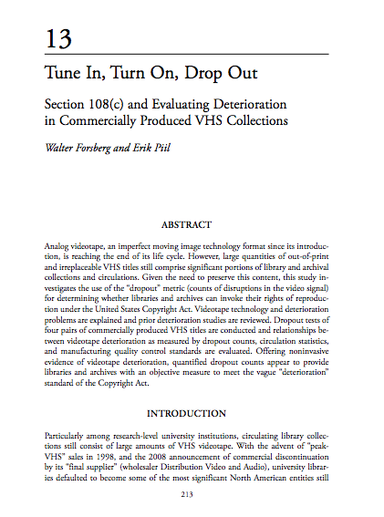
Forsberg, W. & Piil, E. (2014). Tune in, turn
on, drop out. In S. Hastings (Ed.) Annual
Review of Cultural Heritage Informatics
(pp.213-242). Lanham: Rowman &
Littlefield Publishers.
Notes:
Research shows that out of shrink wrap new VHS tape fails to perform at manufacturing standards

Slide 17
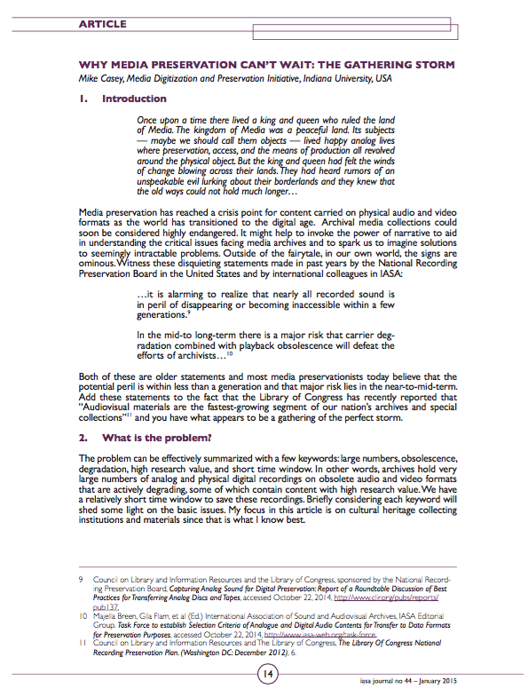
Urgency
Whether that of obsolescence or deterioration, the issue is
critical and urgent.
Casey, M. (2015). Why media preservation
can’t wait: The gathering storm. IASA
Journal, 44, 14-22.
Notes:
The window is closing. Estimates among moving image archivists fall around 2025-8 when the event horizon of degralescence is reached, the combination of degradation and obsolescence of players, parts, and repair personnel make VHS-only content all but unsalvageable.

Slide 18
Arguments against taking action
There are players still available at Walmart.
We will be able to repair our VHS players with parts made with 3D printers.
We lack expertise and/or funds

Slide 19

Don’t kick the can down the road!
Notes:
AN INCONVENIENT TRUTH! VHS digitization and preservation require an investment of time and effort. The benefits may not be seen for many years so it may be hard to appreciate the urgency today. But just like saving for retirement, the stewardship of VHS content is best managed if you invest early.

Slide 20
What constitutes ”Reasonable” effort?
17 U.S. Code § 108 (c) (1)
“The library or archives has, after a reasonable effort, determined that an unused replacement cannot be
obtained at a fair price.”
Notes:
Not clearly defined.
Recommended: VHS Distributor/Copyright Search Log
IMPORTANT. You need only look for current distribution of an unused copy at a fair price. It isn’t necessary to locate the copyright holder!

Slide 21
What constitutes ”Reasonable” effort?
For searching:
WorldCat
Original publisher/distributor
Google
Amazon
Notes:
WorldCat - to determine if a DVD copy appears to have ever been released - perhaps by a different distributor
An online search of the title, key personnel, and “DVD” - should be adequate to determine if the original distributor or a subsequent distributor is selling the video in a current format.
An Amazon search.
If you locate used VHS copies on Amazon or eBay or even one-off “new” copies from third-party sellers, do not hesitate to digitize your copies. These are not adequate replacements.

Slide 22

Notes:
There are a lot of shades of grey in this issue
What if the only replacement copies are in PAL format? If your VHS copy is NTSC, should this prevent you from digitizing your copy?
What if the only available replacement copies don’t have closed captions or subtitles but your VHS copy does?
Would a hosted streaming version of your VHS content meet the definition of an unused replacement copy?
Can you digitize an earlier edit of a film that was later re-edited for the DVD release?

Slide 23
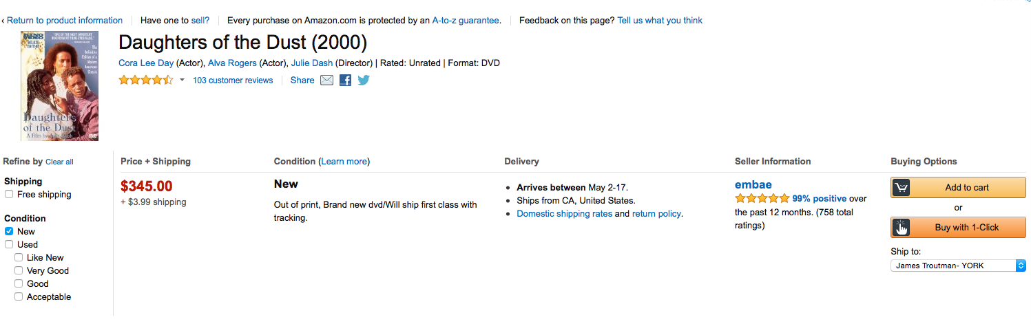
What constitutes ”fair” price?
Notes:
This is a muddy area. “Fair” price is subjective. For large institutions with large acquisitions budgets, there may be greater tolerance for high OP pricing.
We have determined that both reasonable search and fair price precludes titles that are available only thru Term License, or subscription plans.
A pricing model that requires the library to repay for the content, while never owning a permanent copy does not meet the “reasonalbe” standard.

Slide 24
Section108video.com Database
Notes:
Blather here about the participants, yada yada yada

Slide 25
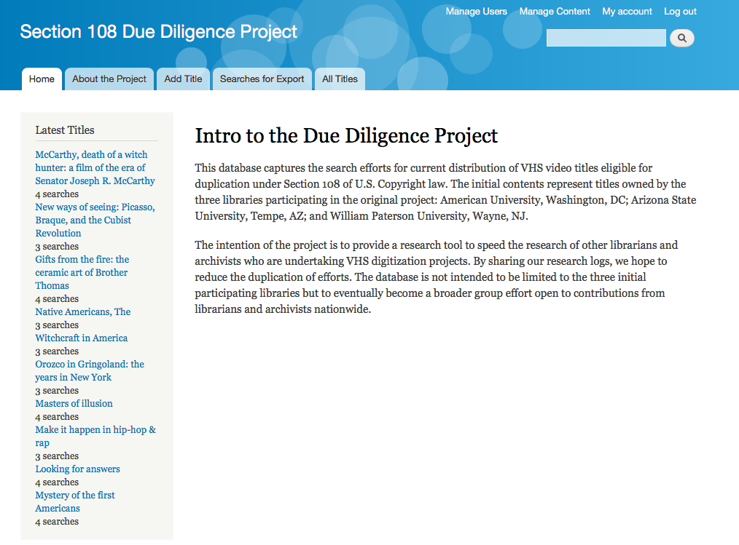
Section108video.com Database

Slide 26
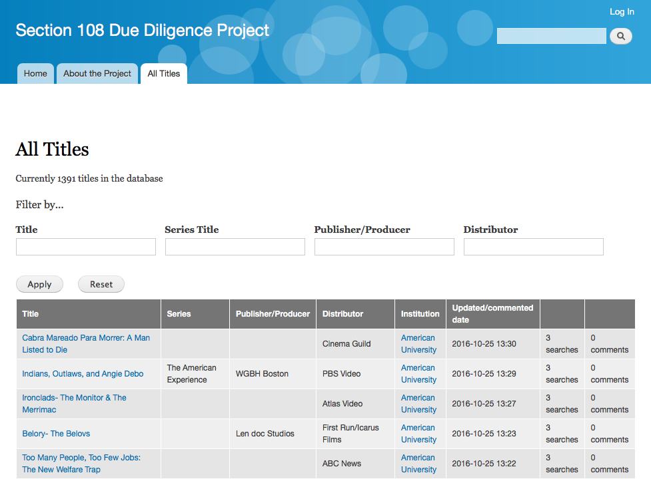
All Titles

Slide 27
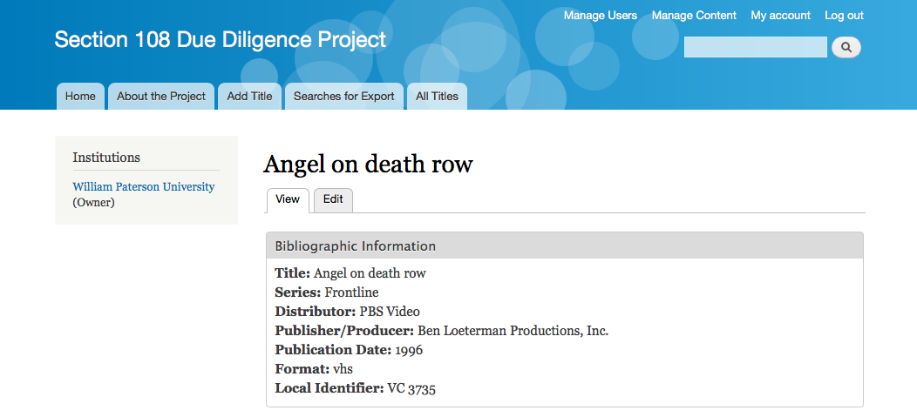
Title Record

Slide 28
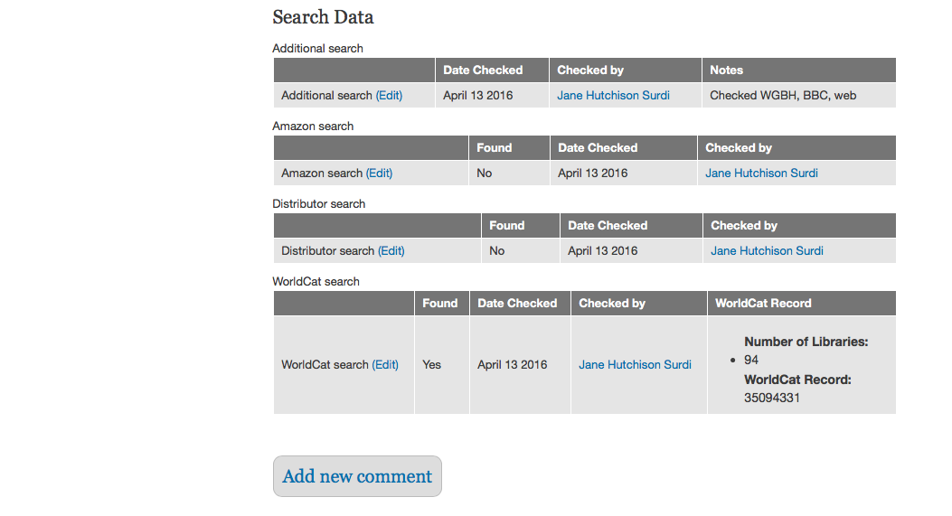
Title Record, Search Data

Slide 29
Title Record, Search Data

Slide 30
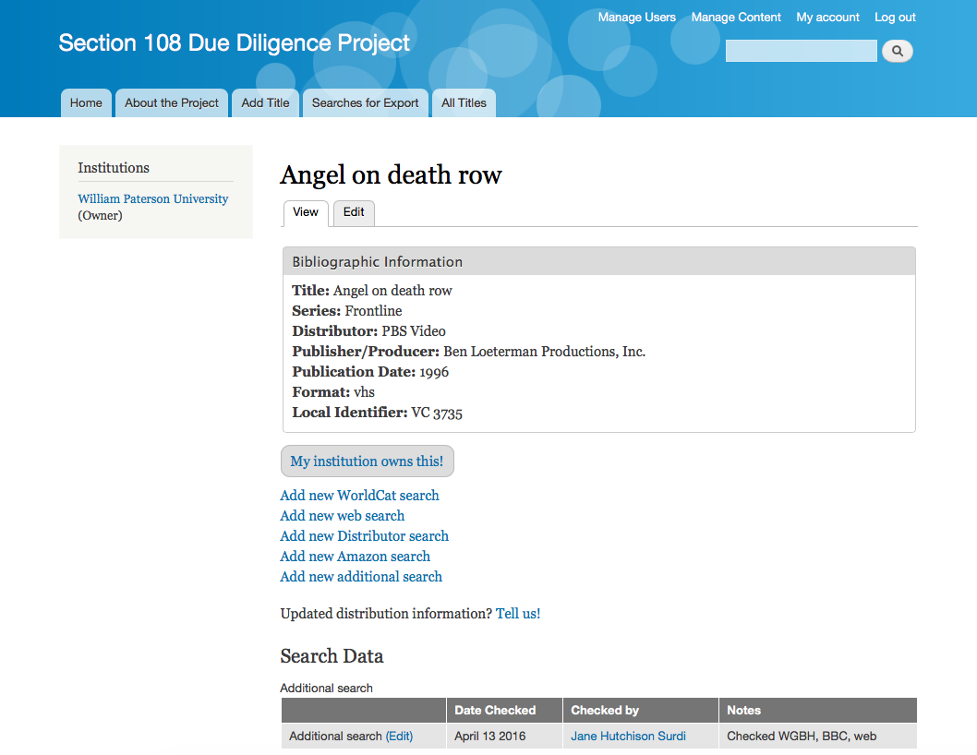
My Institution Option

Slide 31
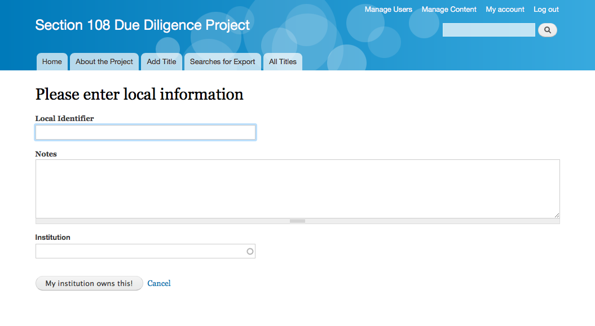
Your Institution

Slide 32
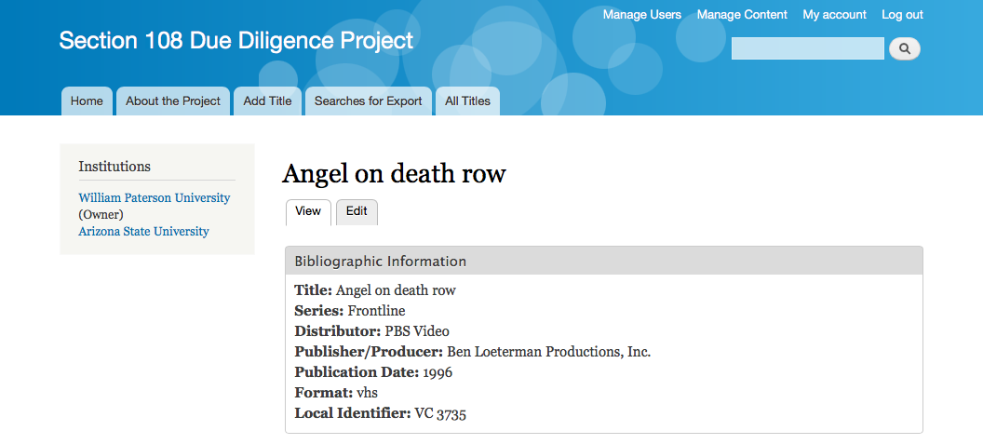
Notes:
Note that the display does not include the local identifier at this time. An enhancement we are working on.

Slide 33
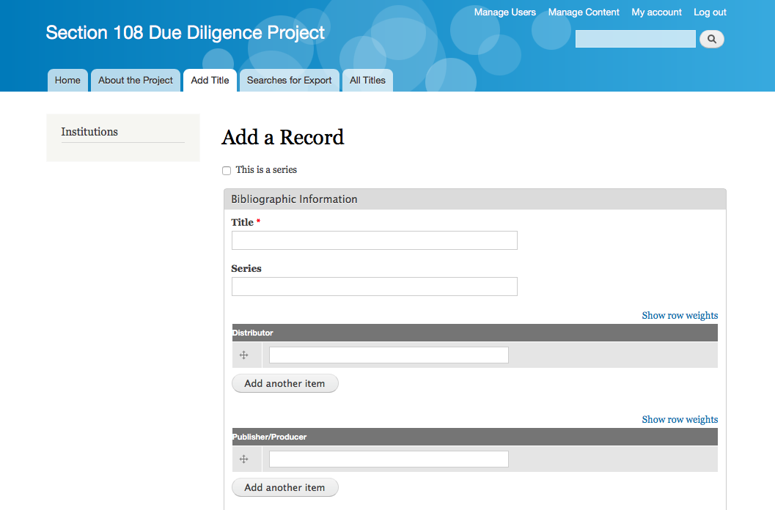
Add Record, Part 1

Slide 34
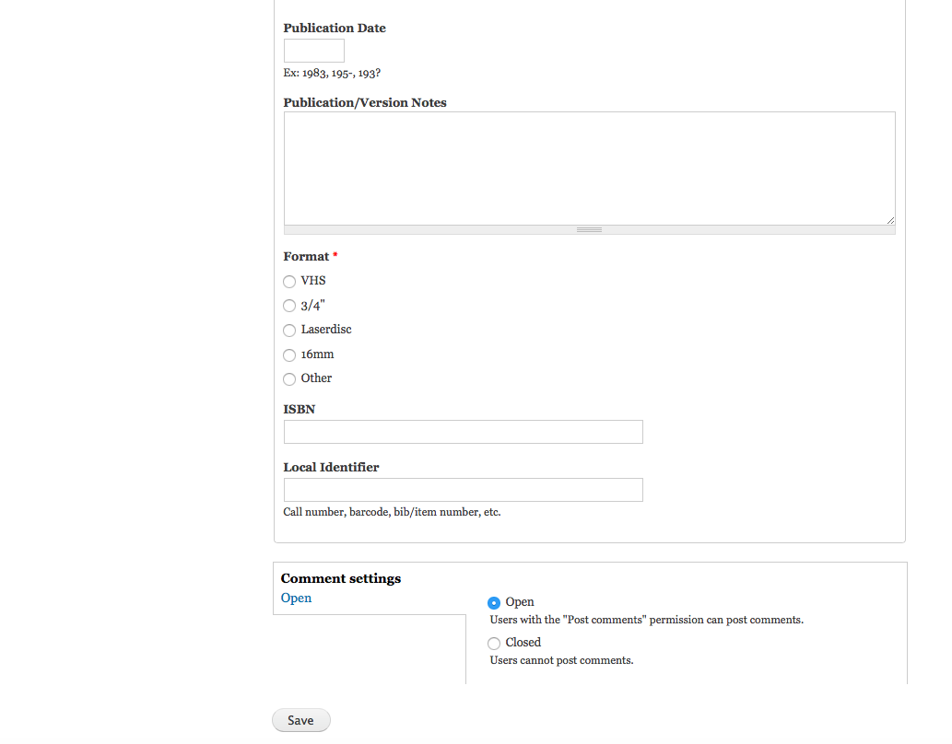
Add Record, Part 2

Slide 35
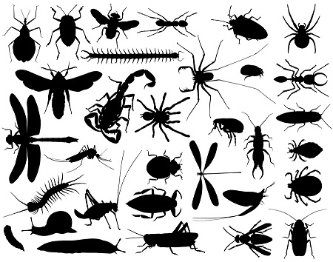
Notes:
Still some bugs…
General comments about our collections, our due diligence, happy to be corrected yada yada

Slide 36
Next steps
Database available now for anyone to view
Making available for others to add titles or metadata
Data entry is not automatic, you need to request a user
account

Slide 37
Pipe Dream
Potential for a large scale preservation effort akin to
The HathiTrust or WEST
Notes:
HathiTrust has expressed no interest.
Such a project would be costly, at $50-80 per digitization…. With captions, Archival copy, Mezzanine copy, streaming copy, DVD perhaps
Given the failure of the US to establish a robuts, continuing preservation effort, hope is not high. See IthakaS+R Issue Brief
Still.....

Slide 38
In the meantime…
Don’t wait to get started with your own collection:
Run a report of your VHS holdings - and take an inventory of
what has been replaced, what is available for replacement,
and what is out of distribution
Using a log form, document your searches for
out-of-distribution titles
Join the section108video.com effort
Become familiar with outside digitizing options
Develop a long-term preservation strategy
Evaluate cost-effectiveness of building an in-house digitizing
station
Learn about implications of long-term digital preservation of
video files

Slide 39
A few more suggestions
Before discarding low-use VHS recordings, offer them to other institutions
Prolong your tapes’ lives by storing in a climate-controlled environment: 65F +/- 3 degrees, rel humidity 40% +/- 5%
Laserdiscs? CD-ROMs? If you don’t have playback
equipment, buy it on ebay now!
After digitizing, do not discard the originals. You may need
to go back to them in a worst-case scenario.

Slide 40
Finally:
The Andrew W. Mellon Foundation has awarded the Council
on Library and Information Resources (CLIR) $2.725 million
for a regranting program to digitize “at risk” audio and
audiovisual materials of high scholarly value.
The program will run four competitions between January
2017 and September 2018, awarding a total of $2.3 million.
Visit https://www.clir.org/recordings-at-risk

Slide 41
References
Besser, H., Brown, M.A., Clarida, R., Forsberg, W., Righter. M.,
& Stoller, M. (2012). Video at risk: Strategies for preserving
commercial video collections in libraries. Section 108
Guidelines. Retrieved from
http://www.nyu.edu/tisch/preservation/research/video-risk/
Casey, M. (2015). Why media preservation can’t wait: The
gathering storm. IASA Journal, 44, 14-22. Retrieved from
http://www.avpreserve.com/wp-content/uploads/2015/04/
casey_iasa_journal_44_part3.pdf

Slide 42
References
Enis, M. (2016). Please rewind: Preservation. Library Journal,
141, 10, 45-47 Retreived from: http:lj.libraryjournal.com/2016/
06/technology/please-rewind-preservation
Forsberg, W. & Piil, E. (2014). Tune in, turn on, drop out. In S.
Hastings (Ed.) Annual Review of Cultural Heritage Informatics
(pp.213-242). Lanham: Rowman & Littlefield Publishers.
New York University. (2012, September 25) Video at Risk:
Strategies for preserving commercial video collections in
research libraries. Retrieved from
http://www.nyu.edu/tisch/preservation/research/video-risk/

Slide 43
References
Marcum, D. (2016). Due diligence and stewardship in a time of
change and uncertainty. Ithaka S+R Issue Brief. Retrieved
from http://www.srithaka.org/wp-content/uploads/2016/04/SR_
Issue_Brief_DueDiligence_Stewardship042616.pdf
U.S. Copyright Office (2014, July 23). Copyright law
of the United States of America and related laws
contained in Title 17 of the United States Code.
Retrieved from
http://www.copyright.gov/title17/92chap1.html#108

Slide 44

Questions?

Slide 45
Contact:
deg farrelly
deg@asu.edu
602.332.3103

Slide 50
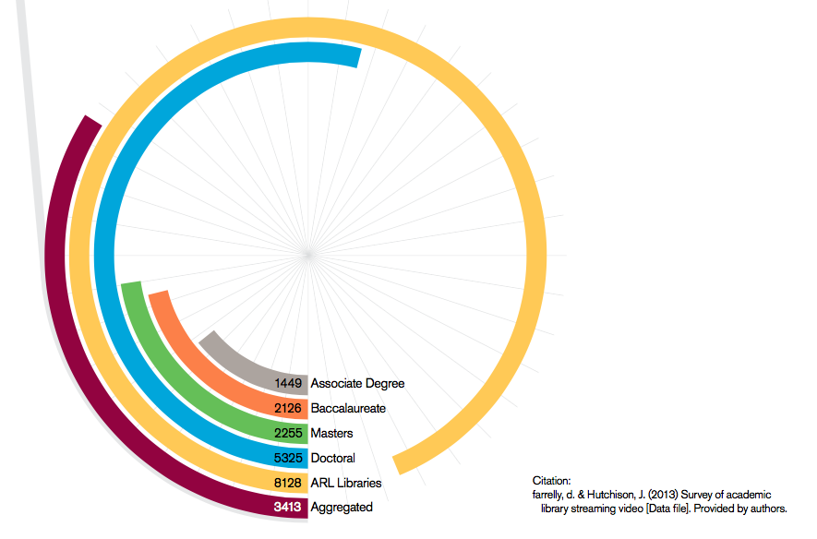
Scope of the Issue
Notes:
This data is an average of all responses, by Carnegie classification of 2013 survey of streaming video in academic libraries. Total responses – 320
CONSERVATIVE estimates are that 15-28% of these titles are no longer available in the marketplace

