Slide 1
Streaming video in
Academic Libraries
Preliminary results from a National Survey
deg farrelly, Arizona State University
Jane Hutchison, William Paterson University
2013 Charleston Conference
Charleston, South Carolina
Notes:
Blah blah blah about us.
Jane Hutchison
Associate Director Instruction & Research Technology William Paterson University
Responsible for the grant funded NJVId consortial streaming portal
Jane and deg co-organized the Higher Education Digital Video Summit, March 2010
Jane and deg are co-partners in RHS Academic Media Consulting

Slide 2
Notes:
<?xml version="1.0" encoding="ISO-8859-1" ?>
<poll url="http://www.polleverywhere.com/multiple_choice_polls/9H2qN1EdjTqseNe">
<!-- This snippet was inserted via the PollEv Presenter app -->
<!-- The presence of this snippet is used to indicate that a poll will be shown during the slideshow -->
<!-- TIP: You can draw a solid, filled rectangle on your slide and the PollEv Presenter will automatically display your poll in that area. -->
<!-- The PollEv Presenter app must also be running and logged in for this to work. -->
<!-- To remove this, simply delete it from the notes yourself or use the PollEv Presenter to remove it for you. -->
<title>My favorite Thanksgiving dish is:</title>
</poll>

Slide 3
Questions
What is the current state of streaming video in academic libraries?
How prevalent is streaming video in academic libraries?
Who has primary responsibility for streaming video?
What hosting platforms are used?
How do users discover and access streaming videos?
How much staff time does streaming video demand?
Notes:
We decided to focus on streaming because we believed it was the future for media collections.
Know that it is rapidly changing, we’ve been involved in that change,
But we wanted to know more of the scope and current snapshot of this relatively new approach to content in academic libraries
After attending a variety of conferences, discussing with our colleagues, these are the primary questions we addressed to inform planning, services and acquisitions for academic libraries. Also provide benchmark data for future study.
We did not address public libraries or the K-12 environment

Slide 4
LITERATURE REVIEW
Notes:
Primary Research Group 2010 survey of academic Libraries

Slide 5
METHODOLOGY

Slide 6
Sent draft survey to trusted professional colleagues for testing
Revised (5 revisions)
Distributed widely through library and media discussion and mailing lists
    VideoLib
    Video Roundtable - ALA
    Media-L
    ACQNet
    CCUMC
    Charleston Conference
    CollDev
    CollLib
    Digital Copyright
Notes:
Used SurveyMonkey
Survey was reviewed by ASU Human Research approval -
Ran the survey for slightly more than 6 weeks
May 8 launch
Reminder May 29
Final reminder June 18
Closed survey June 21
Decided to use library and media discussion listservs as the vehicles for disseminating the survey. Not comprehensive, but covered most discussion lists that academic librarians with media or collection development oversight access.

Slide 7
  Short completion time
  Opt-in responses
  Included incentive to complete survey
Notes:
Provided incentives to complete the survey
Incentive was random drawing from completed surveys for those who opted to be included. Option to be included for all three but only eligible to receive one

Slide 8



  Short completion time
  Opt-in responses
  Included incentive to complete survey
Notes:
CCUMC Preconference workshop
We appreciate the generous donations of these incentives from NMM, Charleston Con and CCUMC

Slide 9
THE SURVEY
tinyurl.com/SurveyASV
Notes:
In the instructions provided a link to the complete survey to review prior to starting the survey…

Slide 10
DEFINITIONS
Notes:
Important that answers addressed what we were looking for, not interpreted by respondents
Aware that terminology may be familiar to some of those responding
We defined key terms in the questionnaire, and we added a link to refer to the definitions online, outside of the survey

Slide 11
VIDEO
Commercially produced and distributed academic, educational, documentary and/or feature content.
Locally produced, repository, institutional advancement/publicity, tutorials, or similar content not included.

Slide 12
Streaming Video
Video content delivered to computer desktops via an Internet connection.
Openly accessible sources such as YouTube or Hulu are not included.

Slide 13
Subscription Streaming Video Collection
A packaged group of videos distributed by a single company that also hosts the content.
Libraries do not individually select titles in a subscription collection. Such collections may cover a single subject area, or may be multi-disciplinary.
Consumer entertainment streaming subscriptions such as Netflix are not included.

Slide 14
Technical Infrastructure & Hosting
Technical Infrastructure
The computer systems and processes for ingesting, hosting, and serving digital video files.
Hosting System
Similar in meaning to "technical infrastructure", the commercial or locally developed interface for housing and streaming digital video files. Often referred to by specific product name, such as Kaltura, Sharestream, Ensemble, etc.

Slide 15
RESPONSES

Slide 16
336 valid responses
Limited to one response per institution
42 ARL institutions
48 U.S. States
6 Canadian Provinces
2 Non-North American responses
Australia and Pakistan
Notes:
Good N for the study
This is the gross number of valid responses.
As we cover various points in the presentation responses are filtered to report on only to those who stream, or to compare by responses to a previous question
We’ll explain the different cohorts in a few minutes

Slide 17
DEMOGRAPHICS

Slide 18
Notes:
<?xml version="1.0" encoding="ISO-8859-1" ?>
<poll url="http://www.polleverywhere.com/multiple_choice_polls/NfCb4oXE20QcPes">
<!-- This snippet was inserted via the PollEv Presenter app -->
<!-- The presence of this snippet is used to indicate that a poll will be shown during the slideshow -->
<!-- TIP: You can draw a solid, filled rectangle on your slide and the PollEv Presenter will automatically display your poll in that area. -->
<!-- The PollEv Presenter app must also be running and logged in for this to work. -->
<!-- To remove this, simply delete it from the notes yourself or use the PollEv Presenter to remove it for you. -->
<title>What is your institution category?</title>
</poll>

Slide 19
Notes:
<?xml version="1.0" encoding="ISO-8859-1" ?>
<poll url="http://www.polleverywhere.com/multiple_choice_polls/GvBmt1ifuBC5y20">
<!-- This snippet was inserted via the PollEv Presenter app -->
<!-- The presence of this snippet is used to indicate that a poll will be shown during the slideshow -->
<!-- TIP: You can draw a solid, filled rectangle on your slide and the PollEv Presenter will automatically display your poll in that area. -->
<!-- The PollEv Presenter app must also be running and logged in for this to work. -->
<!-- To remove this, simply delete it from the notes yourself or use the PollEv Presenter to remove it for you. -->
<title>What is your Carnegie Classification?</title>
</poll>

Slide 20
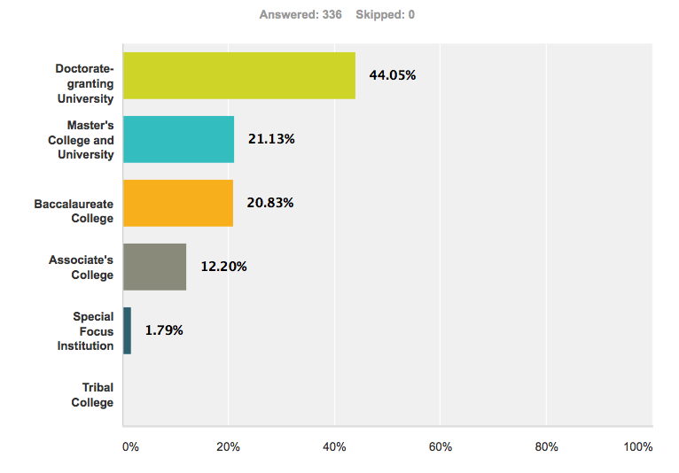
Carnegie classification
Notes:
2. Institution Type (by Carnegie classification) Check one:
Gross numbers – largest are doctoral granting institutions
148 Doc
Master
70 Bacc
41 Associate
6 Special focus
We compared our numbers against information provided by Carnegie.org
7.8 of ALL institutions by Carnegie class
49.8 of Doctoral
9.8 of Masters
8.6 of Bac
2.1 of Associate (But note that there are 1920 of them!)
1.1 of Special Focus
We did not ask about ARL membership. But we added that info to our data set by comparing responses to ARL website
42 ARL libraries
12.5 % of respondents\
33.6 % of ALL ARL institutions
36 % of ARL Academic Libraries

Slide 21
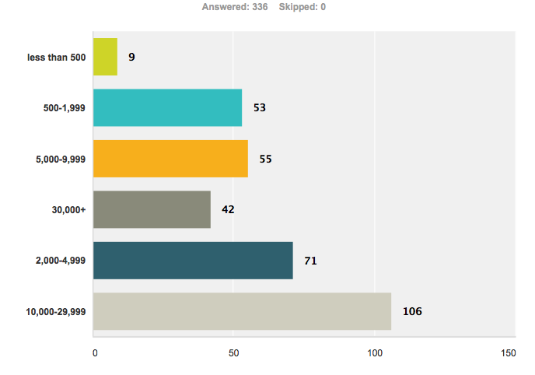
Enrollment
Notes:
4. What is your institution's FTE enrollment?
Doctoral and Associate the largest

Slide 22
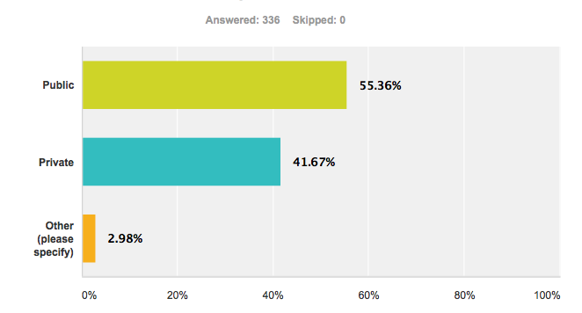
Public or Private
Notes:
5. Is your institution publicly funded or private?
Baccalaurate tends to be more private

Slide 23
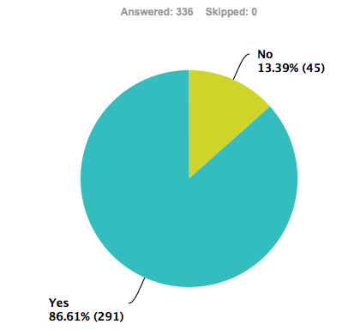
Online courses
Notes:
6. Does your institution offer online courses?

Slide 24
WHO’S
STREAMING
Notes:
Section of the Survey: Streaming Video Technical Infrastructure in Your Institution
The following questions address who in your institution is responsible for the technical infrastructure for streaming video.
23. Does your institution (Library, IT, or other) currently provide streaming video?
Do a poll? Does your institution stream? (Compare with these figures)
Primary Research Group data from 2010 showing 1/3rd of academic libraries provided streaming video
TIPPING POINT

Slide 25
Notes:
<?xml version="1.0" encoding="ISO-8859-1" ?>
<poll url="http://www.polleverywhere.com/multiple_choice_polls/52EyNXbocmZesWH">
<!-- This snippet was inserted via the PollEv Presenter app -->
<!-- The presence of this snippet is used to indicate that a poll will be shown during the slideshow -->
<!-- TIP: You can draw a solid, filled rectangle on your slide and the PollEv Presenter will automatically display your poll in that area. -->
<!-- The PollEv Presenter app must also be running and logged in for this to work. -->
<!-- To remove this, simply delete it from the notes yourself or use the PollEv Presenter to remove it for you. -->
<title>Does your library currently provide streaming video?</title>
</poll>

Slide 26
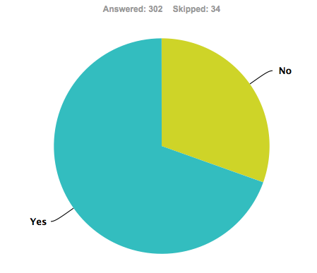
Does your institution stream video
30%
70 %
Notes:
Aggregated 70% yes 30 % no
Comments on how this changes by Carnegies? Look at next slides
IF FILTERED for Online Courses (yes) This number changes slightly to 71% and 29% It’s becoming a standard expectation service. There still are a lot of institutions missing the boat.
Number flipped from 3 years ago (2009)
ARL 92% and Doc 78%.

Slide 27
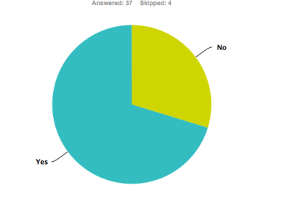
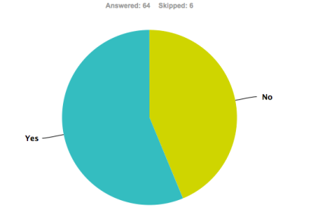
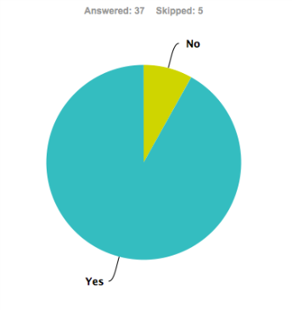
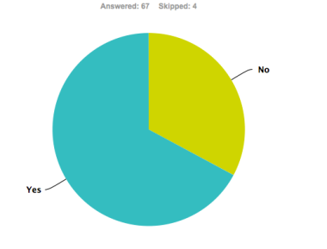
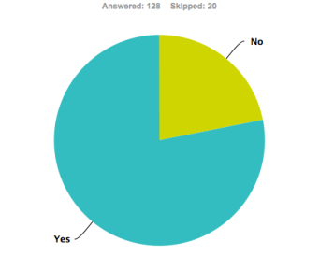
Comparison by carnegie classification
30%
8%
56%
44%
70%
8%
Associate
92%
Baccalaureate
92%
33%
ARL
22%
68%
78%
70 %
70 %
Masters
Doctorate
Notes:
ARL
91% and 9%

Slide 28
Notes:
<?xml version="1.0" encoding="ISO-8859-1" ?>
<poll url="http://www.polleverywhere.com/multiple_choice_polls/7730rUoNuZ6qrQU">
<!-- This snippet was inserted via the PollEv Presenter app -->
<!-- The presence of this snippet is used to indicate that a poll will be shown during the slideshow -->
<!-- TIP: You can draw a solid, filled rectangle on your slide and the PollEv Presenter will automatically display your poll in that area. -->
<!-- The PollEv Presenter app must also be running and logged in for this to work. -->
<!-- To remove this, simply delete it from the notes yourself or use the PollEv Presenter to remove it for you. -->
<title>Does your library plan to stream video within the next 3 years?</title>
</poll>

Slide 29
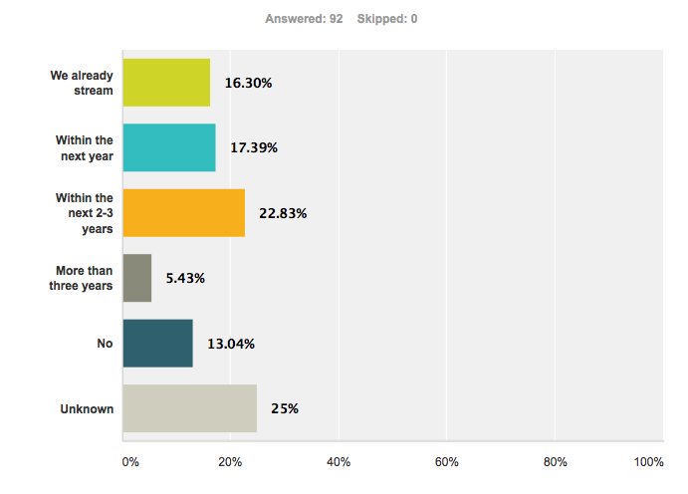
Plan to stream w/in 3 years
Notes:
26. Is your library planning to stream video? If "Yes", when?
filtered to remove those who already stream
Only if asked….. 16% responded we already stream

Slide 30
MEDIA COLLECTION
&
CONVERSION
Notes:
Size of physical copy video collection
Anticipated conversion to streaming formats
Wanted to establish some idea of existing collections and what has already happened in the move to streaming
First questions after demographics and we lost a lot of potential responses here….

Slide 31
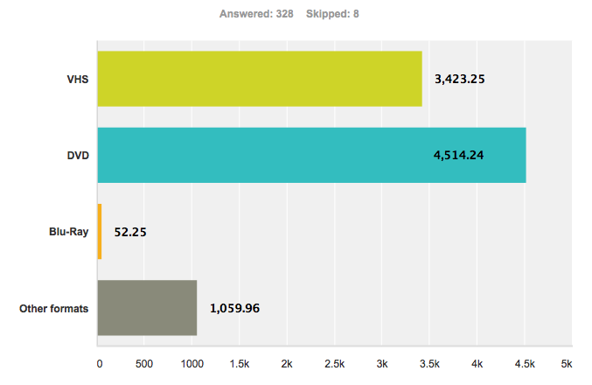
Physical media collection size
Notes:
7. Approximately how many titles are in your physical video collection?
(Numbers only, no commas. If none, enter 0.)
Differences by Carnegie class and by enrollment: Doc instit. Have the largest collections, Bac and Assoc have about the same #
Institutions are not buying blu-ray
Clearly see that DVD has outstripped VHS in collection size
IN THE AGGREGATE tho: 1,100,000 VHS / 1,500,000 DVDs
We asked about size of streaming collections as we asked about licensing models, but the data didn’t come in in a way that we thought was useable.

Slide 32
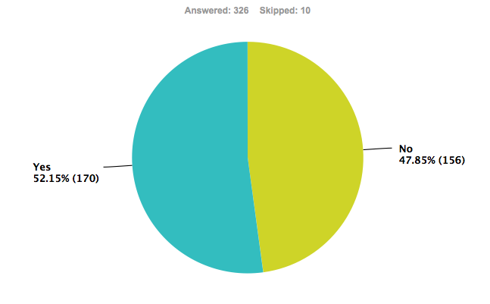
Format shift - Physical to digital
Notes:
8. Has your library replaced or converted any of your physical copy videos with streaming format?
AGGREGATED across all responses
Shows a slight majority have already converted some of their physical collection to streaming
BUT if we limit the response to only those who are streaming

Slide 33
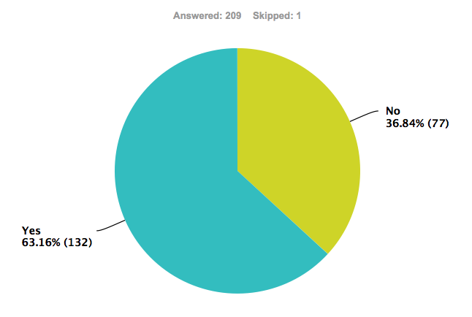
Format shift - Physical to digital
Notes:
8. Has your library replaced or converted any of your physical copy videos with streaming format?
LIMITED to those who stream….
Nearly 2/3rds have retrospectively contributed some of their physical collection to streaming
We did not ask what they converted…. VHS to streaming or DVD to streaming

Slide 34
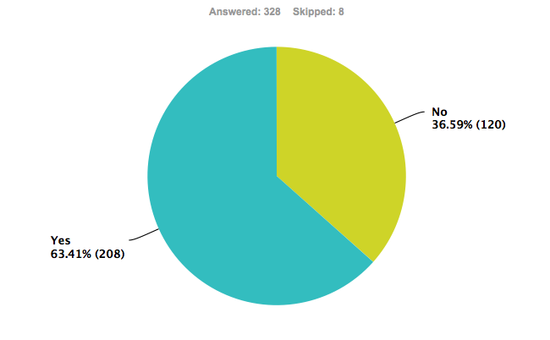
Intention to format shift w/in 3 years
Notes:
10. Do you intend to replace or convert any of your physical copy video with streaming format within the next three years?
Almost 2 thirds of respondents plan to convert physical to digital w/in 3 years
BUT TAKE NOTE OF the difference between those who replied yes and no in slide 35 (have you format shifted)
When compared to response to #23 Do you Stream…
Little difference…. 5% more say Yes they intend to, 5% less say no they do not

Slide 35
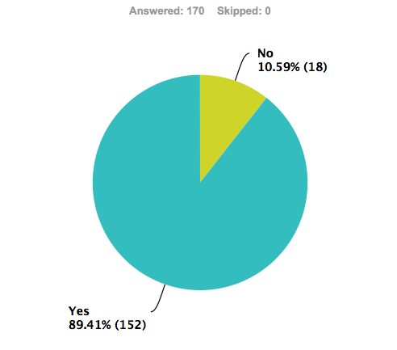
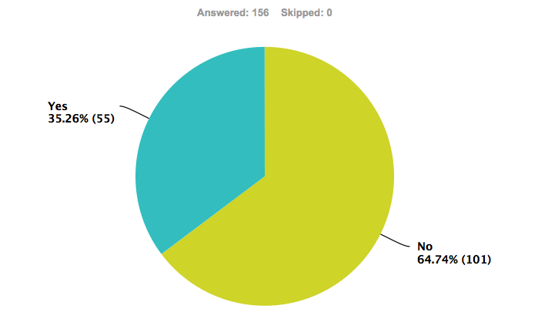
Intention to format shift w/in 3 years
Have already shifted format
Have not shifted format
Notes:
When filtered by those you have and have not already converted portions of their collections….
156 Responses
More than one third of those who have not plan to do so
While nearly 90% of those who have plan to continue to do so.
Bacc and Assoc are more likely not to have converted. Doct are more likely to have done so
We call it conversion really format migration
We have not analyzed intention to format shift in relation to intention to begin streaming.

Slide 36

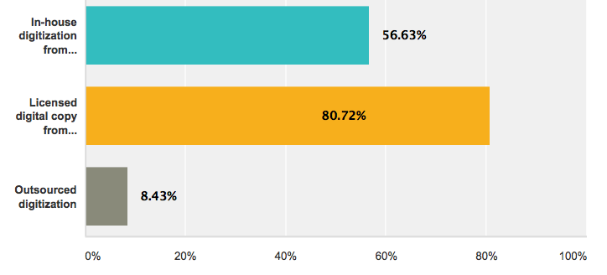
How shifted
Notes:
9. How did you replace or convert physical copies with streaming format? Check all that apply.
Filtered to show responses only of those who have shifted formats
Note, smaller N in response to question before, HAVE you converted
Note: Clearly licensed for distributor or IN HOUSE work
Across all Carnegie classification, most likely to license digital copy from provider.

Slide 37
MEDIA SELECTION
Notes:
How library selects and acquires in all formats
Both physical and streaming
Later questions address selection streaming outside the library

Slide 38
Notes:
<?xml version="1.0" encoding="ISO-8859-1" ?>
<poll url="http://www.polleverywhere.com/multiple_choice_polls/GuLwWGuXvk5CFrF">
<!-- This snippet was inserted via the PollEv Presenter app -->
<!-- The presence of this snippet is used to indicate that a poll will be shown during the slideshow -->
<!-- TIP: You can draw a solid, filled rectangle on your slide and the PollEv Presenter will automatically display your poll in that area. -->
<!-- The PollEv Presenter app must also be running and logged in for this to work. -->
<!-- To remove this, simply delete it from the notes yourself or use the PollEv Presenter to remove it for you. -->
<title>Does your library have a librarian with primary responsibility for media?</title>
</poll>

Slide 39
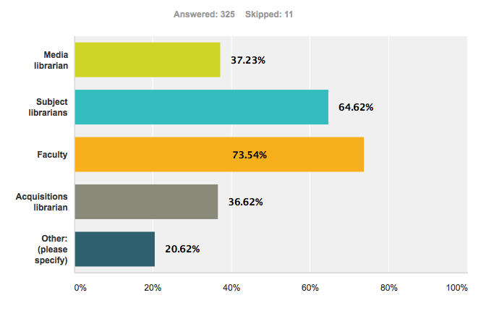
Who selects physical video
Notes:
11. Who selects physical copy video for your collection? Check all that apply.
This slide reflect answers in order that possible answers were presented.
Check all that apply
Error in questions in that we did not ask if there is a media librarian in the institution.
Should have provided more options, such as director/administrator for those smaller libraries. Include Reference/Reserve in Subject librarians and acquisitions should include collection development librarians….again terminology differs at the institutions. When we added those responses, the percentages increased slightly, but at the same ratio

Slide 40
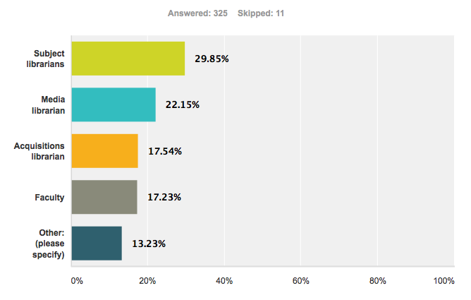
Primary selector for physical video
Notes:
12. Of all those who select physical copy video for your collection, who has primary responsibility for selection?
Again, we needed to add Director and Collection Development Librarian.
Should have asked ifthe library has a dedicated media librarian….if so the data may have been different.
Many noted that patron requests drove the selection by the librarians.

Slide 41
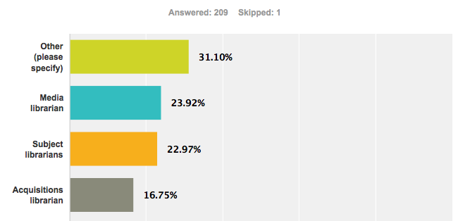
Primary selector for streaming video
Notes:
13. Who primarily selects streaming video for your library?
Tho we haven’t establish who streams yet, how does the selection differ for streaming
There was the possibility to respond We don’t stream
Aggregated data
Limited to those who steam
Drop in N
NOTE, this slide eliminates those that said we don’t stream. N of 1 5.2% of this sample
Didn’t ask about consortiums. Other responses included Director, Shared responsibility (committee), Electronic Resources….Primary responsibility is more distributed than in hard copy purchases. But if you add the 3 catagories of librarians, they are roughly the same.

Slide 42
MEDIA FUNDING
Notes:
Media funding in general
Separate questions for physical and streaming
And separate library and institutional funding as it relates to streaming

Slide 43
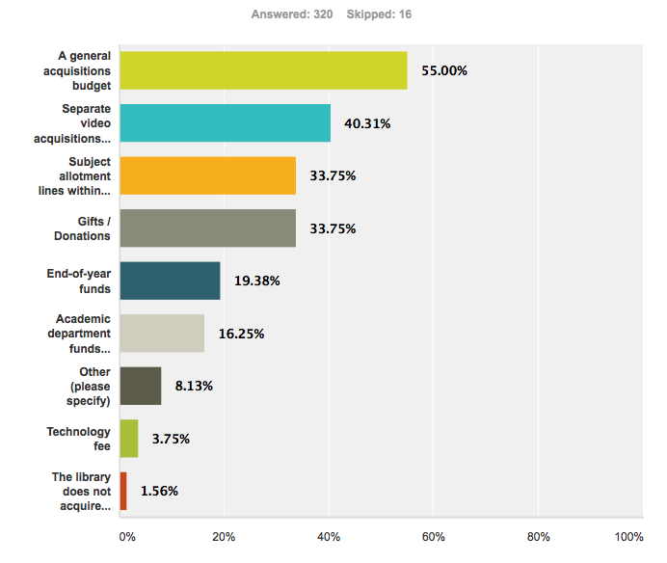
Funding sources for physical video
Notes:
15. What funding sources does your library employ for physical copy video acquisitions (DVD, Blu-ray, etc.)? Check all that apply.
Other: Grants/Endowments are small (9) 3%. Others fell into our other categories.
Varied responses – high % on gifts

Slide 44
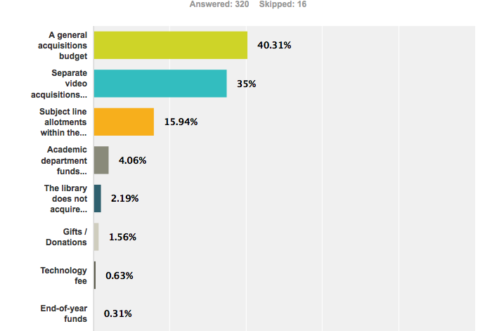
Primary funding for physical video
Notes:
16. Of all the funding sources your library uses, what is the primary funding source for your physical video acquisitions? (DVD, Blu-ray, etc.)
No responses for “Other”. Gifts/donations is interesting.

Slide 45
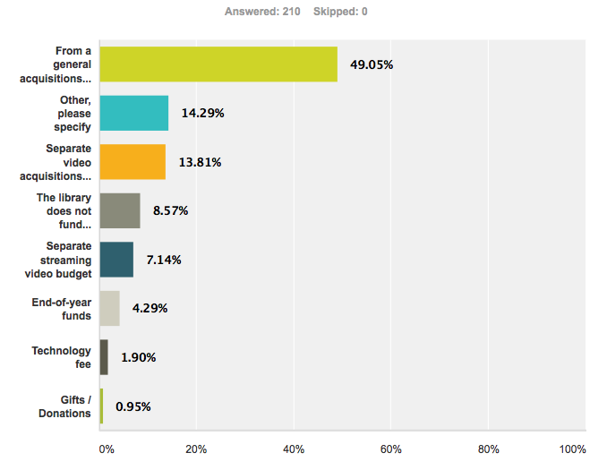
Primary funding for streaming video
Notes:
17. What is the primary funding source for your library's streaming video acquisitions?
Institutional funding for streaming video is addressed in the next question.
Filtered only for those that stream , N = 200+
Streaming is less likely from a separate video budget.
In other – Electronic Resources (4%), grants and distance education.

Slide 46
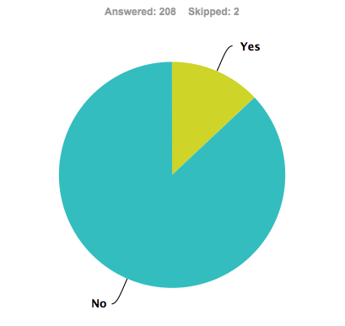
IS streaming video Institutionally funded
13%
87%
Notes:
18. Does your institution fund streaming video acquisitions separate from the Library?
In terms of institutional funding for streaming
Overwhelmingly the funding for streaming is provided by the library, not by outside orgarnizational structure – hard for librarians to say it’s not our responsibility.

Slide 47
How does your institution fund streaming
Departments for course-related work
Online instruction funds
Incorporated into the Media Services budget
Site license paid by University IT
Continuing Education / Distance Learning
Grant money
Consortium divides the funding between member schools
Notes:
19. How does your institution fund streaming video acquisition (separate from the library)?
40 comments
15% don’t know
14% distance ed and or academic department
17% IT / Media services
5% Consortium

Slide 48
Who Selects institutionally funded
Faculty with direction from Media Services
Library recommends with support from Academic Depts
Streaming library acquisitions librarian
Media Services specialist
Department chairs/Deans
Information Technology
Teaching faculty work with Head of Extended Programs
Center for Distributed Learning/Distance Education
Consortium
Don’t know
Notes:
20. Who is primarily responsible for selection of streaming video funded by the institution (separate from the library)?
Don’t know – 23% of responses
What we see if that librarians are not as involved in the selection of streaming video IF it is institutionally funded

Slide 49
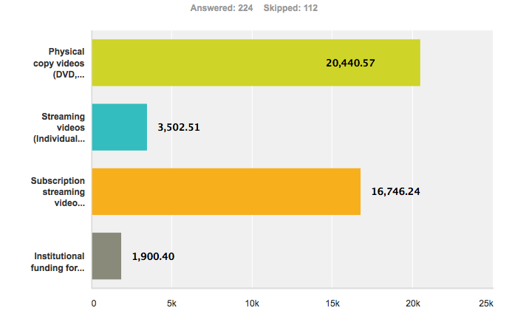
Total video expenditures last fiscal year
Notes:
21. Approximate total video expenditures, by your library and institution, last fiscal year.
(Enter whole numbers, without dollar signs ($), decimals, or commas.)
Open question, numbers entered by respondents
Aggregated across institution types. Varies by Carnegie classification. Doctoral spending most, Masters spending more on subscription, but not much more than physical. Baccalaureate and Associates spending most on physical.
Includes ALL
Spending for streaming now approximates $ for physical
We’re not talking huge amounts of money.
BUT when we filter this data for only those who stream we see some changing patterns

Slide 50
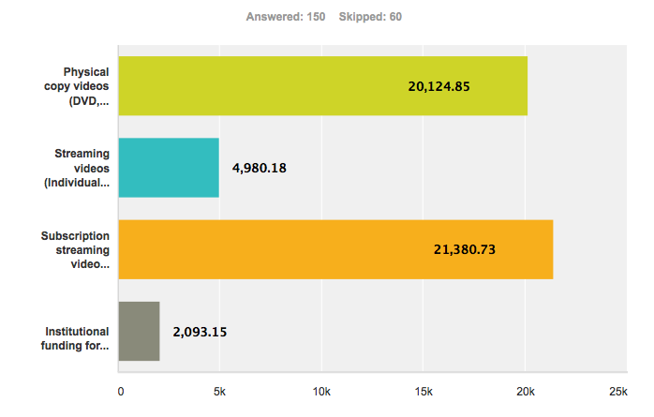
Total video expenditures last fiscal year
Notes:
Filter that by those who stream… and the figures change dramatically
Almost no change in physical spend. About the cost of one documentary title
and 40%+ increase in average spent on individual titles.
Subscription video outstrips physical spend and average spend increases by 27%
Moving to streaming clearly alters the amount spent and how it is applied

Slide 51
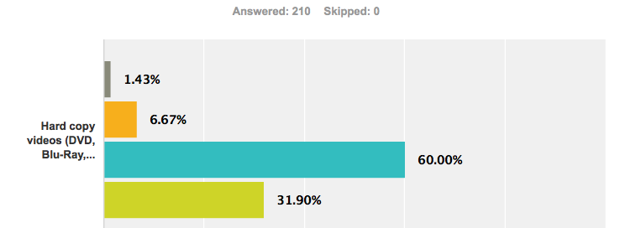

Anticipated spending in next fiscal year
Hard Copy Video Formats
Notes:
22. In the next fiscal year do you anticipate spending less, about the same, or more for video acquisitions?
Not asking specific $$
Asking about change in spending.
Perhaps more valuable for video distributors
As spending on media moves from physical to streaming, can vendors reasonable continue to charge 2x for streaming

Slide 52
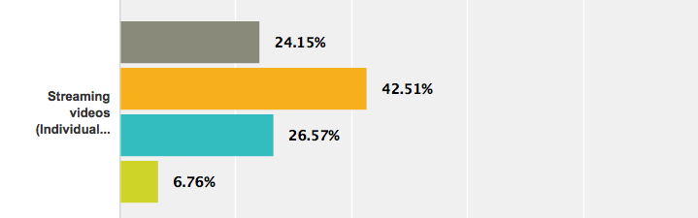
Anticipated spending in next fiscal year
Streaming Videos – Individually Licensed

Slide 53
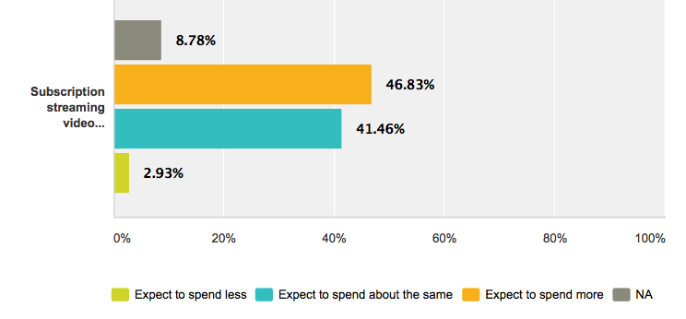
Anticipated spending in next fiscal year
Streaming Video Subscriptions

Slide 54
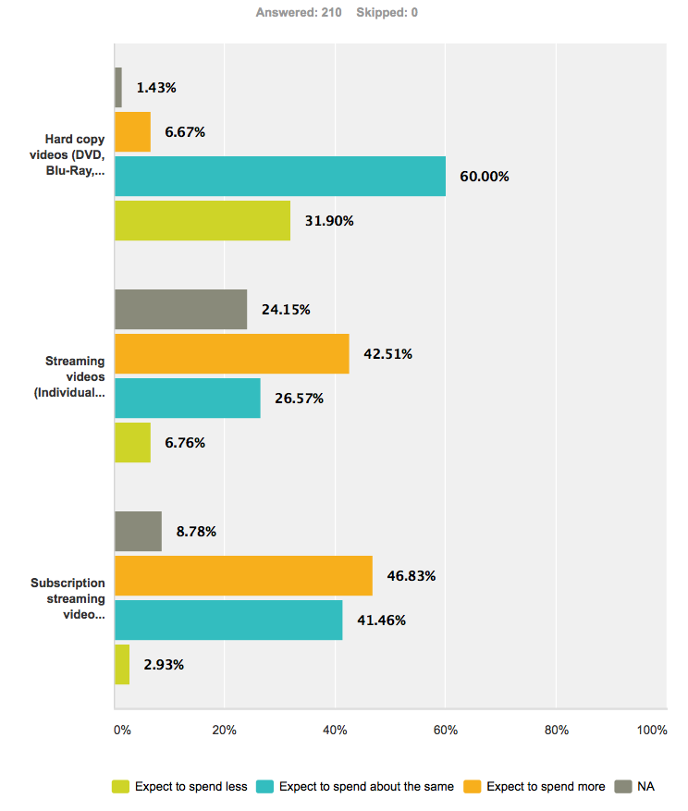
Anticipated spending in next fiscal year
Notes:
Aggregated data

Slide 55
LICENSING
MODELS
Notes:
A series of questions about collections, and licensing
These questions refer to some of the largest and best known streaming video collections. This list is not exhaustive.
Some of these collections are available for either subscription or one-time purchase/license in perpetuity.
Separate questions address subscription to and purchase of these collections.

Slide 56
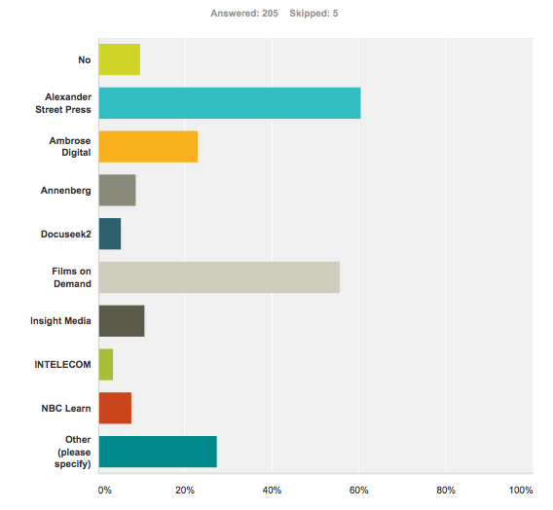
Subscription collections
Notes:
27. Does your library or institution subscribe to streaming video collections from any of these providers? Check all that apply.
OF those who stream….
9.7 DO NOT SUBSCRIBE
Numbers not presented here…. Careful not to interpret this as data on market share by these companies. Merely a snap shot. SOME of the companies we listed, and some that respondents identifed are new to the marketplace
Also note that many respondents don’t know what constitutes a subscription collection…. OTHER items – Psychotherapy.net, Vanderbilt TV News, Medcom, Kanopy, JoVE, Naxos
Sometimes even media librarians get confused between subscription and purchased collections. Many collections available for subscription are also available as one time purchases.

Slide 57
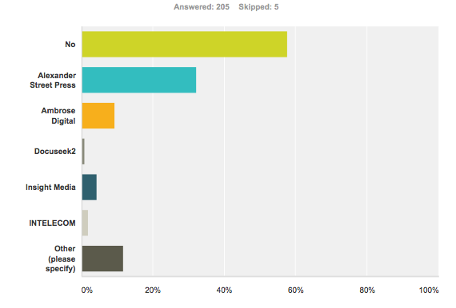
Purchased/Licensed in Perpetuity collections
Notes:
28. Has your library or institution purchased / licensed in perpetuity streaming video collections from any of these providers? Check all that apply.
58% have NOT purchased collection in perpetuity
No surprises. Differences in licensing models. Doctoral institutions more likely to have purchased collections.

Slide 58
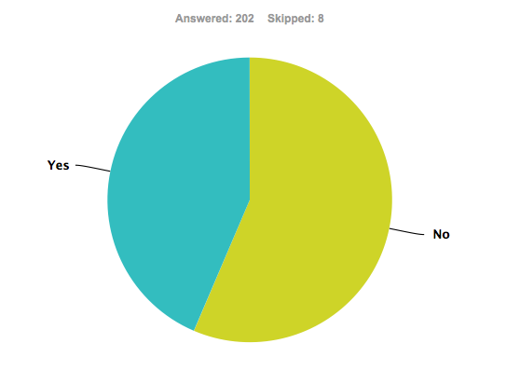
Purchased/Licensed in Perpetuity titles
44%
56%
Notes:
29. Has your library licensed streaming video titles in perpetuity / for the life of the file format?
Common approach for monographic acquisition.
Surprised us… expected to see highter % of perpetuity licenses
What many media librarians SAY they want.
IF the primary selector for streaming is a MEDIA Librarian – this changes to 68% Yes, 32% NO
Primary selector Acquisitions: 17% Yes, 83% No !!!!
Subject Librarians: 52% Yes 48% No

Slide 59
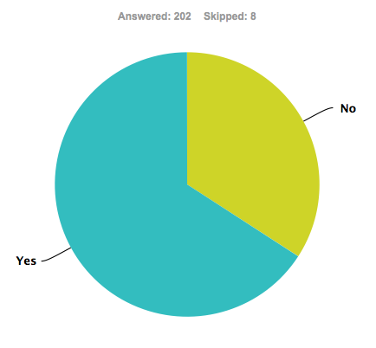
Term Licensed Titles
34%
66%
Notes:
30. Has your library term-licensed streaming videos? (Generally 1-3 years)
Doctoral institutions are more likely to have said said yes than no.
IF a media librarian is the primary selector for streaming these figures change: 74% YES 26% NO
If primary selector Acquisitions: 60% Yes , 40% No
If Subject Librarian: 77 % yes 23% No
Carnegie classifications. The widest distribution of licensing models is in Doctoral

Slide 60
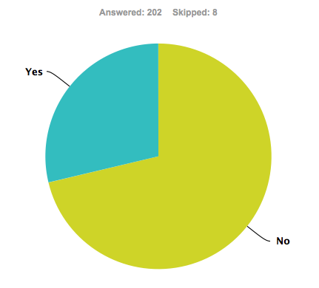
License titles for Course Reserve
29%
71%
Notes:
31. Does your library license streaming videos for course reserve use? (Generally, a period of less than one year)
Libraries pay for copyright for reserves why not media? Almost 3/4 don’t
IF media librarian is primary selector for streaming: numbers change to 36% Yes 64% No
If Acquisitions Librarian primary selector: 26% Yes, 74% No
If Subject Librarians: 25% Yes, 75% No

Slide 61
DIGITIZATION
ON
REQUEST
Notes:
This page addresses policies that guide digitization for streaming of physical copy videos in your library collection. (VHS, DVD, etc.)
The question does not address digitization that occurs in other units of your institution (IT, academic departments, etc.)
We understand that this information may be sensitive. Your responses are confidential. All data is aggregated. Neither you nor your institution will be identified in any dissemination of survey results.
You may opt out of answering these questions by clicking on "Next" to advance to the next question.
Policies that address digitization on request
Copyright issue, UCLA v AIME lawsuit, etc.
But are trying to get a snapshot of current practice

Slide 62
Notes:
<?xml version="1.0" encoding="ISO-8859-1" ?>
<poll url="http://www.polleverywhere.com/multiple_choice_polls/k4SzDqs9zFnxCjD">
<!-- This snippet was inserted via the PollEv Presenter app -->
<!-- The presence of this snippet is used to indicate that a poll will be shown during the slideshow -->
<!-- TIP: You can draw a solid, filled rectangle on your slide and the PollEv Presenter will automatically display your poll in that area. -->
<!-- The PollEv Presenter app must also be running and logged in for this to work. -->
<!-- To remove this, simply delete it from the notes yourself or use the PollEv Presenter to remove it for you. -->
<title>Does your library, on faculty request, digitize and stream videos from your physical collection?</title>
</poll>

Slide 63

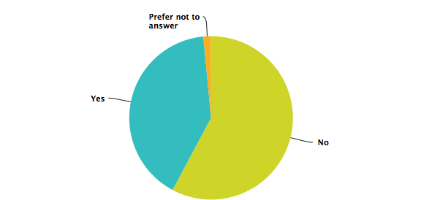
Digitize & Stream on Faculty Request
41%
58%
Notes:
32. Does your library digitize and stream VHS or DVD titles from your collection on request of faculty?
Note that we specified from the Library’s collection. Does not mean that service is not available elsewhere on campus.
By Carnegie classification, significant changes….becomes less of a difference as you go from Assoc 77% No to 19% Yes --- to Doc. Doctorate is 58/40.
Prefer not to answer in all carngegie classes
We don’t know why

Slide 64
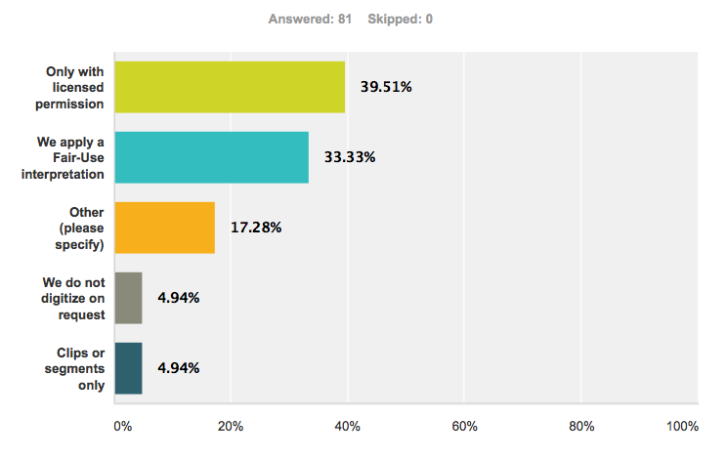
Primary Policy for Digitization on Request
Notes:
33. What is your library's primary policy for digitization on request?
Limited to those who stream and those who replied in #32 that they digitize on request
Underscores that librarians are doing what they need to do via copyright.
Comments In the Other category, mostly say combination of fair use and licensing, some refer to the TEACH ACT, another references ARL Code of Best Practices

Slide 65
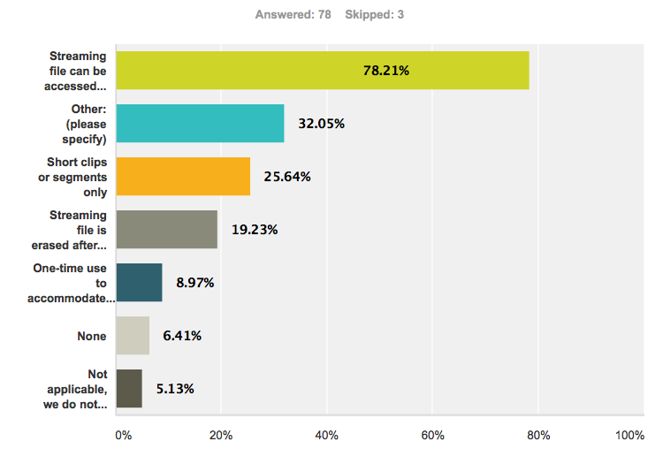
Limits applied to digitization on request
Notes:
34. What limits do you apply when digitizing on request? Check all that apply.
Limited to those who stream
Does NOT mean that this service is not available elsewhere on campus.
In the other category, 4% says it is password protected.
Otherwise, “Other” comments are are broad, repeating and or combining many of the items on the survey,
Time restrictions (a semester or a couple weeks)
Only when not available in streaming
Fair use for clips while pursuing license for full title
Require justification
Limits on the number of items, hours of material
Unique content.

Slide 66
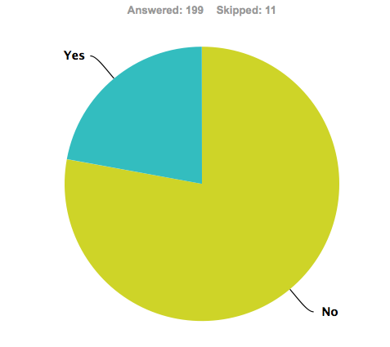
Written Policy Statements on Digitizing
22%
22%
78%
Notes:
35. Does your library have written policy statements on digitization for streaming?
This appears to be an area that is severely lacking in library policies
Results limited to those that stream.
In the aggregate…. (336 responses) Including those who stream and those who do not…. Yes: 16% NO 84%
BUT if we look at who digitizes and streams on request, vs those that do not…..

Slide 67
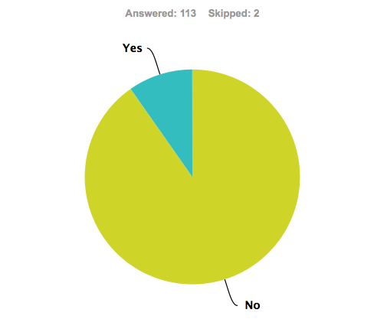
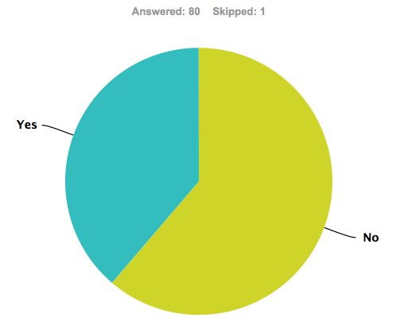
Written Policy Statements on Digitizing
10%
39%
61%
78%
90%
Stream
Digitize on Request
Stream
Don’t digitize on Request
Notes:
35. Does your library have written policy statements on digitization for streaming?
Those who stream AND digitize on request more likely to have a written policy
Compared to those who Stream but DO NOT digitize on request

Slide 68
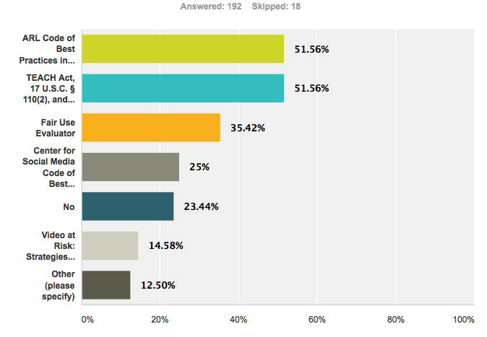
Guiding Documents
Notes:
36. Whether or not you have written policies, do you rely on or refer to any of these documents to guide your local practice? Check all that apply.
We could have asked if they were aware of these documents….
There are go to documents for librarians. We have provided links to these documents at the end of this session. In the other category, included Canadian Copyright Policy, legal counsel and local policy.

Slide 69
DISCOVERY
&
ACCESS
Notes:
A series of questions addressing how users find and access streaming video titles

Slide 70
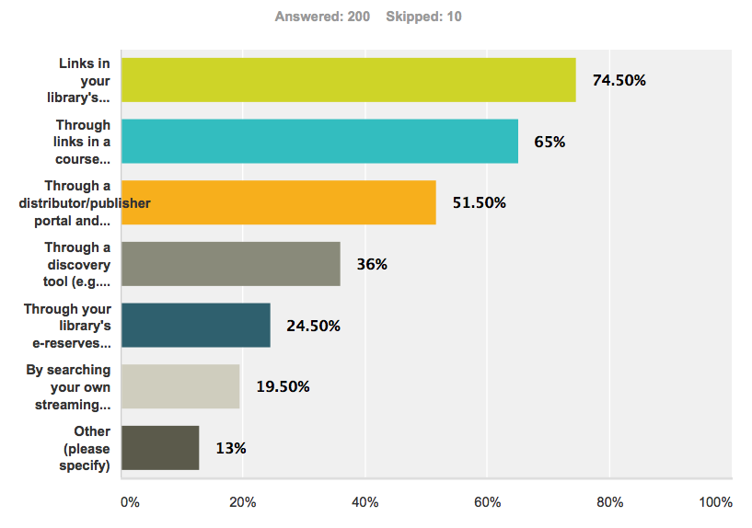
Discovery & Access to Streaming video
Notes:
37. How do your users locate and access your streaming videos? Check all that apply.
Catalog access the clear leader
26 different comments. LibGuides and subject guides account for many of the responses.
Less reliance on discovery tools for others than in the Doctorate category.
Clearly librarians are applying a variety of approaches to accessing content.

Slide 71
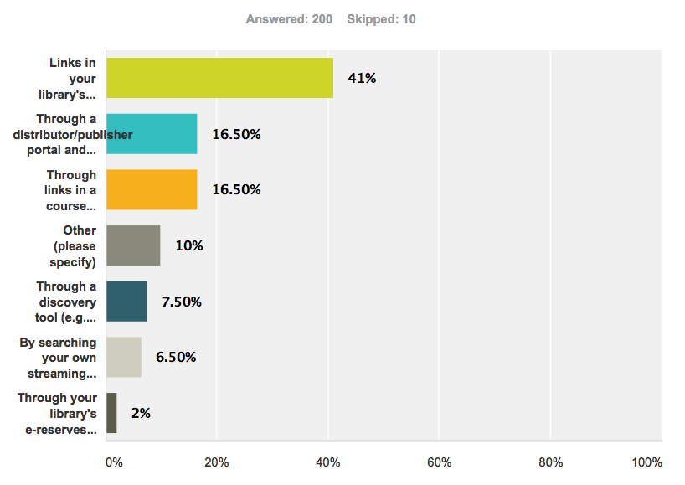
Primary Access point to Streaming Video
Notes:
38. Of the access points you provide, what is the primary access point for streaming videos?
Asked respondents to specify only ONE access point as the Primary access point
In the other category, small #, but these are primarily libguides.
OPAC is the greatest, but there is also strong reliance on distributors portals.
Doctorate use discovery tool more than masters – 13% to 5%. Nonexistent in Bacc and Assoc.

Slide 72
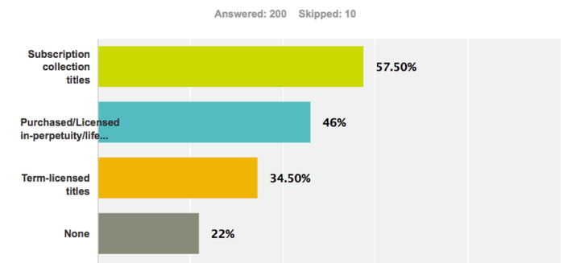
Title Level catalog records
Notes:
39. Which of your streaming videos have (title level) catalog records? Check all that apply.
Comment: initially surprised degree of subscription have catalog record. Personal experience that our catalogers were resistant to providing catalog records for materials we don’t own when we initiated Films on Demand as a PDA model.
Now I understand, we will address in another slide

Slide 73
Title Level catalog records
Notes:
22% said none.
Question: How do your users find the titles? Are there any other collections that you don’t catalog in your library? Streaming videos are treated differently! (Red-headed stepchild)

Slide 74
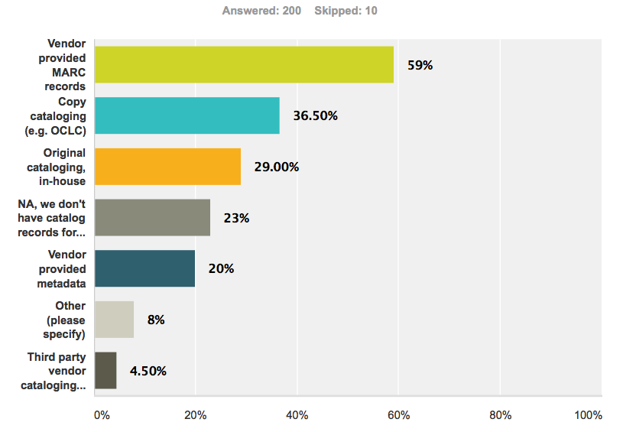
Catalog record sources
Notes:
40. How do you obtain catalog records for your streaming video titles? Check all that apply.
Vendor provided Marc records across for all Carnegie classifications is the highest percentage.

Slide 75
TECHNICAL
INFRASTRUCTURE
Notes:
Section of the Survey: Streaming Video Technical Infrastructure in Your Institution
The following questions address who in your institution is responsible for the technical infrastructure for streaming video.
Earlier in the survey, in definitions, we defined technical infrastructure as:
As computer systems and processes for ingesting, hosting, and serving digital video files.

Slide 76
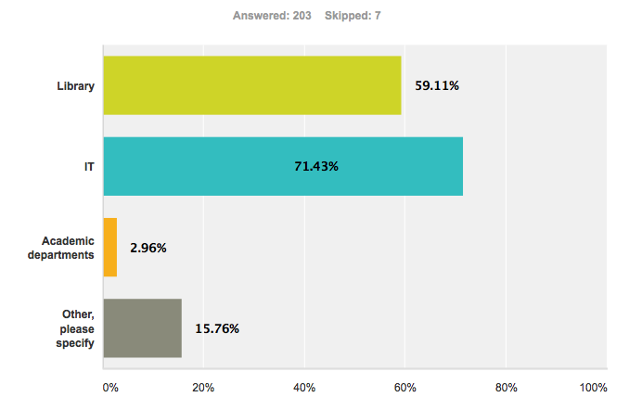
Technical Infrastructure
Notes:
24. Which unit(s) in your institution provide technical infrastructure for streaming video? Check all that apply.
An ALL that APPLY response
Filtered by institutions that stream. In Other over half the responses say it’s IT and Library merged together 9%
Compare to next slide

Slide 77
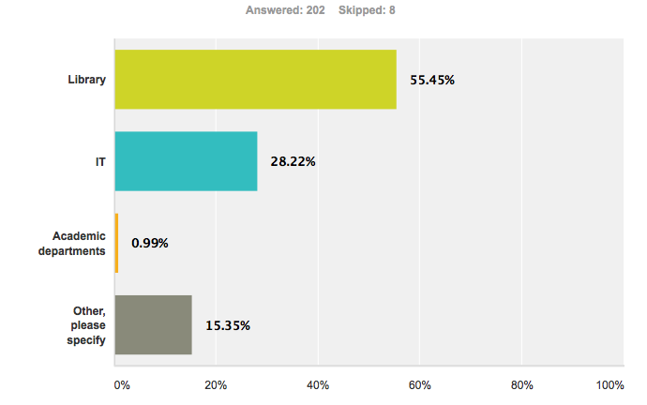
Primary responsibility for infrastructure
Notes:
25. Which unit in your institution has primary responsibility for streaming video?
Library primary responsibility
Nearly 2 to 1
May be a flaw in survey because we do not specifically say technical infrastructure.
BUT, Section heading stated tech infrastructure, and previous question specified tech infrastructure

Slide 78
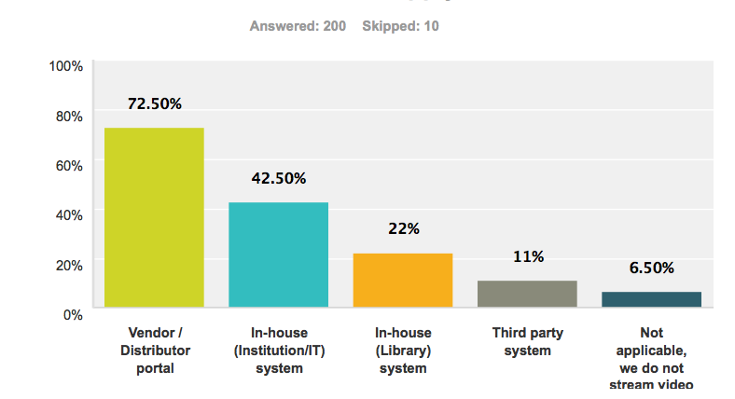
Hosting for streaming videos
Notes:
41. How are your streaming videos hosted? Check all that apply.
Explained that These questions address how your library and/or institution hosts and serves your streaming videos.
In some institutions hosting is provided by both the library and another unit.

Slide 79

percentage of collection hosted
Notes:
Note that these are NOT percentages in the chart. It’s number of people responding.
Aggregated data. To what extent – deserves more time than we’ve given it.

Slide 80


Hosting Platforms
Notes:
43. For your in-house hosting, (either Library or Institution / IT) what streaming platform do you use?
Jane uses a custom platform that she build for NJ. ASU has used to Kaltura and has moved to ShareStream, so we were interested in seeing if there were any patterns.
There aren’t!
To what extent is it important for librarys to know. Look at the percent who say they don’t know. Is that important?
Very small amount of information to draw any conclusions from, not an indicator of market share.
We were concerned about the length of the survey at this point and probably should have split this into two questions for a better ability to analyze
Others were all over the place… including homegrown
This is an area for possible additional study.

Slide 81
WORKLOAD
Notes:
These functions may be performed by various personnel throughout your library.
This question addresses library personnel only. If these processes are performed solely by IT or another unit in your institution, select Unknown/NA.
We’ve also moved into this section of the presentation a question asked during the licensing models portion of the survey

Slide 82


License negotiation
Notes:
14. Who is primarily responsible in your library for negotiating streaming video licenses?
Aggregated
Filtered to include only those you Stream (Question 23)
No definitions of Acq lib. Other is high: Included in other 12% as electronic resources librarian, Director 8% and Consortium 4. It gave us more granulation in responses than we anticipated.
Again, removed data from those who replied we don’t stream
Another highly variable responsibility

Slide 83

Staff Time devoted to streaming
Notes:
Large number of don’t know.
As streaming becomes increasingly prevalent and important, this is a critical consideration of personnel issues.

Slide 84
HINDSIGHT
Notes:
As we analyzed the results we realized that there were questions that perhaps we should have asked.
OR had we asked these questions we would have been able to provide another layer of granularity to our analysis.

Slide 85
Questions not Asked
Does your library have a media librarian?
Does your institution have a media unit separate from the library?
What is the size of your streaming video collection?
Do your collection development policy documents specifically address streaming video?
You indicated you do not catalog your streaming videos. Why not?
How satisfied are you with you with the catalog records / meta data provided by vendors?
Notes:
Media librarian – someone whose specific role is to build/manage the media collection
Media unit separate from the library – possibly under the IT division
Streaming video collection size – we asked but not in a way that was useful for analysis. Did not address total number of subscription titles….]
Collection Development policy – unique matters…. How are they defined in the institution
Curious to know the reasoning behind not providing catalog access to titles.
Are they great? Or just Good enough?

Slide 86
OBSERVATIONS

Slide 87
Streaming video has become a common vehicle
for content delivery in academic libraries.
Regardless of Carnegie classification libraries have primary funding, operational, and decision-making roles in providing streaming video content to their institution.
Libraries prefer, and for the most part provide, title level access to streaming videos in their collections.
BUT, video remains an outlier in the day-to-day treatment of content in academic libraries.
Catalog records for streaming videos depend largely on vendors providing the records or metadata.

Slide 88
There is no dominant model for acquisition of streaming videos. Subscription plans appear to be emerging as the dominant approach.
Librarians are largely unaware of the technological infrastructure used to serve streaming video.
Staffing needs for managing streaming videos appears to be low, but many libraries do not
know what the actual staffing commitment is.
Librarians employ multiple approaches to meet the challenges streaming video presents regarding
copyright.

Slide 89
GUIDING DOCUMENTS

Slide 90
Association of Research Libraries & Center for Social Media. (January 2012). Code of
best practices in fair use for academic and research libraries. Washington, DC,
American University.
http://www.arl.org/pp/ppcopyright/codefairuse/
Besser, Howard et al. (December 2012) Video at risk: Strategies for preserving commercial Video Collections in Libraries. NY: NYU.
http://www.nyu.edu/tisch/preservation/research/video-risk/
Brewer, Michael & ALA Office for Information Technology Policy. (2008). Fair use evaluator.
      http://librarycopyright.net/resources/fairuse/
Center for Social Media. (June 2008). Code of best practices in fair use for online Video.
http://centerforsocialmedia.org/fair-use/best-practices/code-best-practices-fair-use-
online-video
Crews, Kenneth D. Fair use checklist.
http://copyright.columbia.edu
U.S. Copyright Office. Copyright law of the United States of America, Circular 92.
http://www.copyright.gov/title17/92chap1.html
U.S. Copyright Office. TEACH Act, 17 USC § 110(2).
http://www.copyright.gov/title17/92chap1.html#110
Notes:
Documents work knowing
We referred to them earlier when we asked what documents guide local practice.

Slide 91
AREAS FOR ADDITIONAL
RESEARCH

Slide 92
Case studies for work flow and personnel demands
Use data
Return on Investments – cost per use
Quality of and satisfaction with vendor-provided catalog records and meta data
Impact of proliferation of vendor interfaces / analysis of those interfaces
Integration of streaming video metadata with discovery tools

Slide 93
QUESTIONS

Slide 94
Contacts
deg farrelly
Media Librarian / Share Stream Administrator
Arizona State University
deg.farrelly@asu.edu
Jane Hutchison
Associate Director Instruction & Research Technology William Paterson University
hutchisonj@wpunj.edu

Slide 101


Anticipated spending in next fiscal year
Hard Copy Video Formats
Notes:
22. In the next fiscal year do you anticipate spending less, about the same, or more for video acquisitions?
Not asking specific $$
Asking about change in spending.
Perhaps more valuable for video distributors
As spending on media moves from physical to streaming, can vendors reasonable continue to charge 2x for streaming

Slide 102
Anticipated spending in next fiscal year
Streaming Videos – Individually Licensed

Slide 103

Anticipated spending in next fiscal year
Streaming Video Subscriptions

Slide 104

Anticipated spending in next fiscal year
Notes:
Aggregated data

Slide 105

Staff Time devoted to streaming
Notes:
44. Approximately how much personnel time in your library is dedicated to licensing, digitizing, ingestion, and metadata for your streaming video.
These functions may be performed by one or more units and/or personnel throughout your library. Please estimate the aggregate.

Slide 106
Staff Time devoted to streaming
Notes:
Large number of don’t know.
Don’t know because the tasks are done outside the library?
Or because they really don’t know?
As streaming becomes increasingy prevalent and important, this is a critical consideration of personnel issues.

