Slide 1
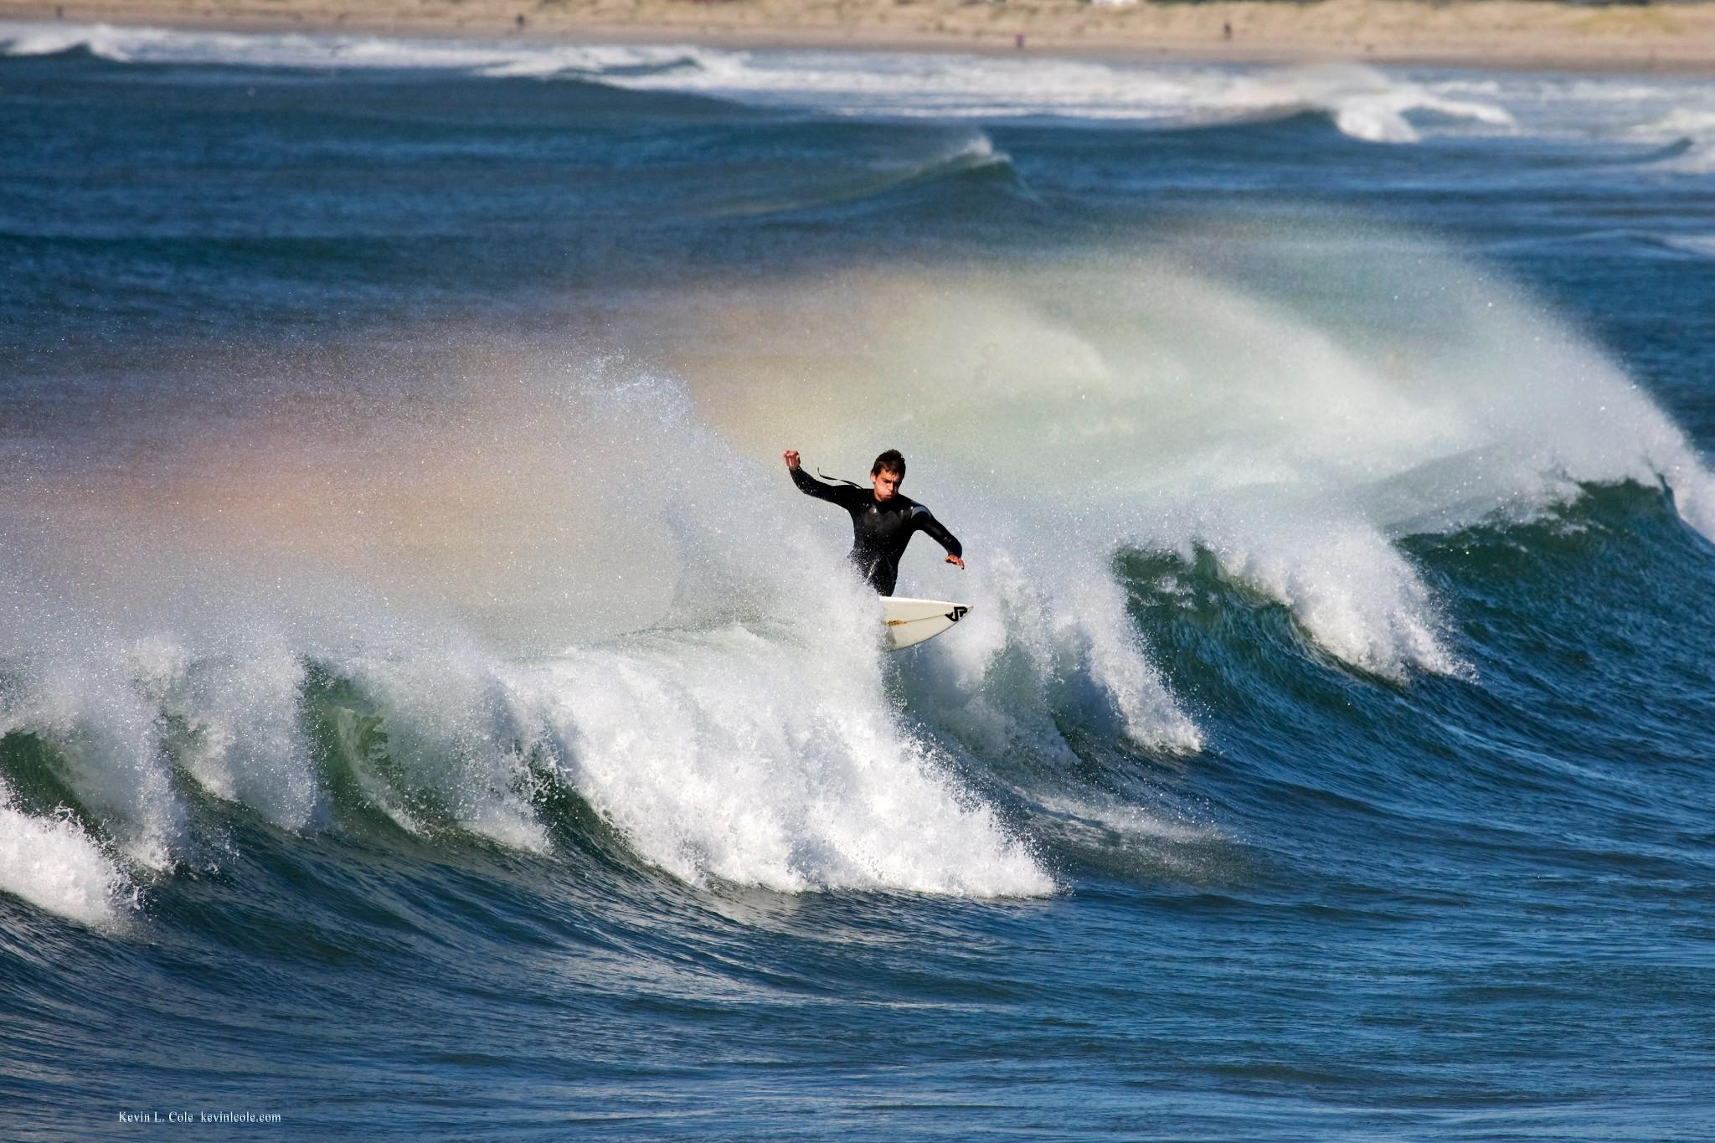
Open Educational Resources:
A Rising Wave of Change and Opportunity
Virginia Pannabecker & Kevin Pardon
Arizona State University Libraries
Downtown Phoenix Campus Library

Slide 2

What is open education?
Notes:
The Open Education movement of today has its roots in Open Education and Progressive Education initiatives in England during the 1960s and 70s. Open Education refers to organizations and institutions that aim to provide education without financial barriers. One official definition and statement regarding today's Open Education movement is the Cape Town Declaration.
http://www.capetowndeclaration.org/read-the-declaration
Declaration - 3 strategies:
educators and learners
open educational resources
open education policy
"...[Open Education] combines the established tradition of sharing good ideas with fellow educators and the collaborative, interactive culture of the Internet. It is built on the belief that everyone should have the freedom to use, customize, improve and redistribute educational resources without constraint. "
~Cape Town Open Education Declaration

Slide 3
Open Educators and Supporters:
Believe that "everyone should have the freedom to use, customize, improve, and redistribute educational resources without constraint"
Share good ideas
Harness the collaborative, interactive culture of the internet
Develop educational resources and make them available online, licensed for free use, reuse, and adaptation
Inspire "a new pedagogy where educators and learners create, shape, and evolve knowledge together"
Cape Town Open Education Declaration, 2007: http://www.capetowndeclaration.org/
Notes:
In this presentation we will focus on OERs, Open Educational Resources that you can use yourself as educators, and that you can consider providing as options for your customer learners - whether they are students, faculty, healthcare professionals, or members of your community.

Slide 4
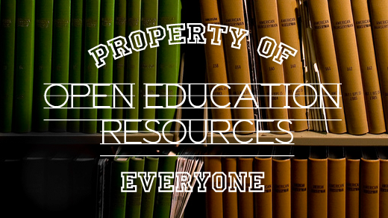
What are OERs?
Open educational resources online and licensed for anyone to:
Reuse, Revise, Remix, & Redistribute
Notes:
The explicit licensing of Open Educational Resources for the purposes of reuse, revision, remixing, and redistribution by others is a key characteristic. The most commonly used licenses to accomplishg this are Creative Commons licenses, in particular the CC BY license that simply requires attribution of the creator for any of these uses, the CC BY NC attribution, non-commercial uses, and the CC BY Sharealike or CC BY NC Sharealike – where (either commerical allowed or non-commercial only) those who re-use the material in any way must also license their new product with the same kind of license (so that others can use their material as well).
Creative Commons licenses: http://creativecommons.org/licenses/
1. Reuse – the right to reuse the content in its unaltered / verbatim form
2. Revise – the right to adapt, adjust, modify, or alter the content itself
3. Remix – the right to combine the original or revised content with other content to create something new
4. Redistribute – the right to make and share copies of the original content, your revisions, or your remixes with others
David Wiley
http://opencontent.org/blog/archives/1123

Slide 5




Open Educational Resources
Notes:
Collegeopentextbooks.org and open stax college are two sources available to look for Open Textbooks, mostly at the undergraduate first and second year levels, in all topic areas.
OER Commons and Merlot are clearinghouses for Open Educational Resources of all types and levels: textbooks, lesson plans, full courses, images, video, audio, etc.; higher education and K-12.

Slide 6
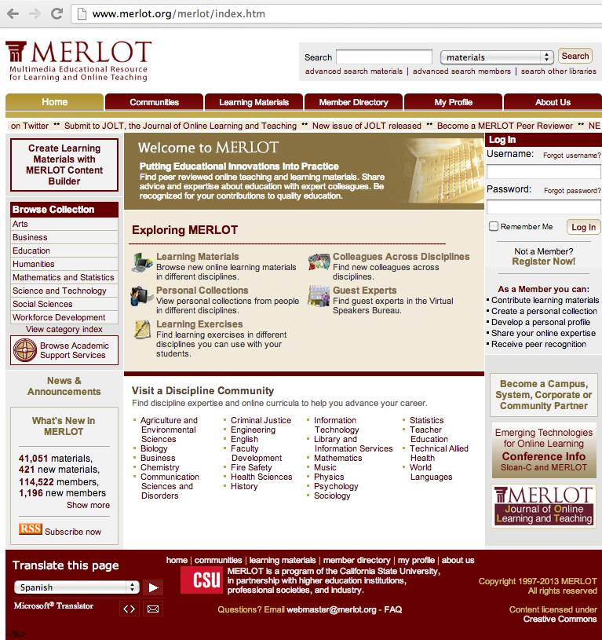
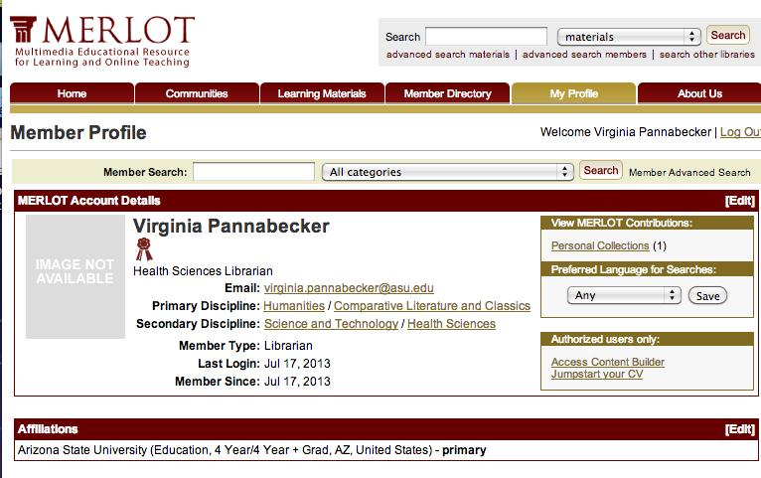
MERLOT
Member
Profiles
Notes:
Contribute materials
Create personal collections
Develop your profile
Share your expertise
Receive peer recognition

Slide 7
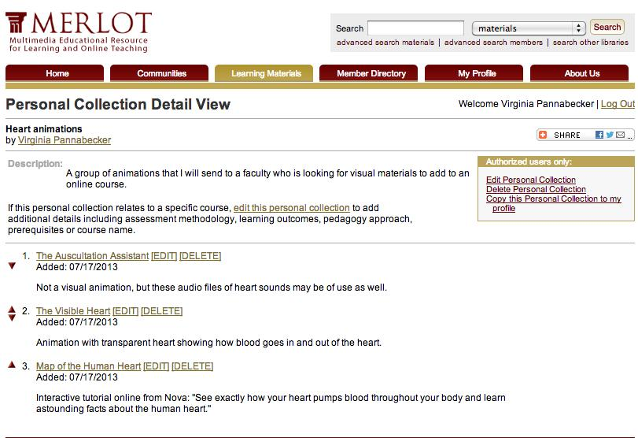
MERLOT Personal Collections
Notes:
This is an example Personal Collection where I collected materials for a hypothetical faculty request for suggestions for online video materials to use in a course that would demonstrate circulation of blood through the heart. I added brief notes about each resource and how it might be helpful.

Slide 8


Open Source
Citation Manager Tools
Notes:
These are 2 options for free citation management tools available online that allow sharing of references with others. They have varying levels of free space and tools, while more space and some tools may require payment.

Slide 9






Open Educational Resources
Notes:
MIT Open Courseware was one of the first to make their course content full open to anyone.
Open Courseware Consortium provides information and links to many open course ware projects and how-to guides on making your courseware open.
Coursera, edX, Udacity, and KhanAcademy are examples of current providers of open courses, including MOOCs (Massive Open Online Courses) at various levels and for all types of topics.

Slide 10
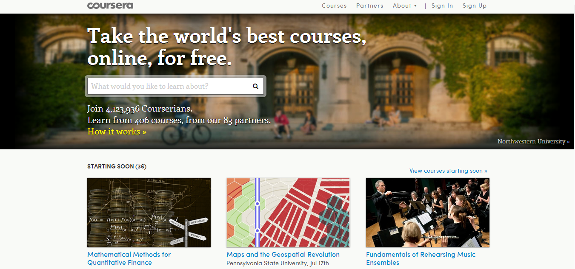
Coursera
Notes:
Coursera’s home page – screen shot

Slide 11
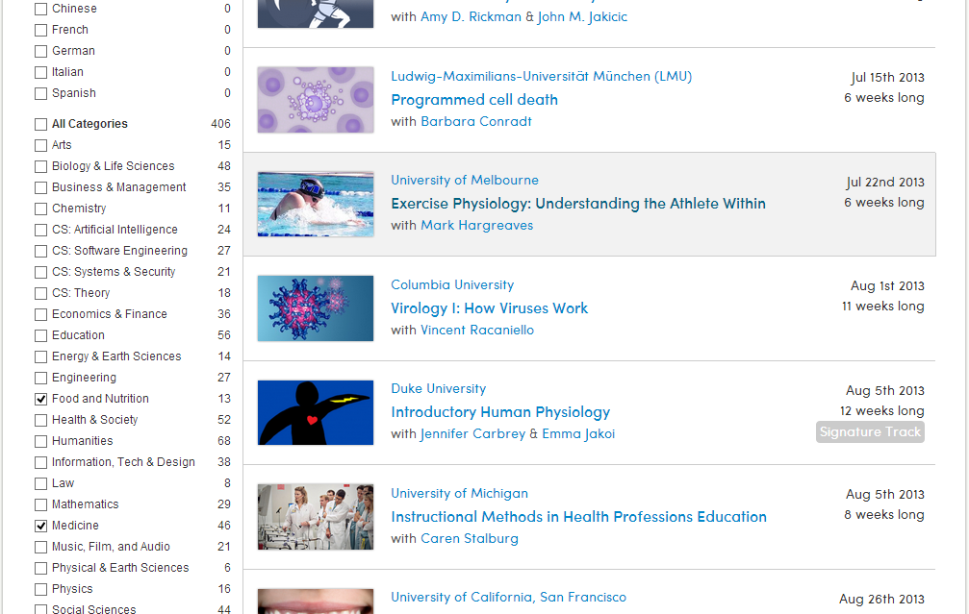
Notes:
Screen shot of courses available in Food and Nutrition and Medicine via Coursera

Slide 12
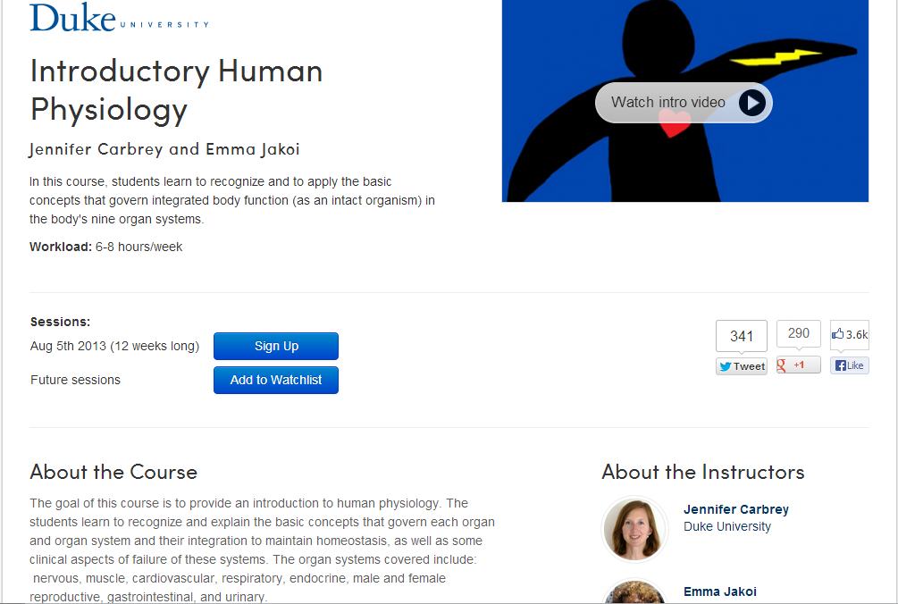
Notes:
Example of a course home page via Coursera.

Slide 13
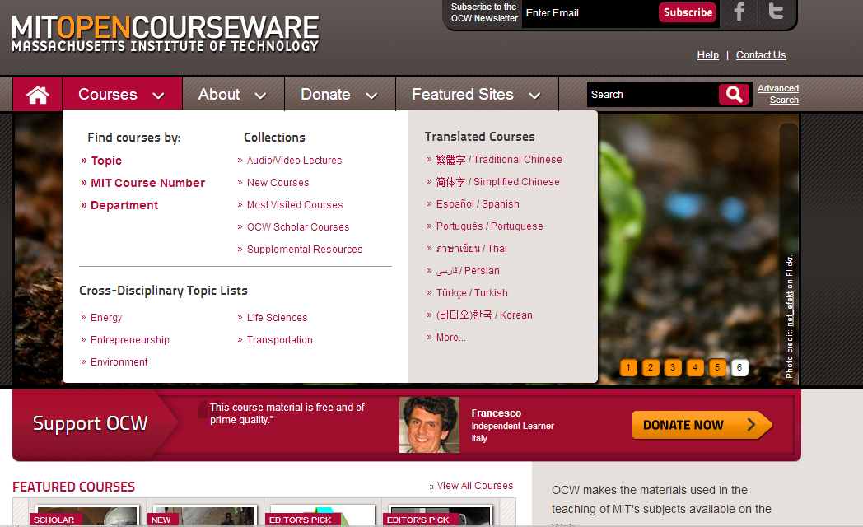
MIT OpenCourseWare
Notes:
MIT OpenCourseWare home page

Slide 14
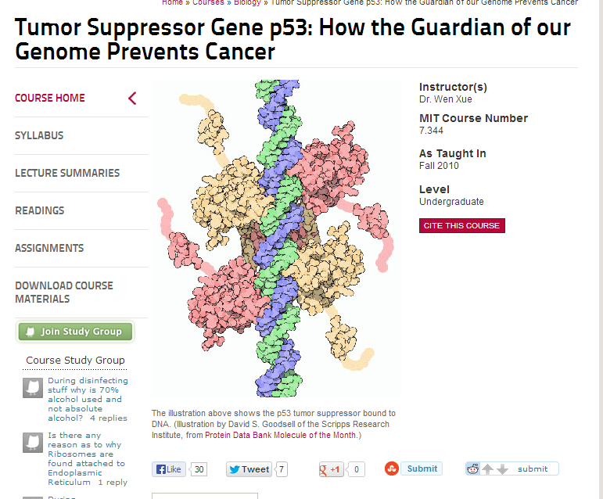
Notes:
Example course via MIT OpenCourseWare

Slide 15

"Open Education Week’s goal is to raise awareness about free and open educational opportunities that exist for everyone, everywhere, right now"
Open Education Week: http://www.openeducationweek.org/aboutoe
Notes:
In March 2013, Arizona State University participated in the 2nd annual Open Education Week. Coordinated by the OpenCourseWare Consortium, Open Education Week aims to raise awareness about open educational resources, the open education movement, and other open educational opportunities.

Slide 16
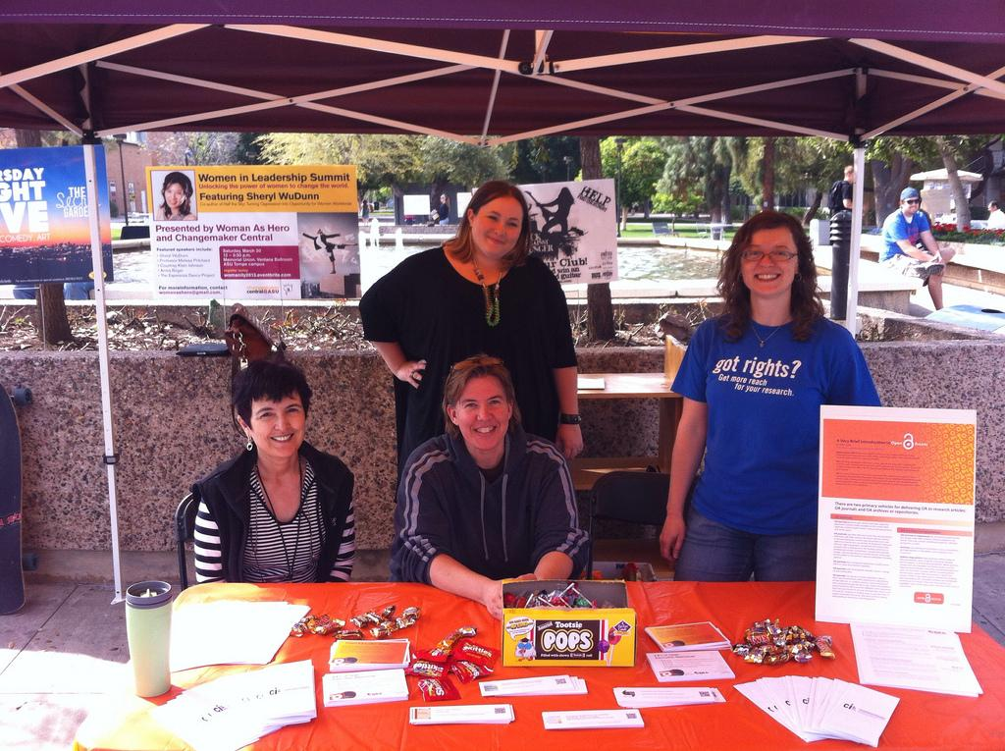
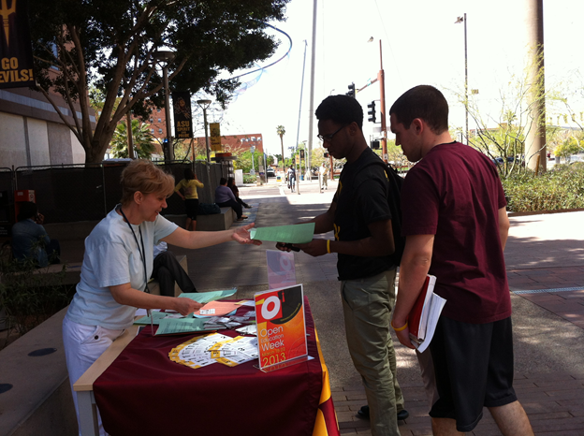

Open Education Week at ASU
Notes:
Our involvement with Open Education Week began the previous year when Anali Perry, ASU’s Scholarly Communication Librarian began to investigate the movement and opportunities to get involved, similar to her projects coordinating ASU Libraries involvement in Open Access Week events in October each year. In preparation for Open Education Week 2013, itself we teamed up with GPSA (ASU's Graduate & Professional Student Association) to plan tabling and create materials to promote Open Education initiatives and Open Educational Resources. GPSA included further information about Open Access and Open Education - from a student's perspective. (Here you can see members of ASU Libraries (Shirin Makhkamdjanova, Sue Sebastian, and Anali Perry) and a member of GPSA manning the booth on the Tempe campus – Left photo, and Downtown Humanities and General Studies Librarian, Alexandra Humphreys speaking with 2 ASU Downtown students at the Downtown Phoenix Campus – Right Photo). *You may also notice the delicious candy and the ‘free textbooks’ bookmarks that link to open textbooks on the tables with which we enticed students and others! ☺

Slide 17


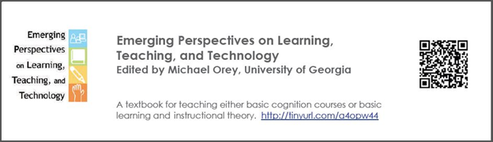
Open Education Week at ASU
Notes:
*We created bookmarks with a short URL and QRcode to an open textbook - one on Art History, one on Sustainability and the Environment, one on Law, and one on Education
*We had a postcard and talking points sheet that highlighted resources and places to get more information
One phrase that drew students to the tables (in addtion to the candy) was, "Want a free textbook?"

Slide 18
Open Education & Health Sciences at ASU Libraries
Where we are now:
Learning more about OE and OERs
Beginning to promote OE and OERs with Open Education Week, recommending OERs for faculty course content requests, and promoting Creative Commons Licensing
Preparing to share our resources
Notes:
Our current status regarding involvement in Open Education at ASU Libraries

Slide 19
What can you do?

Slide 20
What can you do?
Learn more about Open Education and Open Educational Resources

Slide 21
What can you do?
Learn more about Open Education and Open Educational Resources
Promote OE and OERs

Slide 22
What can you do?
Learn more about Open Education and Open Educational Resources
Promote OE and OERs
Get involved and share your resources!

Slide 23
Resources
Learn More about Open Education and Open Educational Resources
Cape Town Open Education Declaration, 2007: http://www.capetowndeclaration.org/read-the-declaration
Introduction to Openness in Education – Open course by David Wiley: https://learn.canvas.net/courses/4
A Basic Guide to Open Educational Resources, 2011: http://www.col.org/resources/publications/Pages/detail.aspx?PID=357
Year in Review: Open Education, 2012. "Open Education: A Diamond in the Rough.": http://opensource.com/education/12/12/top-10-open-education-posts-2012
Open Education Week website: http://www.openeducationweek.org/
Open Education article in Wikipedia: http://en.wikipedia.org/wiki/Open_education
Open Educational Resources article in Wikipedia: http://en.wikipedia.org/wiki/Open_educational_resources

Slide 24
Resources
Promote Open Educational Resources - Sources to discover OERs
Open Textbooks
Openstax College: http://openstaxcollege.org/
College Open Textbooks: http://www.collegeopentextbooks.org/
OER Resource Clearinghouses
Merlot: http://www.merlot.org/merlot/index.htm
OER Commons: http://www.oercommons.org/
Open CourseWare Consortium: http://www.ocwconsortium.org/
Open Source Citation Manager Tools
Zotero: http://www.zotero.org/
Mendeley: http://www.mendeley.com/
Open Courses
Coursera: https://www.coursera.org/
MIT Open Courseware: http://ocw.mit.edu/index.htm
Khan Academy: https://www.khanacademy.org/
Udacity: https://www.udacity.com/
More ways to find OERs - from Creative Commons OER Project: http://wiki.creativecommons.org/Finding_OER

Slide 25
Resources
Get Involved and Share Your Resources
Open Education support via SPARC (Scholarly Publishing and Academic Resources Coalition): http://www.sparc.arl.org/index.shtml
Creative Commons Licensing for Open Use and Open Education: http://wiki.creativecommons.org/Creative_Commons_and_Open_Educational_Resources
Check out more options from the Learn More and Promote Open Educational Resources lists above - become a peer reviewer and/or add content

Slide 26
References
Images used in this presentation
Surfer image: http://www.flickr.com/photos/kevcole/3008381603
Open Education images: http://www.flickr.com/photos/47691521@N07/6956020057
Open Education Resources: http://www.flickr.com/photos/opensourceway/6554315179
Open Ed Week: http://www.openeducationweek.org
Photos from ASU Libraries Open Education Week 2013 tabling events
ASU Libraries Open Education Week 2013 event materials
ASU Libraries Logo from http://commguide.asu.edu/
Questions? image: http://www.flickr.com/photos/eleaf/2536358399
Find this presentation and a PDF of Resources & References online in the ASU Digital Repository at: http://hdl.handle.net/2286/R.I.18178

Slide 27

Virginia.Pannabecker@asu.edu
Kevin.Pardon@asu.edu

