Slide 1






Overcoming Obstacles in Online Learning: Best Practices for Digital Badges in Higher Ed
Bee Gallegos, Lisa Kammerlocher,
Virginia Pannabecker, Kevin Pardon
#HigherEdBadges
Notes:
Introductions

Slide 2
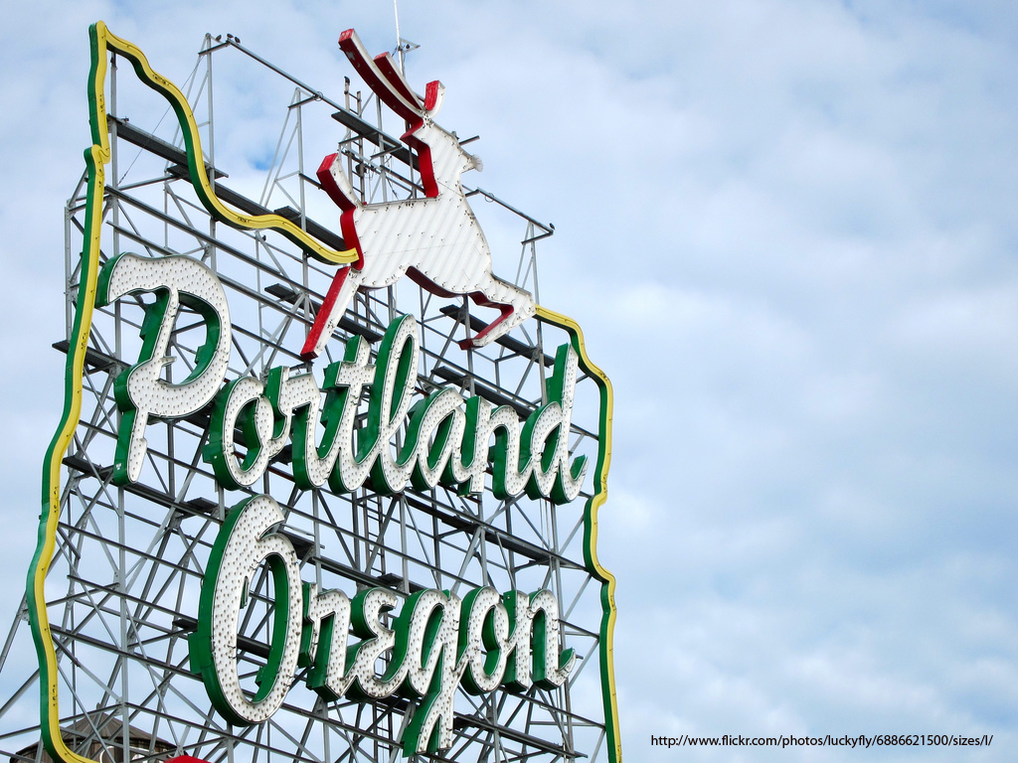
Welcome!
This presentation leaves copyright of the content to the presenter. Unless otherwise noted in the materials, uploaded content carries the Creative Commons Attribution-NonCommercial-ShareAlike license, which grants usage to the general public with the stipulated criteria.
Notes:
Introductions

Slide 3
Are you considering implementing a digital learning badge system at your institution?
Poll link

Slide 4
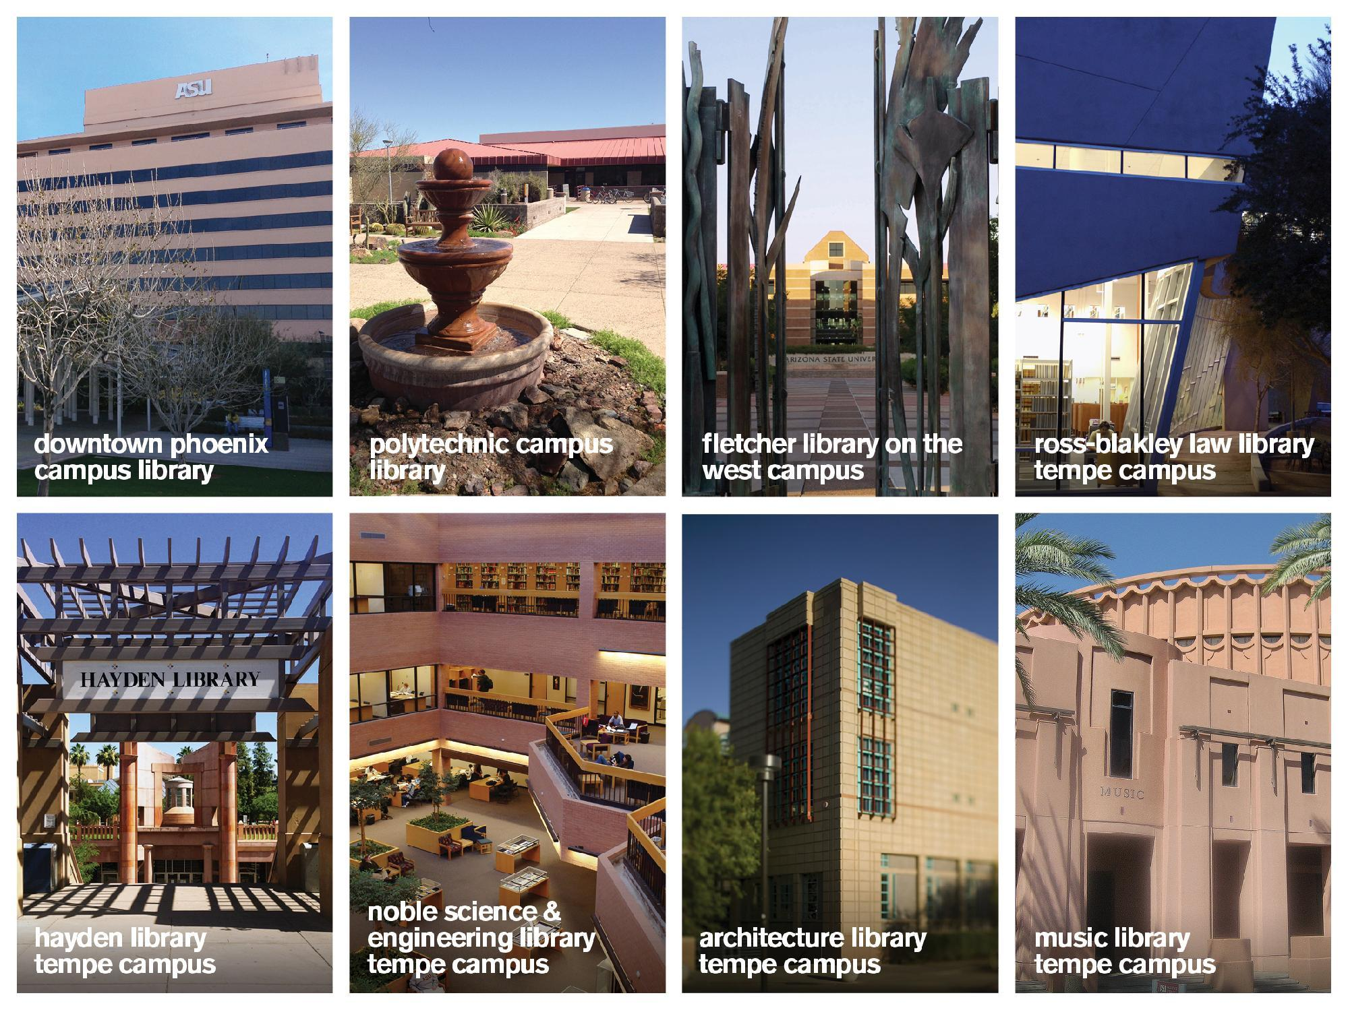
Notes:
Back Story
ASU – large public research institution 70k 45% transfers
4 campuses and online
f2f, hybrid and fully online

Slide 5
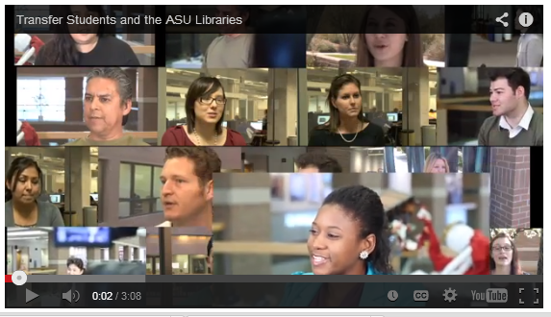
ASU Libraries Digital Badges Project
Transfer Students and the ASU Libraries
Notes:
West campus
Transfer students
Library advisory committee
faculty interviews
Collaboration between ASU Libraries and New College for pilot and planning
Librarians representing different disciplines and campuses
Why badges?
Decreasing resources—financial and human—fewer librarians
Increasing numbers of students and expectations
Need to keep up with increase in student enrollment both online and on the ground—
We needed to find something that is sustainable and scalable and works across disciplines and academic programs BADGES are the answer. Kevin will talk more about them in a few minutes but Learning Badges (also known as Open Badges or Digital Badges) is an innovative and sustainable solution. Many students like learning online so badges meet students at where they are and provide the student with a takeaway of value. Because the are online badges can be accessed on different devices at different times.
another example of flexibility—we have 4 badges—at least 3 have multiple parts—faculty can select most relevant sections to create their own grouping or only select one module
Completion of all modules of a badge means a badge is awarded; completion only one module means the student is awarded a certificate that can be listed on student resume
Their flexibility allows for integration into course work
They consist of basic core information skills linked to national standards so they are recognized skills employers indicated they needed from employees in a recent Project Information Literacy report
Their flexibility also allows us to make changes based on stakeholder needs, we changed the original process of having distinct complete badges to incorporate certificates for intermediate steps. This was after hearing faculty feedback that they would like to have the option to require only a small portion (such as a single module) of a full badge within their course requirements.

Slide 6



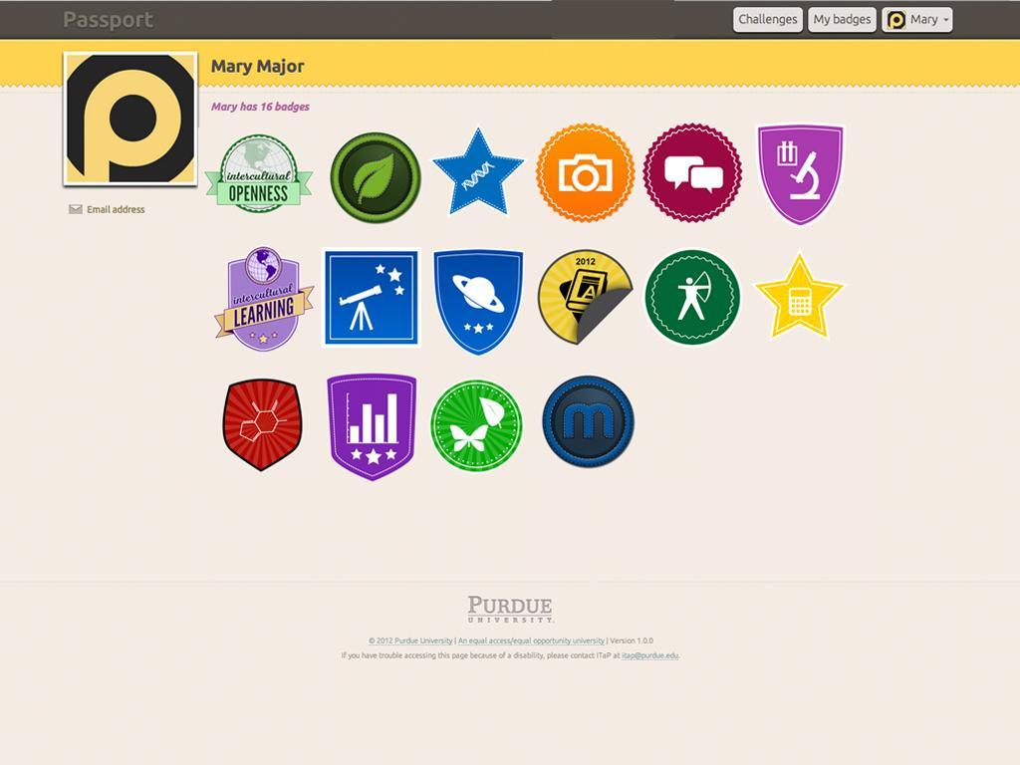
Digital Badges
Notes:
1. What Are Digital Badges?
a. Well they essentially function as symbol or indicator of knowledge, mastery, accomplishment, skill, quality, or interest, etc.
b. So our students, employees…or anyone for that matter, can complete, an instruction module such as a tutorial, perhaps take a quiz or another type of learning assessment…essentially complete some sort of task and then these students earn a digital badge. As I mentioned this earned digital badge represents and shows that the students have mastery of that given topic, learning outcome, or skill.
c. Digital badges thus function as a micro-credentialing system
e. Students can collect these learning badges and display and share them with their professors perhaps as part of an assignment or with prospective employers, or other relevant groups. And this is all done in the online environment.
d. And here are a couple examples of what an actual digital badge might look like. Several of these are mock ups from our project that were ultimately not used and then we have badges from other institutions doing this kind of thing.

Slide 7
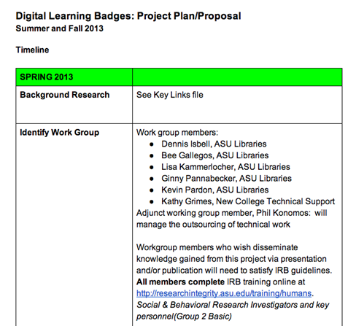
Project Plan
Project Goal and Parameters
Define and develop an online learning program for all students that builds information and research skills and promotes student success. The program must include:
interactive learning components and multimedia presentations;
modular, individually identified skill and activity based components;
multiple learning options when possible;
self-generating recognition for satisfactory completion of modules and packages;
an authentic, self-sustaining model of learning outcomes assessment
Resources Needed
Dedicated team of librarians to develop content, create the individual learning modules and the complete program (curriculum) of sequenced modules
Dedicated or contracted instructional technology staff to construct the platform and web-based modules, assessment interface and digital badge design.
Dedicated IT staff to keep interface operational and to update as needed.
Technologies
Notes:
1. Project Status/Plan/What we did
a. At ASU this past summer we started working on a pilot program for a digital badge system.
b. The project was initiated by librarians but brought in several instructional designers and online instruction technology support individuals to assist.
c. One of our first steps was to create a project plan that you can see here. This link actually leads to our example project plan so if you look on our EDUCAUSE profiles later you can find the slides and find this link.
d. Our focus was on teaching students library and research skills. Our Digital Learning Badges Workgroup envisioned a series of online modules, each one focusing on a discrete set of skills or accomplishments that could build a student’s information competencies in a demonstrable way. Examples included:

Slide 8






Implementation
Technology
Notes:
These logos represent some of the technology we are using in implementing our badges program. We chose to include many types of learning content and found that Storyline is a great product to integrate video, quizzes, interactive activities, and more into a packaged tutorial platform. Omeka is what we are using to create a learning objects repository to store all our content pieces. Blackboard Course Sites is how students will interact with these modules. YouTube is a platform we use to produce videos from ASU Libraries, and also to showcase videos of our modules so far. WordPress is where we will host the badges themselves, and BadgeOS is the plugin for WordPress that will allow us to develop an automated system for badge receipt and upload to the web for students.
Lessons Learned
First: Hire experts to include project team members who have implemented badge systems – specifically regarding reliable methods to certify badge and upload them to viewable, transferable platforms that will work with your institution’s needs
Learning Objects – use what you already have; investigate software that will help you build other needed components or provide the best formats
Style Guide – create a standardized guide listing the format/components of each module (title slide, overview/learning objectives, content, resources slide, completion slide (with progress bar if multiple sections/modules per badge)), font style, color palette, and other aspects of module creation for consistency in appearance and in user experience
Choose a method to store your content pieces – we are using Omeka to create a learning objects repository where we will store final content pieces
Choose a method to host your content – we are using WordPress to host
Choose a Badge delivery system – we will be using Badge OS – we are in the process of hiring a programmer to write the API/s that will enable automated badge posting for students as they complete badges

Slide 9
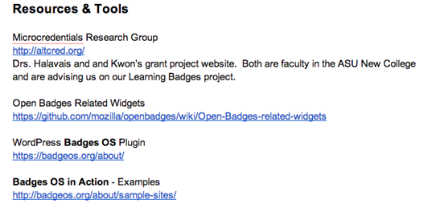
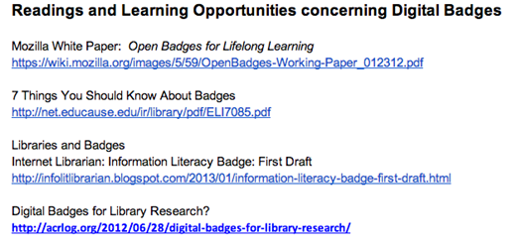
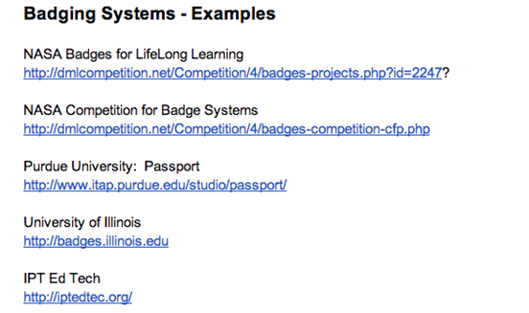
Implementation
Resources and Research
Notes:
We’ve collected a set of links to Resources & Tools we’re using, that we considered, and/or that others are using; Examples of badging systems in higher ed and elsewhere; and Readings and Learning Opportunities available to learn more about digital badges

Slide 10
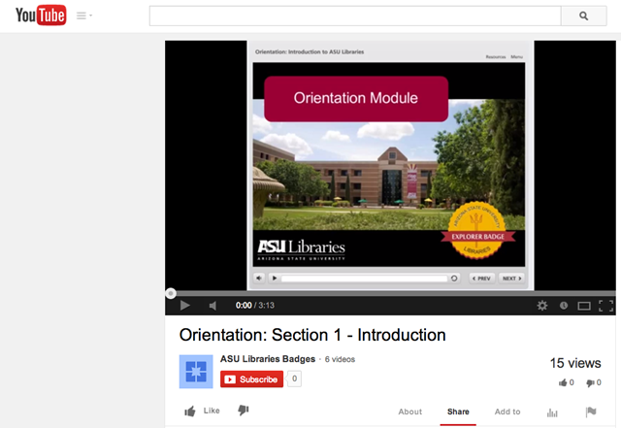
Implementation
Pilot Modules – Explorer Badge – Module 1

Slide 11
How would learners at your institution benefit from digital learning badges?
Poll link

Slide 12
What are some ideas you have about implementing a badges program at your institution?
What would your badges program address?
What challenges might you face in getting started?
What are some first steps you might take?

Slide 13

Questions?
Bee Gallegos
Bee.Gallegos@asu.edu
Lisa Kammerlocher
lk@asu.edu
Virginia Pannabecker
virginia.pannabecker@asu.edu
Kevin Pardon
Kevin.Pardon@asu.edu
Presentation Resources & References:
http://libguides.asu.edu/educauseportland2014

