Slide 1

Opening Minds to Open Access: Best Practices at Arizona State University Libraries
Virginia Pannabecker
Health Sciences Librarian
& Alexandra Humphreys
Instruction and Education Librarian

Slide 2

Opening Minds to Open Access
“Those with access to these resources — students, librarians, scientists — you have been given a privilege. You get to feed at this banquet of knowledge while the rest of the world is locked out. But you need not — indeed, morally, you cannot — keep this privilege for yourselves.”
~Aaron Swartz, Guerilla Open Access Manifesto (http://archive.org/stream/GuerillaOpenAccessManifesto/
Goamjuly2008_djvu.txt)

Slide 3

Opening Minds to Open Access
“ We’re interested in Open Access because a student’s education is only as valuable as the information that a student has access to… Open Access increases the value of our education after we leave school.”
~Matt Cooper
Immediate Past President of the National Association of Graduate-Professional Students
~ at the SPARC/World Bank 2012 Open Access Week Kickoff event

Slide 4

Opening Minds to Open Access
What is Open Access (OA) to research literature?
  Free of charge for users
  Online
  Free of most copyright and licensing restrictions

Slide 5
Opening Minds to Open Access
Today you will learn about:
Events
  Open Access Week
  Open Education Week
  Every Day OA (presentations, webcasts, etc.)
Methods for Promoting OA Participation
  Scholarly Communication library guide
  Memberships
  Conference presentations
  ASU Digital Repository
Finding OA Resources
  Open Access Library Guide
  Institutional Repositories (access via Google Scholar)
  DOAJ

Slide 6

Opening Minds to Open Access: Events
Open Access Week @ ASU
International Open Access Week - http://www.openaccessweek.org/ -Global event -- every October
Webinars (e.g., SPARC, World Bank, ALA, ACRL)
Presentations (e.g., brown-bags, lectures, etc.)
Events co-sponsored by the ASU Graduate and Professional Student Association (GPSA)
Events with Faculty and Researchers - Selecting a Journal & Open Access options

Slide 7



Opening Minds to Open Access: Open Access Week @ ASU

Slide 8
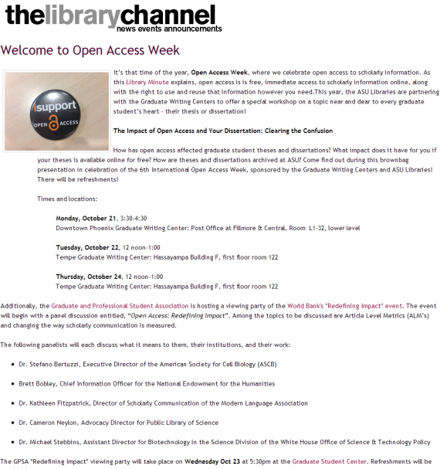
Opening Minds to Open Access: Open Access Week @ ASU

Slide 9
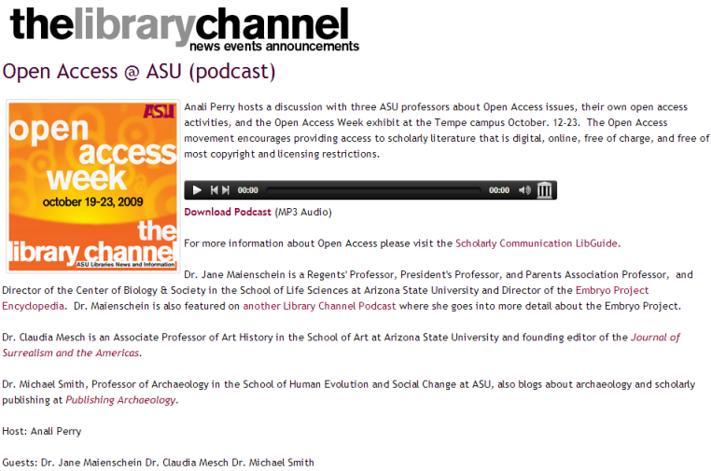
Opening Minds to Open Access: Open Access Week @ ASU

Slide 10

Opening Minds to Open Access: Events
"Open Education Week’s goal is to raise awareness about free and open educational opportunities that exist for everyone, everywhere, right now"

Slide 11
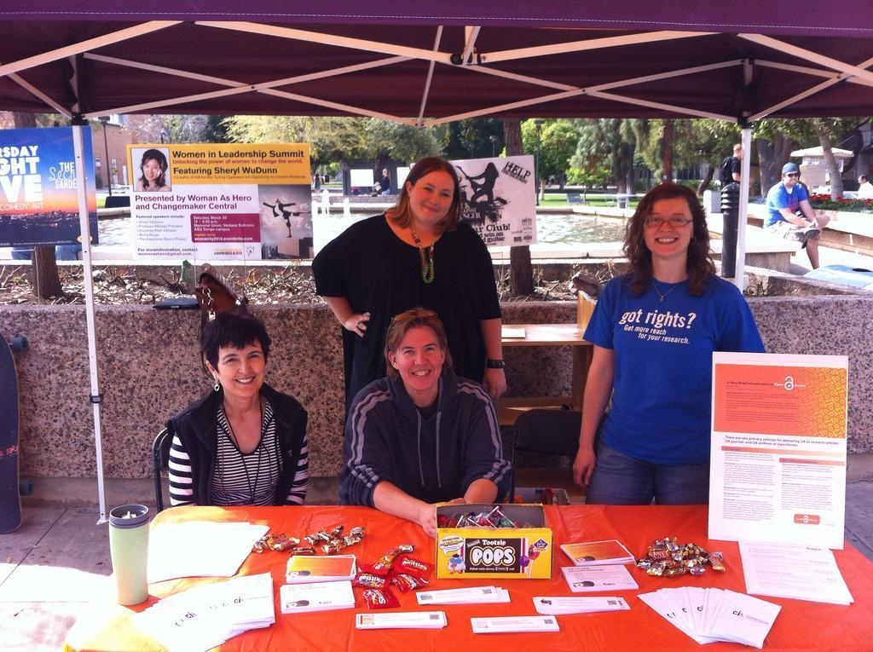
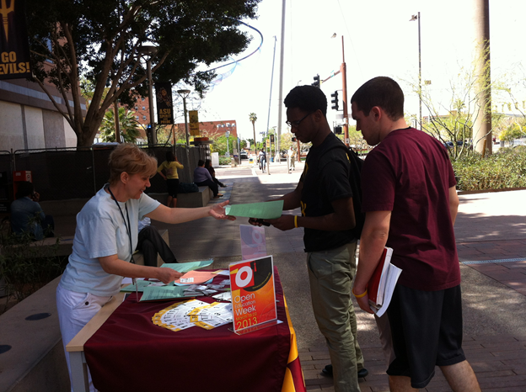
Opening Minds to Open Access: Events
Open Education Week at ASU

Slide 12

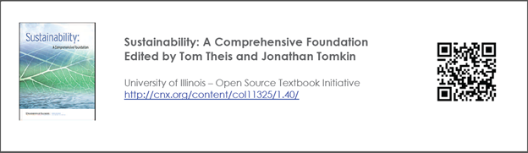

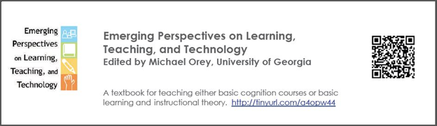
Opening Minds to Open Access: Open Education Week @ ASU

Slide 13
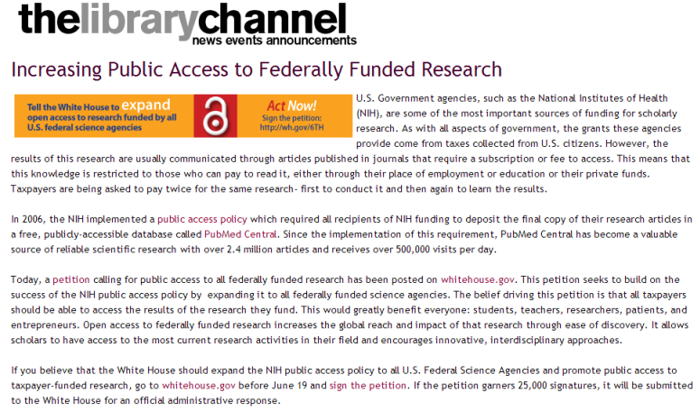
Opening Minds to Open Access: Every Day OA
Presentations and other events during the year

Slide 14
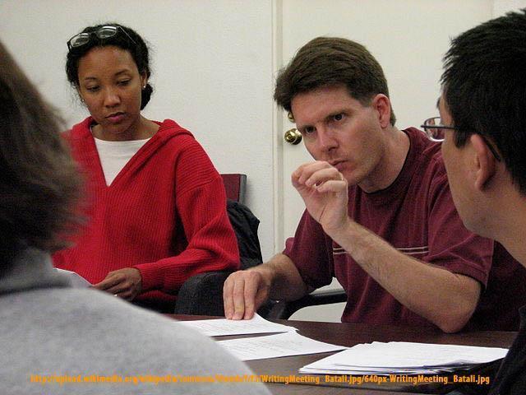

Opening Minds to Open Access: Every Day OA
Providing Open Access support in context as a member of a faculty writing group, and during research / curricular support.

Slide 15
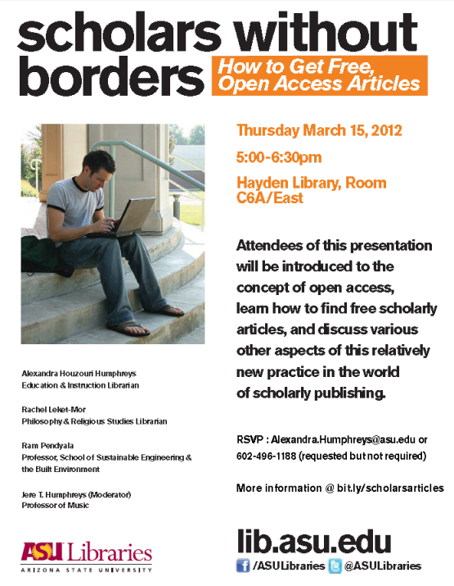

Opening Minds to Open Access: Every Day OA

Slide 16

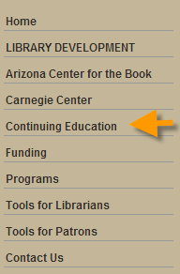

Opening Minds to Open Access: Every Day OA
http://www.azlibrary.gov/extension/continuing_education.aspx

Slide 17
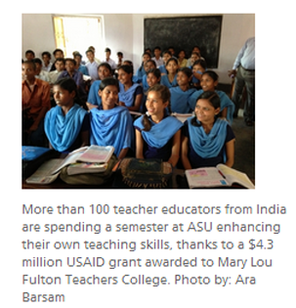
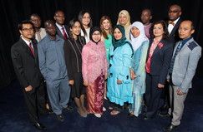
Opening Minds to Open Access: Every Day OA
Library research sessions with international students and scholars
Mary Lou Fulton Teachers College
International Leaders in Education (ILEP)
India Support for Teacher Education
Program (In-STEP)

Slide 18
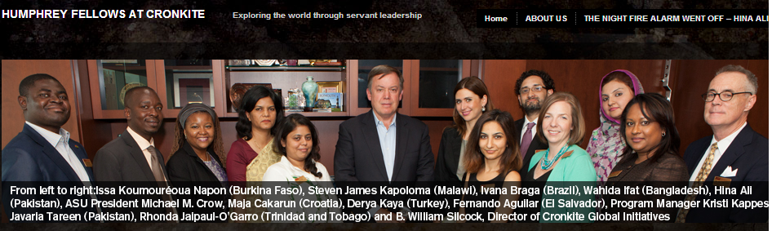
Opening Minds to Open Access: Every Day OA
Library research sessions with international students and scholars
The Walter Cronkite School of Journalism and Mass Communication
The Hubert H. Humphrey Fellowship, in partnership with the U.S. State Department and the Institute of International Education brings mid-career journalists and communication professionals from emerging democracies to the Cronkite School for a year of intensive leadership training, academic study and professional experiences.

Slide 19
Opening Minds to Open Access: Promote Open Access
On October 20, 2010, The Librarians Assembly passed an Open Access Resolution declaring our commitment to Open Access.
We, the Librarians Assembly of Arizona State University (ASU) Libraries, resolve the following:
1. To disseminate our scholarship as broadly as possible. We endeavor to make our scholarly work openly accessible in conformance with open access principles. Whenever possible, we make our scholarship available in digital format, online, and free of charge.
2. To grant ASU Libraries a Creative Commons "Attribution Noncommercial-No Derivative Works 3.0 United States" license to each of our scholarly works to allow the ASU Libraries the right to archive and make publicly available the full text of our scholarly works via the ASU Libraries' digital repository.
3. To deposit the author's final version of our scholarly work in the digital repository as soon as is possible, recognizing that some publishers may impose an embargo period.
4. To seek publishers whose policies allow us to make our scholarly works freely available online. When a publisher’s policies do not allow us to make our works freely available online, we resolve to engage in good faith negotiations with the publisher to allow deposit of pre- or postprint versions of our scholarly work in the digital repository.
5. To promote Open Access on campus and assist scholars in making their research openly available.
The resolution applies to the scholarly works authored and co-authored while employed at ASU Libraries, beginning with works submitted for publication after October 20, 2010. The works encompassed by this resolution include journal articles and conference proceedings. We encourage the deposit of other scholarly work as defined by Librarians Assembly.
This open access resolution will be reviewed by Librarians Assembly after one year.

Slide 20
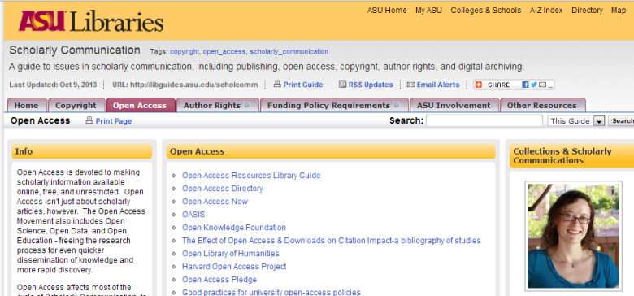
Opening Minds to Open Access
Promote Open Access
ASU Scholarly Communication Guide (Open Access): http://libguides.asu.edu/content.php?pid=29995&sid=783323

Slide 21

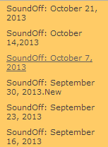

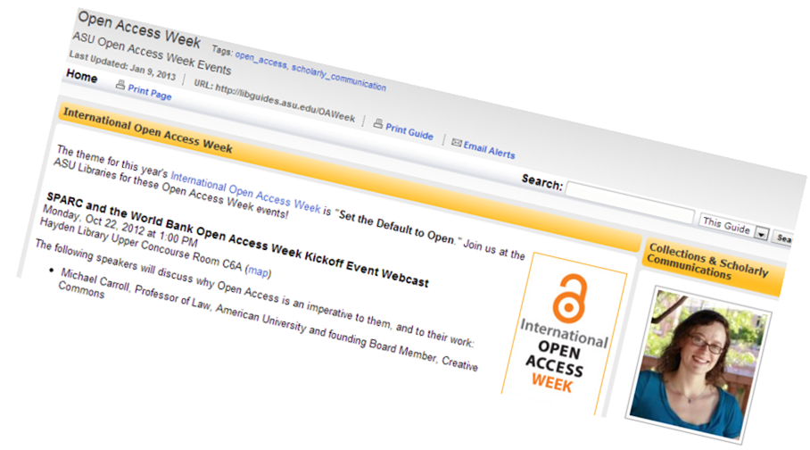

Opening Minds to Open Access: Promote OA

Slide 22
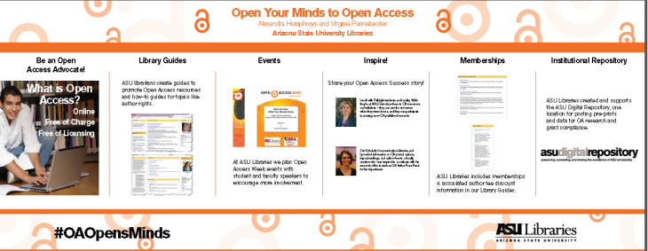

Opening Minds to Open Access: Promote OA
Conference Presentations

Slide 23
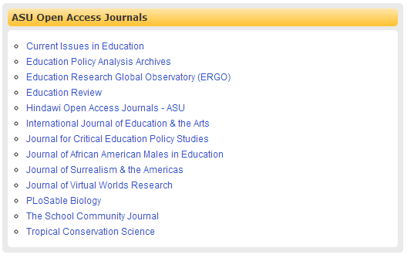
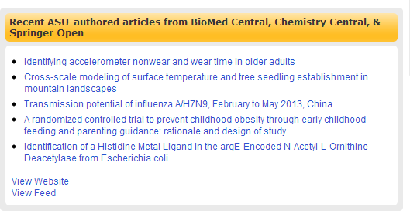
Opening Minds to Open Access: Promote OA

Slide 24
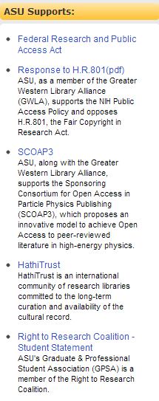
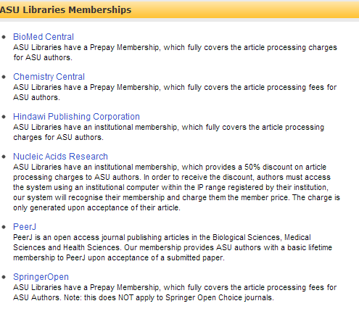
Opening Minds to Open Access: Promote Open Access
Memberships

Slide 25


Opening Minds to Open Access: ASU Digital Repository
Arizona State University Digital Repository: http://repository.asu.edu/

Slide 26
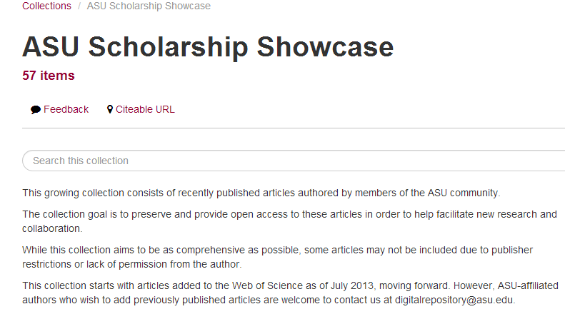
Opening Minds to Open Access: ASU Digital Repository

Slide 27

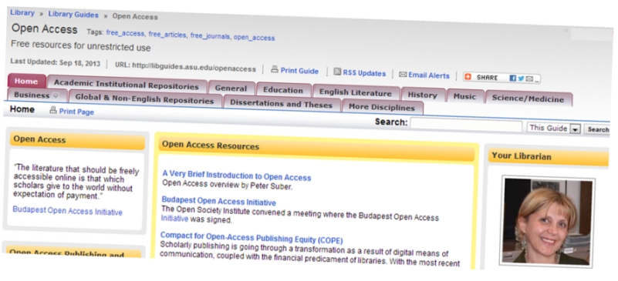
Opening Minds to Open Access
Finding Open Access Resources
Google Scholar: http://scholar.google.com/
Open Access Library Guide: http://libguides.asu.edu/openaccess

Slide 28

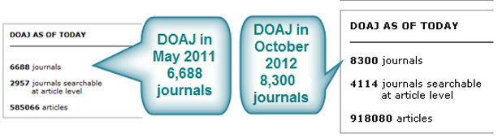
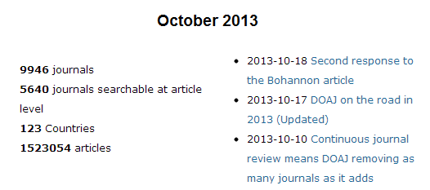
Opening Minds to Open Access: Finding Open Access Resources
Directory of Open Access (DOAJ):http://www.doaj.org/
Articles published in DOAJ:

Slide 29

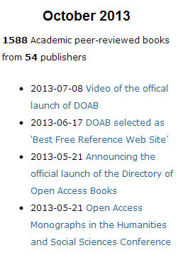
Opening Minds to Open Access: Finding Open Access Resources

Slide 30
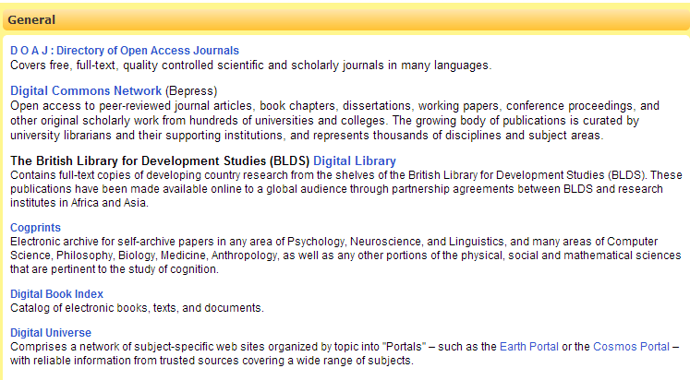
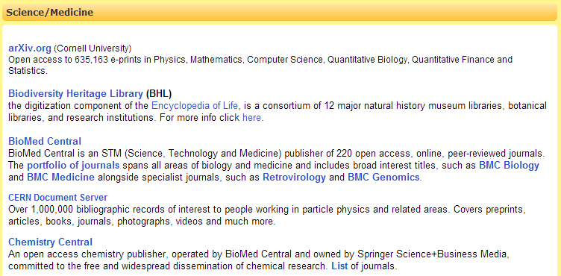
Opening Minds to Open Access: Finding Open Access Resources

Slide 31
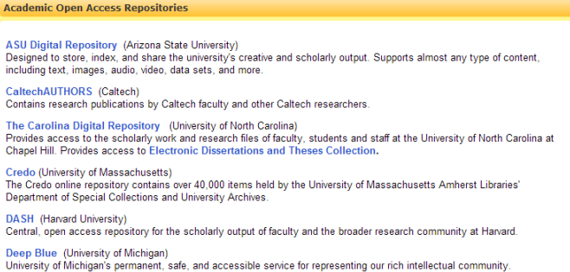
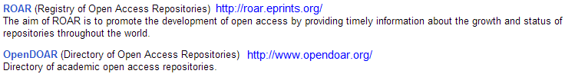
Opening Minds to Open Access: Finding Open Access Resources
Institutional Repositories
OpenDOAR ROAR

Slide 32
Opening Minds to Open Access: Resources
Learn More about Open Access
Peter Suber’s ‘Very Brief Introduction to Open Access’: http://legacy.earlham.edu/~peters/fos/brief.htm
SPARC (Scholarly Publishing and Academic Resources Coalition): http://www.sparc.arl.org/issues
Aaron Swartz Guerilla Open Access Manifesto: http://archive.org/stream/GuerillaOpenAccessManifesto/Goamjuly2008_djvu.txt
Promote Open Access Resources - Sources to discover OA resources
Open Access Resources Library Guide: http://libguides.asu.edu/openaccess
Scholarly Communications Library Guide: http://libguides.asu.edu/scholcomm
DOAJ (Journals): http://www.doaj.org/
DOAB (Books): http://www.doabooks.org/
DOAR (Institutional & Disciplinary Repositories): http://www.opendoar.org/
ROAR (Registry of Open Access Repositories): http://roar.eprints.org/
Get Involved and Share Your Resources
Open Access Week: http://www.openaccessweek.org/
Open Education Week: http://www.openeducationweek.org/

Slide 33
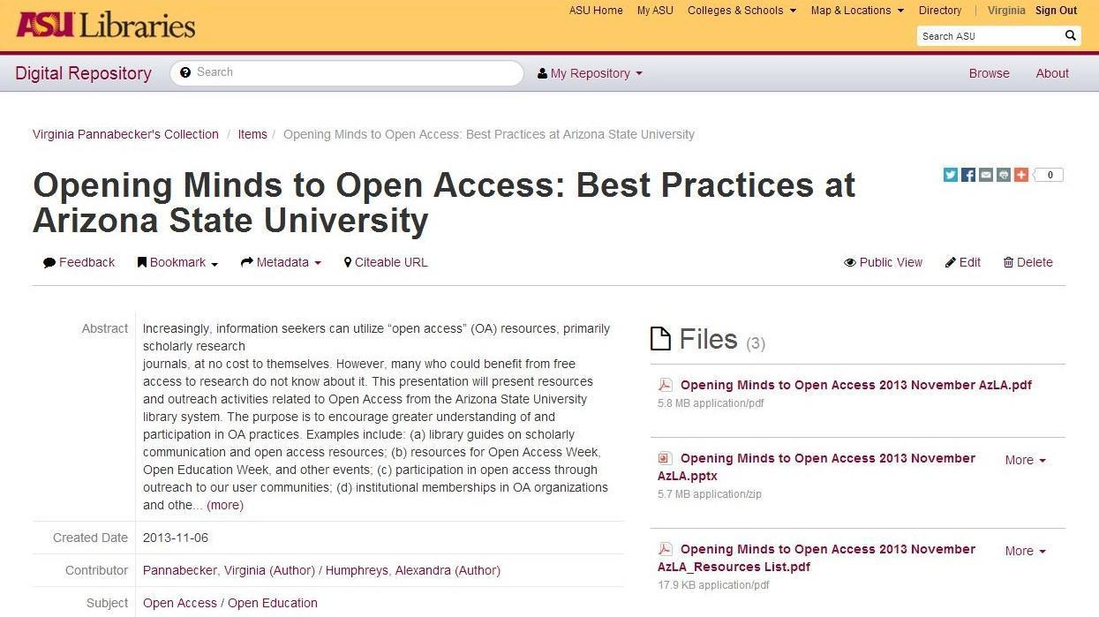
Opening Minds to Open Access: Presentation & Resources List Archived Files
Find our Presentation and Resources List in the ASU Digital Repository:
http://hdl.handle.net/2286/R.I.18994

Slide 34
Opening Minds to Open Access: Image References
Images used in this presentation
ASU Libraries Logo from http://commguide.asu.edu/
Image of Aaron Swartz with quote: http://www.pallenberg.net/post/40412664791/there-is-no-justice-in-following-unjust-laws
ASU Libraries Channel images: https://lib.asu.edu/librarychannel
Open Access lock image: http://www.library.vcu.edu/blog/news/assets_c/2012/10/open-access-logo.jpg-2056.html
Open Access images, Open Access Week banner: http://www.openaccessweek.org/
Open Ed Week: http://www.openeducationweek.org
Photos from ASU Libraries Open Education Week 2013 tabling events
ASU Libraries Open Education Week 2013 event materials
Image of writing group, (CC license): http://upload.wikimedia.org/wikipedia/commons/thumb/f/f3/WritingMeeting_Batali.jpg/640px-WritingMeeting_Batali.jpg
Image of email envelope (CC license, by Nevit Dilmen): http://upload.wikimedia.org/wikipedia/commons/thumb/f/f3/WritingMeeting_Batali.jpg/640px-WritingMeeting_Batali.jpg
Questions? image (CC license): http://www.flickr.com/photos/eleaf/2536358399

Slide 35

Virginia.Pannabecker@asu.edu
Alexandra.Humphreys@asu.edu

