Slide 1
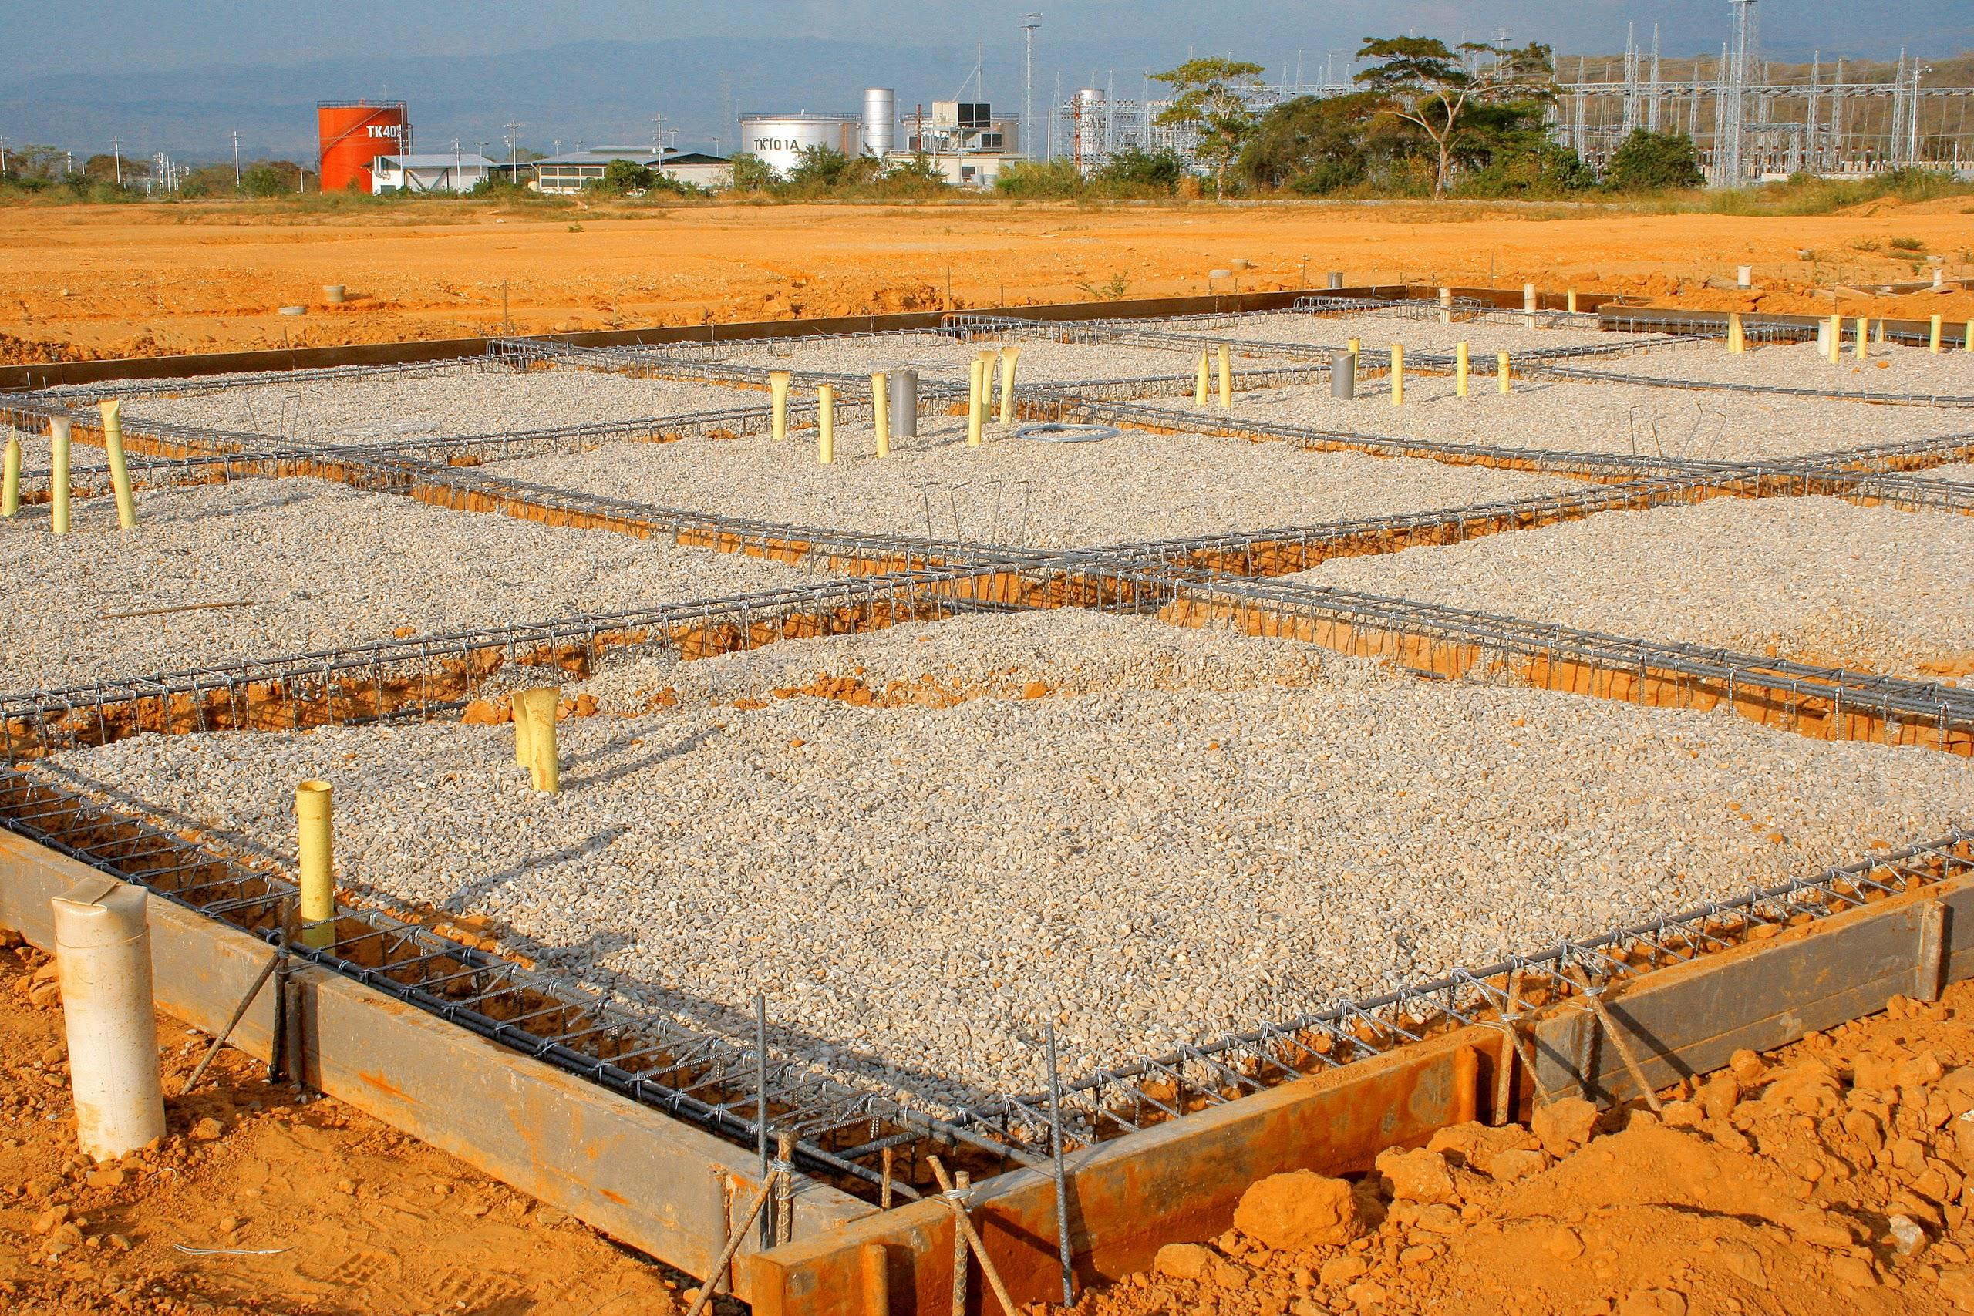
Building a Foundation
for Lifelong Research
Open Access and Open Educational Resources
in Allied Health Higher Education

Slide 2
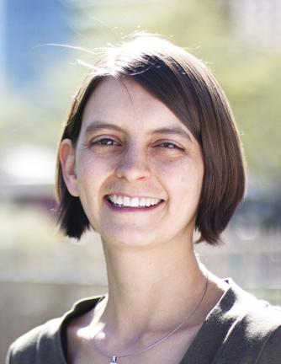


Virginia Pannabecker
Health Sciences Librarian
Arizona State University
Downtown Phoenix Campus
virginia.pannabecker@asu.edu
@VPannabecker
www.linkedin.com/pub/virginia-pannabecker/23/a4/38

Slide 3
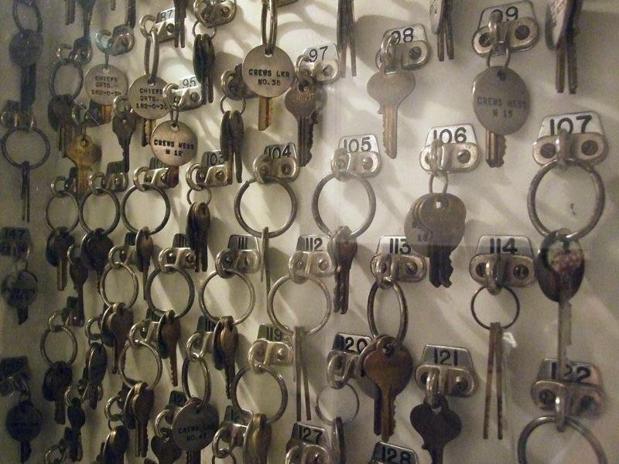
Notes:
Have you ever been asked about access to library research by an alumna of your institution? Only to have to let them know that they no longer have access as they are not part of the institution? (Or, at least, no online / interlibrary loan access?)
"...a student's education is only as valuable as the information that a student
has access to..."
~Matt Cooper, National Association of Graduate and Professional Students, 2012 President

Slide 4

Notes:
Librarians can work with students, researchers, faculty, community to consider their role in increasing access to such research in the future
“Those with access to these resources — students, librarians, scientists — you have been given a privilege. You get to feed at this banquet of knowledge while the rest of the world is locked out. But you need not — indeed, morally, you cannot — keep this privilege for yourselves.”
~Aaron Swartz, Guerilla Open Access Manifesto (http://archive.org/stream/GuerillaOpenAccessManifesto/Goamjuly2008_djvu.txt)

Slide 5

Notes:
Open source movement
Open Access
Open Education
Open Science
Open….everything!
What is Open Education?
Open Educators and Supporters:
Inspire "a new pedagogy where educators and learners create, shape, and evolve knowledge together"

Slide 6

Research Literature that is:
Online
Free of charge
Free of most copyright and licensing restrictions
Notes:
Open Access provides:
Research Literature
Online
Free of charge
Free of most copyright and licensing restrictions

Slide 7

OERs
Open educational resources online and licensed for anyone to:
Reuse, Revise, Remix, & Redistribute

Slide 8



Licensing & Author Rights
Notes:
Integrate OA/OE into curriculum/use
faculty
students
you
=
content creators - know your rights! Use licenses to make it explicit how you are allowing others to use, modify, and redistribute your content!

Slide 9

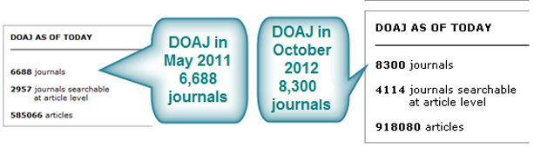






Open Access
Resources
Directory of Open Access Journals (DOAJ): http://www.doaj.org/
Open Access
Library Guide
libguides.asu.edu/openaccess

Slide 10









Open Educational Resources
Open Education
Library Guide
libguides.asu.edu/OpenEducation

Slide 11
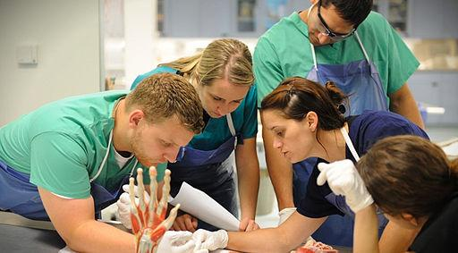
Integrating OA and OERs into Curriculum
Notes:
Integrate OA and OERs into curriculum
Some things you may already be doing:
-Encouraging the use of and facilitating expert use of the primary open access research database in health: PubMed
-Consumer health - how to read medical research
-Discipline specific
OERs - videos, images, more
author rights - grads, research, faculty

Slide 12
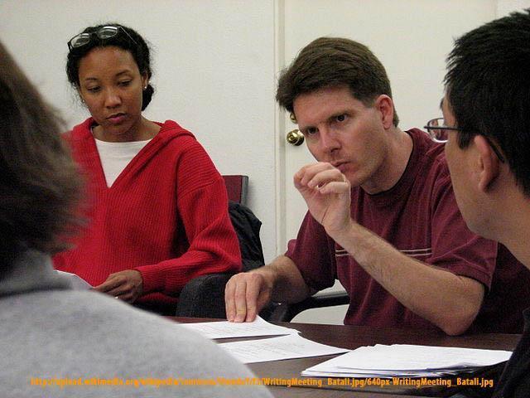
Supporting Faculty Use & Creation of OA and OERs
Notes:
Support faculty use and involvement in OA and OE resources and initiatives
Grant planning - consider building in fees to publish in OA journals
Publishing - author rights, OA options,
OA ‘predatory’ journals - how to tell the difference; support this
Selecting a journal - resources (Eigenfactor), memberships / OA author fees
Repository options
Involve them in events
Ways to do this - when they ask about journal selection, about grant publishing requirements

Slide 13

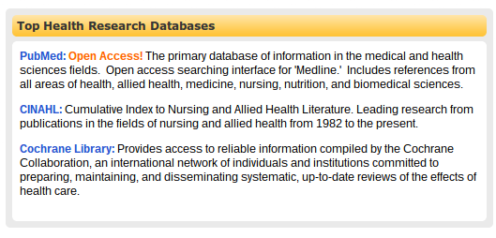
Using & Supporting
Open Access
Resources
Alumni
Community Partners
Students
Classes
Notes:
Use of OA
- health examples
- alumni, community partners!! (research partners, nonprofits), ...continuing ed
-students - in classes highlight them as lifelong learning resources
-students - esp grad students - talk with them about electronic dissertations and theses - how will they license theirs? will they archive it or will it be automatically archived?

Slide 14
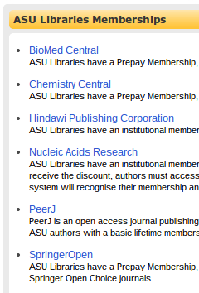
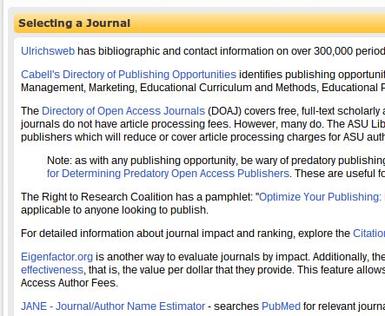

Using & Supporting
Open Access
Resources
Faculty
Researchers
Graduate Students
Getting Published
Library Guide
libguides.asu.edu/gettingpublished

Slide 15

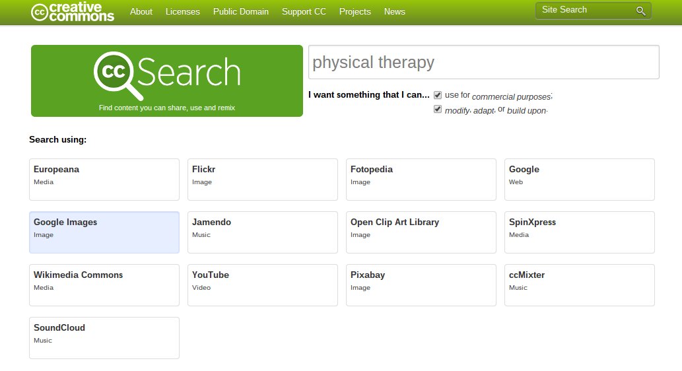
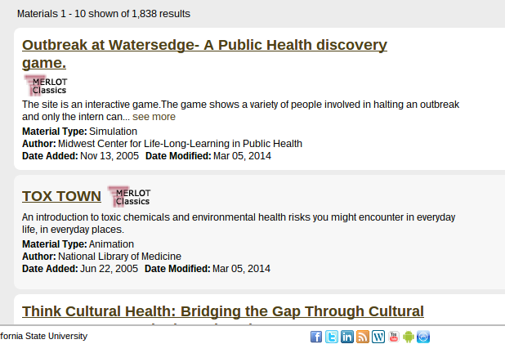
Using
Open Educational Resources
Notes:
Creative Commons Search is a great way to introduce students to open licensing practices that explicitly tell others how and to what extent they may reuse or adapt the content. *A great place to do this is when students are looking for images to use in creating presentations or online products for their courses. This may even be an opportunity to talk about the different CC licenses and suggest that they license the work they create with a creative commons license.

Slide 16

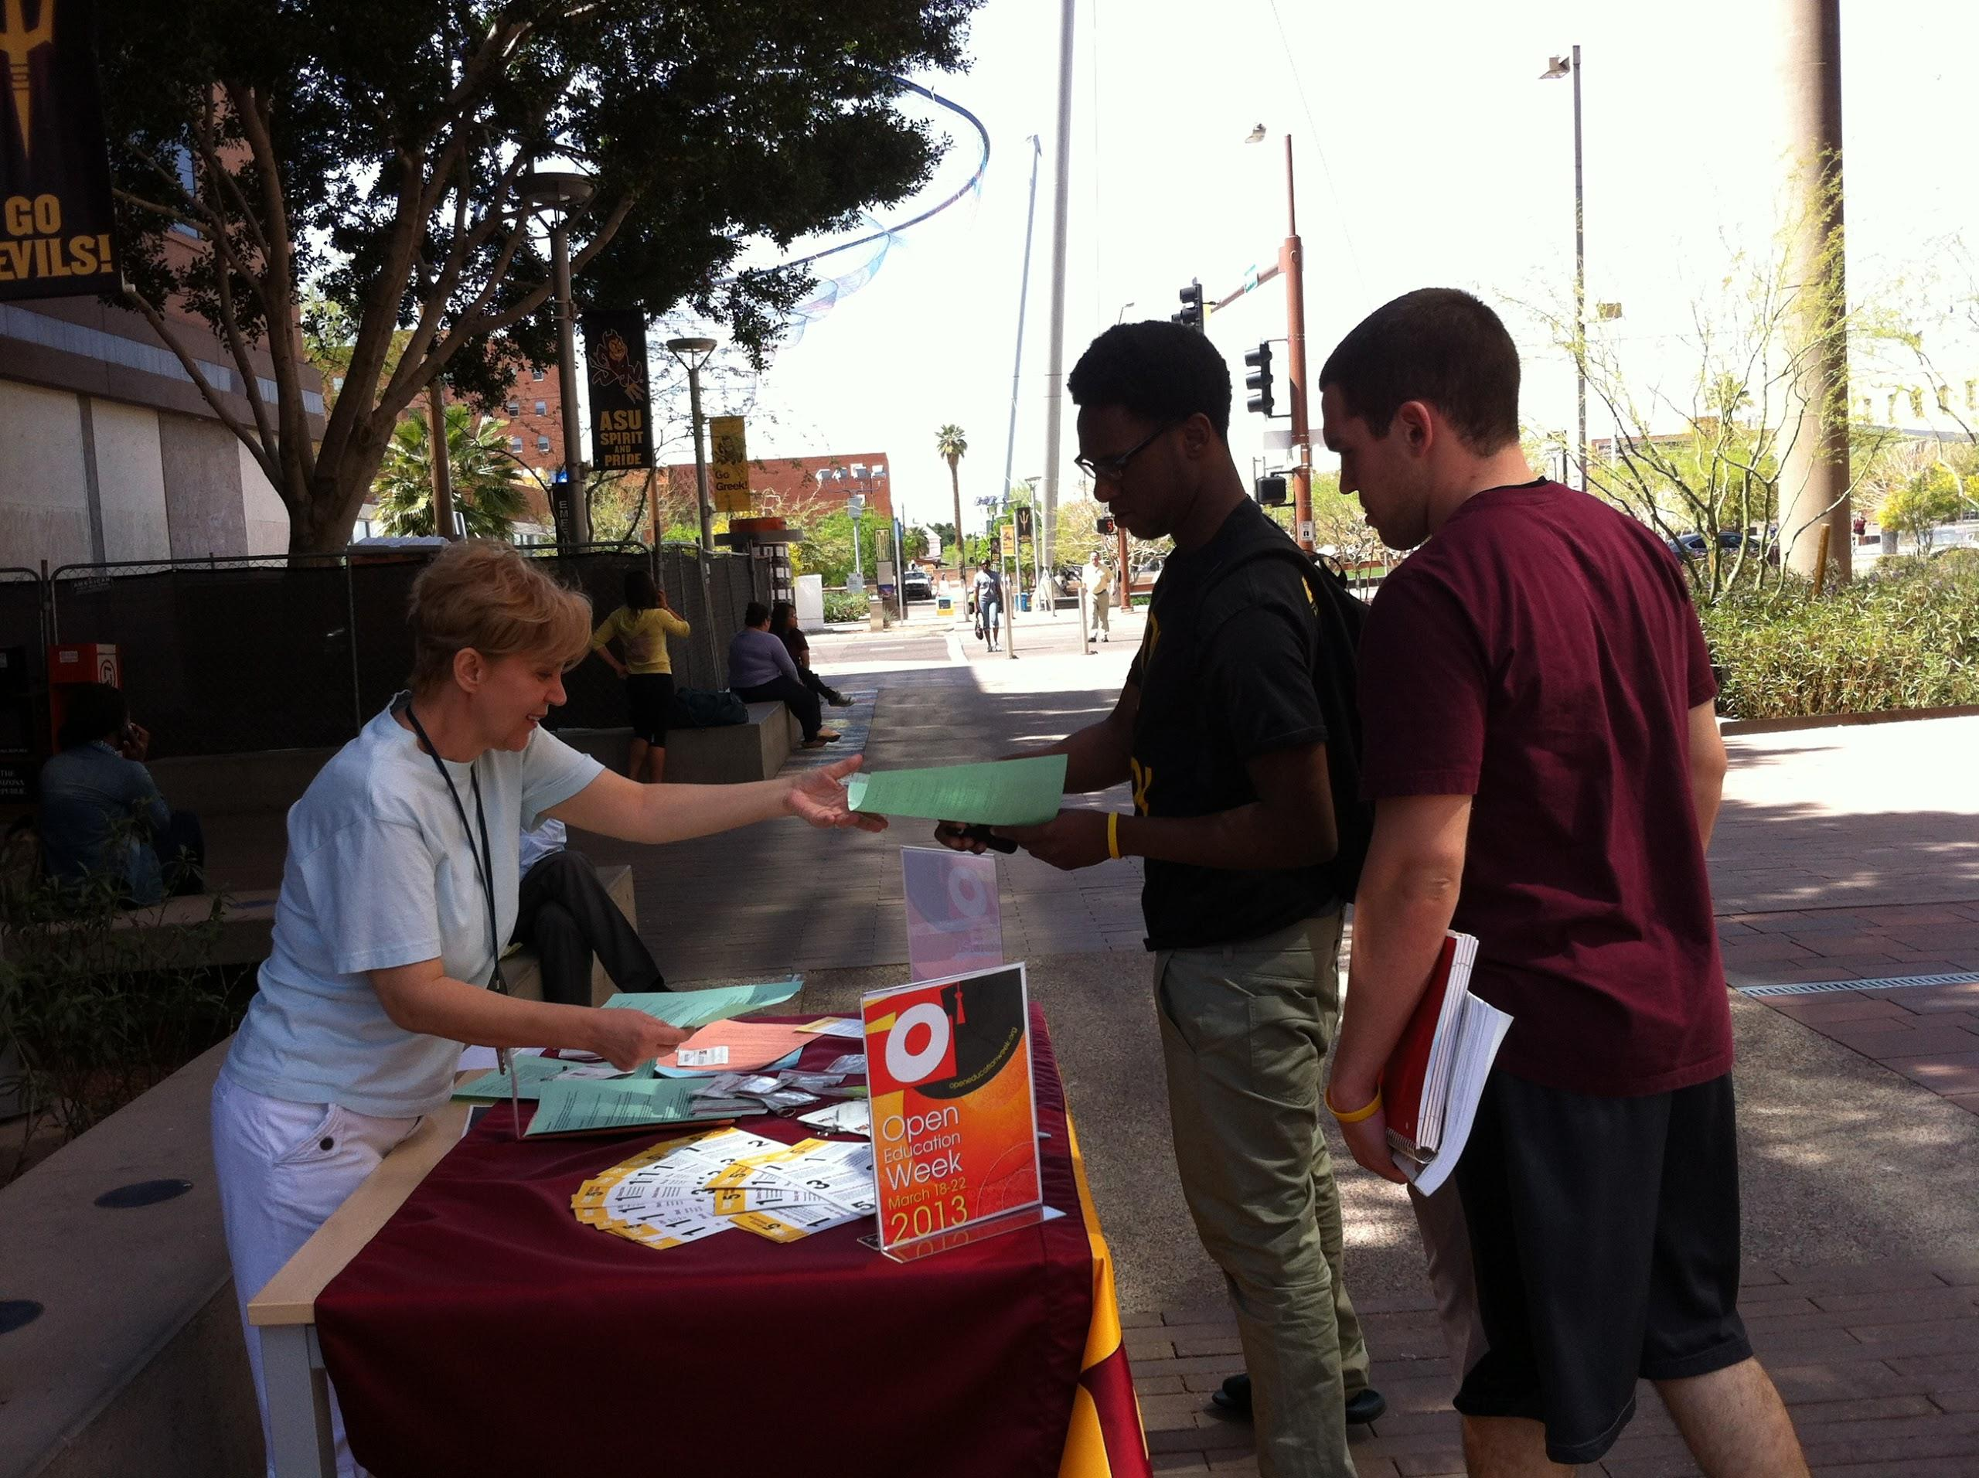

Promoting OA and OE Resources

Slide 17
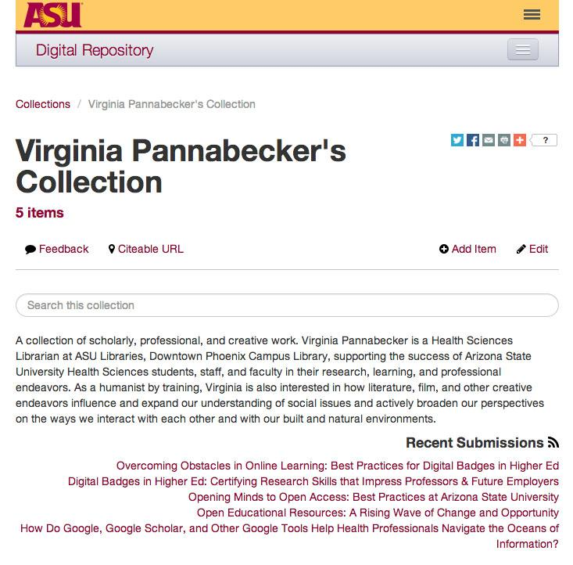


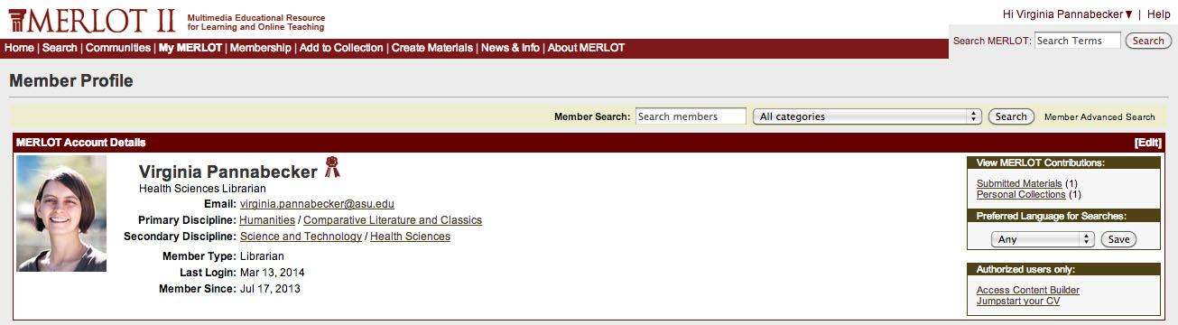
Getting Involved

Slide 18

Notes:
Open Access and Open Education promote Lifelong learning practices!

Slide 19
Resources & In-Session Prep!
Join us at MLA 2014 for the in-person follow up to this and more flipped presentations!
Title: Building a Foundation for Lifelong Research: Emphasizing Open Access and Open Educational Resources in Allied Health Higher Education
Track: Structural Adjustments: Changes in Education
Date: Sunday, May 18, 2014
Time: 4:30 PM – 5:55 PM
Before the session:
Choose your favorite discussion topics or suggest new ones:
http://tinyurl.com/BuildingAFoundationMLA2014
Check out the Building a Foundation Google site:
https://sites.google.com/site/buildingafoundationmla2014/
Share ideas for the in-person discussion - at the form above or on the Google site
Get OA and OE resource lists
Notes:
To make the in-person part of this flipped conference session as targeted and useful as possible, please tell me more about you and your interests in Open Access, Open Education, and Open Educational resources.
This should take 5 minutes total - filling out the survey:
Thanks for your time and interest! Looking forward to seeing you at MLA in Chicago!

Slide 20
Images used in this presentation are all licensed with a Creative Commons license allowing for reuse with attribution:
building foundation: http://upload.wikimedia.org/wikipedia/commons/4/4b/Base-foundation-2.jpg
learn highway sign:http://pixabay.com/en/learn-note-sign-directory-64058/
keys: http://www.flickr.com/photos/josephleenovak/5559755789/
fireworks: http://pixabay.com/en/fireworks-rockets-explosion-260573/
OA buttons: http://www.flickr.com/photos/34070876@N08/3602393341/
OA logo: http://commons.wikimedia.org/wiki/File%3AOpen_Access_PLoS.svg
chiropractic students stuyding anatomy: http://commons.wikimedia.org/wiki/File%3AChiropractic_students_learning_anatomy.jpg
email envelope: http://commons.wikimedia.org/wiki/File%3AEnvelope_email.svg
literature review tutorial: http://www.lib.ncsu.edu/tutorials/lit-review/

Slide 21
Virginia Pannabecker
Health Sciences Librarian
Arizona State University
Downtown Phoenix Campus
virginia.pannabecker@asu.edu
@VPannabecker
www.linkedin.com/pub/virginia-pannabecker/23/a4/38
Notes:
Hi!
My name is Ginny (Virginia) Pannabecker. I’m a Health Sciences Librarian at Arizona State University

