Slide 1


Lincoln Ragsdale’s Emancipation Proclamation Radio Shows
Robert Spindler
Curator, Arizona Collection
Speaking the Unspeakable Conference
Saturday February 18, 2017
rob.spindler@asu.edu

Slide 2
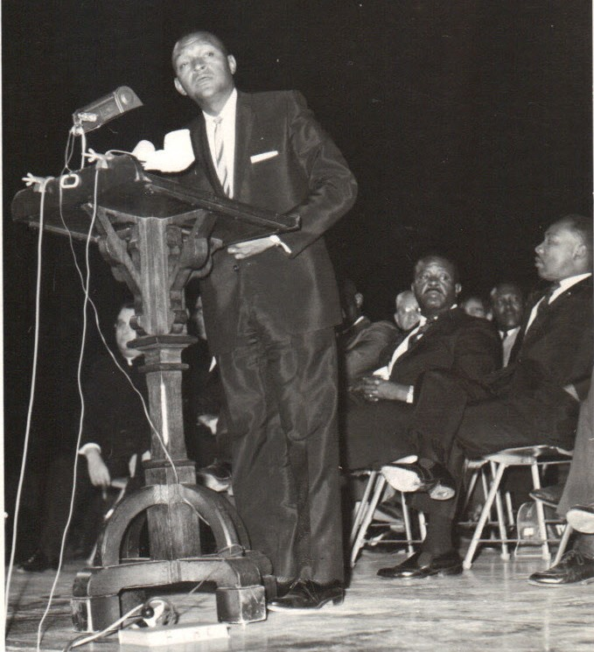
Lincoln Ragsdale
Founded Ragsdale Mortuary and Valley Life Insurance Co.
Known for their integrated workforce and opportunities for job training and advancement for black workers.
Lincoln and Eleanor were important civil rights leaders in the Valley’s black community

Slide 3
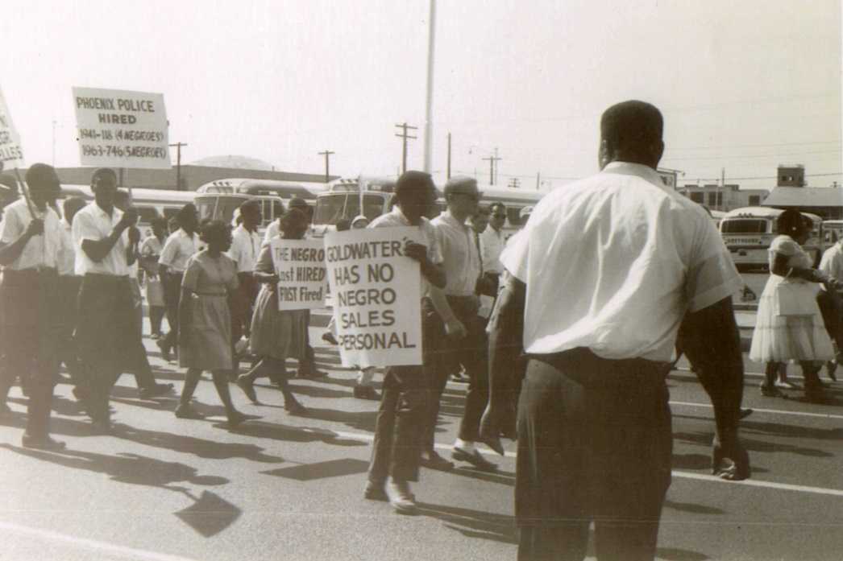
Maricopa County NAACP
Lincoln Ragsdale was Vice President
Worked with NAACP President Rev. George Brooks of Southminister Presbyterian Church on employment discrimination issues
Brooks good cop / Ragsdale
bad cop

Slide 4

Emancipation Proclamation Radio Shows
KCAC radio, 1963-1964
Austin Coleman, host
30 minute Sunday morning gospel music show
NAACP update by Ragsdale in every broadcast

Slide 5
KCAC Radio Show Clips
Eyewitness account:
El Rey Café Sit-in, ca.
September 1, 1963
  Echoes the March on Washington of August 28th
  “Stepped Up” Integration movement
  “Decency” in housing, education, employment
  Christian faith gives “strength”
  We Shall Overcome

Slide 6
KCAC Radio Show Clips
Ragsdale’s Easter message Sunday March 22, 1964
  Christian values of equality and brotherhood
  Compares the sacrifice of Jesus to those of the community “What price are you willing to pay?”

Slide 7
For More Information
Lincoln Ragsdale Emancipation Proclamation Audio Recordings (google: Lincoln Ragsdale Audio)
Matthew C. Whitaker, Race Work: The Rise of Civil Rights in the Urban West, 2005
Mary Melcher, “Blacks and Whites Together: Interracial Leadership in the Phoenix Civil Rights Movement” Journal of Arizona History 32(2):195-216 (1991).

Slide 8
Lincoln Ragsdale’s Emancipation Proclamation Radio Shows
Robert Spindler
Curator, Arizona Collection
Speaking the Unspeakable Conference
Saturday February 18, 2017
rob.spindler@asu.edu

