Slide 1
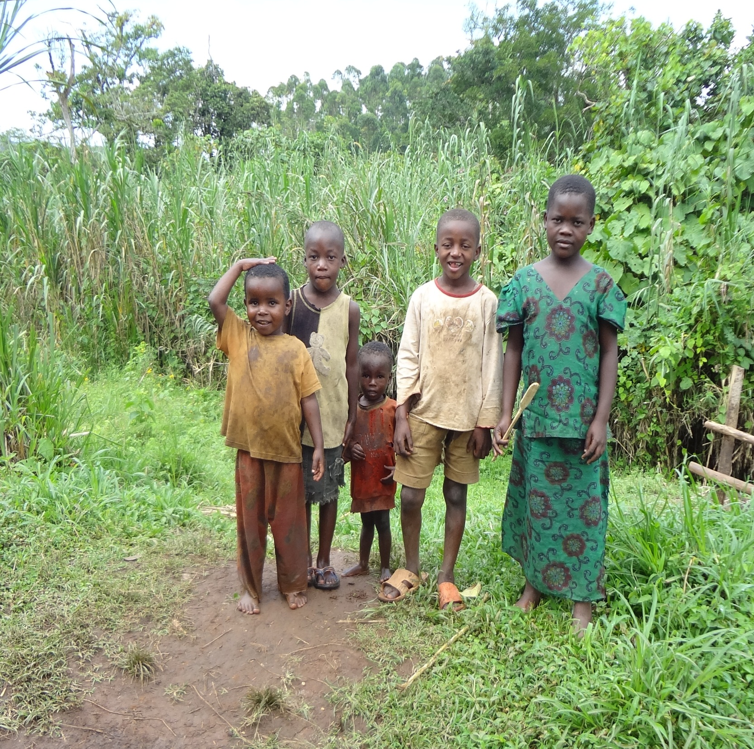


Understanding the 2010
Susan Spierre
Human Development Index
Global Institute of Sustainability
Arizona State University,
Tempe AZ
Email: susan.spierre@asu.edu
Calculation
Advisers: Thomas P. Seager, Evan Selinger, & Brad Allenby
Findings
The HDI calculation procedure has been modified to address some former concerns and/or critiques [4]. Despite these refinements, composite indices like the HDI are inherently distorted by the normalization and weighting procedures that facilitate comparisons, but result in loss of information [5]. Examination of the current HDI methodology demonstrates that diminishing returns, especially to the income dimension, are inherent to the HDI calculation. Specifically, the use of a logarithmic function in normalizing the income dimension (equation 2) represents the philosophical and economic argument that, “because achieving a respectable level of human development does not require unlimited income” [6].
Previous analysis show that the HDI provides a robust measure of human development that is not significantly biased statistically by the choice of the functional form of life expectancy, the minimum goalposts, or by the weighting of dimensions [7]. Furthermore, our sensitivity analysis verifies that the diminishing return to HDI is apparent even when the logarithmic formula for income (equation 2) is replaced with the non-logarithmic dimension equation (equation 1) and the geometric mean is replaced with an arithmetic mean (Figure 2). Furthermore, the curvilinear relationship between economic development and life expectancy, as well as the diminishing returns to subjective well-being from income are verified by the World Value Survey [8].
Photograph taken October, 2011 near Fort Portal, Uganda
Introduction
Each year, the United Nation’s Development Program (UNDP) publishes the Human Development Index (HDI), which is a composite index that offers a method of evaluating international human development not only by economic advances but also in terms of the capabilities of individuals within a country.
Human development, energy, and therefore greenhouse gases (GHGs) are inherently linked under current technology constraints. Figure 1 confirms that nations with higher HDI values produce more CO₂ as a result of greater energy consumption. However, the figure also exposes the diminishing returns in HDI that accrue as GHG emissions increase. If accurate, this latter relationship implies that developed nations have a moral obligation to reduce CO₂ emissions because, under a global mitigation system, these emission cuts could enable emission increases in underdeveloped countries that result in major improvements in human development.
This study investigates the origin of the diminishing returns to HDI, given its important implications for climate policy and development. Specifically, we examine the current HDI calculation procedure to determine if the observed relationship is a factor of dimension normalization and/or aggregation within the HDI calculation.
“when radical inequalities exist, it is unfair for people in states with far more than enough to expect people in states with less than enough to turn their attention away from their own problems in order to cooperate with the much better-off in solving their problems” –Henry Shue (1999)
Figure 1. An empirical comparison of the HDI and per capita CO2 emissions by country. Countries with higher HDI values produce more CO2 as a result of greater energy consumption. The area of the bubbles represents the size of the population of each country. Data is from the 2010 Human Development Report.
2010 HDI Methodology
The current HDI is the result of many years of experience and refinements [2]; here we focus
on the most recent formulation, established in 2010, which includes three elements:
  health as measured by life expectancy at birth,
  education as a combination of the expected years of schooling for a child entering school today, and the mean years of prior schooling for adults aged 25 and older, and
  standard of living as purchasing-power-parity (PPP) per-capita Gross National Income (GNI) [3].
The current HDI assigns equal weight to all three dimensions, with the two education sub-indices also weighted equally. These three incommensurate dimensions are first normalized to dimensionless values between 0 and 1 (equation 1). Normalization is based on observed global minima and maxima over the period for which the HDI has been computed (Table 1). However, the income dimension is normalized differently, using a natural logarithmic function (equation 2). The results are aggregated into the overall HDI by calculating the geometric mean of all three dimensions (equation 3) [3].
Table 1. Goalposts for 2010 HDI, Source: 2010 HDR Technical Notes
Dimension | Observed Maximum | Minimum
Life Expectancy (years) | 83.2 (Japan, 2011) | 20
Mean Years of Schooling | 13.2 (United States, 2000) | 0
Expected Years of Schooling | 20.6 (Australia, 2002) | 0
Per capita income (PPP$) | 108,211 (United Arab Emirates, 1980) | 163 (Zimbabwe, 2008)
(1) $Dimension index= \frac{actual value − minimum value}{maximum value{ −} minimum value}$
(1) 𝐷𝑖𝑚𝑒𝑛𝑠𝑖𝑜𝑛 𝑖𝑛𝑑𝑒𝑥= (𝑎𝑐𝑡𝑢𝑎𝑙 𝑣𝑎𝑙𝑢𝑒 − 𝑚𝑖𝑛𝑖𝑚𝑢𝑚 𝑣𝑎𝑙𝑢𝑒)/(〖maximum value〗⁡〖 −〗 𝑚𝑖𝑛𝑖𝑚𝑢𝑚 𝑣𝑎𝑙𝑢𝑒)
$\left(2\right) Income Index= \frac{\ln\left(actual PPP\$\right)−ln(163 PPP\$)}{\ln\left(108,211 PPP\$\right)−ln(163 PPP\$)}$
(2) 𝐼𝑛𝑐𝑜𝑚𝑒 𝐼𝑛𝑑𝑒𝑥= ( ln⁡(𝑎𝑐𝑡𝑢𝑎𝑙 𝑃𝑃𝑃$)−ln(163 𝑃𝑃𝑃$))/(ln⁡(108,211 𝑃𝑃𝑃$)−ln(163 𝑃𝑃𝑃$))
$$\left(3\right) HDI={(H_{Health }∗H_{Education}∗H_{Living standard})}^{1/3}$$
(3) 𝐻𝐷𝐼=〖(𝐻_(𝐻𝑒𝑎𝑙𝑡ℎ )∗𝐻_𝐸𝑑𝑢𝑐𝑎𝑡𝑖𝑜𝑛∗𝐻_(𝐿𝑖𝑣𝑖𝑛𝑔 𝑠𝑡𝑎𝑛𝑑𝑎𝑟𝑑))〗^(1/3)
Figure 2. Sensitivity Analysis of 2010 HDI Methodology to the power differentiations within the functional form. Even without the natural logarithmic transformation of the income dimension and the geometric mean used to aggregate the data (HDI 4), there is still an apparent diminishing returns to HDI as per capita CO2 emissions increase.
Conclusion
We conclude that the diminishing returns to HDI is not driven solely by the functional form of the HDI calculation and is likely caused by the inherent qualities of human well-being. This finding suggests that developed nations are morally obligated to reduce their GHG emissions, since they can do so without experiencing significant reductions in human development.
Photograph taken in October 2011near Fort Portal, Uganda
References
[1] Steinberger, J.K., Roberts, J.T., Peters, G.P., Baiocchi, G. (2012) “Pathways of Human Development and Carbon Emissions Embodied in Trade” Nature Climate Change, 2: 81–85.
[2] Stanton, E. A. (2007) “The Human Development Index: A History, Political Economy Research Institute”, UMass Amherst, Working paper series no. 127.
[3] UNDP (2010) Human Development Report 2010, The Real Wealth of Nations: Pathways to Human Development, Oxford University Press, Oxford.
[4] Noorbakhsh, F. (1998) “The Human Development Index: Some Technical Issues and Alternative Indices.” Journal of International Development, 10(5): 589–605.
[5] Prado, V., Rogers, K., and Seager, T.P. (2012) “Integration of MCDA tools in valuation of comparative life cycle assessment” in Life Cycle Assessment: A Guide to Sustainable Products, Benefits of Life Cycle Thinking (Curran, M.A eds.). Under Review.
[6] UNDP (2001) Human Development Report 2001, Making New Technologies Work for Human Development, Oxford University, Oxford.
[7] García, C., and Kovacevic, M. (2011) “Uncertainty and Sensitivity Analysis of the Human Development Index.” Human Development Research Paper 47. UNDP–HDRO, New York.
[8] Inglehart, R. (1999) “Globalization and Postmodern Values”, The Washington Quarterly, 23:1 pp. 215–228.

