Slide 1


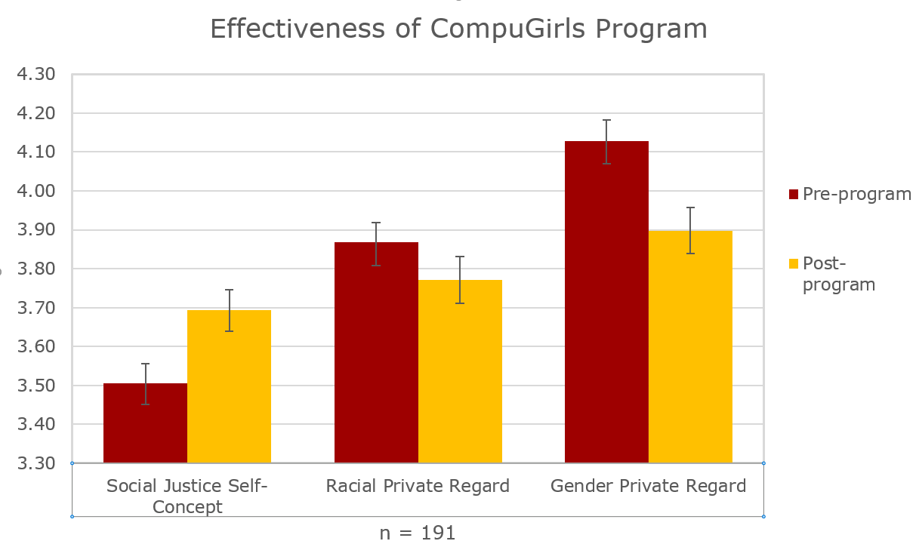
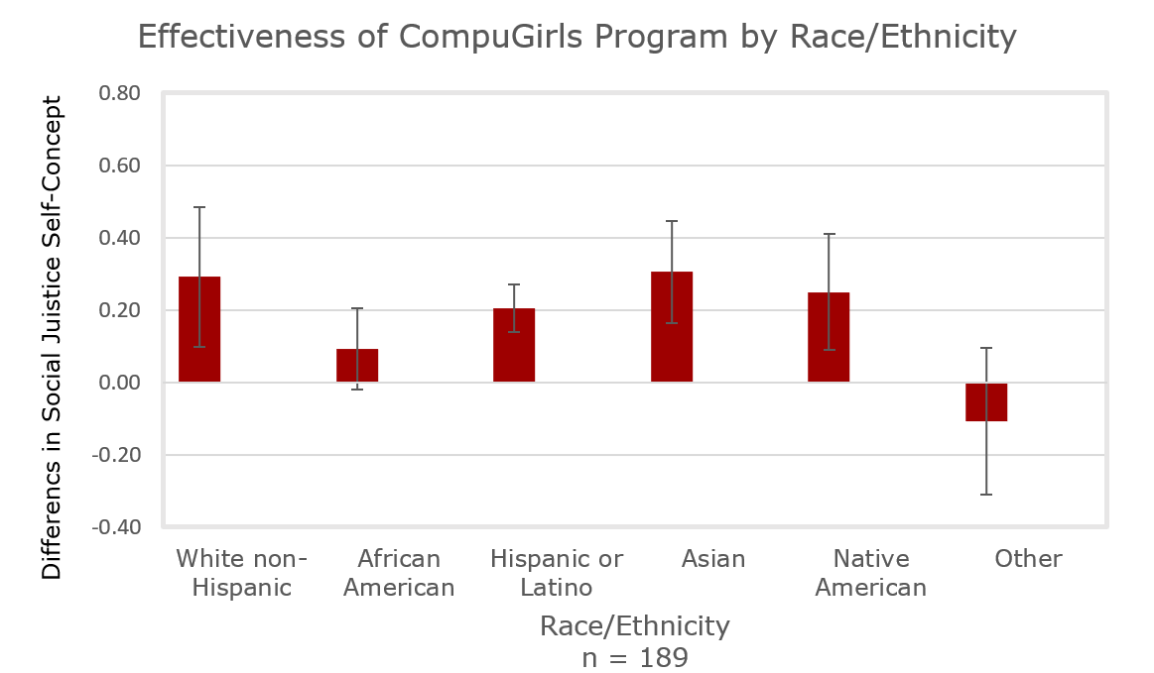
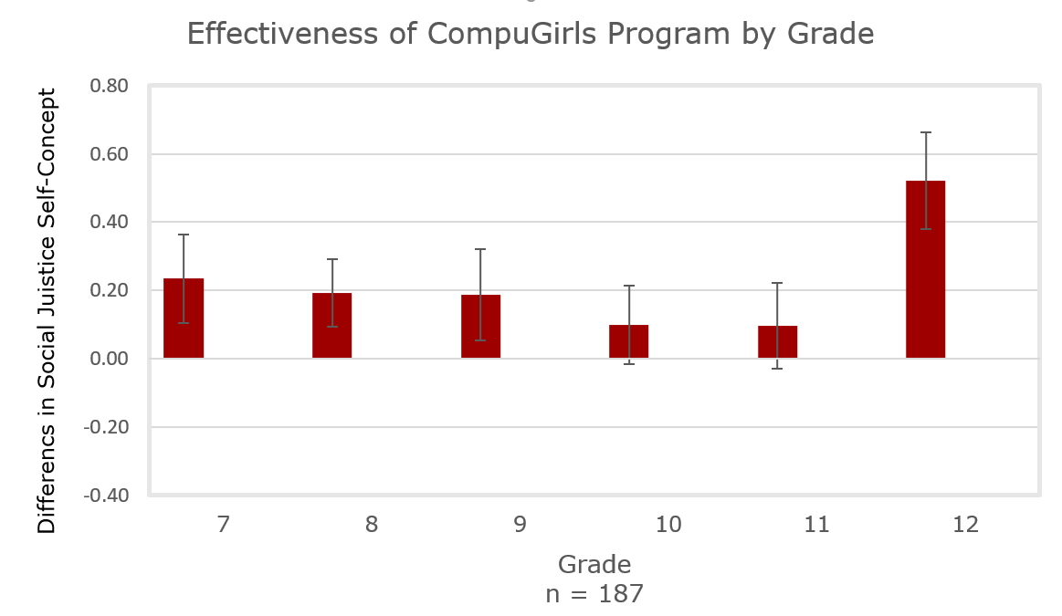

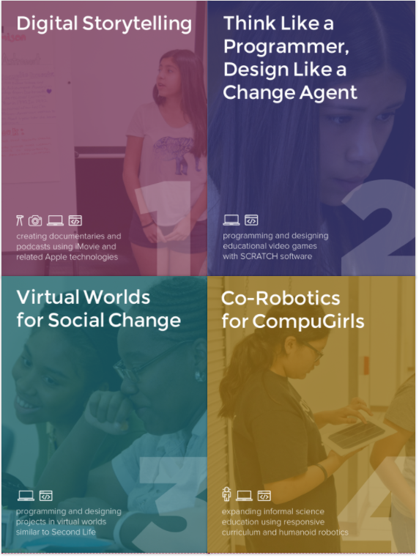
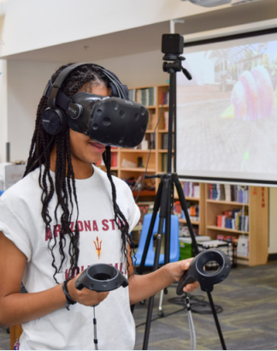
Social Justice in Digital Media: Evidence from the CompuGirls Program using an Intersectionality Framework
Chun Tao, M.S. & Kimberly A. Scott, Ed.D.
The Center for Gender Equity in Science and Technology (CGEST), Arizona State University | Contact: Chun.Tao@asu.edu
INTRODUCTION
Women of color (e.g. African, Latina, Native American) remain underrepresented in computer-science related fields (NSF, 2007, 2016).
In response, several programs have developed lessons in hopes of “motivating” underrepresented girls towards technology. Programs, like the NSF-funded CompuGirls, have demonstrated positive implications on female youths’ academic, social, and technological self-efficacy (Lee et al., 2015; Ashcraft et al., in press).
However, little is known about girls’ of color awareness of and engagement in relevant social justice issues in digital media (for an exception, see Scott & Garcia, 2016).
THE PRESENT STUDY
Using an intersectionality framework (Collins, 2016; Crenshaw, 1991), this study examines the effects of CompuGirls, a GSE-funded girl-centered culturally responsive educational program, on girls’ social justice self-concept.
Further, this study examines whether the program’s effects vary upon girls’ intersecting identities.
RESULTS
Table 1
Demographics of participants in the pre- and post-tests.
Note. Missing data are excluded.
 | Pre-test | Post-test
Total N | 276 | 191 (69.2%)
Age
M (SD) | 14.17 (1.71) | 13.94 (1.68)
Range | 11-19 | 11-18
Grade
M (SD) | 9.46 (1.63) | 9.23 (1.62)
Range | 6th – 13th (College) | 6th – 13th (College)
Race
White non-Hispanic | 38 (14.0%) | 22 (11.6%)
African American | 61 (22.5%) | 37 (31.2%)
Hispanic or Latino | 118 (43.5%) | 95 (50.3%)
Asian | 10 (3.7%) | 4 (2.1%)
Native American | 11 (4.1%) | 7 (3.7%)
Other | 33 (12.2%) | 24 (12.7%)
***
***
Figure 1. Graph of program outcomes between pre- and post-tests.
*** = p < .001.
METHOD
Participants and Procedures
A total of 302 female youths aged 11-19 years of diverse racial-ethnic identities participated in the CompuGirls Program between 2013 and 2016.
Participants were invited to responded to pre- and post-program assessments. Among all participants, 276 completed the pre-test and 191 completed the post-test.
Girls reporting greater initial racial private regard before program demonstrated greater increase in their levels of social justice self-concept.
The greater increase in racial private regard post program, the greater increase in social justice self-concept.
Gender private regard was unrelated to program outcome.
Figure 1. Two-way interaction between sex and experience of gay-related stress on measures of internal stress.
Pre-
Program Assessment
Post-Program Assessment
Figure 2. Graph of program outcomes by race/ethnicity.
Figure 3. Graph of program outcomes by grade.
Measures
Social justice self-concept
  I encourage my peers to use digital media as a means to address social justice issues.
  I have a clear understanding of how digital media can be used to address social justice issues.
  My family has a clear understanding that digital media can help address social justice.
  My family and I talk about digital media and social justice issues.
Racial Private Regard
  I feel good about being a member of my racial group.
Gender Private Regard
  I feel good about being of my gender.
Demographics
  Age, grade, race/ethnicity
DISCUSSION AND CONCLUSIONS
Our findings demonstrated that CompuGirls’ culturally responsive curriculum was effective in inspiring girls aged 11 to 19 years in identifying themselves as social justice change agent in the digital world.
Drawing from the intersectionality framework (Collins, 2016; Crenshaw, 1991), we found that the program effectiveness may vary upon girls’ race/ethnicity, grade, and their private regard of their race prior to participating in the CompuGirls.
Limitations include attrition, limited sample size and thus lack of power for detection of statistically meaningful comparisons across age, grade, and race/ethnicity groups, and preliminary development of the social justice self-concept measure.
The finding on decrease in girls’ gender private regard is interesting as it may suggest potential internalization of gender stereotypes, which warrants further research to tease apart these two concepts and allow additional follow-up comparisons.
Prospective studies are encouraged to assess both self-concepts and actions of girls’ social justice engagement and identify strategies to aspire those that were less affected in this study (e.g., African American girls, girls of lower racial private regard).
ACKNOWLEDGEMENT: Many thanks go to the National Science Foundation for their funding for the project (NSF #1136079), the CGEST team, as well as participants in CompuGirls programs.

